Slide 1

EduHub: E-Learning Platform Database with MongoDB
Godwin Emmanuel Bandawa
October
2025

Slide 2
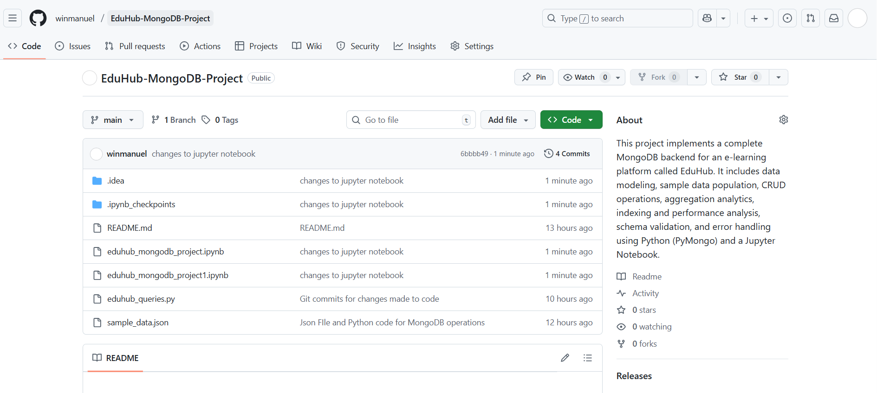
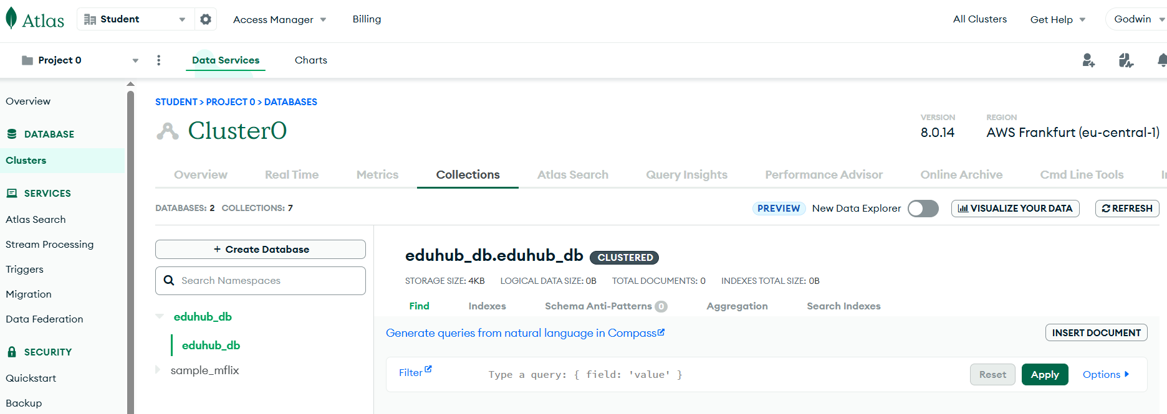
Project Overview
This project serves to consolidate and demonstrate your comprehensive understanding of MongoDB database concepts, operations, and best practices. Through building a real-world application database, you will showcase your ability to design, implement, and optimize a NoSQL database solution that addresses practical business requirements.
Why MongoDB was chosen (flexible schema, scalability, real-time queries).
Main project goals:
Design & implement MongoDB database
Support CRUD, analytics, performance

Slide 3
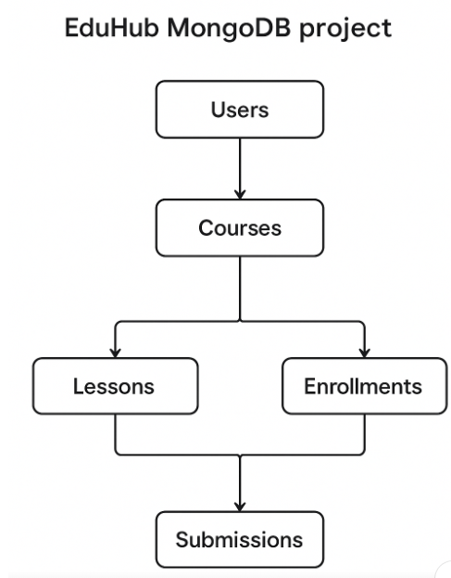
Database Structure
List of collections: users, courses, enrollments, lessons, assignments, submissions

Slide 4
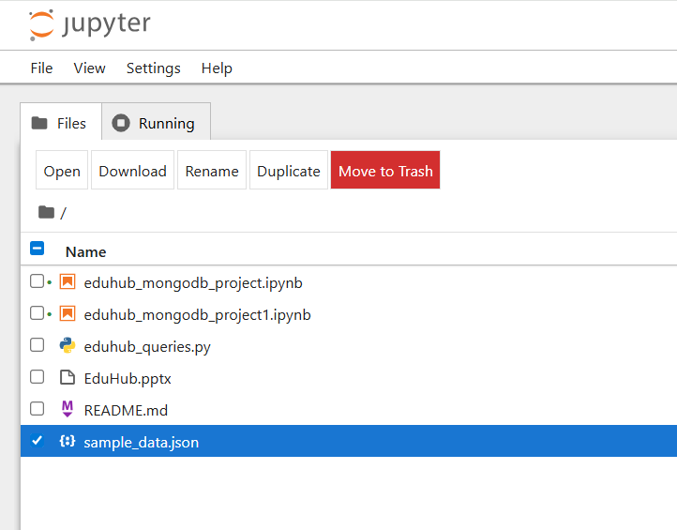
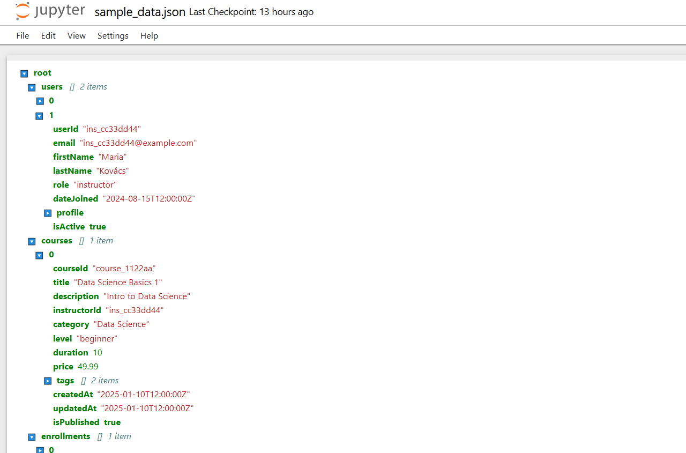
Data Modeling
Example schema fields (user & course).
JSON-style snippet for 1–2 collections.

Slide 5
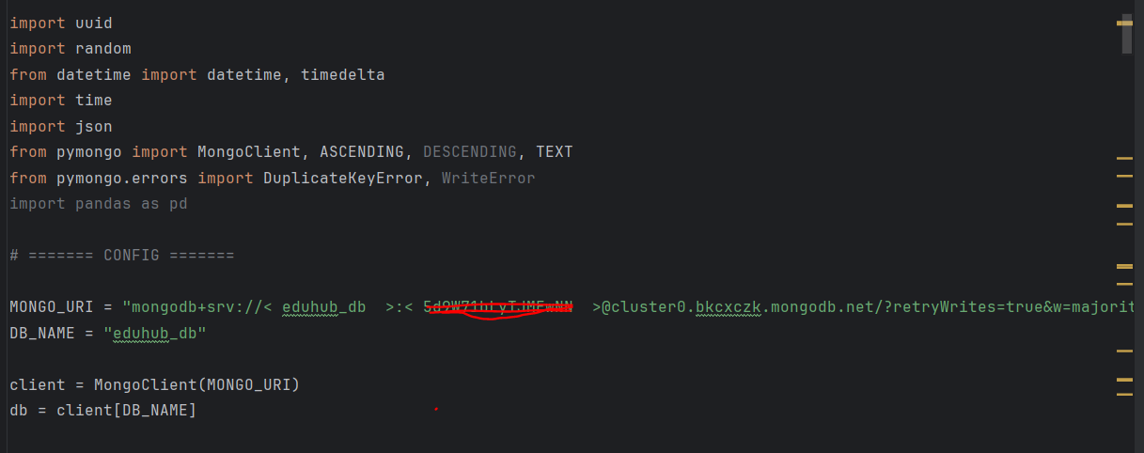
Key Features (CRUD)
User management (register/login/update).
Course management (create, publish, categorize).
Enrollment & progress tracking.
Assessment system (assignments, submissions, grading).

Slide 6
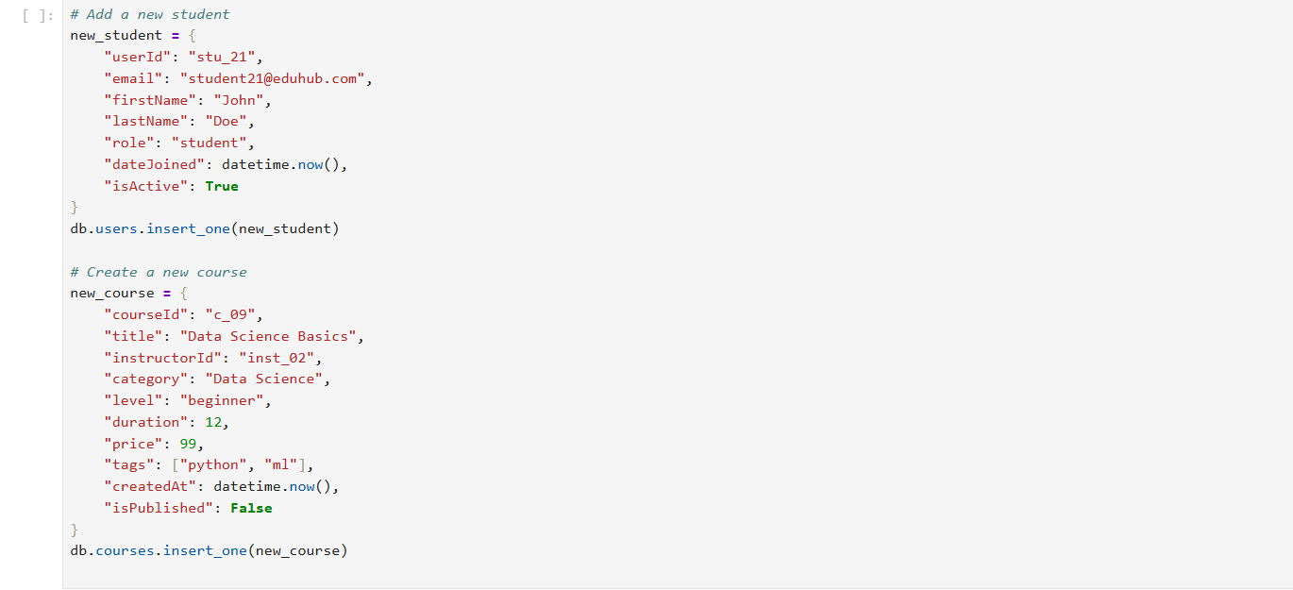
Advanced Queries & Aggregation
Enrollment statistics (per course, per category).
Student performance analysis (average grade, completion rate).
Instructor analytics (students taught, revenue).
Example: Aggregation pipeline screenshot or summary.

Slide 7
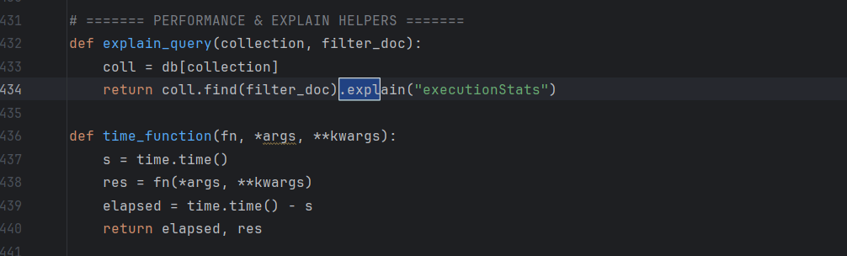
Performance & Indexing
Indexes used: email, course title, assignment due date.
Query optimization with .explain().

Slide 8
Key Learnings
NoSQL schema design trade-offs.
How MongoDB handles scalability.
Using PyMongo & Jupyter for testing.

