Slide 1

TriageDesk
SOC Alert Triage & Incident Management Platform
Turning thousands of raw security alerts into a handful of managed incidents.
Win Myat Aung (Zane) · IT Project 1 — Siam University · Blue Team / SOC
Notes:
Hi, I'm Zane. My project is TriageDesk — a SOC alert triage and incident management platform. In one line: it turns thousands of raw security alerts into a small number of managed incidents an analyst can actually work.

Slide 2




The Problem: Alert Overload
Security tools produce far more alerts than any analyst can review.
Analysts drown in noise
Most alerts are false alarms — real ones get buried.
1,000s
Threats dwell for weeks
A genuine alert is missed or nobody owns it in time.
alerts per day, from many different tools
No single view or workflow
Each tool has its own console; nothing ties them together.
Notes:
The core problem is alert overload. A company runs many security tools and together they fire thousands of alerts a day. Analysts can't review them all, so real threats get buried in noise, incidents sit unowned, and there's no single place to manage them.

Slide 3

The Idea, in Plain Terms
Think of a building full of smoke detectors — and one control room.
Today: many alarms, no one listening
TriageDesk: one control room
>
Brings every alert onto one screen
Labels where it came from & how dangerous
Groups alarms that are really the same fire
Starts a timer so nothing is ignored
Each tool beeps in its own way. One real fire hides among the burnt toast.
Notes:
The simple picture: a company's tools are like smoke detectors all over a building. There are thousands of beeps and most are harmless, but one is a real fire. TriageDesk is the control room — it pulls every beep onto one screen, labels it, groups related ones, and puts a timer on each so nothing gets ignored.

Slide 4





How It Works: One Alert's Journey
Every alert flows through five automatic steps before an analyst even looks.
>
>
>
>
1. Ingest
2. Enrich
3. Score
4. Correlate
5. Track (SLA)
Collect from any tool, translate to one format
Add threat-intel & asset context
Rank risk 0–100
Group related alerts into incidents
Deadlines + auto-escalation
Result: the analyst opens one risk-ranked queue of incidents — each already enriched, scored, grouped, and on an SLA countdown.
Notes:
This is the heart of the project. Every alert travels through five automatic steps: ingest and normalize, enrich with context, score the risk, correlate into incidents, and put it on an SLA clock. By the time an analyst looks, the work of triage is mostly done — they see one ranked queue of incidents, not a wall of raw alerts.

Slide 5

System Architecture
A simple pipeline — each stage is independent and testable.
Alert Sources
TriageDesk Engine
Analyst-facing
Wazuh (EDR/host)
Normalize
Enrich
Suricata (network)
>
Score
Correlate
>
Web Dashboard
Firewall / Email
SLA engine
Workflow + Audit
REST API
SQLite (history & audit)
Notes:
Architecture is a straight pipeline. On the left, alerts come from many sources. In the middle, the engine normalizes, enriches, scores, correlates, applies SLAs, and runs the analyst workflow. On the right, everything is persisted to a database and shown on the dashboard. Because every stage only speaks one common alert format, adding a new source is just one small parser.

Slide 6
Enrichment: From Raw Alert to Decision
The system answers the questions an analyst would otherwise look up by hand.
RAW ALERT
Risk Score = severity + intel + asset value
Connection from 45.146.164.110 to 10.0.10.5
— who is that? does it matter?
100
▼ enrich
ENRICHED
CRITICAL
Source on threat feed: C2 (95%)
Target = PAYROLL-DB (crown jewel)
External source, hitting internal asset
A 'medium' alert on the payroll database outranks a 'high' alert on a test box — context decides priority.
Notes:
Enrichment is what turns a raw alert into a decision. On its own an alert just says 'IP X talked to IP Y.' TriageDesk automatically checks: is the source on a threat feed? Is the target one of our important systems? Is the source internal? Then it rolls severity, threat-intel confidence and asset value into one risk score. That's why a medium alert on the payroll database can outrank a high alert on a throwaway test box.

Slide 7
Correlation: Cutting the Noise
One attack fires many alerts — the system groups them into a single case.
66 raw alerts
42 incidents
36%
>
fewer things to look at
Alerts from the same source in a time window collapse into one incident an analyst works as a single case.
Notes:
A single attack — say a brute-force attempt — can throw dozens of alerts. Correlation groups alerts from the same source within a time window into one incident. In the demo, 66 raw alerts became 42 incidents, so the analyst works fewer, richer cases instead of a flood of individual alerts.

Slide 8
SLA Tracking & Escalation
The feature that makes this incident management, not just an alert list.
MTTA
MTTR
97%
1h 46m
resolve
on time
mean time to acknowledge
mean time to resolve, tracked
acknowledged within SLA
How the clock works
On track
At risk
Breached
Escalated
>
>
>
Plenty of time left
Final 25% of the window
Deadline passed
Auto-raised to the top
Notes:
This is what makes it a real incident-management tool. Every incident gets two deadlines based on severity — one to acknowledge, one to resolve. The system shows whether each is on track, at risk, breached, and it automatically escalates serious incidents nobody has picked up. That produces the metrics a SOC is actually measured on: mean time to acknowledge, mean time to resolve, and SLA compliance.

Slide 9
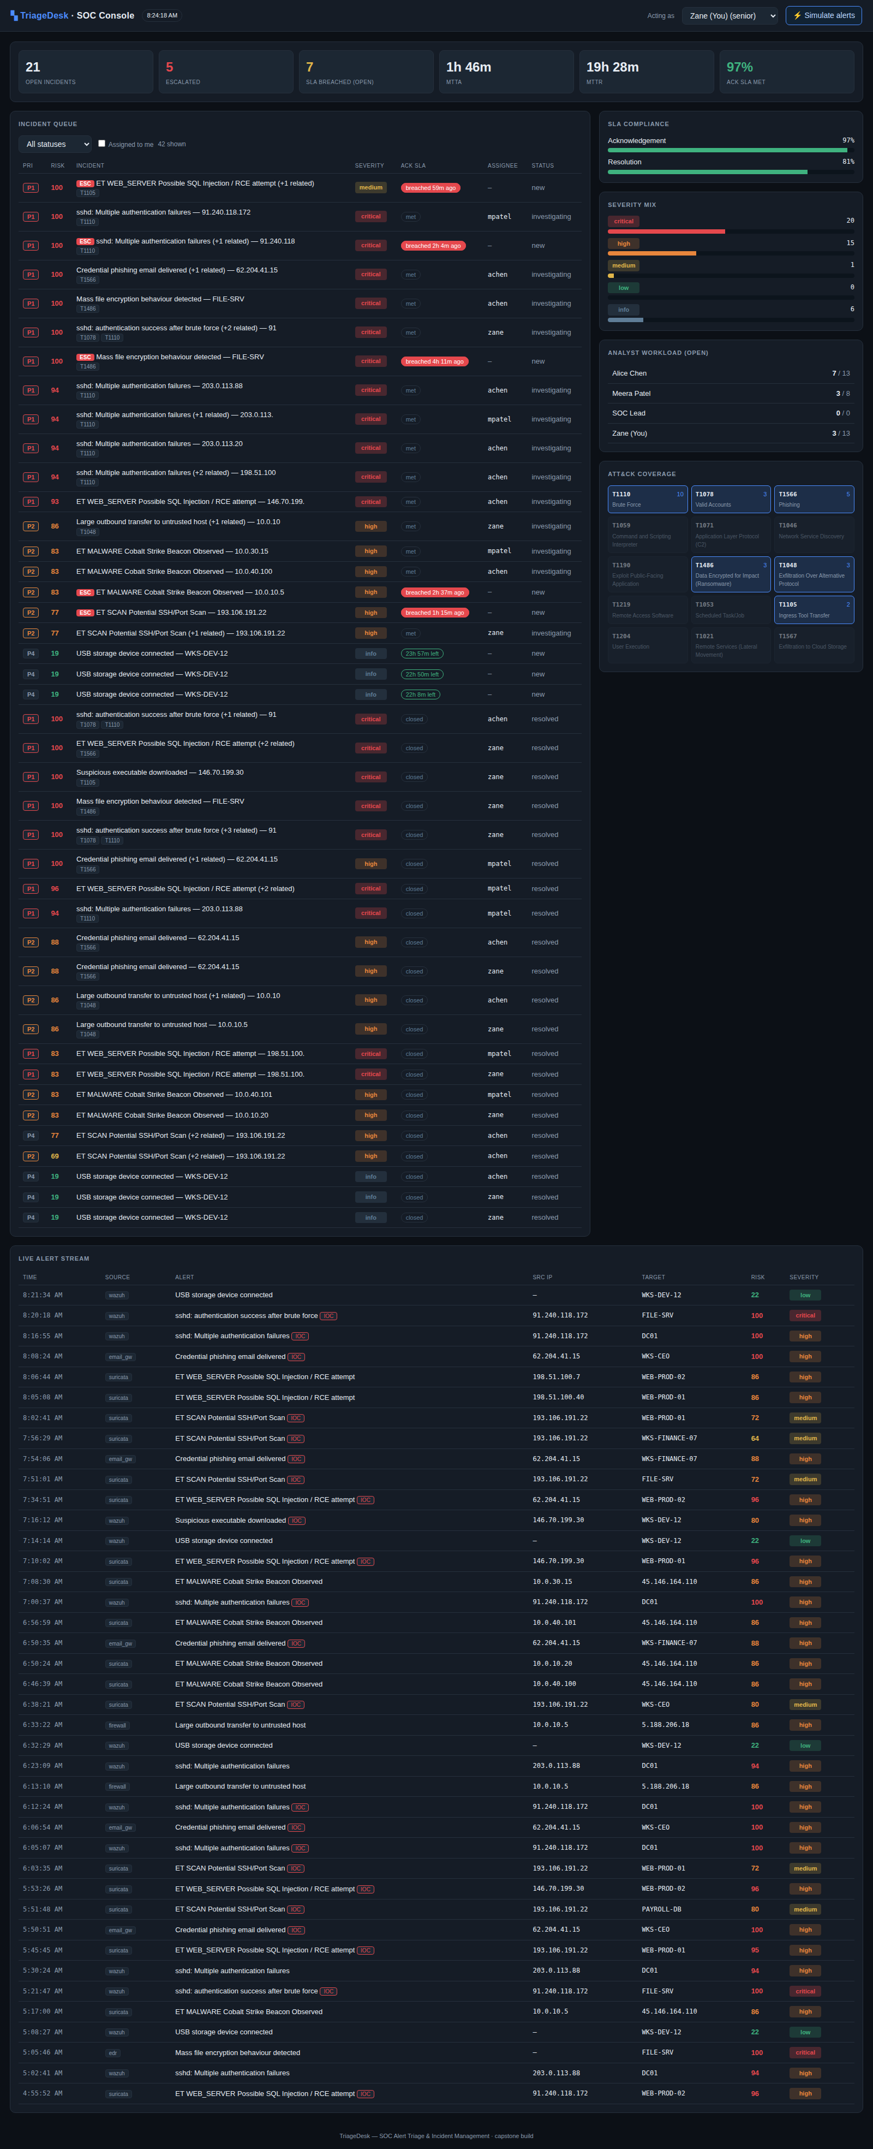

The Analyst Console
Everything on one screen: risk-ranked queue, live SLA timers, team metrics, ATT&CK coverage.
KPI row
open, escalated, MTTA, MTTR, SLA %
Risk-ranked queue
worst incidents first, ESC = escalated
SLA chips
countdown per incident
ATT&CK heatmap
techniques seen light up
Notes:
This is the live console. The top row is the team's health at a glance. The main table is the incident queue, sorted by risk, with SLA countdown chips and red ESC tags for escalated incidents. On the right are the severity mix, analyst workload, and a MITRE ATT&CK coverage map. I'll demo this live.

Slide 10
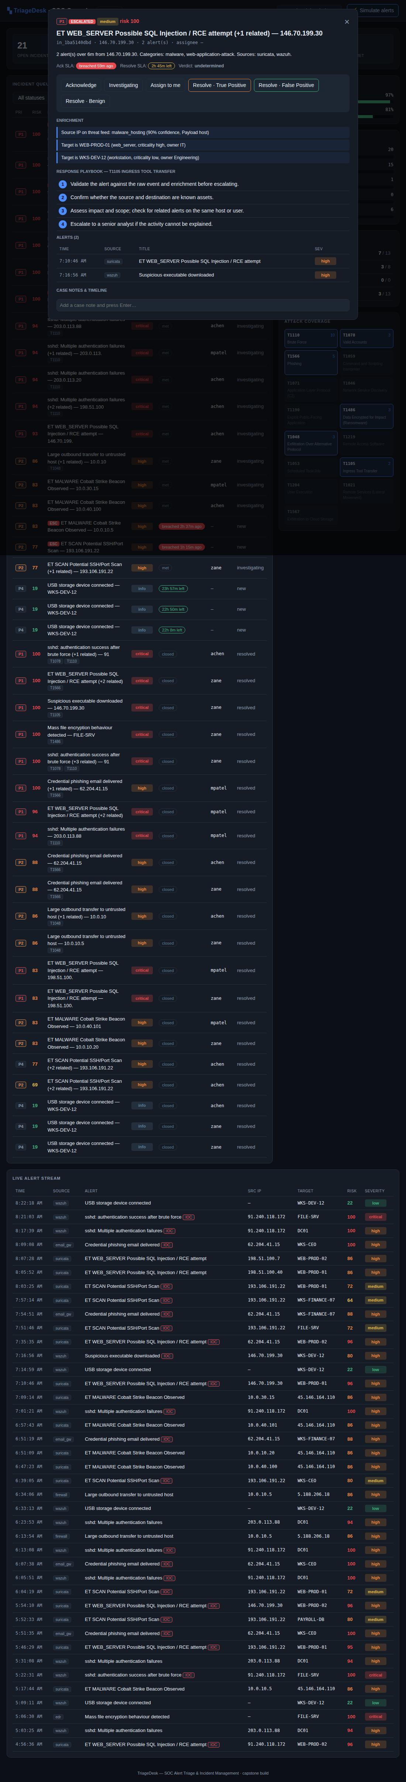

Working an Incident
Click any incident: context, a response playbook, and one-click actions.
Enrichment
why it's dangerous, in plain words
ATT&CK playbook
step-by-step response for the analyst
SLA + actions
acknowledge, assign, resolve with a verdict
Audit trail
every action is recorded
Notes:
When the analyst opens an incident, everything needed to act is on one page: the enrichment explaining why it's dangerous, a MITRE ATT&CK-based response playbook, the SLA status, and one-click actions to acknowledge, assign, and resolve with a verdict. Every action is logged to an audit trail.

Slide 11



How It's Built
Small, open, and fully tested — runs on a laptop with no paid services.
Python + FastAPI
SQLite
Single-file dashboard
REST API backend; ~1,450 lines of my own code
Zero-setup database for history & audit
Plain HTML/JS — no framework, runs offline
MITRE ATT&CK
24 automated tests
Offline threat-intel
15 techniques mapped, with playbooks
All passing — every stage verified
Bundled feed + asset inventory; live feeds pluggable
Notes:
On the build: it's about 1,450 lines of my own Python behind a FastAPI backend, with a zero-setup SQLite database and a single-file dashboard that runs offline. Incidents map to MITRE ATT&CK with response playbooks. And there are 24 automated tests covering every stage — parsing, enrichment, correlation, SLA breaches, and the workflow — all passing.

Slide 12
Results (Demo Dataset)
Deterministic seed data, so the numbers are the same every run.
66
42
97%
alerts ingested
incidents correlated
acknowledged on time
5
24
0
auto-escalated
tests passing
paid services / setup
Notes:
On the demo dataset: 66 alerts collapsed into 42 incidents, 97% were acknowledged within SLA, 5 were automatically escalated, 24 tests pass, and it needs zero paid services and zero setup to run. All reproducible.

Slide 13

Honest Limits & What's Next
Knowing the boundaries is part of good security work.
Current limits
Version 2 roadmap
Simple 'acting analyst' selector, not real login/RBAC
Threat-intel & asset lists are bundled samples, not live feeds
Correlation is rule-based (same source + time window)
Assists response; doesn't take actions automatically
Real authentication & role-based access
Live threat feeds (AbuseIPDB, OTX) + CMDB sync
Automated response actions → toward SOAR
Two-way integration with Wazuh / a SIEM
Notes:
Being honest about limits: it uses a simple analyst selector rather than real login; the threat and asset data are bundled samples; correlation is rule-based; and it assists response rather than acting automatically. The version-2 roadmap is real authentication, live threat feeds, automated response actions moving toward a SOAR, and two-way integration with a SIEM like Wazuh, which I already use.

Slide 14
In one sentence
TriageDesk pulls every alert into one place, adds context, groups them into incidents, and tracks response deadlines — so nothing serious slips through.
Thank you — questions welcome.
Win Myat Aung (Zane) · IT Project 1 · Siam University
Notes:
To summarize: TriageDesk pulls every alert into one place, adds context, groups them into incidents, and tracks response deadlines so nothing serious slips through — the core job of a SOC analyst, in one tool. Thank you — I'm happy to take questions or demo it live.

