Slide 1
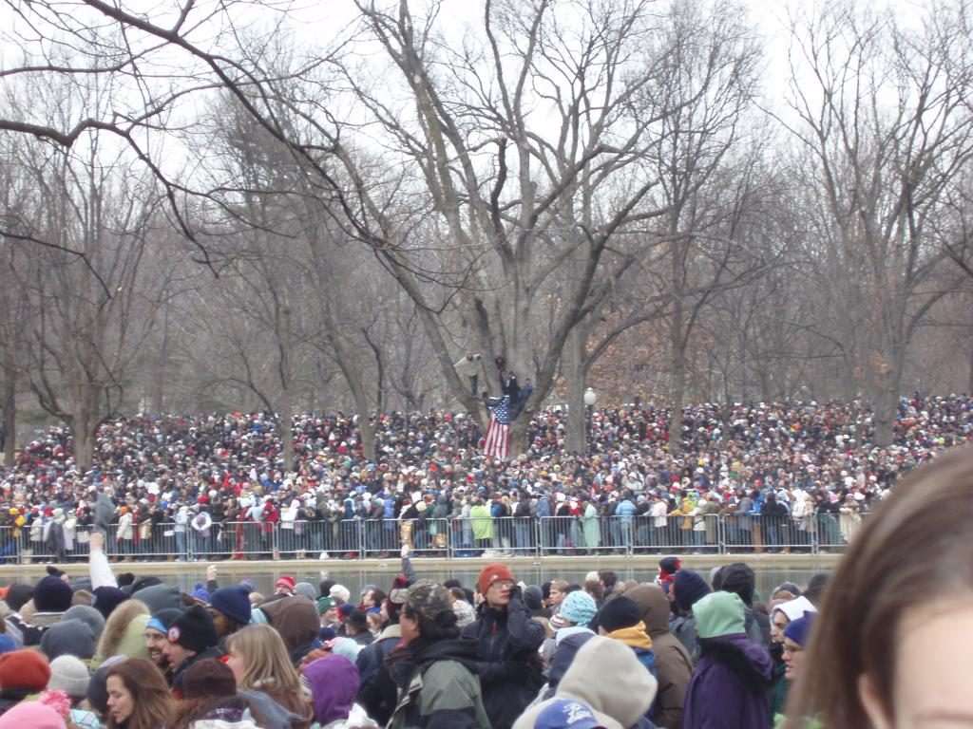
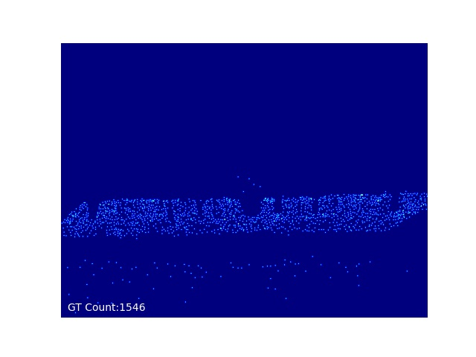
CL_DCNN 1.0
CL_DCNN v1_1_0
通道维度的拼接
前端网络
后端网络
Conv1-2
Conv2-2
Conv3-3
Conv4-3
Dconv1
Upconv1
Dconv2
Upconv2
Dconv3
Upconv3
Conv 1x1
MP：2x2
MP：2x2
MP：2x2
Stride：2
Stride：2
Stride：2

Slide 2
Shape kernel_size - channels - stride - padding (- dilation_rate)
CL_DCNN v1_1_0
input
(1, 128, 128)
Conv 3-64-1-1 *2
(64, 128, 128)
Output
MaxPool
(1, 128, 128)
(64, 64, 64)
F.unsample(factor=2)
Conv 1-1-1-0
Conv 3-128-1-1 *2
(128, 64, 64)
(64, 128, 128)
(1, 128, 128)
(128, 64, 64)
DConv 3-64-1-2-2
Conv 1-64-1-0
MaxPool
(64, 64, 64)
(64, 64, 64)
(128, 32, 32)
F.unsample(factor=2)
Conv 3-256-1-1 *3
(256, 32, 32)
(128, 64, 64)
(256, 32, 32)
Conv 1-128-1-0
MaxPool
DConv 3-128-1-2-2
(256, 16, 16)
(128, 32, 32)
(128, 32, 32)
Conv 3-512-1-1 *3
F.unsample(factor=2)
(512, 16, 16)
(512, 16, 16)
(256, 32, 32)
DConv 3-256-1-2-2
Conv 1-256-1-0
(256, 16, 16)
(256, 16, 16)

Slide 3
CL_DCNN 1.0
CL_DCNN V1_1_1
CL_DCNN V1_1_0的基础
将上采样层改为转置卷积并改变通道数
CL_DCNN V1_1_0的基础
将上采样层改为转置卷积并改变通道数
1、验证集的dataloader不打乱顺序
2、网络层参数初始化
3、lr不变，采用固定的1e-5
4、629 epoch开始，每隔3个epoch学习率更新 StepLR gamma=0.1(最好的mae=12.0,mse=18.74)
CL_DCNN V1_1_2
CL_DCNN V1_1_0的基础
将上采样层改为转置卷积并改变通道数
1、验证集的dataloader不打乱顺序
2、网络层参数初始化
3、初始学习率改为0.95e-5，从300epoch开始，每10个epoch更新学习率
CL_DCNN V1_1_3

Slide 4
Shape kernel_size - channels - stride - padding (- dilation_rate)
CL_DCNN v1_1_1~v1_1_3
input
(1, 128, 128)
Conv 3-64-1-1 *2
(64, 128, 128)
Output
MaxPool
(1, 128, 128)
(64, 64, 64)
ContransposedConv
4-22-2-1
Conv 1-1-1-0
Conv 3-128-1-1 *2
(88, 64, 64)
(1, 128, 128)
(22, 128, 128)
(128, 64, 64)
DConv 3-24-1-2-2
Conv 1-44-1-0
MaxPool
(24, 64, 64)
(44, 64, 64)
(128, 32, 32)
ContransposedConv
4-48-2-1
Conv 3-256-1-1 *3
(192, 32, 32)
(256, 32, 32)
(48, 64, 64)
MaxPool
DConv 3-64-1-2-2
Conv 1-96-1-0
(256, 16, 16)
(64, 32, 32)
(96, 32, 32)
Conv 3-512-1-1 *3
ContransposedConv
4-128-2-1
(512, 16, 16)
(512, 16, 16)
(128, 32, 32)
DConv 3-256-1-2-2
Conv 1-256-1-0
(256, 16, 16)
(256, 16, 16)

Slide 5
CL_DCNN V1_1_0的基础
将上采样层改为转置卷积并改变通道数
和低层特征连接时，连接最大池化之前的层
1、验证集的dataloader不打乱顺序
2、网络层参数初始化
3、初始学习率改为0.95e-5，从100epoch开始，每10个epoch更新学习率
CL_DCNN V1_1_4

Slide 6
Shape kernel_size - channels - stride - padding (- dilation_rate)
input
Output
(3, 128, 128)
Conv 3-64-1-1 *2
(1, 128, 128)
Conv 1-1-1-0
(64, 128, 128)
(86, 128, 128)
MaxPool
ContransposedConv
4-22-2-1
(1, 128, 128)
(64, 64, 64)
(22, 128, 128)
Conv 3-128-1-1 *2
DConv 3-44-1-2-2
(128, 64, 64)
(176, 64, 64)
(44, 64, 64)
MaxPool
ContransposedConv
4-48-2-1
Conv 1-88-1-0
(128, 32, 32)
(88, 64, 64)
Conv 3-256-1-1 *3
(48, 64, 64)
DConv 3-96-1-2-2
(256, 32, 32)
MaxPool
ContransposedConv
4-128-2-1
(384, 32, 32)
(96, 32, 32)
(256, 16, 16)
(128, 32, 32 )
Conv 1-192-1-0
Conv 3-512-1-1 *3
DConv 3-256-1-2-2
(192, 32, 32)
CL_DCNN v1_1_4
(512, 16, 16)
(256, 16, 16)

Slide 7
CL_DCNN v1_2
CL_DCNN 1.0
前端网络
后端网络
Conv1-2
Conv2-2
Conv3-3
Conv4-3
Dconv1
Upconv1
Dconv2
Upconv2
Dconv3
Upconv3
Dconv4
Conv 1x1
MP：2x2
MP：2x2
MP：2x2
Stride：2
Stride：2
Stride：2
Dconv4
DBR 3-32-1-2-2
DBR 3-16-1-2-2
DBR 3-8-1-2-2
DBR
Dilate Conv
BN
ReLU

Slide 8
CL_DCNN v1_3
CL_DCNN 1.0
前端网络
后端网络
Conv1-2
Conv2-2
Conv3-3
Conv4-3
Dconv1
Upconv1
Dconv2
Upconv2
Dconv3
Upconv3
Conv4
Conv 1x1
MP：2x2
MP：2x2
MP：2x2
Stride：2
Stride：2
Stride：2
Conv4
CBR 3-32-1-1
CBR 3-32-1-1
CBR 3-16-1-1
CBR 3-8-1-1
CBR
Conv
BN
ReLU

Slide 9
CL_DCNN 2.0
CL_DCNN v2
数值相加
前端网络
后端网络
Conv1-2
Conv2-2
Conv3-3
Conv4-3
Dconv1
Upconv1
Dconv2
Upconv2
Dconv3
Upconv3
Conv 1x1
MP：2x2
MP：2x2
MP：2x2
Stride：2
Stride：2
Stride：2

Slide 10
Shape kernel_size - channels - stride - padding (- dilation_rate)
CL_DCNN 3.0
CL_DCNN v3
input
output
(3, 128, 128)
(1, 128, 128)
VGG10
DCM *k
转置卷积
(512, 16, 16)
(512, 16, 16)
(1, 128, 128)

Slide 11
CL_DCNN v3
CL_DCNN 3.0
DCMs
DCM
1
DCM
2
DCM
m
Conv
CBR
1-256-0-1
DilateConv
TranslateConv
CBR
1-128-0-1
DBR
3-64-2-1-2
DBR
3-32-2-1-2
DBR
3-16-2-1-2
CBR
1-256-0-1
C

Slide 12
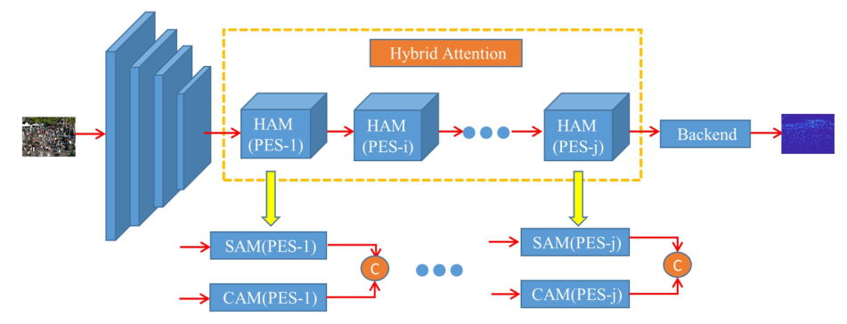
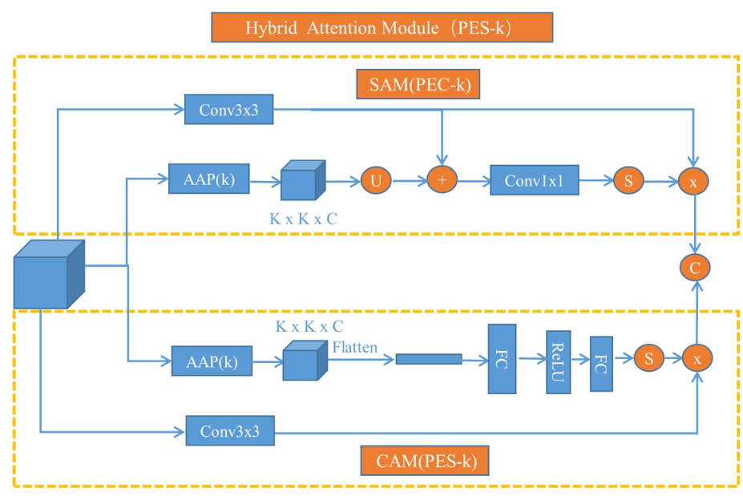
HANet

Slide 13
CL_DCNN 3.0
CL_DCNN v3_1
Conv
Dilate Conv
DCMs
DCM
1
DCM
2
DCM
m
CBR
1-256-0-1
CBR
1-128-0-1
DBR
3-64-2-1-2
DBR
3-32-2-1-2
DBR
3-16-2-1-2
CBR
1-256-0-1
C

Slide 14
DCMs
DCM
1
DCM
2
DCM
m
DCM
Conv
CBR
1-256-0-1
Dilate Conv
CBR
1-128-0-1
DBR
3-64-2-1-2
DBR
3-32-2-1-2
DBR
3-16-2-1-2
CBR
1-256-0-1
C

Slide 15
CSRNet V1
（失败）
CSRNet将MP层替换为stride=2的DW Conv深度可分离卷积

Slide 16
CSRNet V2
Shape kernel_size - channels - stride - padding (- dilation_rate)
（失败）
input
Conv 1-16-1-0
Conv 1-32-1-0
Conv 1-64-1-0
Conv 3-32-1-1
Conv 3-64-1-1
Conv 3-128-1-1
Conv 3-256-1-1
Conv 3-32-1-1
Conv 3-64-1-1
Conv 3-128-1-1
Conv 1-1-1-0
DConv 3-32-1-2-2
DConv 3-64-1-2-2
DConv 3-128-1-2-2

Slide 17
DSNet
Shape kernel_size - channels - stride - padding (- dilation_rate)
input
Conv 1-9-1-0
MaxPool
DWconv 3-72-1-1
DWconv 3-216-1-1
Conv 1-1-1-0
DWconv 5-9-1-1
MaxPool
Conv 1-144-1-0
Conv 1-216-1-0
F.unsample(2)
Conv 1-27-1-0
MaxPool

Slide 18
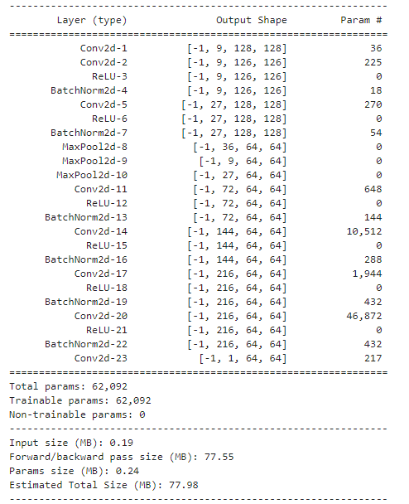
DSNet

