Slide 1



Jaff_shop_project
View in Power BI
Last data refresh:
28/04/2026 11:37:57 UTC
Downloaded at:
28/04/2026 11:50:36 UTC

Slide 2
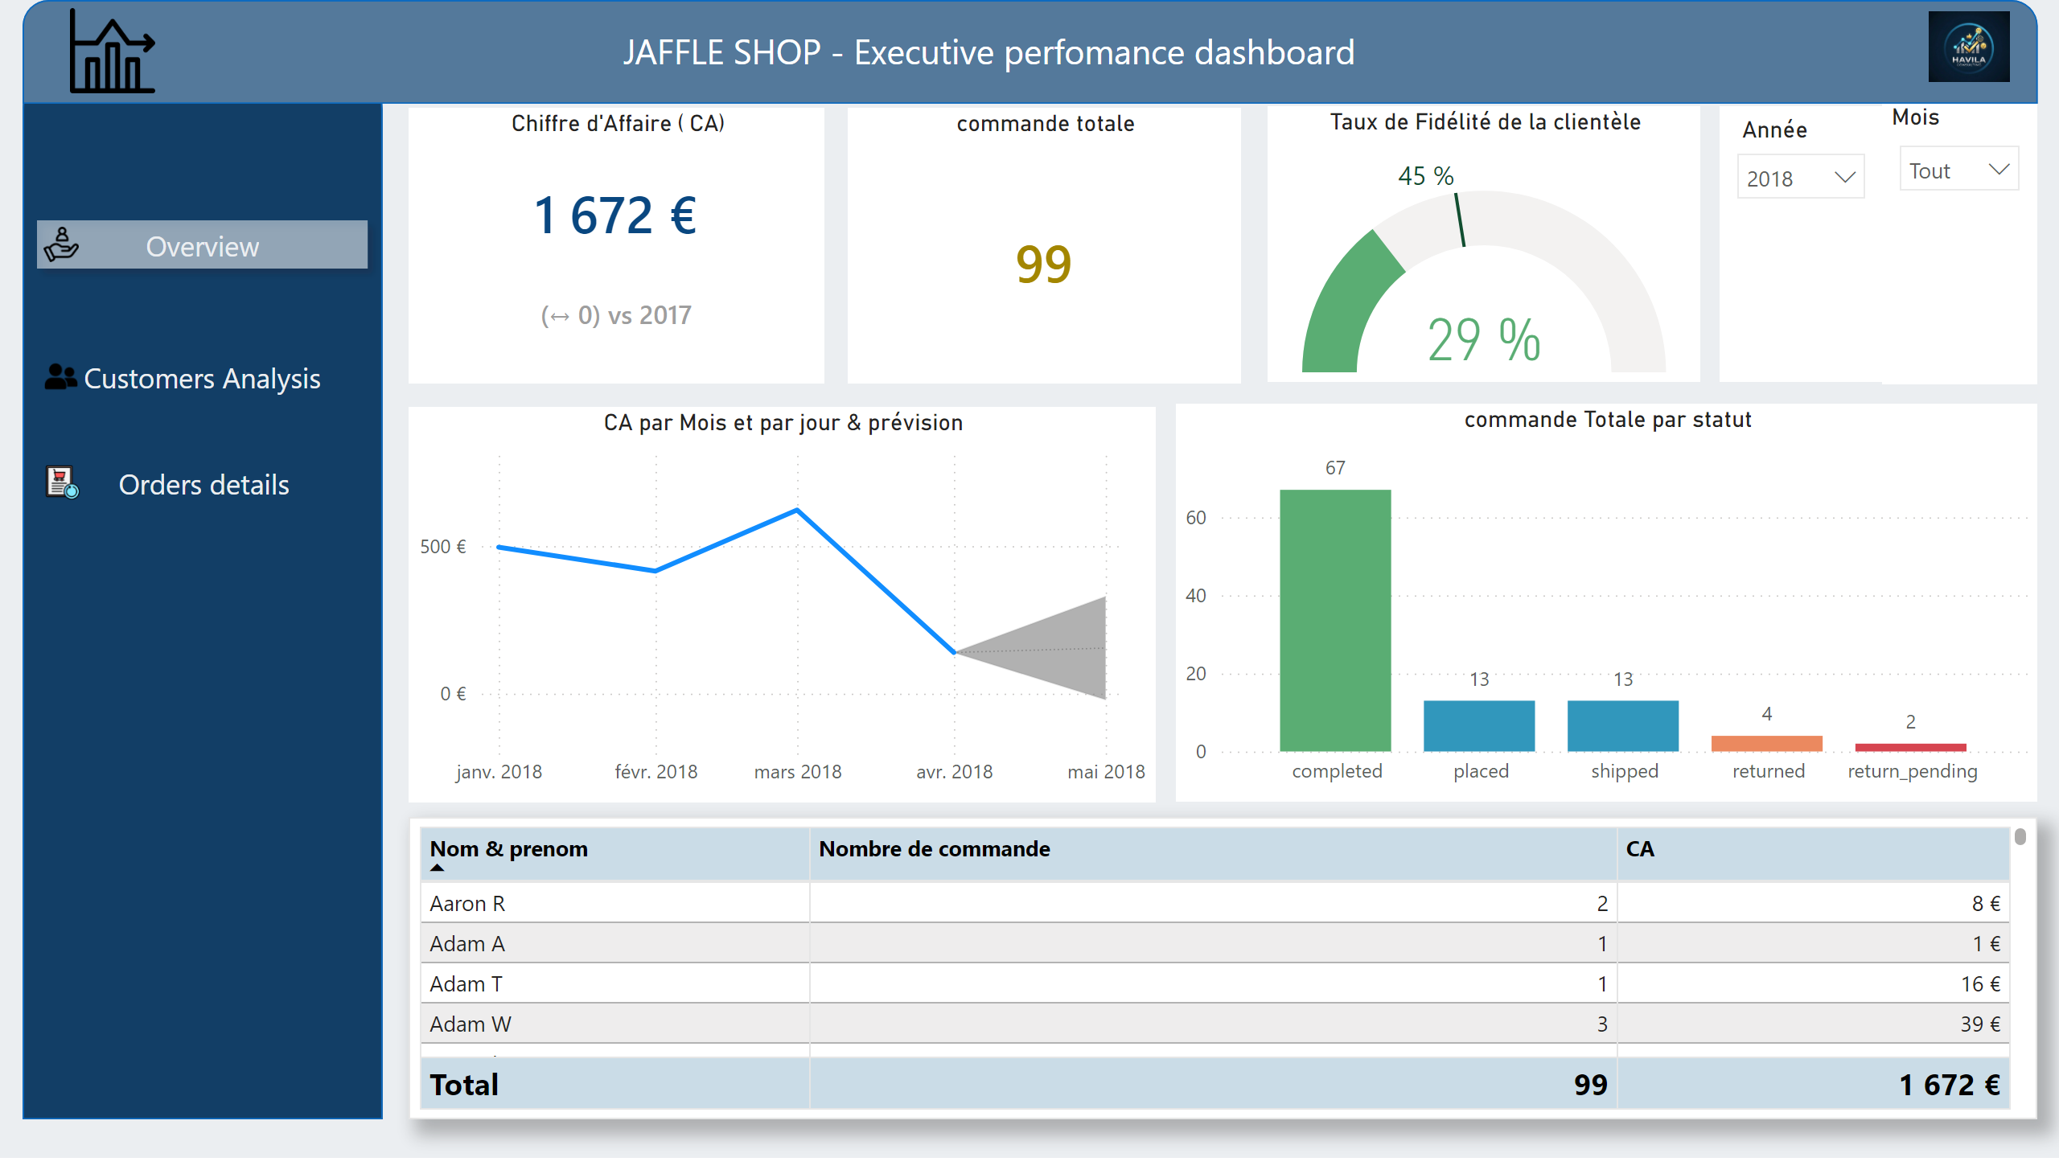
Overview
Notes:
image
No alt text provided
Mois
No alt text provided
actionButton
No alt text provided
actionButton
No alt text provided
Taux de Fidélité de la clientèle
No alt text provided
CA par Mois et par jour & prévision
No alt text provided
textbox
No alt text provided
actionButton
No alt text provided
slicer
No alt text provided
tableEx
No alt text provided
shape
No alt text provided
commande totale
No alt text provided
commande Totale par statut
No alt text provided
image
No alt text provided
shape
No alt text provided
Chiffre d'Affaire ( CA)
No alt text provided

Slide 3
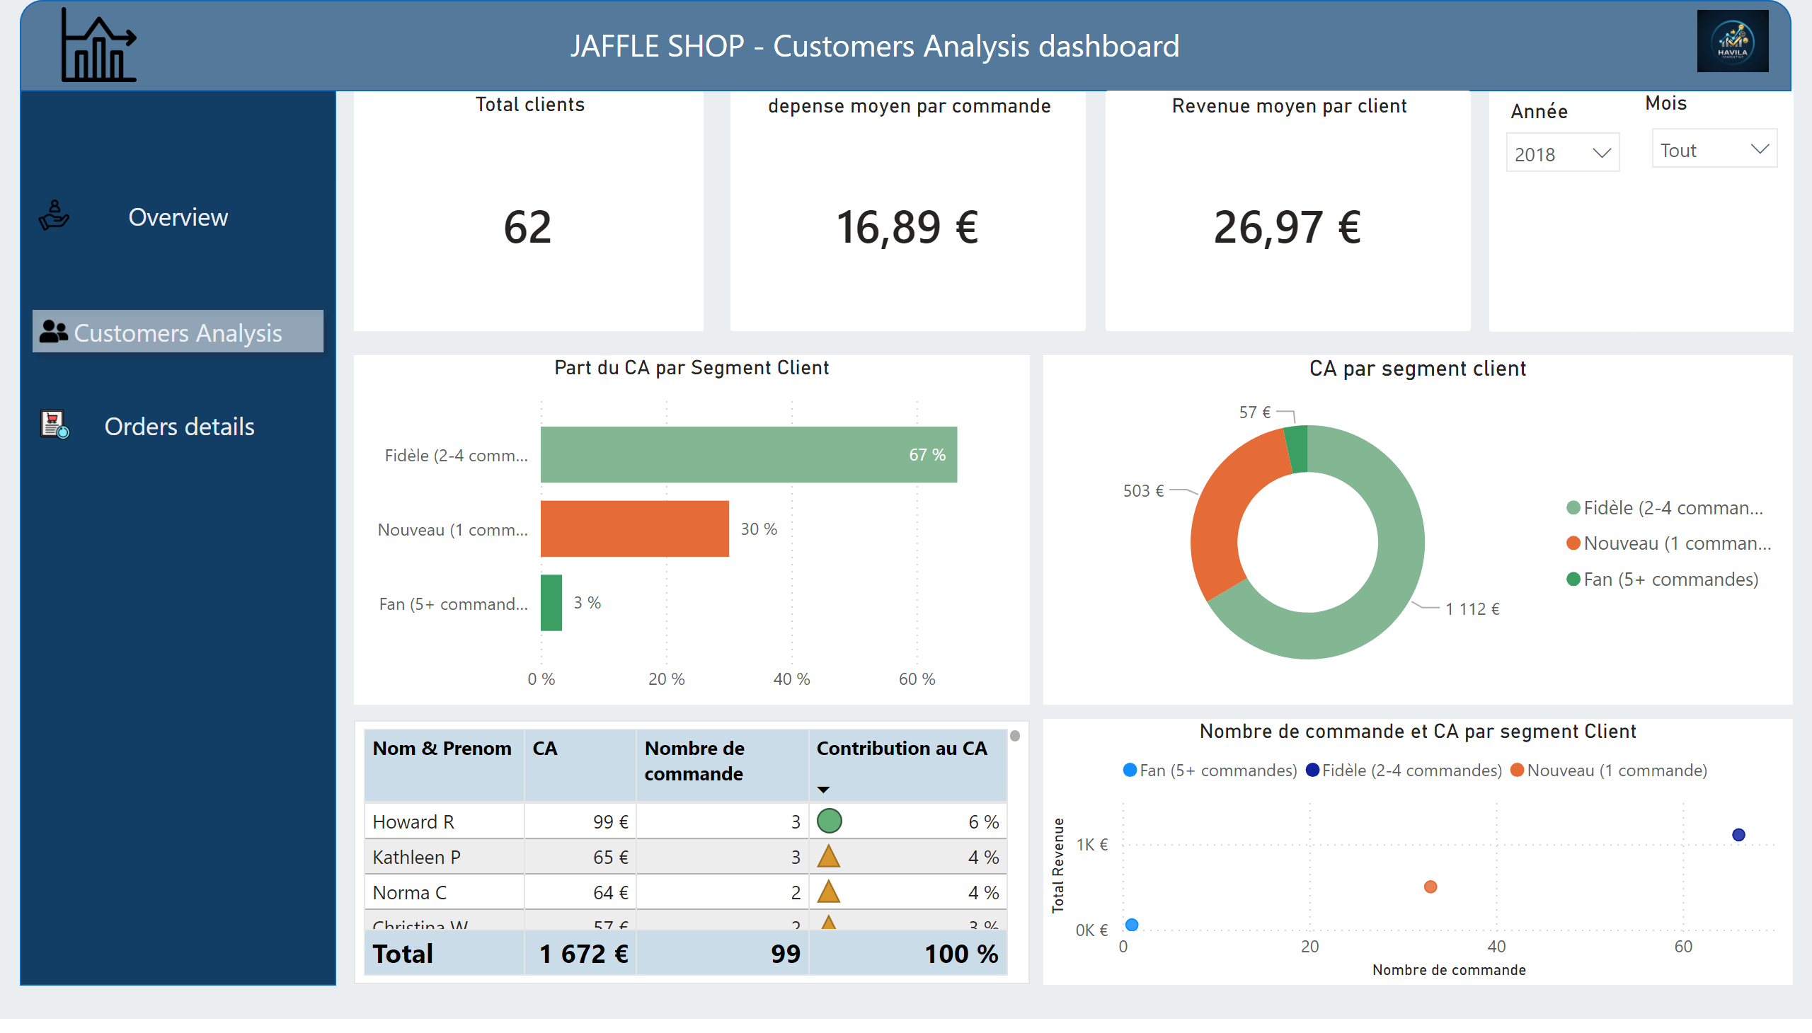
Customers analysis
Notes:
tableEx
No alt text provided
Mois
No alt text provided
shape
No alt text provided
Part du CA par Segment Client
No alt text provided
Total clients
No alt text provided
actionButton
No alt text provided
shape
No alt text provided
textbox
No alt text provided
image
No alt text provided
slicer
No alt text provided
image
No alt text provided
depense moyen par commande
No alt text provided
actionButton
No alt text provided
CA par segment client
No alt text provided
actionButton
No alt text provided
Revenue moyen par client
No alt text provided
Nombre de commande et CA par segment Client
No alt text provided

Slide 4
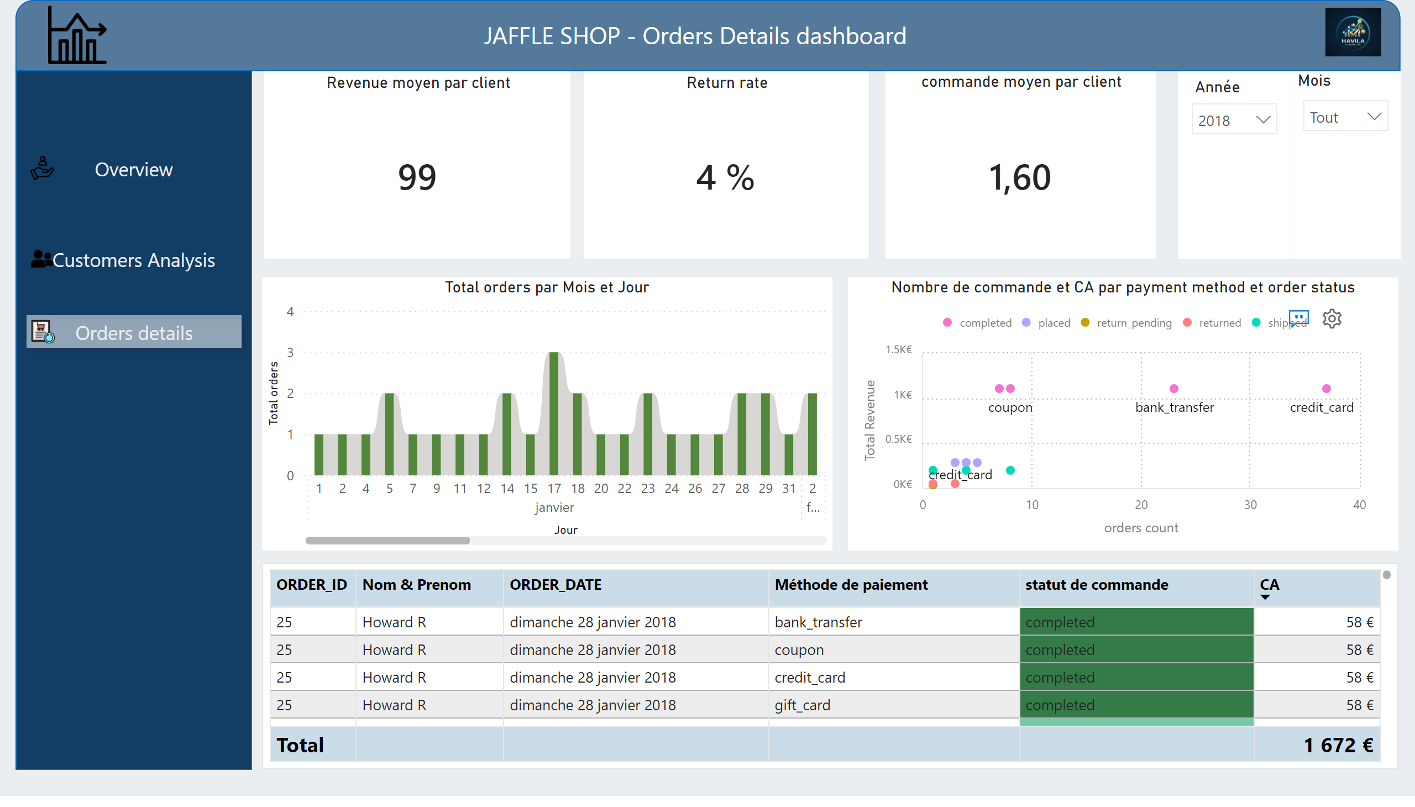
Orders details
Notes:
Mois
No alt text provided
commande moyen par client
No alt text provided
shape
No alt text provided
ribbonChart
No alt text provided
textbox
No alt text provided
image
No alt text provided
shape
No alt text provided
image
No alt text provided
slicer
No alt text provided
Return rate
No alt text provided
actionButton
No alt text provided
actionButton
No alt text provided
actionButton
No alt text provided
Nombre de commande et CA par payment method et order status
No alt text provided
tableEx
No alt text provided
Revenue moyen par client
No alt text provided

