Slide 1
Assignment 3 (NLP) Writeup DO NOT TAG
Name:
GT Email:

Slide 2
Seq2Seq Results – Default configuration Values are for last epoch
RNN
Training Loss: 4.61
Training Perplexity: 100.72
Validation Loss: 4.70
Validation Perplexity: 109.83
LSTM
Training Loss: 3.15
Training Perplexity: 23.28
Validation Loss: 3.32
Validation Perplexity: 27.59
RNN-with-Attention
Training Loss: 1.49
Training Perplexity: 4.46
Validation Loss: 1.85
Validation Perplexity: 6.37
LSTM-with-Attention
Training Loss: 3.66
Training Perplexity: 38.99
Validation Loss: 3.65
Validation Perplexity: 38.70

Slide 3
Seq2Seq Explanation (RNN vs LSTM)
Compare your RNN result to your LSTM result and explain why they differ.
Comparison Item w/ results:
RNN: Training Perplexity ≈ 100, Validation Perplexity ≈ 110
LSTM: Training Perplexity ≈ 4.46, Validation Perplexity ≈ 27.6
Observations:
I summerized the differences in four metrics:
Training loss: LSTM learns faster and fits data better
Training Perplexity: LSTM outperforms RNN in prediction.
Validation Loss: LSTM generalize better than RNN
Validation Perplexity: LSTM has lower uncertainty on unseen data
Explanation of difference:
RNN forgets earlier token quickly due to the vanishing gradient problem, while LSTM selectively remembers over long sequence dependencies ( it has a LSTM Memory Mechanism of using gates (input, forget, output) to control flow of information In the task like seq2seq (translation) → thus LSTM performs better than the vanila RNN
In short: LSTM outperforms RNN because it migrates the vanishing gradient problem and captures long range dependencies more effectively.

Slide 4
Seq2Seq Explanation (RNN vs RNN-with-Attention)
Compare your RNN result to your RNN-with-Attention result and explain why they differ.
Comparison Item w/ results:
RNN: Training Perplexity ≈ 100, Validation Perplexity ≈ 110
RNN w/ attention: Training Perplexity ≈ 4.5, Validation Perplexity ≈ 6
Observations:
I summarized the differences && observations in four metrics:
Training loss: attention added is faster and helps LSTM in convergence.
Training Perplexity: attention added helps to get more accuracy in prediction.
Validation Loss: generalization improves.
Validation Perplexity: attention added helps to perform better, the decoder can selectively use encoder info.
Explanation of difference:
Adding attention to vanilla dramatically improves the validation perplexity
Attention added allows the decoder to focus on the most relevant part of the sequence sources of each step, instead of solely relying on the last hidden state of the encoder.

Slide 5
Seq2Seq Results – Best model Values are for last epoch
Your best model after hyper-parameter tuning
Best model
Training Loss: 1.49
Training Perplexity: 4.46
Validation Loss: 1.85
Validation Perplexity: 6.37
List your best model hyper-parameter values including model type: ?
Best model hyper parameter values including model type:
Model type: RNN + Attention
Hidden size: 2
Embedding size: 4
Number of attention heads: 1
Feedforward hidden size: 2
LR: 1e-3
Dropout:0.2

Slide 6
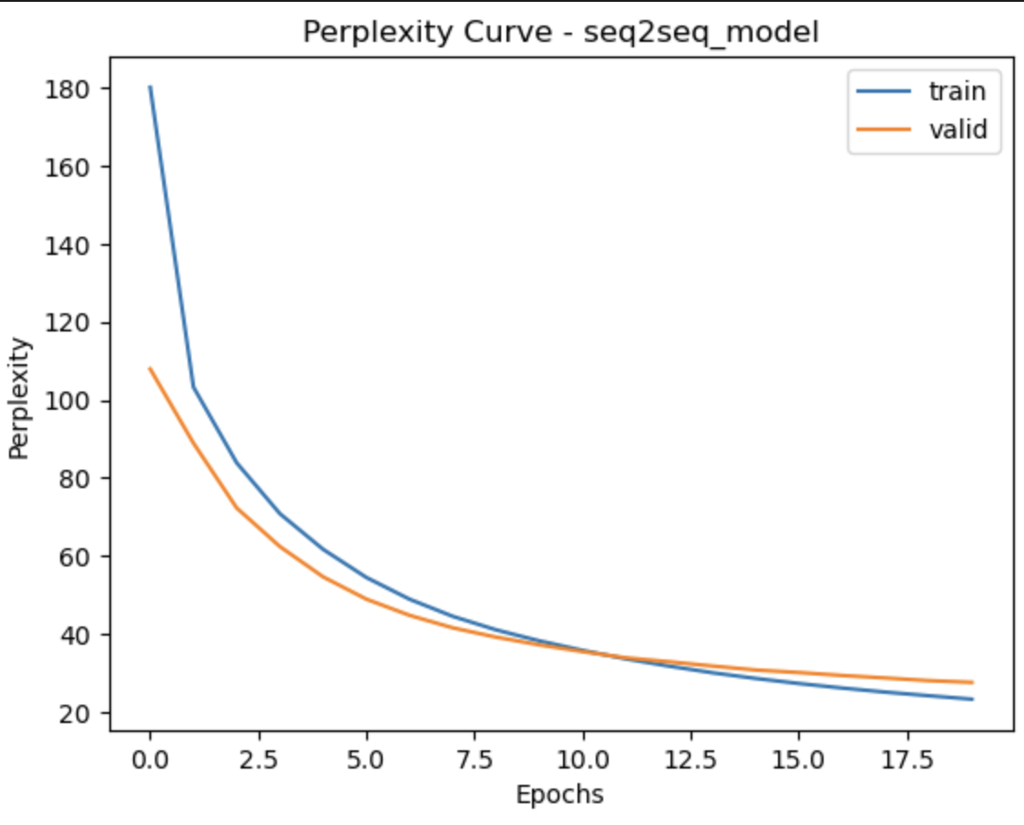
Seq2Seq Best model Learning Curves (Perplexity)
Describe in text:
- Learning curve starts very high for seq2seqRNN
Gets flatten after around 10 epochs, indicating convergence
Validation closely follows the training perplexity, indicating no severe overfitting

Slide 7
Seq2Seq Explanation – Best model
Explain the details of your best model. Explain what you did to improve your model’s performance and why
Best Model details:
Uses attention to focus on relevant input tokens.
Improvement done:
Added attention mechanism
Tuned hidden size, and embedding size, did not change the lr
Reasoning:
Attention mechanism allows dynamic weighting on input token in tern of relevance for sequence resource, improving prediction accuracy.
Hyperparameters tuning ensure stable training and prevent overfitting/underfitting.

Slide 8
Transformer Results Values are for last epoch
Default configuration (Encoder Only)
Training Loss: 2.17
Training Perplexity: 8.73
Validation Loss: 3.09
Validation Perplexity: 21.89
Default configuration (full transformer)
Training Loss: 1.49
Training Perplexity: 4.46
Validation Loss: 1.85
Validation Perplexity: 6.37
List your best model hyper-parameter values (full transformer): ?
Hidden size: 128
Embedding size: 128
Number of attention heads: 2 heads
Feedforward hidden size: 2048
Optimizer / learning rate: Adam 1e-3
Dropout: 0.2
Best model (full transformer)
Training Loss: 1.49
Training Perplexity: 4.46
Validation Loss: 1.85
Validation Perplexity: 6.37

Slide 9
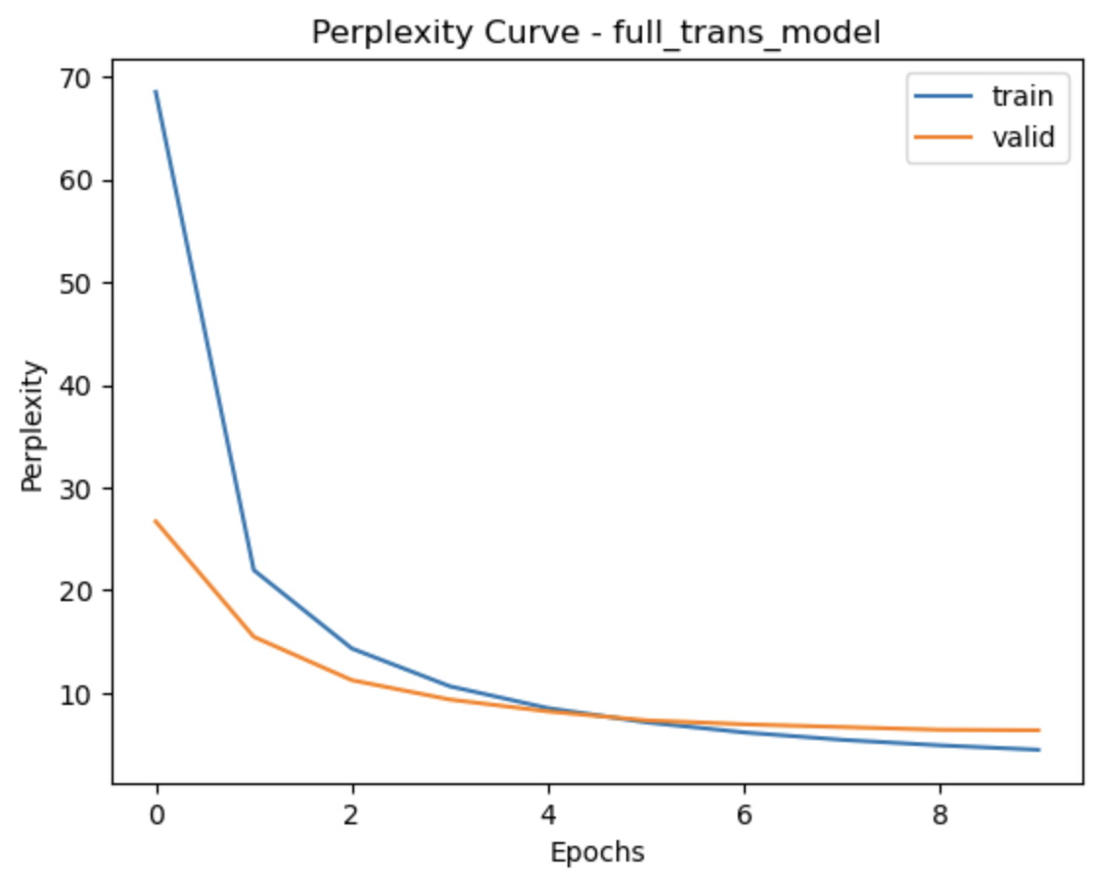
Full Transformer Best model Learning Curves (Perplexity)
Describe in text:
- The Perplexity drops fast in early epochs, and then slowly converge
Train && valid curves are very close, indicating minimal overfitting
Full transfer converge faster than seq2seq RNN or LSTM

Slide 10
Full Transformer Explanation – Best model
Explain what you did here and why you did it to improve your model performance.
Best Model details:
Full transformer combo: encoder + decoder + multi-heads attention gives the best performance
Improvement done:
Added positional encoding for sequential info
Tuned hyperparameters: embedding & hidden sizes
Used residual connections and layer normalization
Reasoning:
Attention mechanism allows global context access (not sequential like RNN)
Multi-heads attention allows multiple representation subspaces
Residual + normalization stableize training

Slide 11
Transformer (Encoder Only) Translation Results (default settings)
Put translation results for your model (1st 9 sentences) here. You may remove duplicate <pad> and <eos> tokens for each sentence.
True Translation | Predicted Translation
<sos> a man in an orange hat starring at something <eos> | <sos> a man in an orange hat s hat is <unk> something <eos>
<sos> a boston terrier is running on lush green grass in front of a white fence <eos> | <sos> a boston <unk> dog is running through tall green grass in front of a white fence <eos>
<sos> a girl in karate uniform breaking a stick with a front kick <eos> | <sos> a girl in a karate uniform is using a board with a <unk> <eos>
<sos> five people wearing winter jackets and helmets stand in the snow with <unk> in the background <eos> | <sos> five people in helmets and helmets stand with helmets in the background <eos>
<sos> people are fixing the roof of a house <eos> | <sos> people are fixing the roof of a house <eos>
<sos> a group of people standing in front of an igloo <eos> | <sos> a group of people stand in front of a stone building <eos>
<sos> a guy works on a building <eos> | <sos> a guy working on a building using a building <eos>
<sos> a man in a vest is sitting in a chair and holding magazines <eos> | <sos> a man in a vest is sitting on a chair holding a desk <eos>
<sos> a mother and her young son enjoying a beautiful day outside <eos> | <sos> a mother and her son enjoying a beautiful day outdoors <eos>

Slide 12
Full Transformer Translation Results (best model)
Put translation results for your best model (1st 9 sentences) here. You may remove duplicate <pad> and <eos> tokens for each sentence.
True Translation | Predicted Translation
<sos> a man in an orange hat staring at something <eos> | <sos> a man in an orange hat staring at something <eos>
<sos> a boston terrier is running on lush green grass in front of a white fence <eos> | <sos> a boston terrier is running on lush green grass in front of a white fence <eos>
<sos> a girl in karate uniform breaking a stick with a front kick <eos> | <sos> a girl in karate uniform breaking a stick with a front kick <eos>
<sos> five people wearing winter jackets and helmets stand in the snow with <unk> in the background <eos> | <sos> five people wearing winter jackets and helmets stand in the snow with <unk> in the background <eos>
<sos> people are fixing the roof of a house <eos> | <sos> people are fixing the roof of a house <eos>
<sos> a group of people standing in front of an igloo <eos> | <sos> a group of people standing in front of an igloo <eos>
<sos> a guy works on a building <eos> | <sos> a guy works on a building <eos>
<sos> a man in a vest is sitting in a chair and holding magazines <eos> | <sos> a man in a vest is sitting in a chair and holding magazines <eos>
<sos> a mother and her young son enjoying a beautiful day outside <eos> | <sos> a mother and her young son enjoying a beautiful day outside <eos>
Table 2

Slide 13
Seq2Seq (Best model) Translation Results
Put translation results for your best model (1st 9 sentences) here. You may remove duplicate <pad> and <eos> tokens for each sentence.
True Translation | Predicted Translation
<sos> a man in an orange hat staring at something <eos> | <sos> a man in an orange hat staring at something <eos>
<sos> a boston terrier is running on lush green grass in front of a white fence <eos> | <sos> a boston terrier is running on lush green grass in front of a white fence <eos>
<sos> a girl in karate uniform breaking a stick with a front kick <eos> | <sos> a girl in karate uniform breaking a stick with a front kick <eos>
<sos> five people wearing winter jackets and helmets stand in the snow with <unk> in the background <eos> | <sos> five people wearing winter jackets and helmets stand in the snow with <unk> in the background <eos>
<sos> people are fixing the roof of a house <eos> | <sos> people are fixing the roof of a house <eos>
<sos> a group of people standing in front of an igloo <eos> | <sos> a group of people standing in front of an igloo <eos>
<sos> a guy works on a building <eos> | <sos> a guy works on a building <eos>
<sos> a man in a vest is sitting in a chair and holding magazines <eos> | <sos> a man in a vest is sitting in a chair and holding magazines <eos>
<sos> a mother and her young son enjoying a beautiful day outside <eos> | <sos> a mother and her young son enjoying a beautiful day outside <eos>

Slide 14
Compare Transformer (Encoder Only) to Transformer (Full transformer)
Compare your results for default settings for Encoder Only Transformer vs best model for Full transformer both quantitatively and qualitatively. Explain why you see differences.
Quantitative Comparison (validation/perplexity/loss):
Encoder only transformer is of 21.89 validation perplexity while the full transformer is of 6.36 of it.
Encoder only transformer misses words or their order sometimes, whereas the full transformer can execute the sentences gramatically correct and better preserve meaning
Why:
Full transformer uses both encoder, decoder with attentions that allows every token to attend the full sequence source while decoding.
Encoder only transformer can not model autoregressive dependencies while decoding. It only provides context embedding

Slide 15
Compare Seq2Seq to Transformer (Best models)
Compare your Seq2Seq best model results to your Transformer best model results both quantitatively and qualitatively and explain the differences.
Quantitative Comparison (validation/perplexity/loss):
Best seq2seq(RNN + Attention) is of Validation Perplexity: 6.37, roughly the same as the best transformer (full transformer best), in my case they two are identical after rounding up, usually full transformer can scale better in longer sequence
seq2seq may make small errors than best transformer on long sentence or rare words.
Full transformer produces smoother sentence with good grammar, better long-range sequence.
Why:
Seq2seq relies on recurrent connections and attention to selective focus, but it still process sequence sequentially.
Full transformer is parallelized and uses multi head attention to capture the dependencies globally

Slide 16
Theory question
Add additional slides if necessary

Slide 17
Paper discussion
Name the paper you chose and answer the questions related to it. Add additional slides as necessary

