Slide 1

DSO 530 Machine Learning
Option Price
Prediction
Group 6:
Sue(Xinxue) Gu, Fangfei Li, Haiqing Liu, Guoqiong Sun, Huiyi Zhang, Yulin Zhang

Slide 2



Overview
Model 1
01
02
03
04
05
Regression
Classification
Evaluation
Implementation
Conclusion

Slide 3
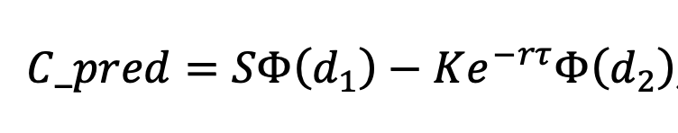
Executive Summary
Model 1
Project Goal
Examining European call option pricing data on the S&P 500
Predict current option value and BS formula applied is Over or Under
Data:1680 rows, 6 fields
Black-Scholes option pricing formula
Variables
Value (C): Current option value
S: Current asset value
K: Strike price of option
r: Annual interest rate
tau: Time to maturity (in years)
BS: The Black-Scholes formula was applied to this data (using some 𝜎) to get C_pred. If an option has C_pred – C > 0, we associate that option by (Over); otherwise, we associate that option with (Under).

Slide 4
01
Regression
Linear Regression
K-Nearest Neighbor
Random Forest
XGBoost

Slide 5
Regression
Criterion
R^2
R^2
Model 1
Model 2
Model 1
Linear Regression
Fits a linear model with coefficients w=(w1,...,wp) to minimize the residual sum of squares between the observed targets in the dataset, and the targets predicted by the linear approximation.
In-sample r^2 = 0.9113
Out-of-sample r^2 = 0.9136
K-Nearest Neighbor Regression
Non-parametric method that approximates the association between independent variables and the continuous outcome by averaging the observations in the same neighborhood.
In-sample r^2 = 0.9790
Out-of-sample r^2 = 0.9744
Regression Classification Model Evaluation Implementation Conclusion

Slide 6
Regression
Criterion
R^2
Model 3
Model 4
Random Forest
An ensemble learning method that operate by constructing a multitude of decision trees at training time and outputting the class that is the mode of the mean or average prediction of the individual trees.
In-sample r^2 = 0.9993
Out-of-sample r^2 = 0.9967
XGBoost
A decision-tree-based ensemble machine learning algorithm that uses a gradient boosting framework
In-sample r^2 = 0.9999
Out-of-sample r^2 = 0.9985
Regression Classification Model Evaluation Implementation Conclusion

Slide 7
02
Classification
Logistic Regression
Naïve Bayes
K-Nearest Neighbor
SVM
Decision Tree
XGboost

Slide 8
Criterion
Classification Error
Classification
Criteria
Model 1
Mo
Model 2
Logistic Regression
Models the probabilities for classification problems with two possible outcomes and uses the logistic function to squeeze the output of a linear equation between 0 and 1.
Classification error: 0.080
Naive Bayes
Assumes that the value of a particular feature is independent of the value of any other feature, given the class variable.
Classification error: 0.092
Regression Classification Model Evaluation Implementation Conclusion

Slide 9
Criterion
Classification Error
Classification
Criteria
Model 3
MoModModel 4
K-nearest neighbors
A simple algorithm that is classified by a majority vote of its neighbors, with the case being assigned to the class most common amongst its K nearest neighbors measured by a distance function.
Performance plot and GridSearchCV to find the best k
Classification error:
k= 3, 0.075
k= 46, 0.074
SVM
Uses a technique called the kernel trick to transform your data and then based on these transformations it finds an optimal boundary between the possible outputs.
Kernels: Linear, rbf, poly
SVC(kernel='rbf', C=1000.0, gamma = 'auto')
Classification error: 0.082
Regression Classification Model Evaluation Implementation Conclusion

Slide 10
Classification
Criterion
Classification Error
Model 5
MoModModel 6
Decision Tree
A Supervised Machine Learning where the data is continuously split according to a certain parameter.
Tried max_depth ranges from 1 to 5 and found the max_depth = 3
Classification error: 0.093
XGboost
Effective for a wide range of regression and classification predictive modeling problems.
Offers a range of hyperparameters that give fine-grained control over the model training procedure.
N_estimator = 100
Classification error: 0.067
Regression Classification Model Evaluation Implementation Conclusion

Slide 11
03
Model Evaluation
Subset Selection
Cross Validation (10f, LOOCV)
Overfitting Discussion
Normalize VS not Normalize
Fine tune parameters

Slide 12
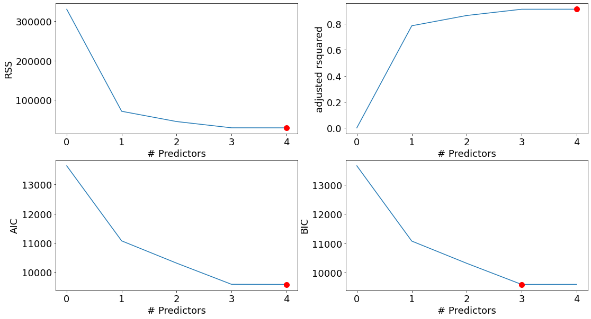
Feature Selection - Why We Used 4 Features
Regression
Regression Classification Model Evaluation Implementation Conclusion

Slide 13
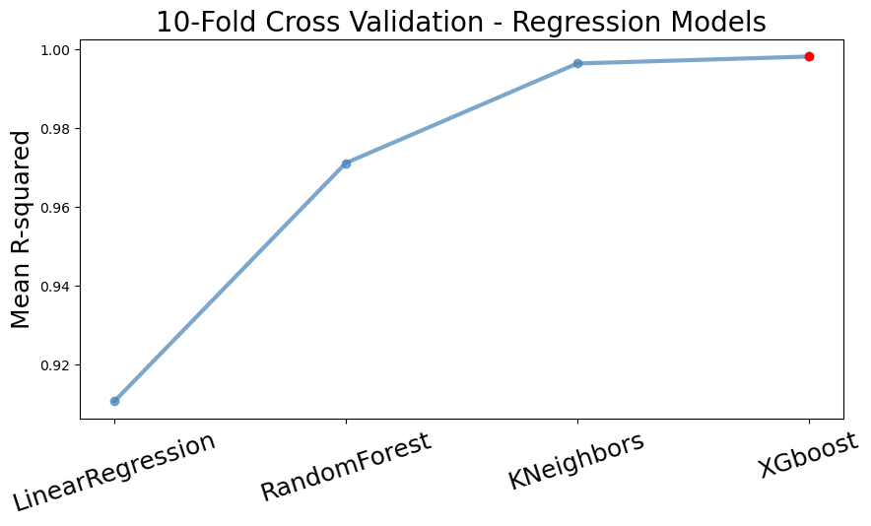
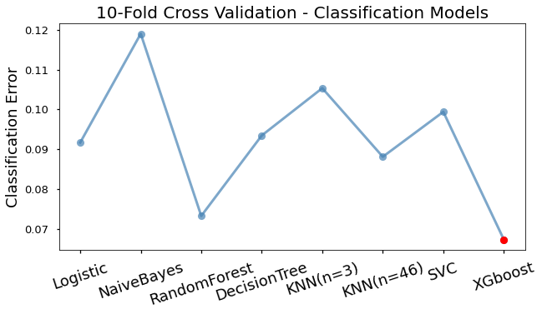
Cross Validation - 10 Folds
Regression
Classification
Best Model​ | Mean R-squared
XGBoost | 0.998​
Best Model​ | Mean Classification Error
XGBoost | 0.067
Regression Classification Model Evaluation Implementation Conclusion

Slide 14
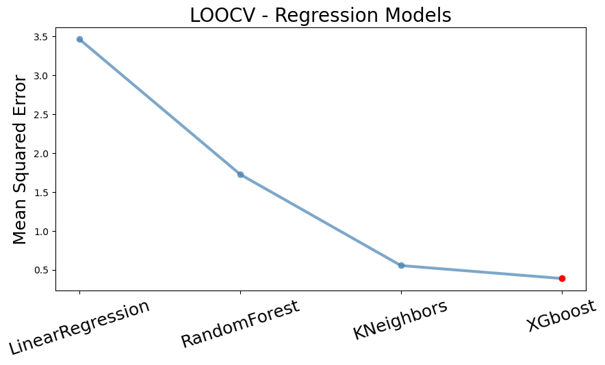
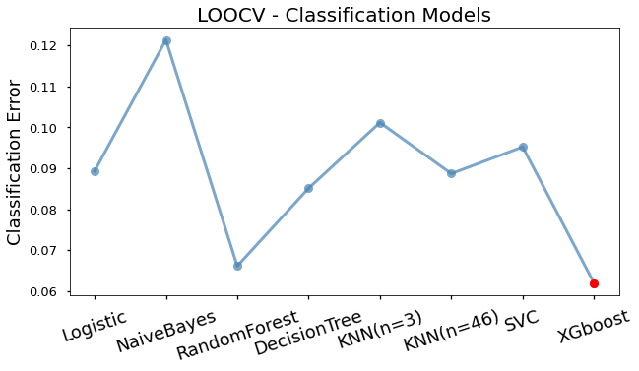
Cross Validation - LOOCV
Regression
Classification
Best Model​ | Average Mean Squared Error
XGBoost | 0.387
Best Model​ | Mean Classification Error
XGBoost | 0.062
Regression Classification Model Evaluation Implementation Conclusion

Slide 15
Overfitting
Regression/Classification
K-Fold Cross Validation
The procedure has a single parameter called k that refers to the number of groups that a given data sample is to be split into.
Leave One Out Cross Validation
This approach leaves 1 data point out of training data, i.e. if there are n data points in the original sample then, n-1 samples are used to train the model and p points are used as the validation set.
The Accuracy of the model is the average of the accuracy of each fold.
Overfit Model: Overfitting occurs when a statistical model or machine learning algorithm captures the noise of the data. Intuitively, overfitting occurs when the model or the algorithm fits the data too well.
Cross Validation Result
Regression Classification Model Evaluation Implementation Conclusion

Slide 16
Impact of Normalization
Regression
Classification
​ | Model​ | OutofSample R^2​ | OutofSample R^2​(Norm)​
0​ | LinearRegression()​ | 0.9136 | 0.9136
2​ | RandomForestRegressor('max_features': 'auto', 'n_estimators': 70) | 0.9994 | 0.9968
4​ | KNeighborsRegressor(n_neighbors=4) | 0.9744 | 0.9751
7​ | XGBRegressor() | 0.9985 | 0.9985
 | Model | Classification Error | Classification Error(Norm)
0 | LogisticRegression(max_iter=10000, penalty='none') | 0.086 | 0.092
1 | GaussianNB() | 0.119 | 0.119
2 | RandomForestClassifier() | 0.071 | 0.070
3 | DecisionTreeClassifier(max_depth=3) | 0.093 | 0.093
4 | KNeighborsClassifier(n_neighbors=3) | 0.075 | 0.105
5 | KNeighborsClassifier(n_neighbors=46) | 0.074 | 0.088
6 | SVC(C=1000.0, gamma='auto') | 0.082 | 0.099
7 | XGBClassifier(n_estimator = 100) | 0.067 | 0.067
Regression Classification Model Evaluation Implementation Conclusion

Slide 17
Fine Tune Parameter - Steps
1
Build untuned parameters in XGBoost model
Build XGBoost Hyperparameters Dictionary
Common Tree tunable parameters
= [learning rate,gamma, lambda,alpha,max_depth,sub_sampl........]
Linear Tunable parameters = [lambda,alpha,lambda_bias]
Use RandomizedSearchCV and GridSearchCV to find the best parameters based on ROC_AUC
Compare the 2 models.
2
3
4
Regression Classification Model Evaluation Implementation Conclusion

Slide 18
04
Implementation
The Final Model
Fit All the Data Available

Slide 19
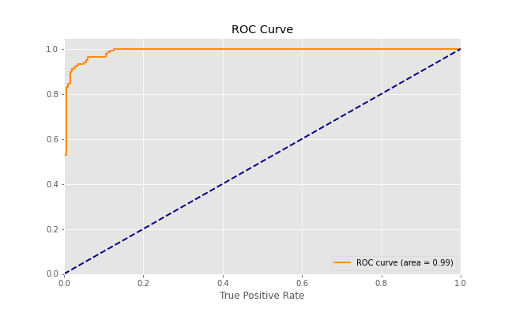
Final Model
Regression
Classification
Model | Out of Sample R^2
XGBRegressor | 0.99846
Model | Classification Error
XGBClassifier | 0.06726
Parameters: objective ='reg:linear', colsample_bytree = 0.3, learning_rate = 0.1, max_depth = 5, alpha = 10, n_estimators = 10
Parameters: max_depth = 6, n-estimator = 100
Advantage of XGBoost
Has regularization, can help to reduce overfitting
Make splits up to the Max_depth specified and then start pruning the tree backwards and remove splits beyond which there is no positive gain.
Not a greedy algorithm comparing to GBM
Regression Classification Model Evaluation Implementation Conclusion

Slide 20
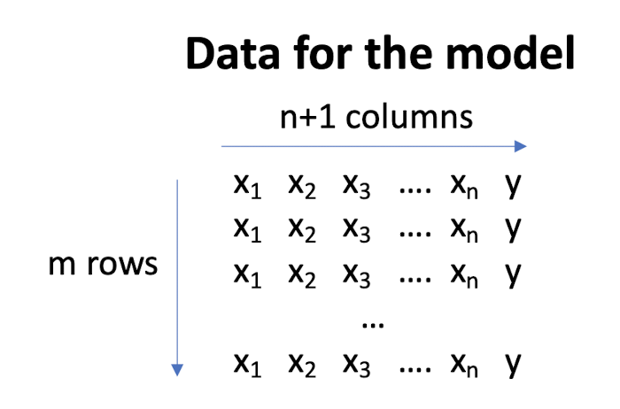
Fit All the Data Available
Regression
Classification
XGBregressor
4+1 Columns
Prediction on
'option_test_wolabel.csv'
1680 Rows
XGBclassifier
'option_train.csv'
Regression Classification Model Evaluation Implementation Conclusion

Slide 21
05
Conclusion
Summary
Findings

Slide 22
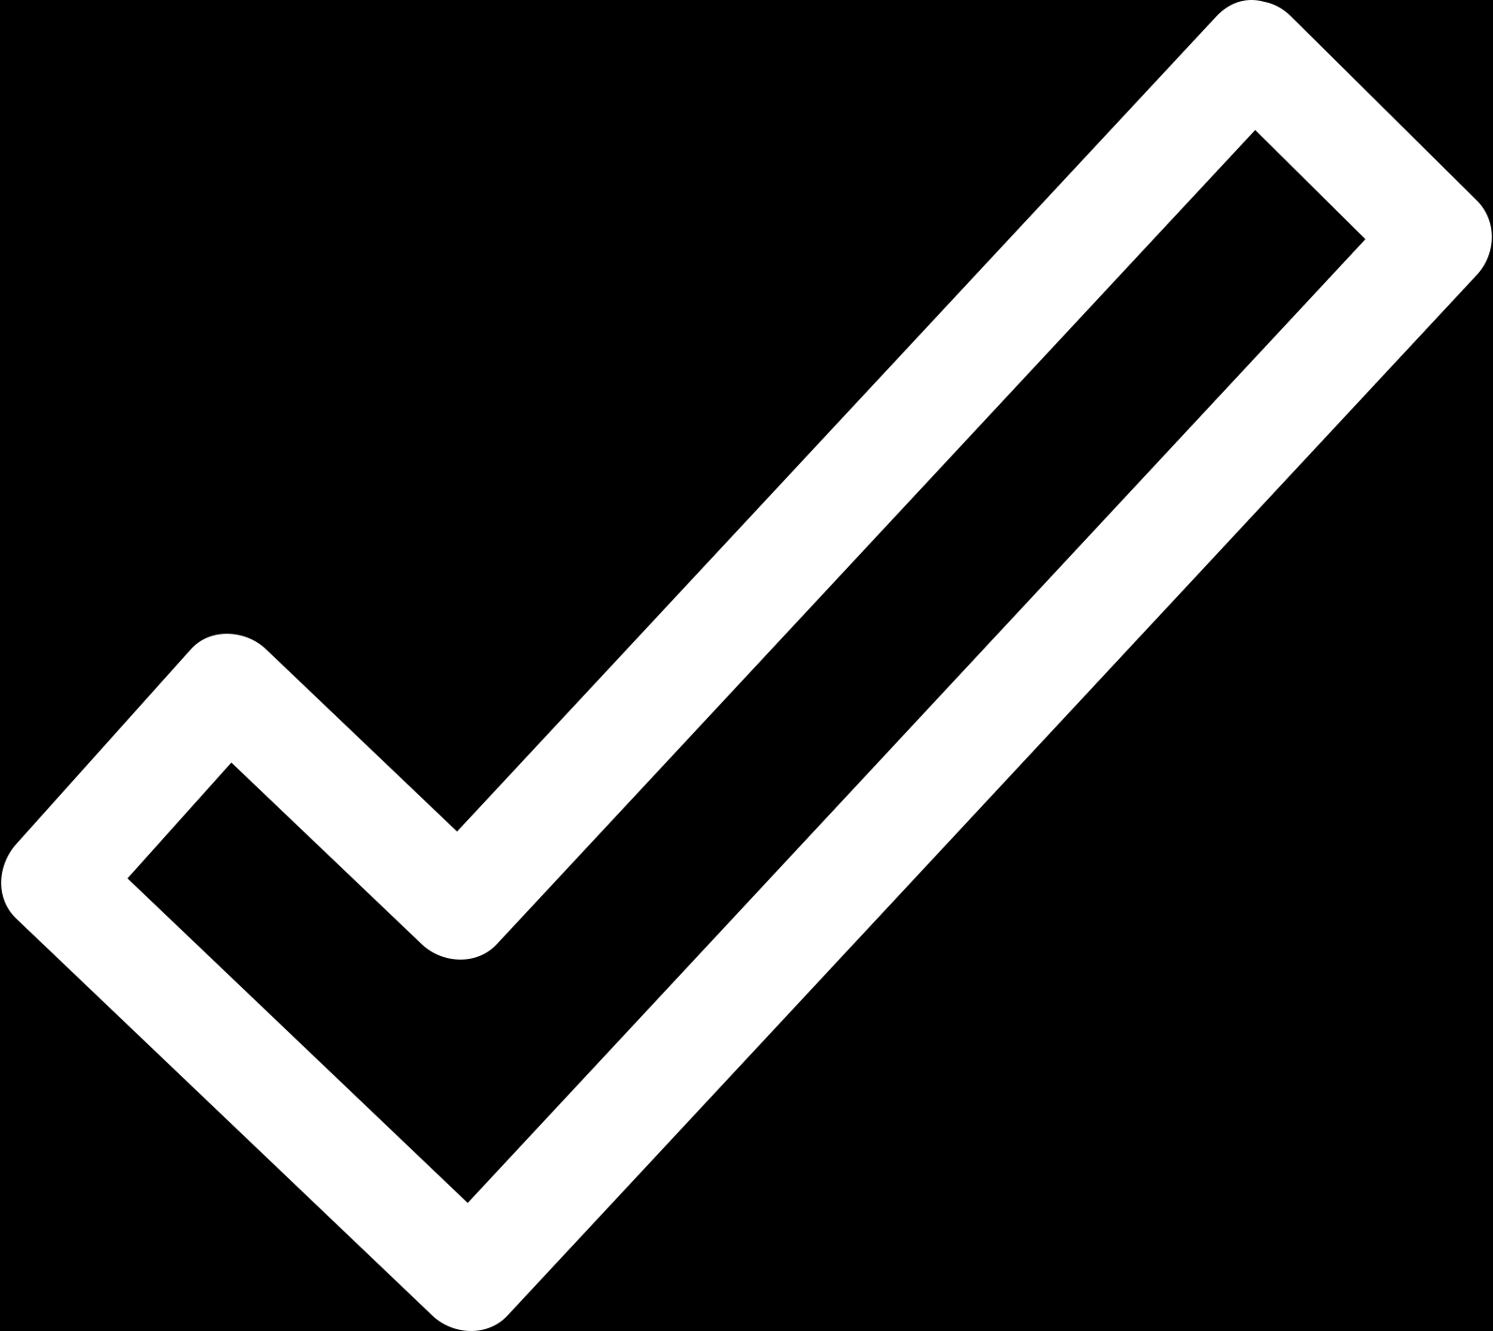
Conclusion
1
Model | Performance
XGBRegressor | R^2 = 0.99846
XGBClassifier | Error = 0.06726
Identify target variable (y)
Try individual models with different leaning algorithms and different parameters
2
Special Dataset
Small data size
Low dimension
Feature values’ scale does not vary much
Findings
Normalization does not help for this data
Tree models perform better
Simple models for simple dataset
3
Select one best model from each algorithm
4
Implement 10-folds validation to compare the performance
5
Analyze the impact of normalization, tune hyperparameter
6
Train with all the available data to get the final model
Regression Classification Model Evaluation Implementation Conclusion

Slide 23
Thanks for
your attention!

