Slide 1

PART 03
Article Writing & Design

Slide 2

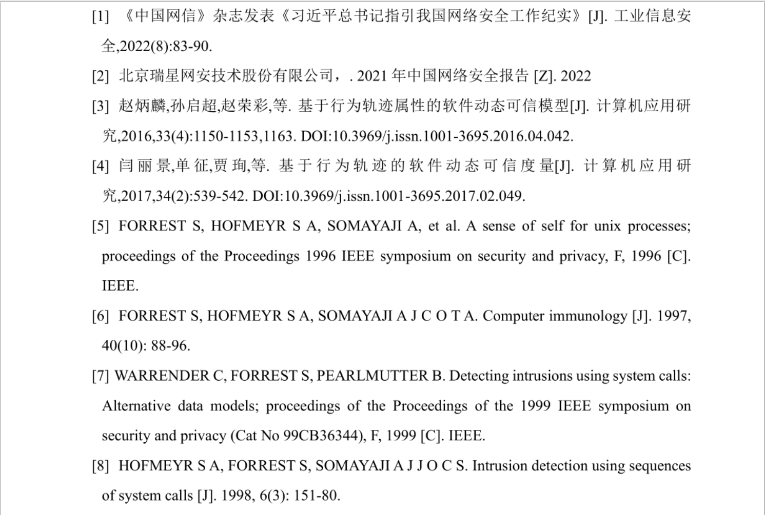




窦艺初
Pre-Research
hands-on
Data Survey
Search
AI study

Slide 3
Support Formats
李婷婷
PubMed, Web of Science, Scopus…
Journal Articles, Books, Patents, Presentations, Theses, Reports…
PDFs, Word documents, image files…
APA, MLA, Chicago, Harvard…
Bibliographic Databases
Document Types
File Formats
Citation Styles

Slide 4
Comparison
李婷婷
 | EndNote | Mendeley | Zotero
Price | Charging | Free | Free
cross-platform | Mac,Windows | Mac,Windows,Linux | Mac,Windows,Linux
Organize PDF | √ | √ | √
Document Sync | × | √ | √
Comment | √ | √ | √
label | √ | √ | √
Full text search across PDFs | √ | √ | √
Private groups | √ | √ | √
Public groups | × | √ | √
Community | × | √ | √
Mobile App | Pad | Stop | IPad & iPhone
Internal citation formatting | >200 | 15 | 12

Slide 5
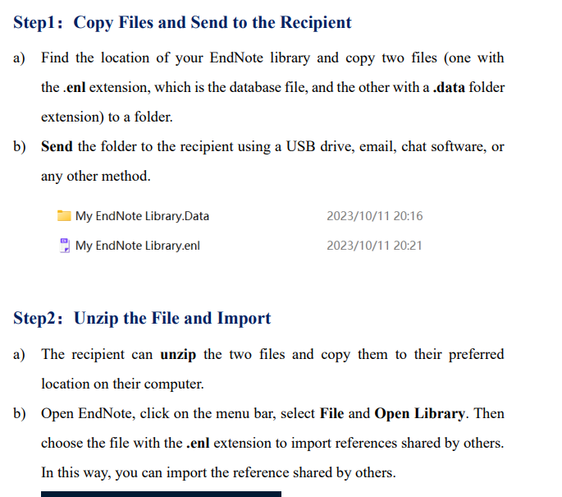
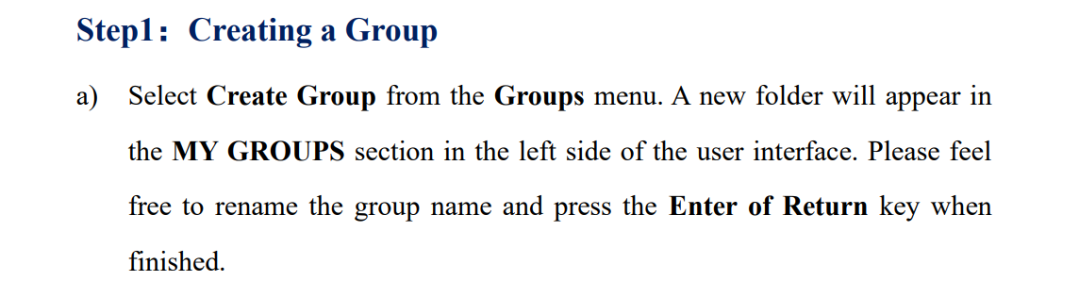
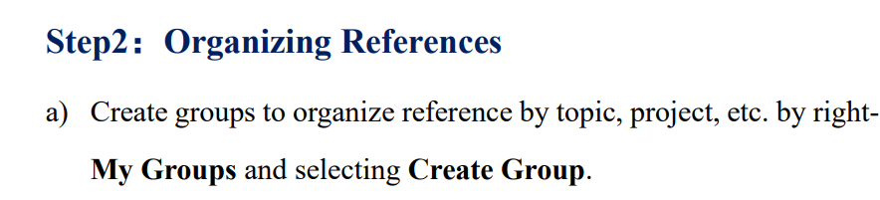
Step-by-step Approach
李婷婷
More detailed
Clear instructions
Boldfaced

Slide 6
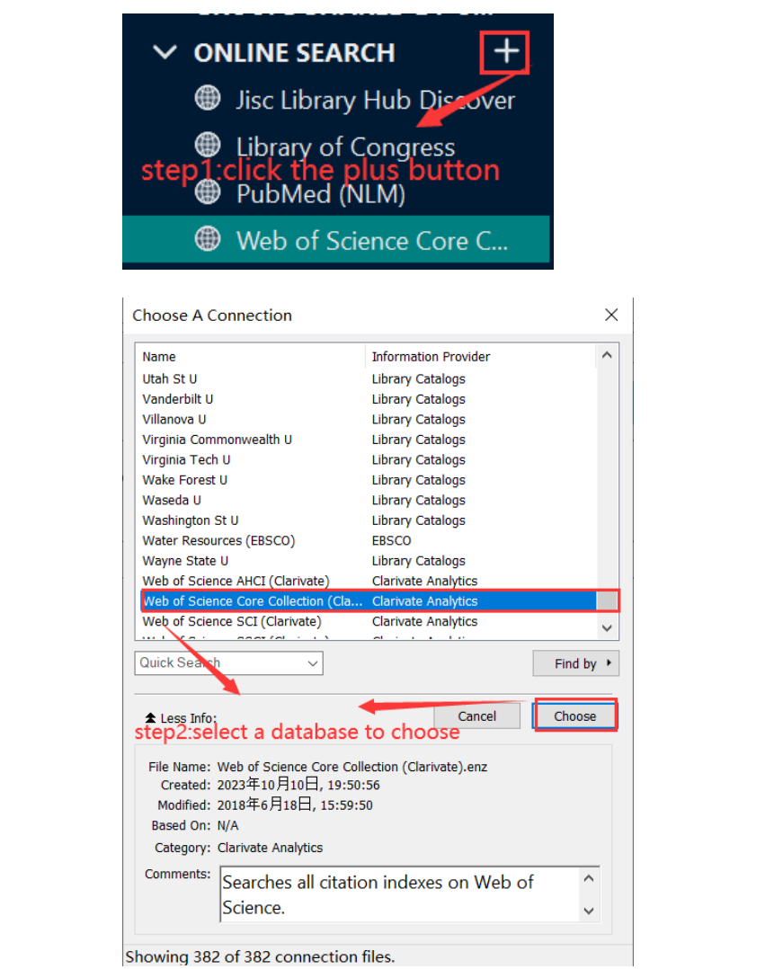
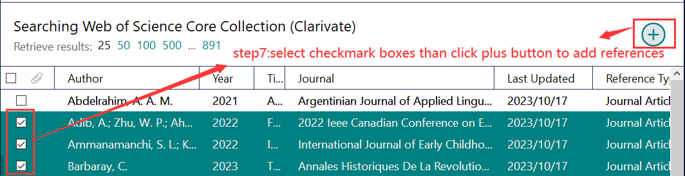
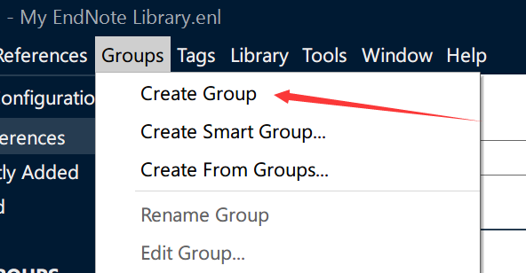
Visual Aid
李婷婷
Rectangle & Arrow
Label with Annotations

Slide 7
Improvements
孙利峰
UI
Functions
Price
Integration
Networks

Slide 8
Chinese-friendly
孙利峰
Chinese Character Support
Chinese UI
Translation
Chinese Literature Types
Chinese Styles
Chinese Search
Chinese Database Support
Database
Citation

