Slide 1

EndNote User Manual Pre
EndNote用户手册
The world’s best reference manager
汇报人：Group1

Slide 2

Why we
choose EndNote
Typesetting
Improvements
02
04
06
Start
End
01
03
05
07
Contribution of
group member
Reasons for Selecting
4 EndNote Functions
Polishing
Summary
2

Slide 3
PART 01
Contribution of group member

Slide 4
Contribution
Name | Document
孙利峰 | Improvements
韩永欣 | Literature Sharing
金子昂 | Literature Management
窦艺初 | Literature Citation
陈巍炜 | Literature Collection
侯宇捷 | Features
李婷婷 | Introduction
Short Text Here
点击添加标题点击添加标题点击添加标题点击添加标题, 点击添加标题点击添加标题点击添加标题点击添加标题 点击添加标题点击添加标题点击添加标题点击添加标题nibh lacus laoreet turpis, quis

Slide 5
PART 02
Why we choose EndNote

Slide 6

Introduction
Organize
Store
Reference
Notes:
EndNote is a citation management and reference management software that aids academic researchers, students, and professionals in organizing, storing, and referencing their bibliographic resources. The following is an overview of EndNote, its development history, and supported file formats.

Slide 7
Overview
Reference Collection
Reference Management
Reference Citation
Reference Sharing
Notes:
EndNote provides a robust platform to assist users in:
1.Collecting, organizing, and citing references
2.Easily creating academic papers, research reports, and other scholarly documents
3.Storing and managing bibliographic information
4.Automatically generating reference lists and citing references

Slide 8
PART 03
Reasons for Selecting 4 EndNote Functions
Notes:
In crafting the user manual for EndNote, our team carefully selected four fundamental sections that serve as the foundation of the software's functionality and utility. These sections were chosen with the aim of providing a comprehensive understanding of the essential features that users commonly engage with during their academic research.

Slide 9
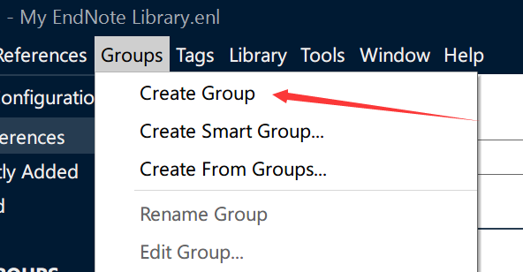
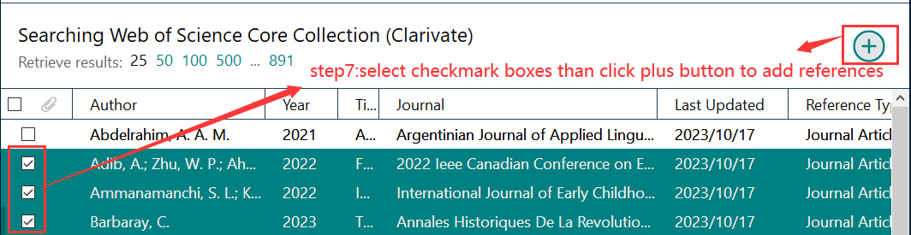
1. Reference Collection
2. Reference Management
A repository of references
The most basic function
The need to manage references after collected
Facilitate reference retrieval
Notes:
Reference Collection: This section was included to highlight the critical aspect of building a robust repository of references. Reference collection is the most basic function of EndNote so it is placed at the beginning.
Reference Management: The selection of this section was driven by the need to offer users the method to manage and manipulate references after collected. Users can organize the collected references into folders for easy reference retrieval and management. The mechanism for organizing the EndNote library is called ‘Groups’ as you can see in the picture.

Slide 10
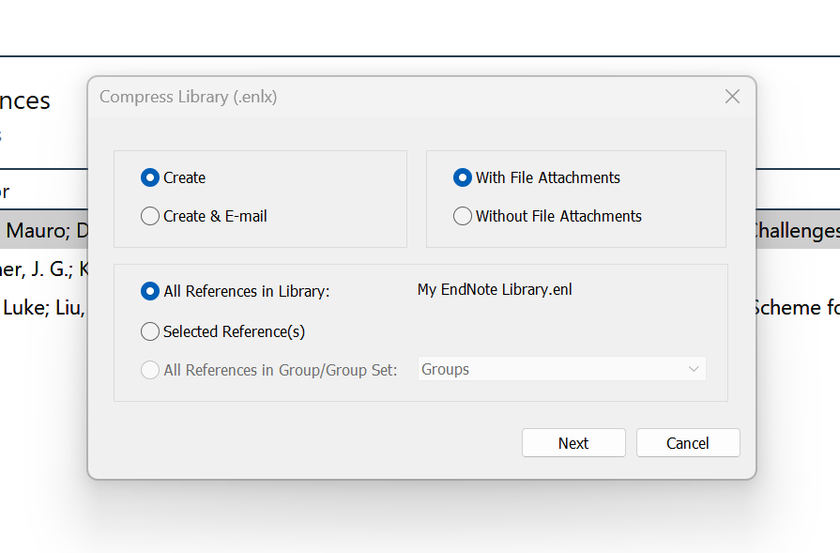
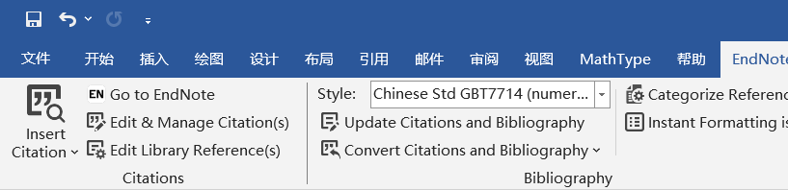
3. Reference Citation
4. Reference Sharing
The need for citation after reading the literature
Generate reference lists automatically
Emphasize collaboration and information dissemination
An advantage of software
Notes:
3. Reference Citation: Due to the potential need for citation after reading the literature, we chose the function of reference citation. Users can directly generate reference lists in Word or LaTeX using EndNote, and select the appropriate citation format.
4. Reference Sharing: This section was chosen to emphasize the importance of collaboration and information dissemination within the academic community. Reference sharing enables users to conveniently share the collected references with others and it is also an advantage of using electronic reference management software.

Slide 11
PART 04
Typesetting

Slide 12
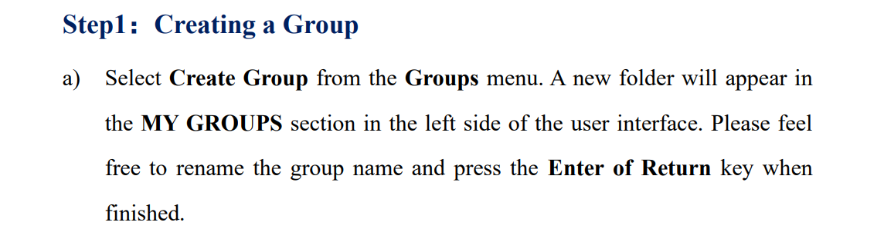
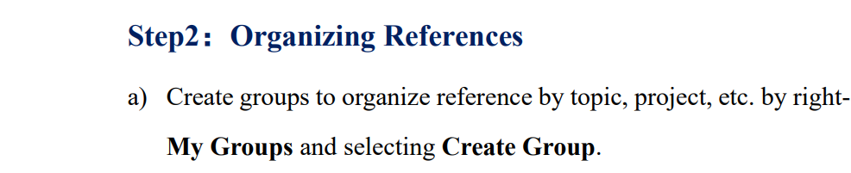
Typesetting
Step by step
Gradation
Bold
Notes:
First of all, in order to guide readers to use EndNotes correctly, we use Step by Step mode for typesetting in the "How to use it" module. Secondly, We rank all the steps. For example, We set Step 1,Step 2.And in each step we also set a）b）c) steps ,we do these to help readers better understand how they are going. Moreover, we&apos;ve bolded key steps to prevent readers from missing them.

Slide 13
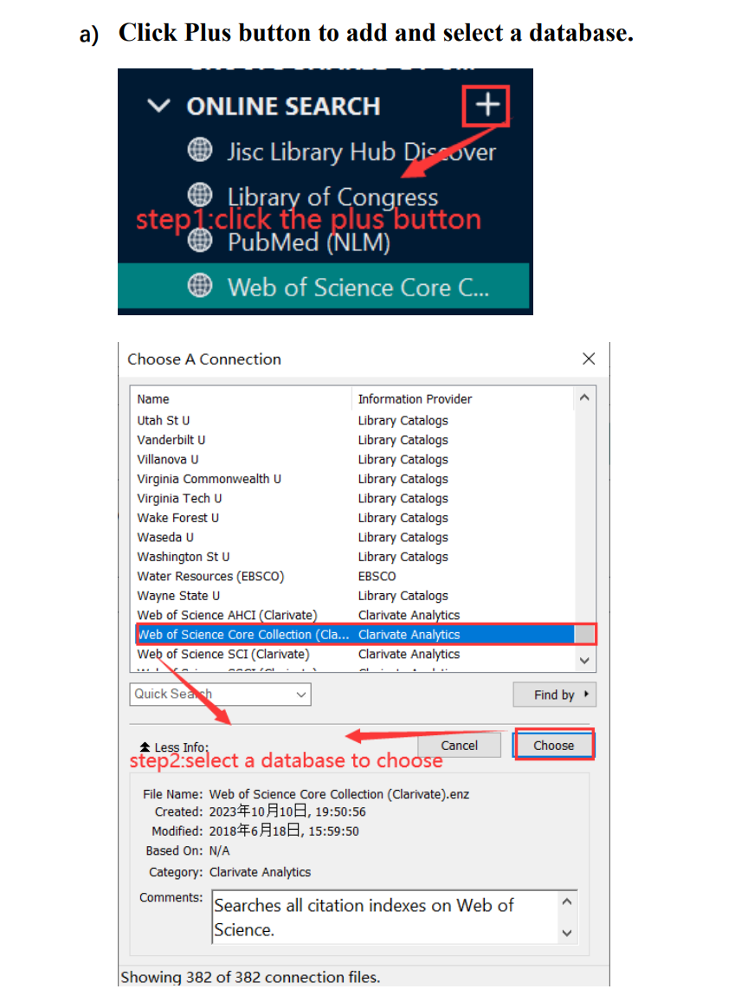
Typesetting
Rectangle
Arrow
Annotation
Notes:
For each specific step, we demonstrate the corresponding user interface and use rectangles and arrows to indicate the location of the operation. Furthermore,In order to make it easier for the reader to understand, we have also given corresponding annotations.

Slide 14
PART 05
Polish

Slide 15

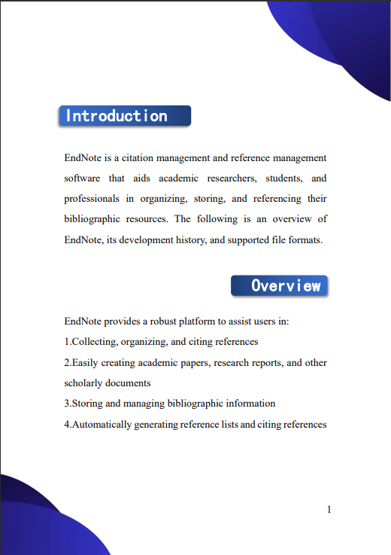
New cover
New subtitle
Notes:
To start, I designed a neat cover page. This not only provides clarity that our content pertains to the EndNote user manual but also elevates its visual appeal. Then, I revamped the titles of all sections in the document. Compared to the previous version where titles were merely bolded, I used artistic fonts and added rectangular frames that match the cover's color, enhancing their visibility.

Slide 16
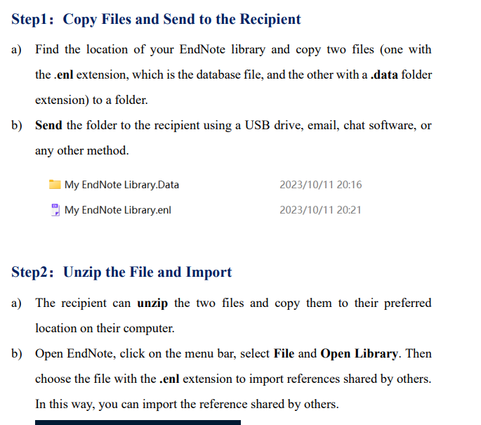
Fonts and Line spacing
Notes:
Furthermore, I made adjustments to the text font and size, standardizing it to the 'Times New Roman' font, and increased the line spacing, all in an effort to improve the manual's readability and user experience.

Slide 17
PART 06
Improvements

Slide 18
Improvements
UI
Functions
Price
Integration
Networks
Notes:
As stated before, EndNote is a very popular tool, but it can do better.
EndNote's UI is a bit outdated, it needs to be improved and integration with other tools needs to be simplified to make it more modern and easy to use.EndNote's online functionality is not powerful enough, it needs to increase its online functionality while keeping its performance. In addition, the price of EndNote is too high for students.

Slide 19
Chinese-friendly
Chinese Character Support
Chinese UI
Translation
Chinese Literature Types
Chinese Styles
Chinese Search
Chinese Database Support
Database
Citation
Notes:
For Chinese users, some specific improvements can help EndNote quickly enter the Chinese market. These include Chinese UI and Chinese character support, support for Chinese databases and searching, and citation of Chinese document types.
In short, EndNote is an excellent tool, but it still has a lot of space for improvement.

Slide 20
PART 07
Summary

Slide 21

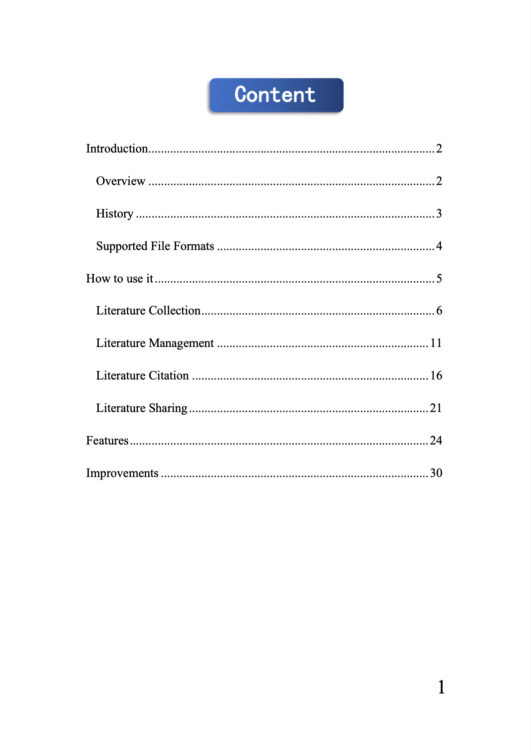



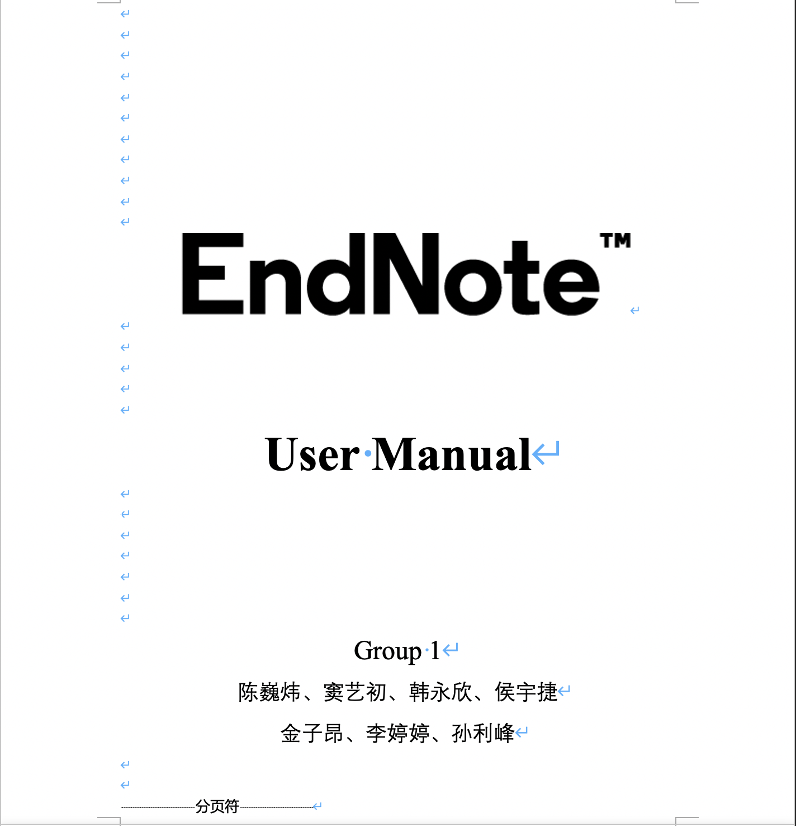



Summary
Introduction
Functions
Improvements
Notes:
Thank you for your time. Today, we mainly introduced our work on the user manual of EndNote. And finally let me summarize our work. Firstly, we chose EndNote as our target, and divided it into three main parts: Introduction, Functions, and Improvements. Then, we assigned tasks reasonably and made preliminary progress after a period of hard work. However, we were not satisfied, so we redesigned and adjusted it, and finally achieved our satisfactory results.
.

Slide 22
EndNote
感谢观看与指导
汇报人：Group1

