Slide 1


Slide 2
Mumbai Rainfall Prediction Using Machine Learning Done by Vinothkumar . S
Abstract
This project focuses on the strategic enhancement of water resource management in Mumbai by utilizing predictive rainfall patterns. The anticipation of these patterns is key to optimizing water allocation and storage, which will not only reduce costs but also guarantee a consistent water supply.
Furthermore, the project emphasizes the importance of improved preparedness through early warnings of below-average rainfall, enabling the implementation of water conservation measures and mitigating drought impacts. This proactive approach bolsters Mumbai’s resilience against water scarcity.

Slide 3
Cont., Abstract
Lastly, informed decision-making is highlighted, where rainfall forecasts inform the timing of infrastructure maintenance and upgrades, ensuring minimal disruption and heightened efficiency during the monsoon season.
Collectively, these strategies form a comprehensive framework for sustainable water management in Mumbai.

Slide 4
Objective
The primary objective of this project is to develop and implement a robust Machine Learning (ML) framework to enhance water resource management in Mumbai. By leveraging ML models, the project aims to:
Predict Rainfall Patterns: Utilize historical weather data and real-time climate variables to train predictive models that can forecast rainfall with high accuracy. This will enable efficient planning and allocation of water resources.
Integrate ML insights with municipal decision-making processes to inform policy and investment in water infrastructure, leading to cost-effective and resilient water management solutions.

Slide 5
Machine Learning Approach
The machine learning process involves building a predictive model that can be used to find a solution for a problem statement
Machine Learning has various stages as follows:
1) Define objective
2) Data gathering
3) Analyse the data identify the type model to select (Regression or Classification)
4) Preparing data or preprocessing of data
5) Data exploration
6) Building a Model
7) Model Evaluation
8) Prediction

Slide 6
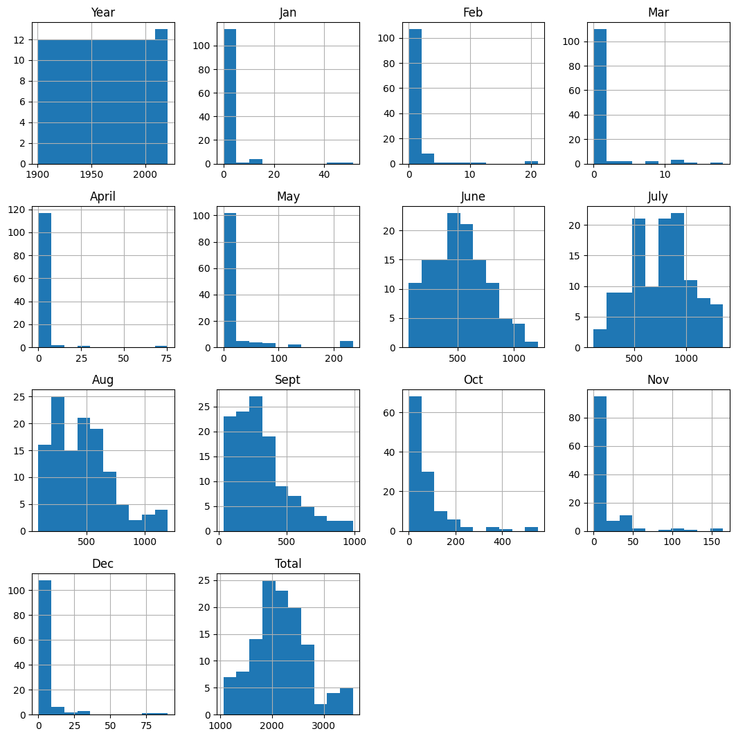
Data Analysis
Source:https://data.opencity.in/dataset/mumbai-rainfall-data
Simple Histogram

Slide 7
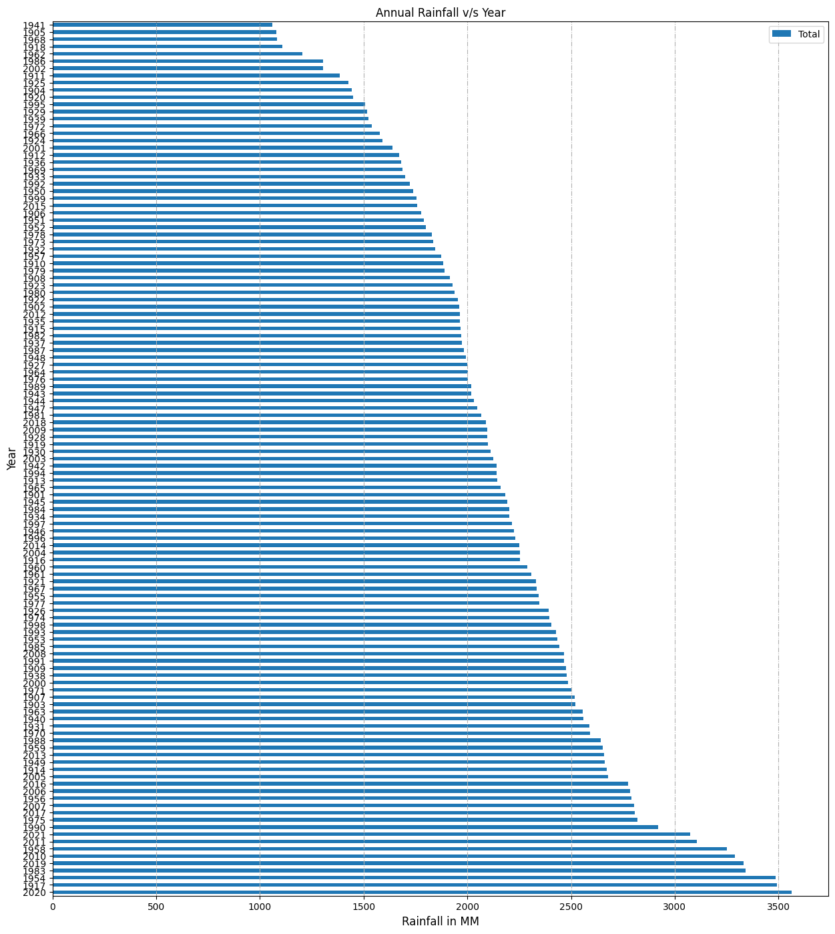
Data Analysis

Slide 8
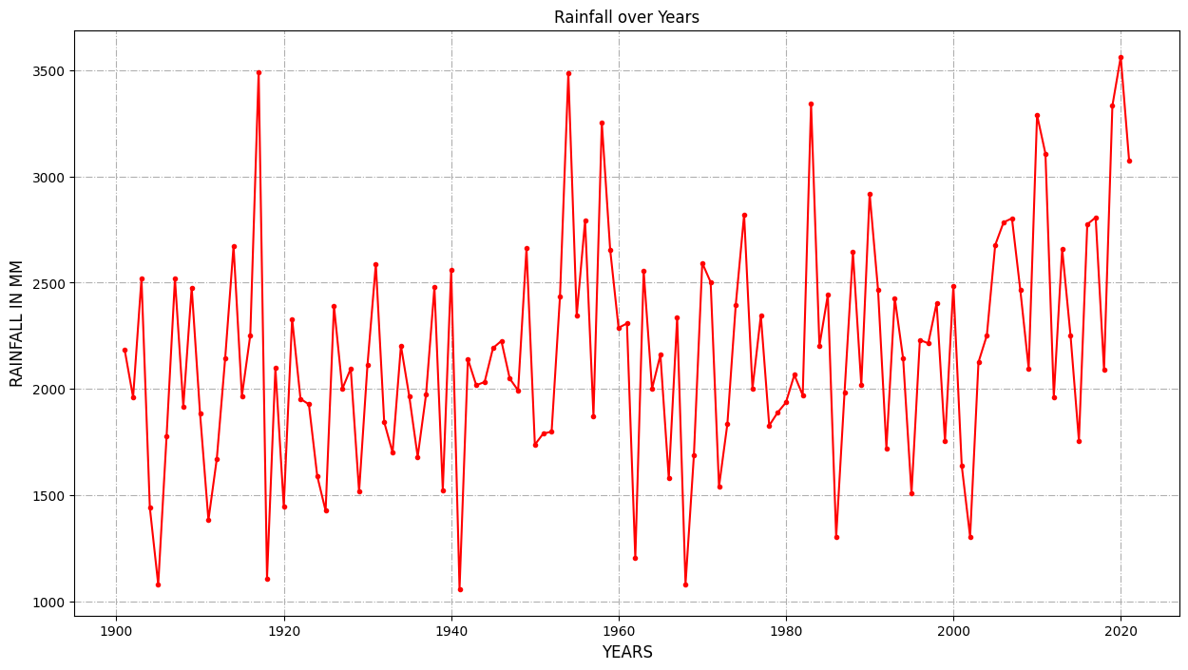
Data Analysis

Slide 9
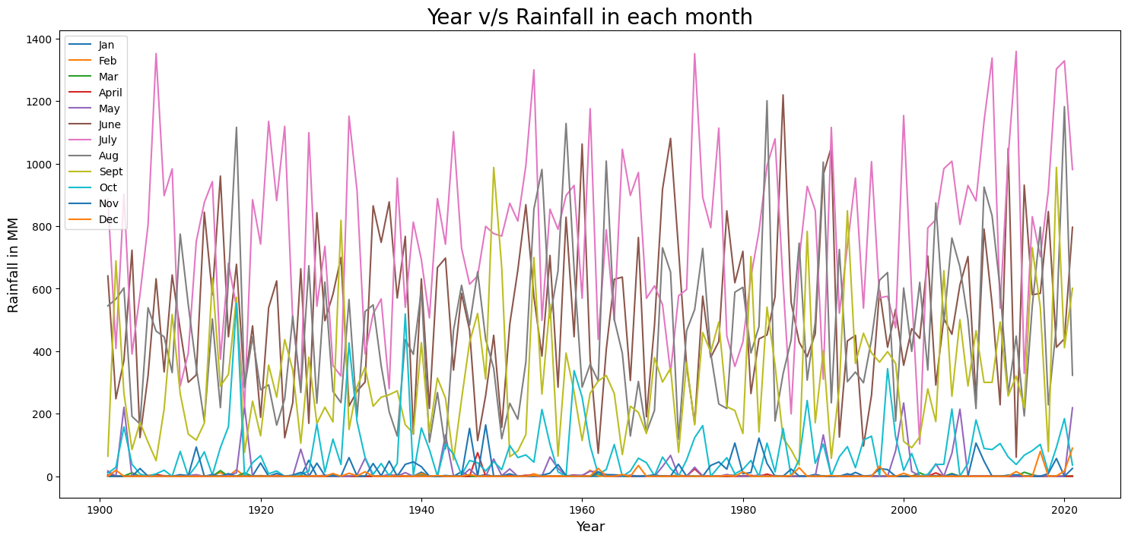
Data Analysis July has most and feb has least rainfall

Slide 10
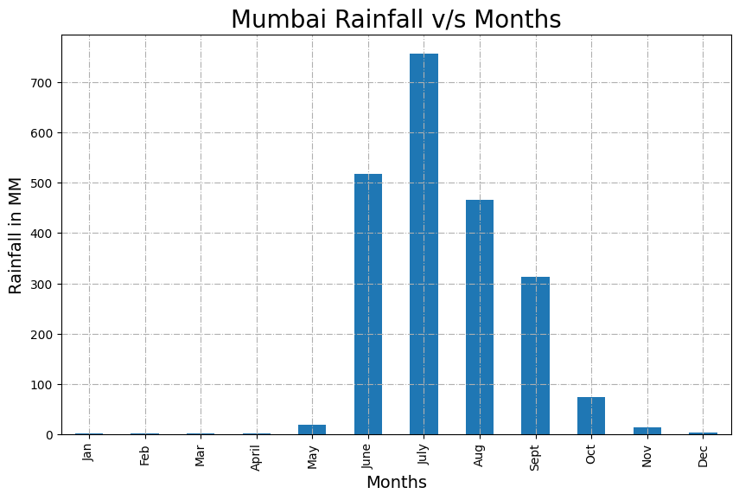
Data Analysis Mumbai receives more rainfall in July month more than 750mm of rainfall.

Slide 11
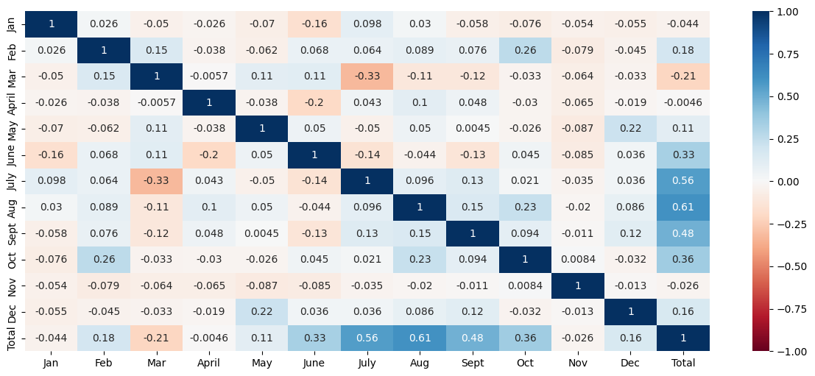
Data Analysis June-Sept contributes to more rainfall in Mumbai in any given year

Slide 12
Machine Learning Models Used
Linear Regression Model
Polynomial Regression Model
Decision Tree regression
RandomForrest regression model
Ensemble (Voting and Stacking regressor)

Slide 13
Models Comparison
Model | R squared | Mean Squared Error | Variance Score
Linear Regression | 0.77748 | 323.3694 | 0.7775
Polynomial Regression | 0.78416 | 318.4774 | 0.7842
Decision Tree Regressor | 0.83013 | 282.5619 | 0.8301
Random Forrest Regressor | 0.86601 | 250.9302 | 0.866
Ensemble Voting Regressor | 0.87206 | 245.1958 | 0.8721
Ensemble Stacking Regressor | 0.87735 | 240.0547 | 0.8774

Slide 14
Implications for Mumbai Rainfall Prediction
Linear and Polynomial Regression Models: While simpler to implement and interpret, these models are less effective in capturing the intricate patterns of monsoon rainfall.
Decision Tree and Random Forest Regressors: These models significantly improve prediction accuracy by handling non-linearities and interactions in the data.
Ensemble Methods (Voting and Stacking): The ensemble approaches leverage the strengths of multiple models, offering the highest prediction accuracy. Specifically, the Ensemble Stacking Regressor demonstrates superior performance, making it the best choice for predicting Mumbai's rainfall.

Slide 15
Final output and performance of the Model
Among the models compared, the Ensemble Stacking Regressor has the best performance with the highest R squared value of 0.87735, the lowest Mean Squared Error of 240.0547, and the highest Variance Score of 0.8774. This indicates that the Ensemble Stacking Regressor provides the most accurate predictions and best captures the variance in the data.

Slide 16
Source Code
https://github.com/winoth4/BIA_Project
Data:
https://github.com/winoth4/BIA_Project/main/src/Mumbai-monthly-rains.csv
Data Analysis:
https://github.com/winoth4/BIA_Project/blob/main/src/Mumbai_Rainfall_data_analyzes.ipynb

Slide 17
Cont., Source Code
Linear regression Model:
https://github.com/winoth4/BIA_Project/blob/main/src/RainFallPred_MultiLinearRegression.ipynb
Polynomial regression Model:
https://github.com/winoth4/BIA_Project/blob/main/src/RainFallPred_PolynomialRegression.ipynb
Decision Tree:
https://github.com/winoth4/BIA_Project/blob/main/src/RainFallPred_DecisionTree.ipynb
RandomForrest Model:
https://github.com/winoth4/BIA_Project/blob/main/src/RainFallPred_Randomforrest.ipynb
Ensemble Model:
https://github.com/winoth4/BIA_Project/blob/main/src/RainFallPred_EnsemblePrediction.ipynb
Final Prediction :
https://github.com/winoth4/BIA_Project/blob/main/src/predict.ipynb

Slide 18
Thank You!!

