Slide 1
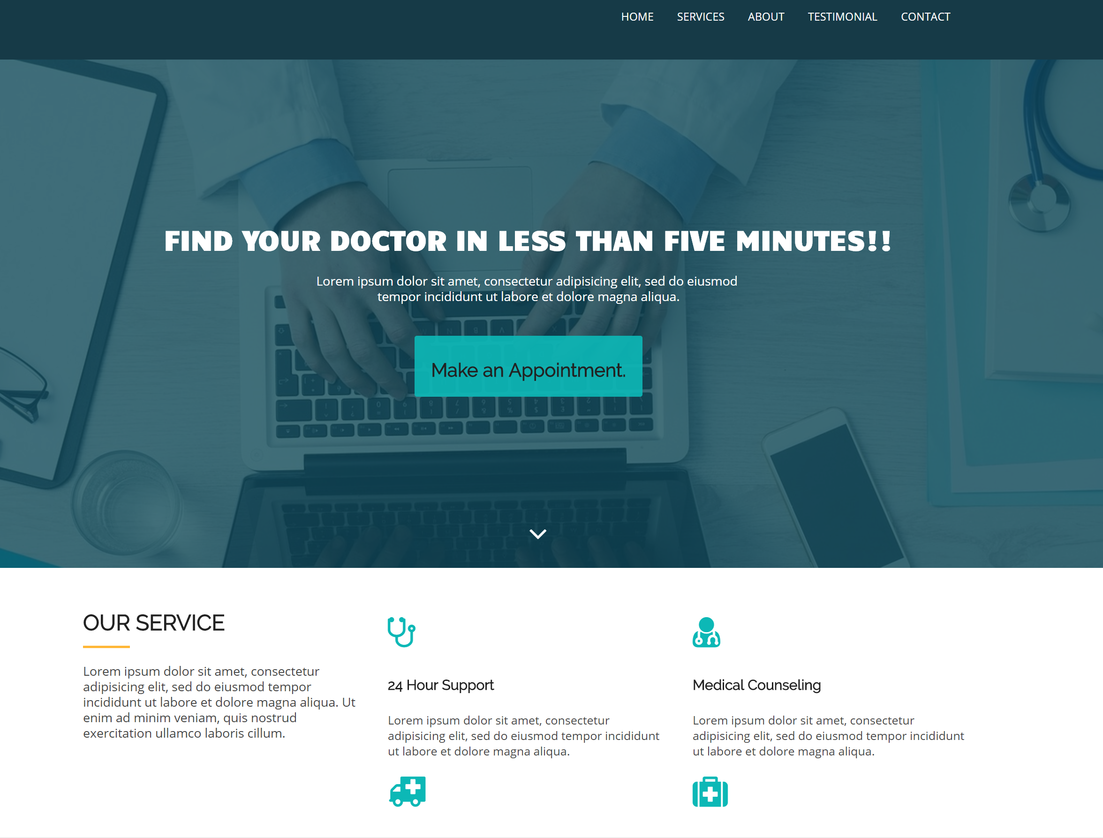
Medical Clinic clinic.ipd10.c0m
Medical clinic is a fast way for interaction between patients, clinic doctors and staff, by ability to show doctor’s available time, book appointment online, …
By:
Vajiheh Seyedzadeh
Winoto Janputra
Fall - 2017

Slide 2
Background
Website to show clinic services, doctors, …
See doctor’s available time and Make an appointment
Ability to define and modify doctor’s schedule by themselves
Ability to see list of appointments in calendar view by doctors
Show notification for new / cancel appointments
Online Pre-Payment – Using pay-pal
Add note to patient’s profile by doctors
Goal: Make a fast way for interaction between patients, clinic’s doctors and staffs

Slide 3
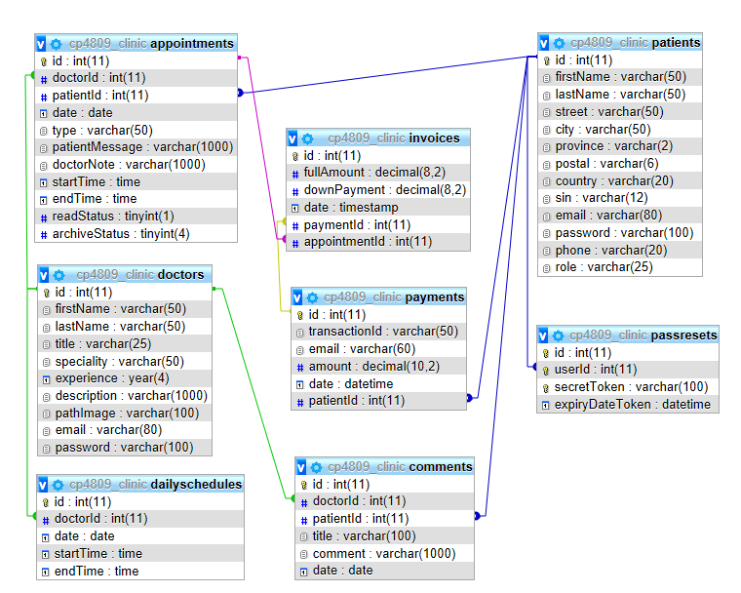
DB Structure

Slide 4
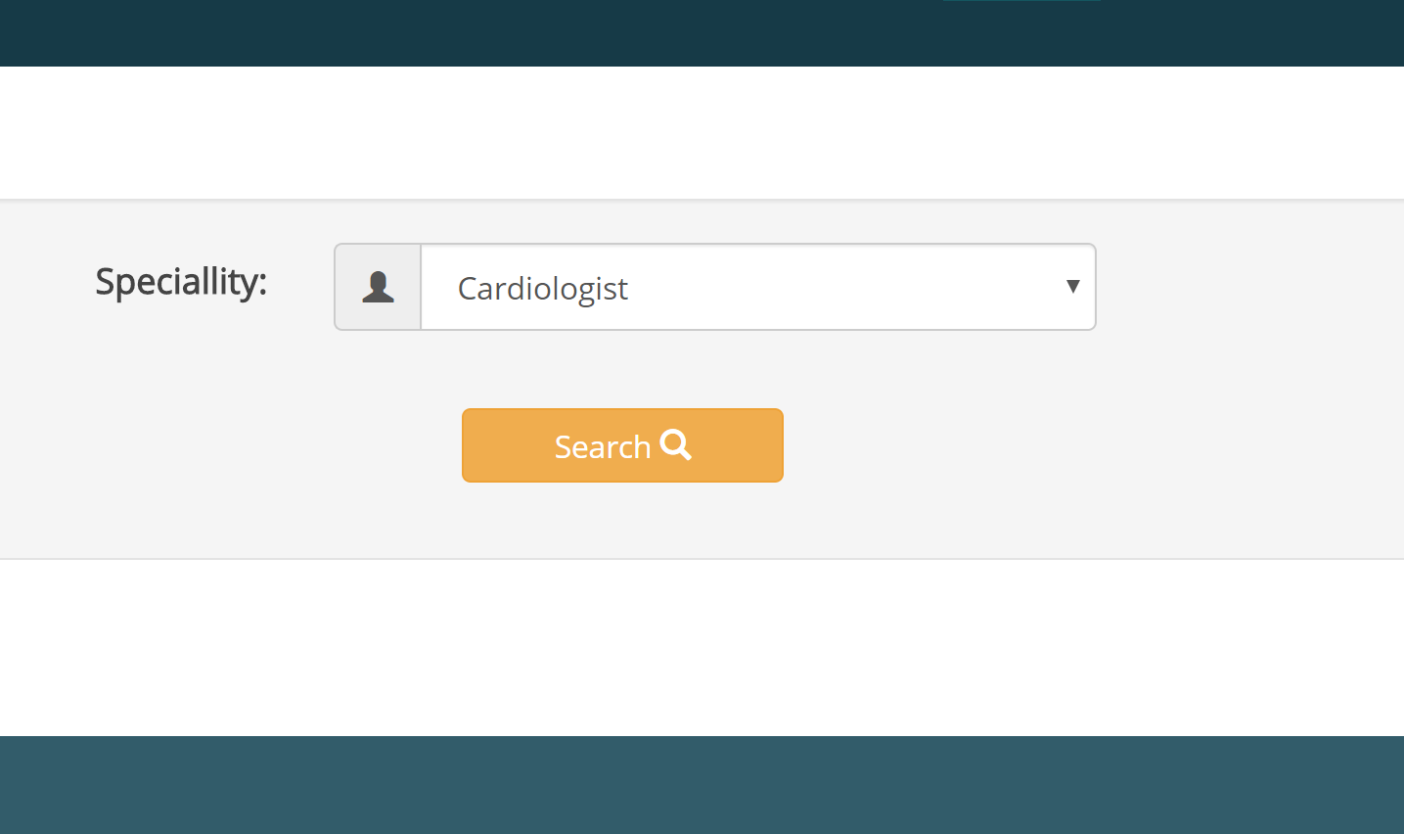
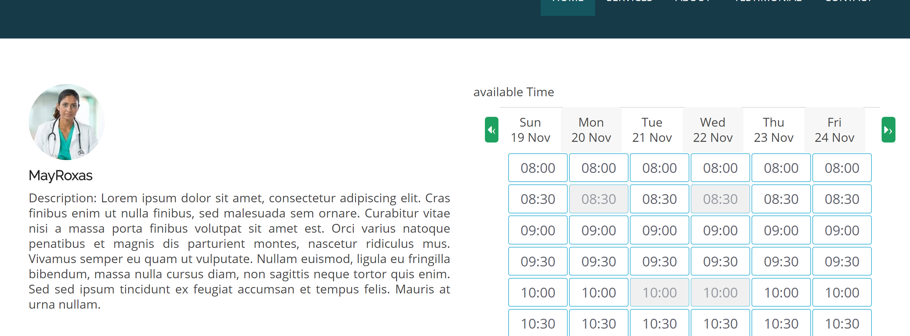
Search doctors and See available times
Ability to search doctors based on their speciality
Ability to see doctor’s information
Show doctor’s available time
Select time and make appointment

Slide 5
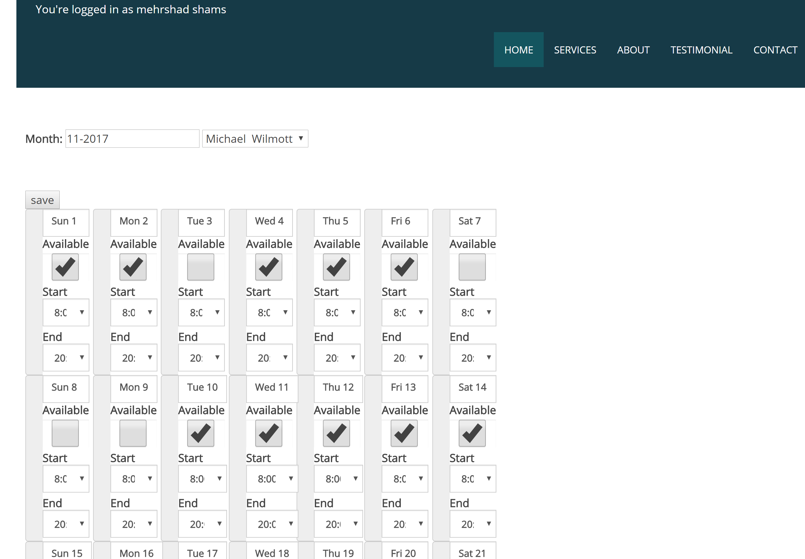
Doctor’s Schedule
Ability to define an modify schedule for different month

Slide 6
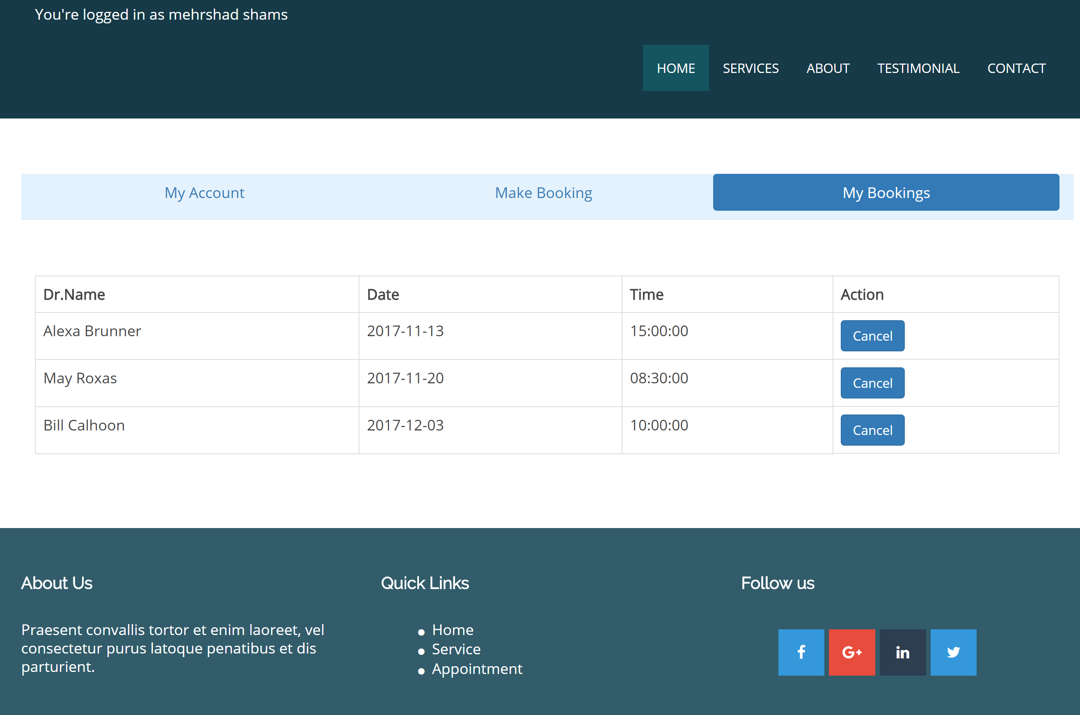
Patient’s Profile
See list of bookings
Ability to cancel appointments
Ability to make new appointment

Slide 7
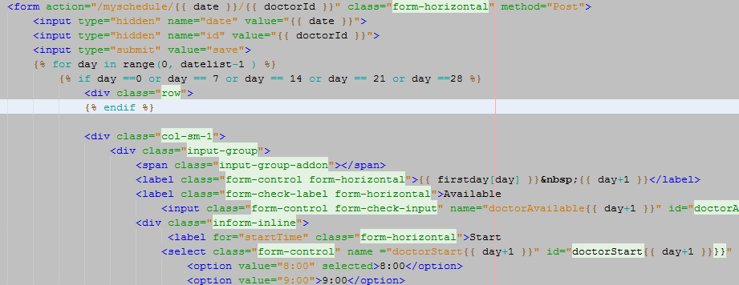
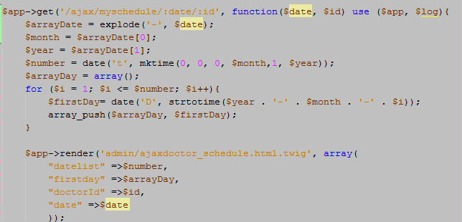
Challenges and solution:
Make relation between doctor’s schedule and appointment and show doctor’s available times

Slide 8
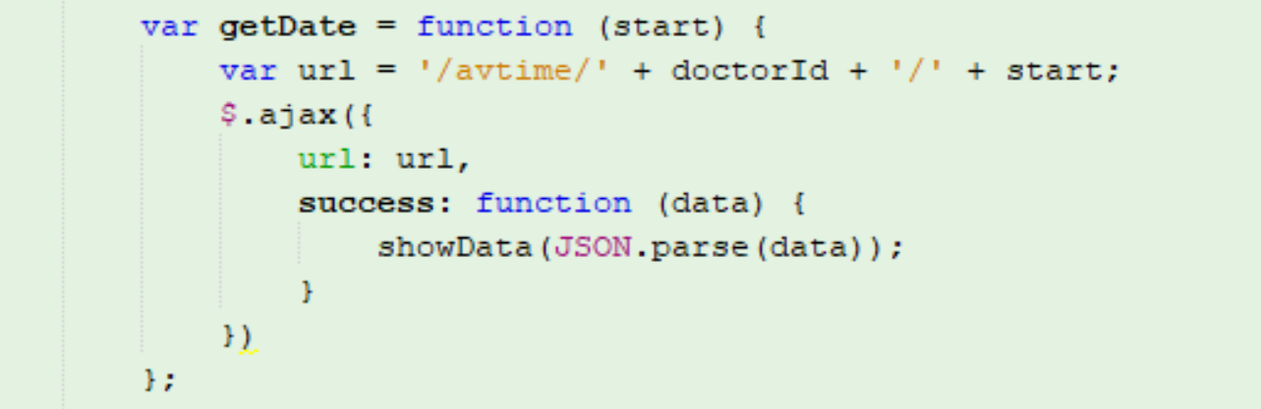
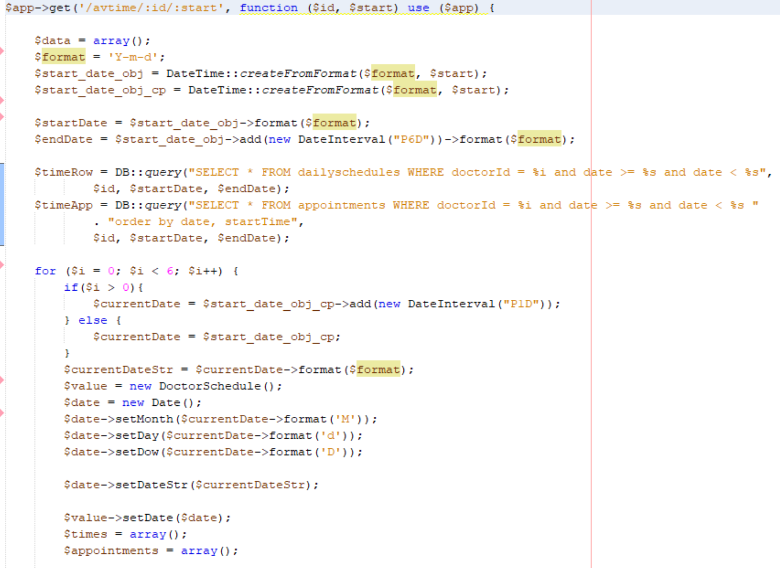
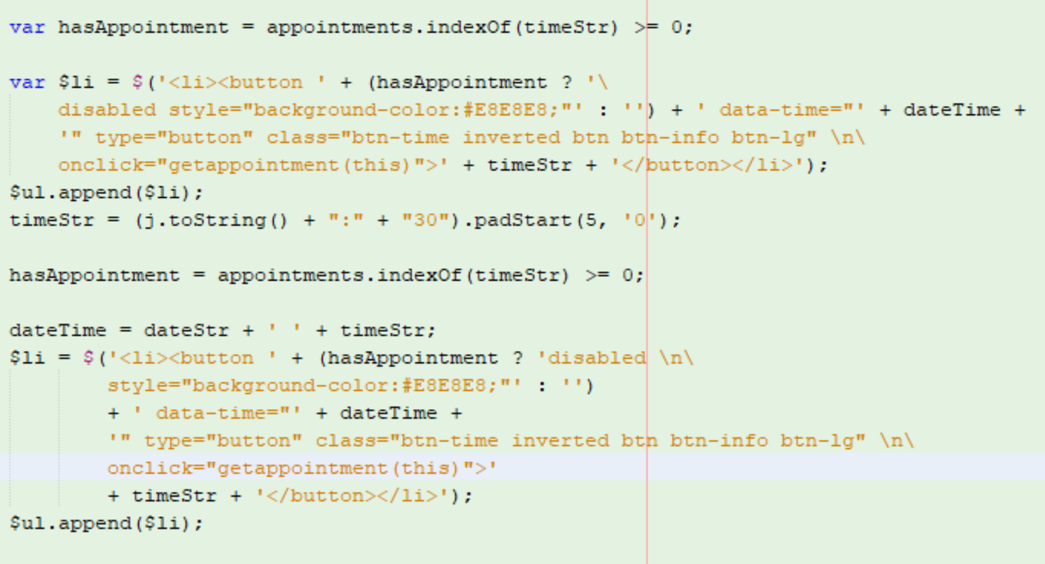
Make relation between doctor’s schedule and appointment and show doctor’s available times

Slide 9
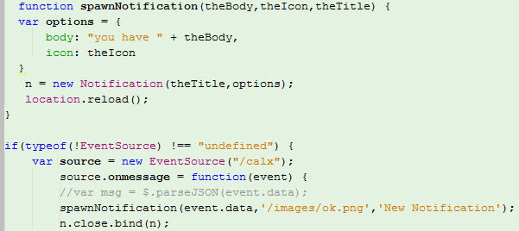
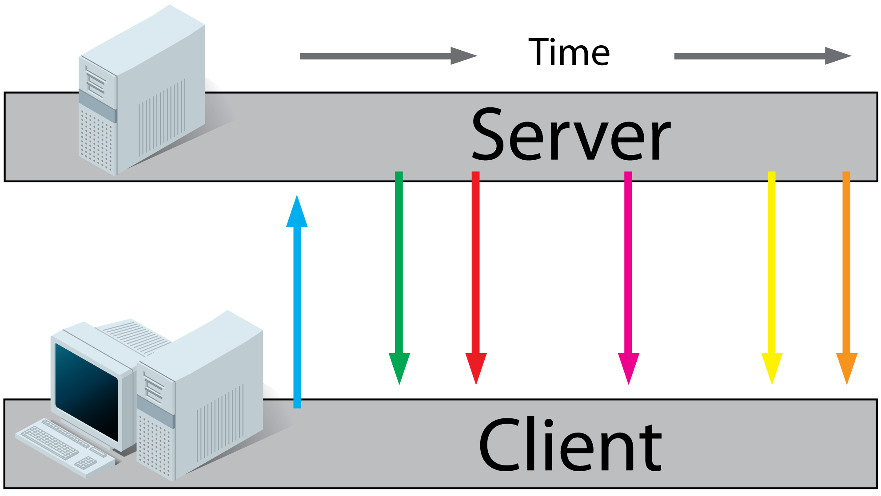
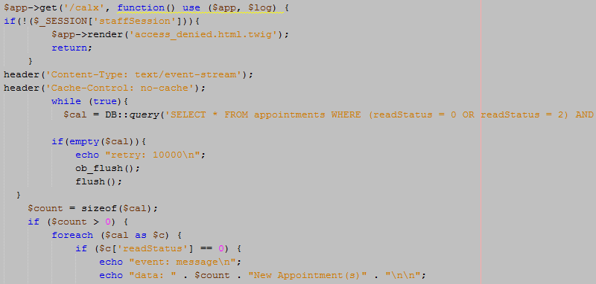
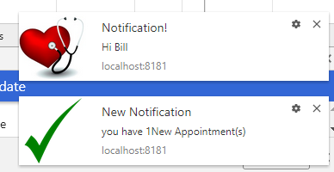

Show doctor’s appointment in calendar view and show notification for new and canceled appointment
Fullcalendar.js
Server-Sent Event

Slide 10
What we learned:
PHP using MeekroDB framework, Slim and twig template
Ajax and jquery
Paypal API
WebSocket, Server-Sent Event
Future Works:
Make access for patients to add comment for doctors
Thank you for your time!

