Slide 1

Inspire to inquire
By Tommy Truong, Yingwen Tan, Brian Vu, William Nguyen

Slide 2



Problem?
Those with disabilities
Low socioeconomic status
Excluded communities
Lack of priority on education

Slide 3
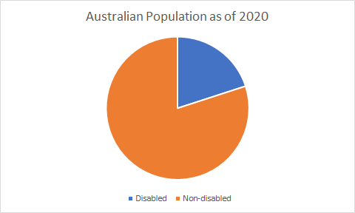
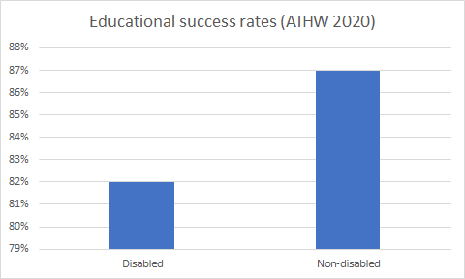
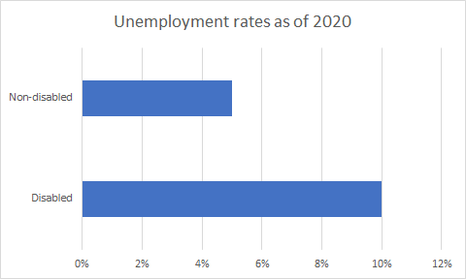
Why?
1 in 5 Australians have a disability
Unemployment rate for the disabled are 10% compared to only 5% for non-disabled peoples.
Students with disability have lower educational success rates (82%) than domestic population (87%)

Slide 4


Solution?
Education beyond the classroom
Inspirational mentors
Accessible

Slide 5



Roadmap
Build partnerships
Communities meet and inspire
Expansion of application

Slide 6

Our Goal
Accessible platform to meet and inspire others
Provide education for practical skills

