Slide 1
Welcome!

Slide 2
In this task you will a picture appear on the top of the screen one at a time.
Press G if the presented face on top is female.
Press H if the presented face on top is male.

Slide 3
On some trials, the picture shifts from the top to the bottom.
If the picture is below, decide if the picture shows a happy or angry face
Press B if the presented face below is happy.
Press N if the presented face below is angry.
It is important that you respond as quickly and accurately as possible.

Slide 4
We will go through a demonstration in the next few slides

Slide 5
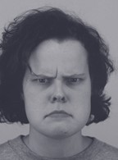
+
Face on top is female. Press G

Slide 6

+
Face on top is female. Press G

Slide 7

+
Face on top is male. Press H

Slide 8
+
Face on bottom is angry. Press N

Slide 9
+
Face on bottom is happy. Press B

Slide 10

+
Face on bottom is angry. Press N

Slide 11
This is the end of the instructions and demonstration.
Please notify the researcher.

