Slide 1
Welcome to the experiment

Slide 2
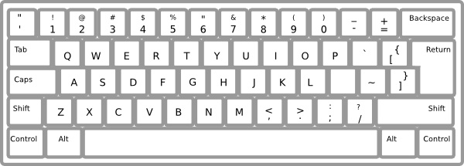
Working Memory Task
Please put your left index finger on the ‘A’ key, and right index finger on the ‘L’ key
Notes:
Please add #1 (left) and #4 (right) to the figure

Slide 3
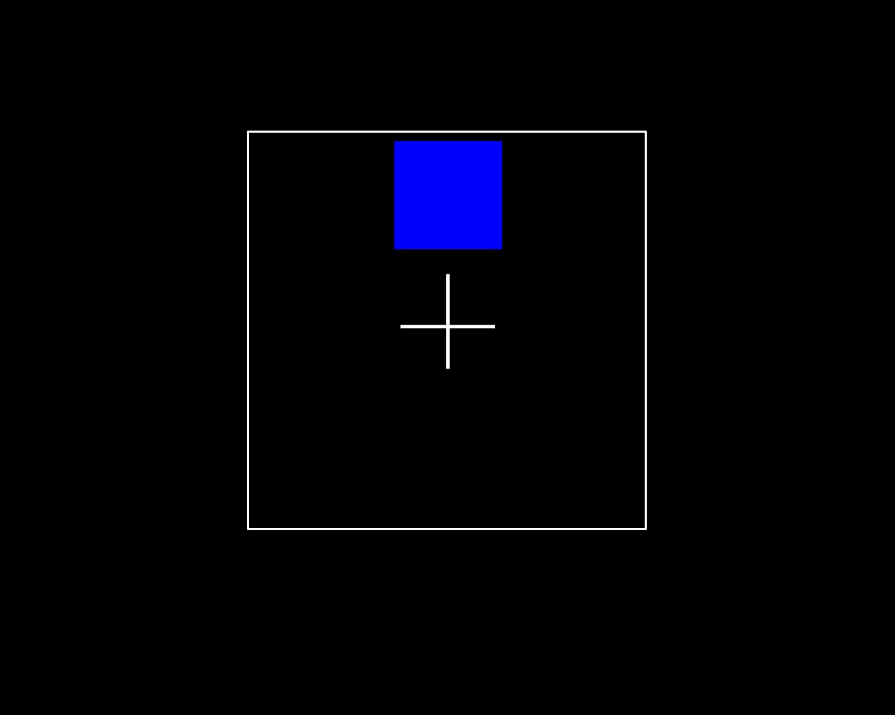
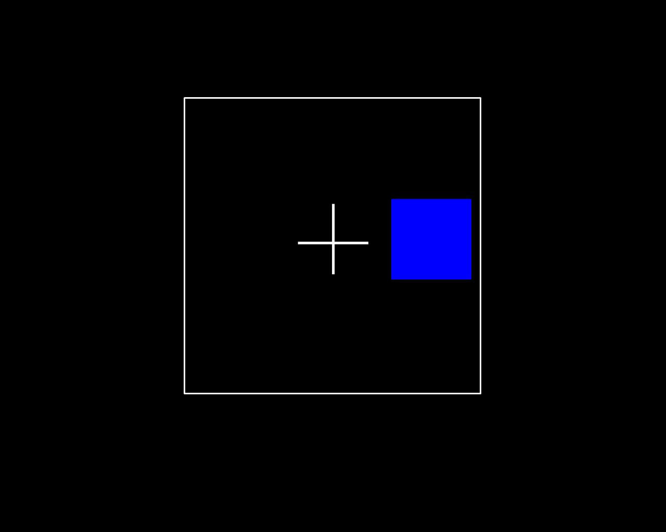
Working Memory Task
In this test, you will see a sequence of blue squares appearing one after another on different locations on the computer screen:
… …
1st square
2nd square
3rd square
4th square
The presentation rate is quite fast, a new square is coming every 3 seconds.
Please try to work as quickly and accurately as possible

Slide 4
If you are asked to do a 1-back task:
Press “A” if the square is in the same location as the 1 trial before Press “L” if the square is in the different location than 1 trial before
… …
1st square
2nd square
3rd square
4th square
Here, you have to press “L”, because there is nothing to compare with
Here, you have to press “A”, because the square appears at the same location as just before
Here, you have to press “L”, because the square does not appear at the same location as just before
Here, you have to press “L”, because the square does not appear at the same location as just before

Slide 5
This is a 1-back task
Press “A” if the square is in the same location as the 1 trial before
Press “L” if the square is in the different location from the 1 trial before
Please try to work as quickly and accurately as possible
Press any key to continue

Slide 6
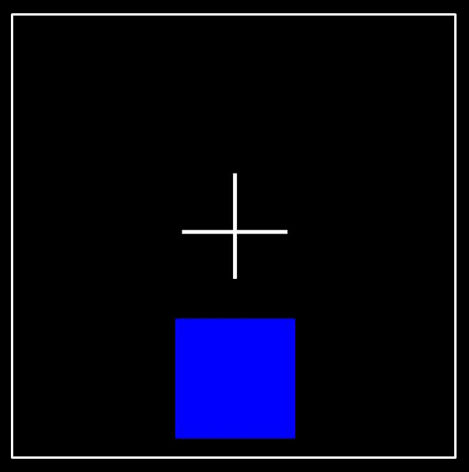
If you are asked to do a 2-back task:
Press “A” if the square is in the same location as the 2 trials before Press “L” if the square is in the different location than 2 trials before
… …
1st square
2nd square
3rd square
4th square
5th square
Here, you have to press “L”, because there is nothing to compare with
Here, you have to press “L”, because there is nothing to compare with
Here, you have to press “A”, because the square appears at the same location 2 trials before
Here, you have to press “L”, because the square does not appear at the same location 2 trials before
Here, you have to press “A”, because the square appears at the same location 2 trials before

Slide 7
This is a 2-back task
Press “A” if the square is in the same location as the 2 trials before
Press “L” if the square is in the different location from the 2 trials before
Please try to work as quickly and accurately as possible
Press any key to continue

Slide 8
If you are asked to do a 3-back task:
Press “A” if the square is in the same location as the 3 trials before Press “L” if the square is in the different location than 3 trials before
… …
1st square
2nd square
3rd square
4th square
5th square
Here, you have to press “L”, because there is nothing to compare with
Here, you have to press “L”, because there is nothing to compare with
Here, you have to press “L”, because there is nothing to compare with
Here, you have to press “L”, because the square does not appear at the same location 3 trials before
Here, you have to press “A”, because the square appears at the same location 3 trials before

Slide 9
This is a 3-back task
Press “A” if the square is in the same location as the 3 trials before
Press “L” if the square is in the different location from the 3 trials before
Please try to work as quickly and accurately as possible
Press any key to continue

Slide 10
If you are asked to do a 4-back task:
Press “A” if the square is in the same location as the 4 trials before Press “L” if the square is in the different location than 4 trials before
… …
1st square
2nd square
3rd square
4th square
5th square
6th square
Here, you have to press “L”, because there is nothing to compare with
Here, you have to press “L”, because there is nothing to compare with
Here, you have to press “L”, because there is nothing to compare with
Here, you have to press “L”, because there is nothing to compare with
Here, you have to press “A”, because the square appears at the same location 4 trials before
Here, you have to press “L”, because the square does not appear at the same location 4 trials before

Slide 11
This is a 4-back task
Press “A” if the square is in the same location as the 4 trials before
Press “L” if the square is in the different location from the 4 trials before
Please try to work as quickly and accurately as possible
Press any key to continue

Slide 12
As you have probably noticed, the test gets harder from 1-back, 2-back, to 3-back. The 3-back task is challenging for many people, but some could do very well.
Please relax, keep your mind in it and try your best!

Slide 13
To make you familiar with the task, you can now practice by doing a 1-back, 2-back, and 3-back.
For the first n-trials of the task, please press “L” as there are no trials to compare with.
If you have forgotten the pattern during the task, please restart the count from that trial.

