Slide 1
EDES 301 Sketch Interpreter PCB
Winson Lin

Slide 2
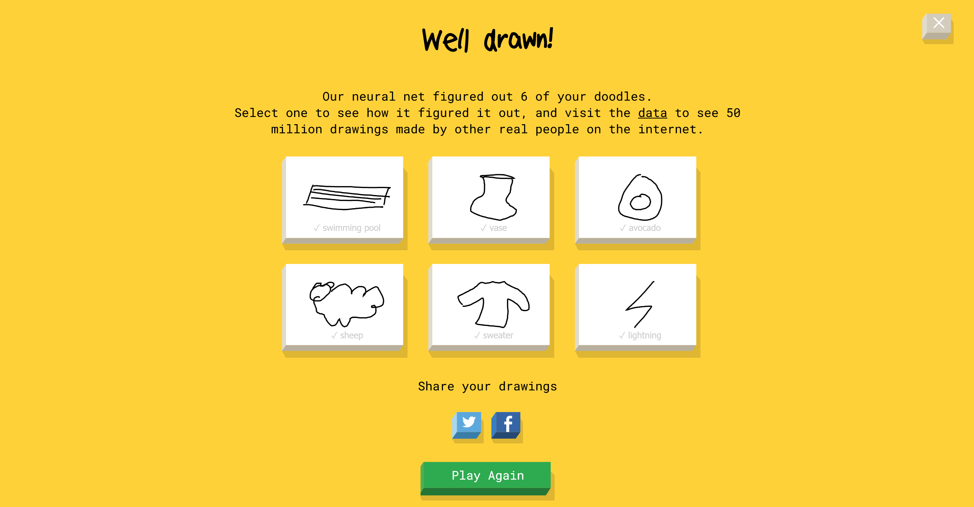
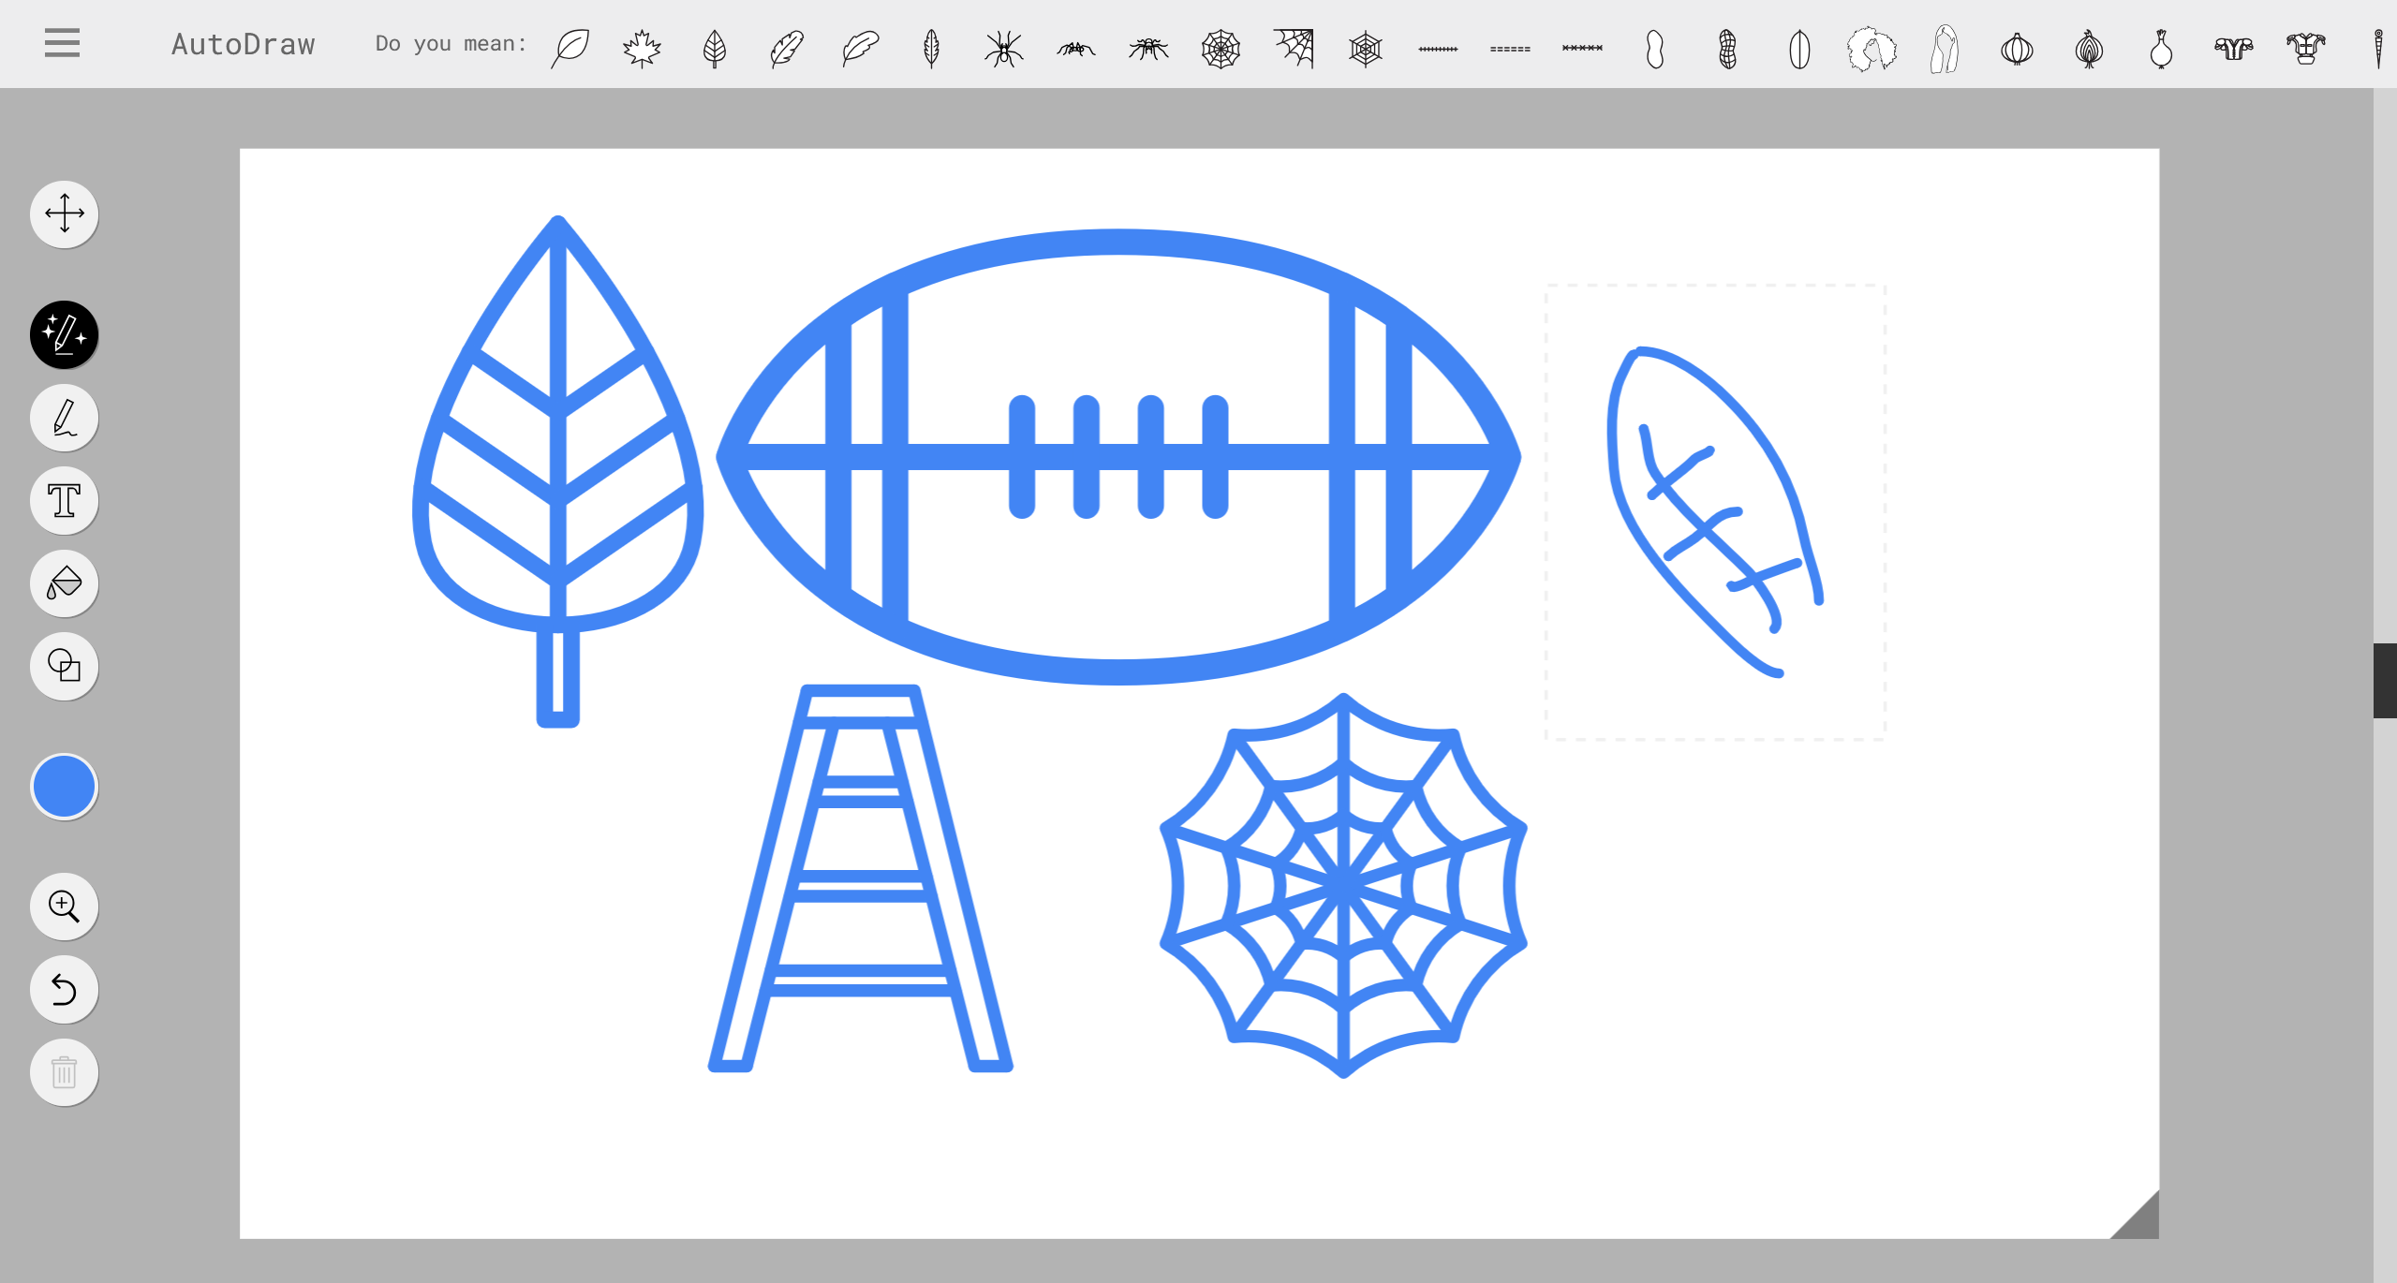
Background Information
dataset
I have bad handwriting and even worse drawings
Idea: an algorithm that can interpret what I write and draw
Project:
A device that prompts user to provide a drawing input
Produces guess based on the drawing
Inspired by Google’s Quick, Draw!
Differences:
UI
Guessing button, removing timer
Implementation of eraser, colors, stroke size
Lower-level implementation
Limited categories from their dataset
Creating/finding a different dataset to make project possible within timeframe

Slide 3
System Block Diagram: “Sketch Identifier”
MicroSD Card
PocketBeagle
ILI9341
SD Card Interface
SPI, GPIO
I2C, GPIO
X,Y breakout
STMPE610

Slide 4
Mechanical Drawing
Wanted to keep the back flat to facilitate drawing
4”
.25”
.25”
ILI9341 (SPI Touchscreen)
Pocket
Beagle
STMPE610QTR
3”
.25”
FRONT
BACK

