Slide 1
EDES 301 Sketch Interpreter Proposal
Feb 23, 2025
Winson Lin

Slide 2
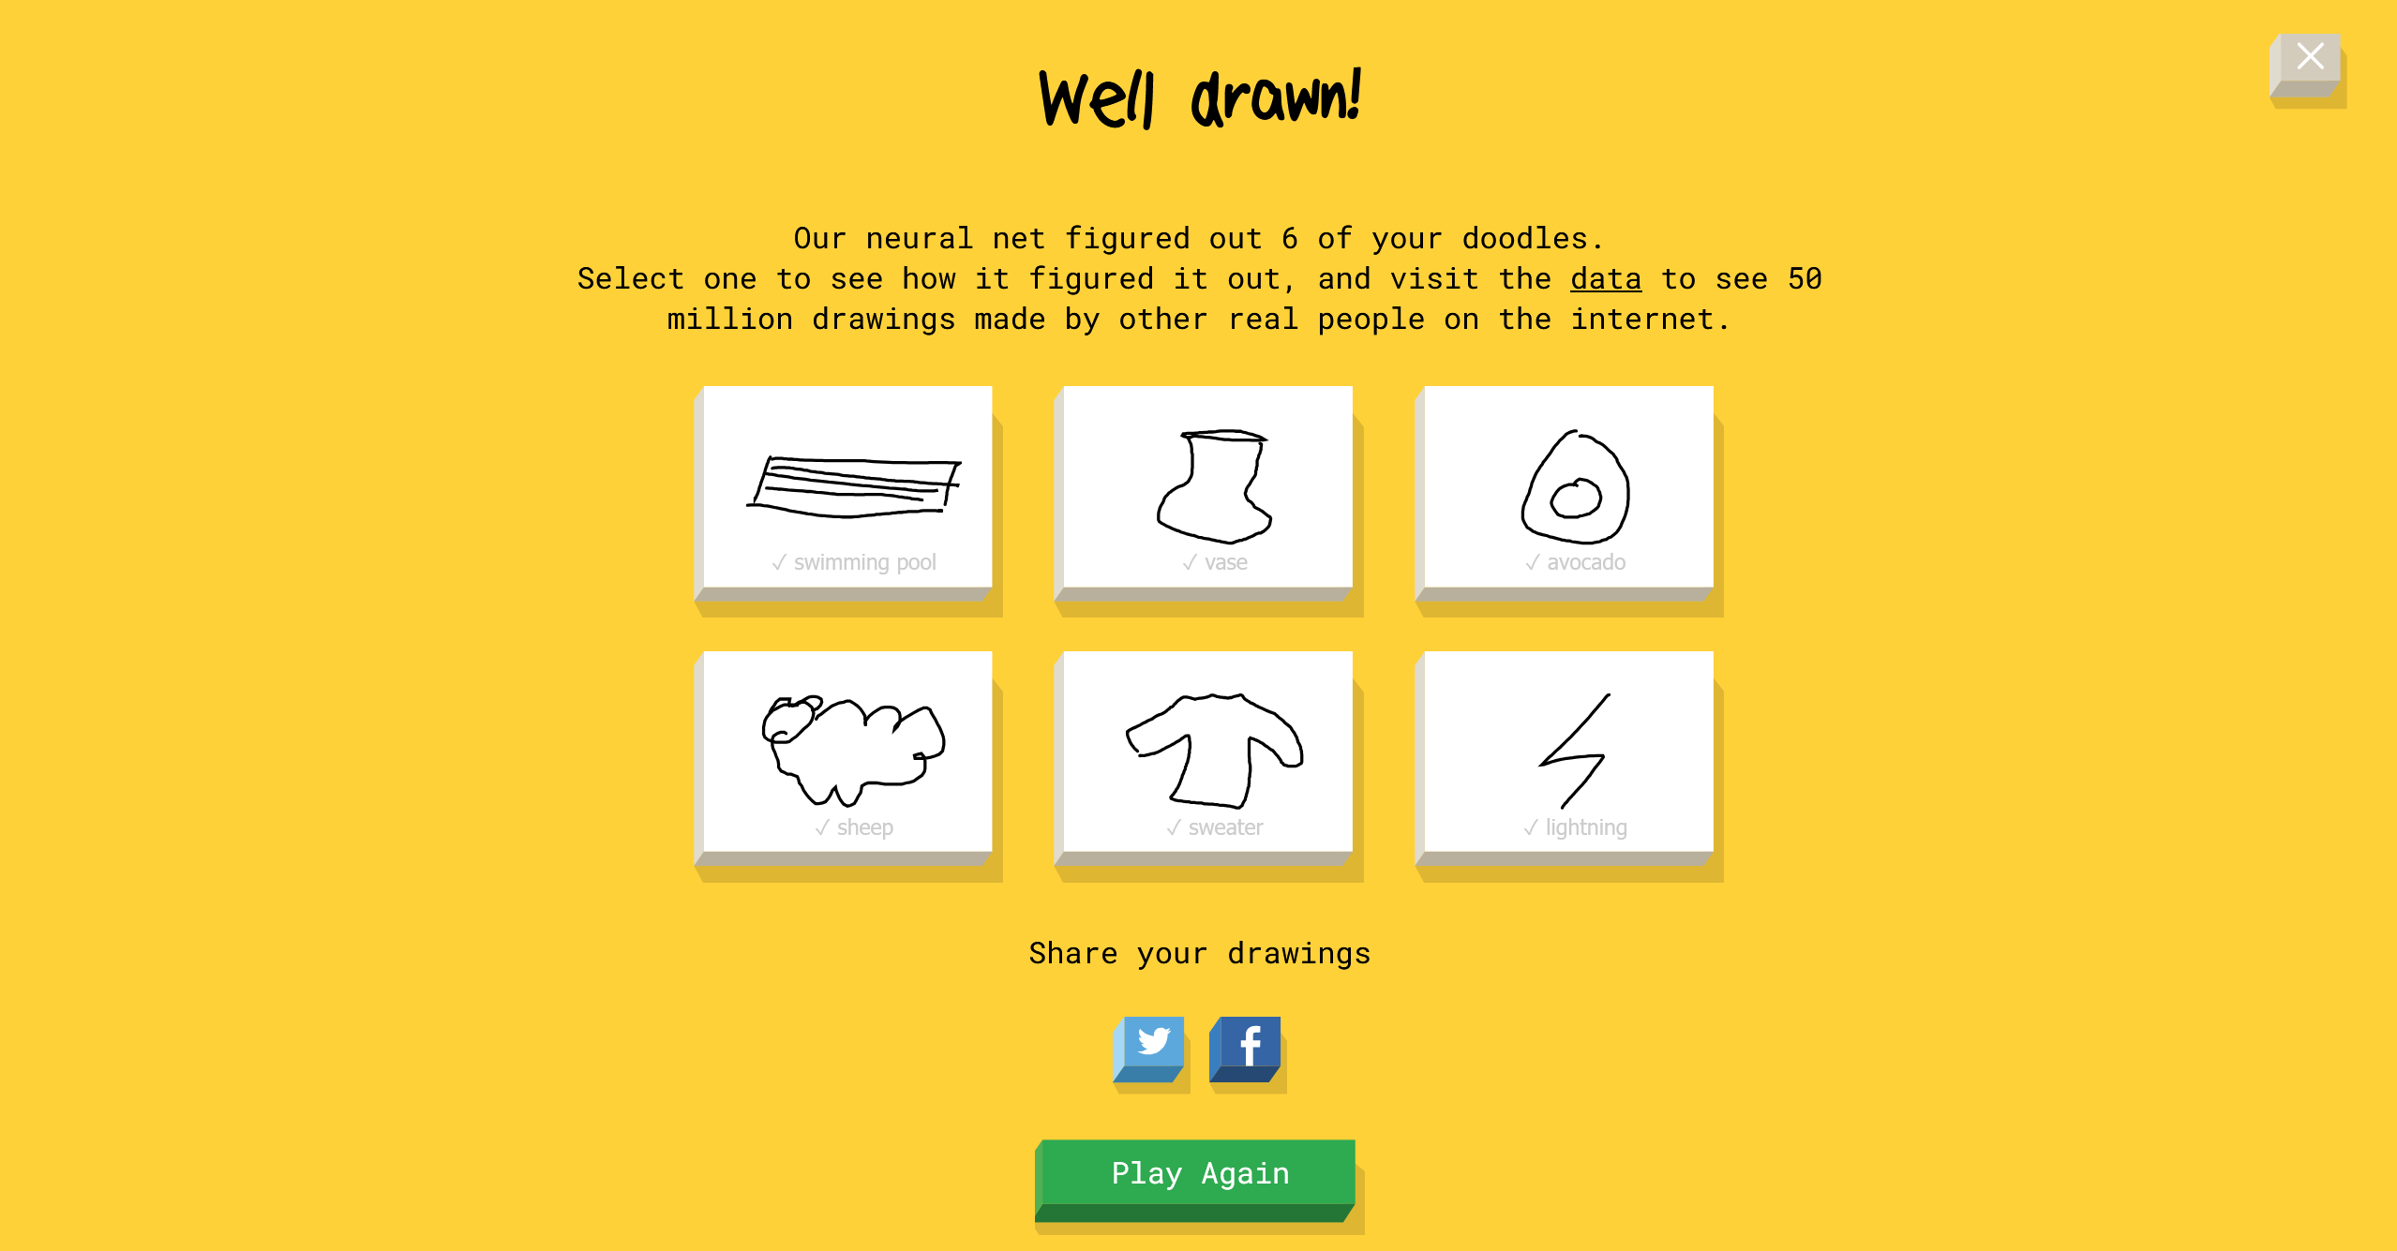
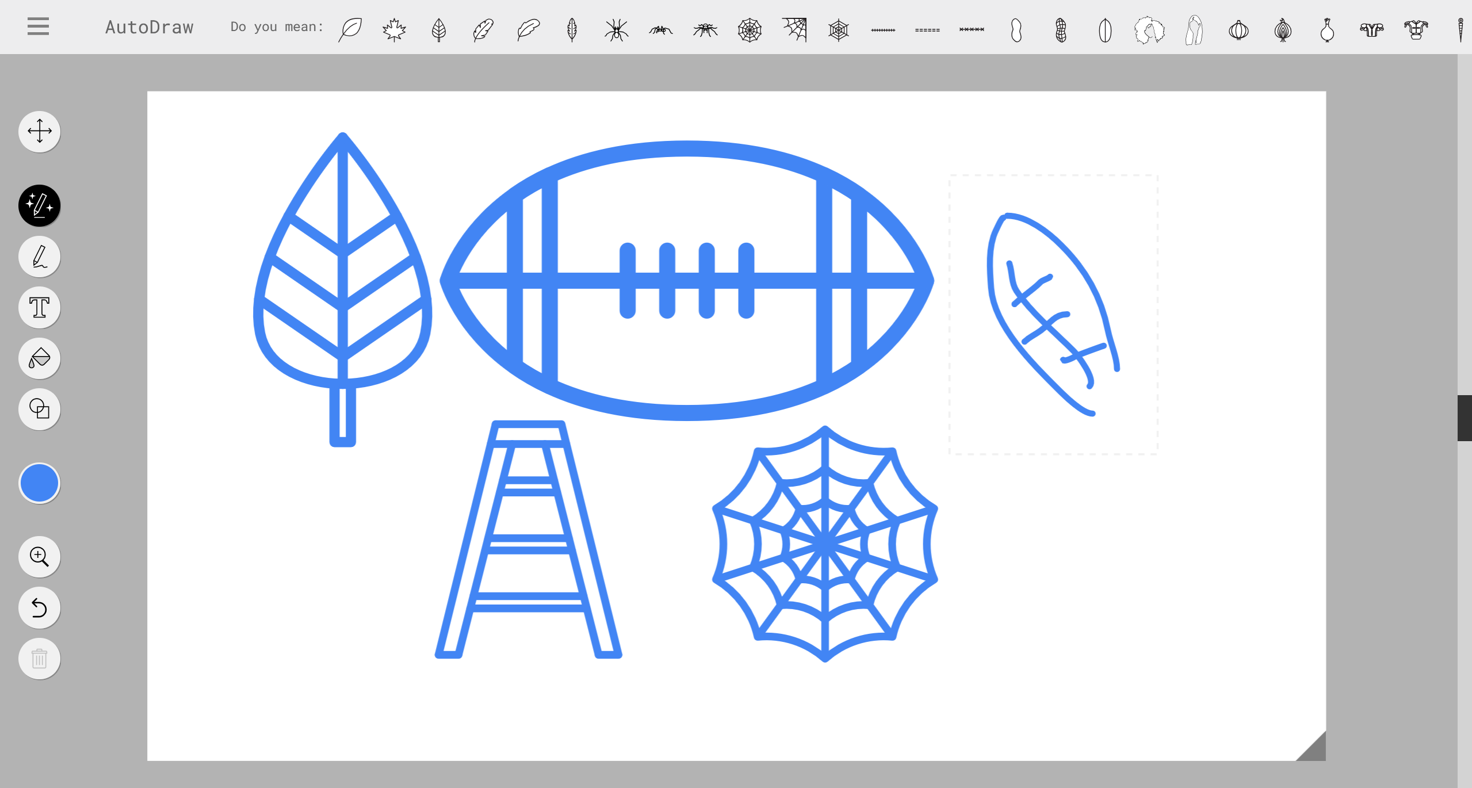
Background Information
dataset
I have bad handwriting and even worse drawings
Idea: an algorithm that can interpret what I write and draw
Project:
A device that prompts user to provide a drawing input
Produces guess based on the drawing
Inspired by Google’s Quick, Draw!
Differences:
UI
Guessing button, removing timer
Implementation of eraser, colors, stroke size
Lower-level implementation
Limited categories from their dataset
Creating/finding a different dataset to make project possible within timeframe

Slide 3
System Block Diagram
MicroSD Card
PocketBeagle
ILI9341
SD Card Interface
SPI, GPIO

Slide 4
Power Block Diagram
5V Supply
5V
PocketBeagle
3.3 V
ILI9341
3.3 V
MicroSD Card

Slide 5
Components / Budget
Component | EDES301 to Buy? | Cost
SPI Screen – ILI9341 | Y | $29.95
Possibly:
Power Supply | * | -
USB Wi-Fi - TL-WN725N | ** | $9.99
*Is an external 5V power supply necessary?
**On-board Wi-Fi probably not necessary, also would need to make or purchase USB A hub?

