Slide 1

Government Polytechnic, Nagpur Project on “E-COMMERCE ON MOBILE”
Academic Year 2014-15
GUIDE CO-GUIDE
Mrs. Priyanka Ghode Ms.S.Gayakwad

Slide 2
CONTENT
Introduction
Objectives
Requirement
Features For Customer
Features For Admin
Technologies
GUI
Work Progress
What Next ?
References

Slide 3
Introduction
E-commerce:-The sale and purchase of goods or services
Requirement gathering
Templates
Phases
Site Development

Slide 4
Objectives
Develop E-commerce Website for Mobile
UI is Better than existing sites
Admin Panel to manage the Site
Customer panel for Customers

Slide 5
Features For Customer
Search all product
Create an account
Add the products to the cart
Can also manage their account
Deleting account

Slide 6
Features For Admin
Add a new product
Change ,edit product brands, categories
Viewing product
Deleting product
Manage customer account

Slide 7
Technologies
PHP & MySQL
WAMP/XAMPP
HTML5
CSS
JavaScript
BootStrap
Dreamweaver CS5

Slide 8
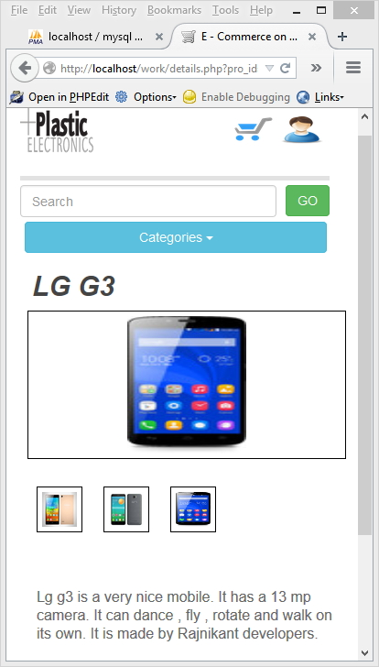
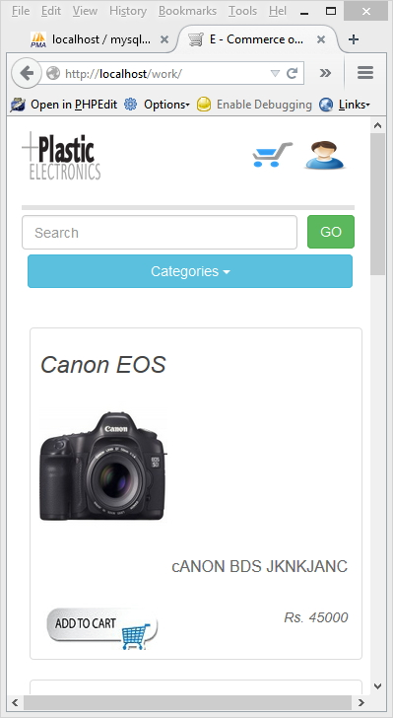
GUI For Customer

Slide 9
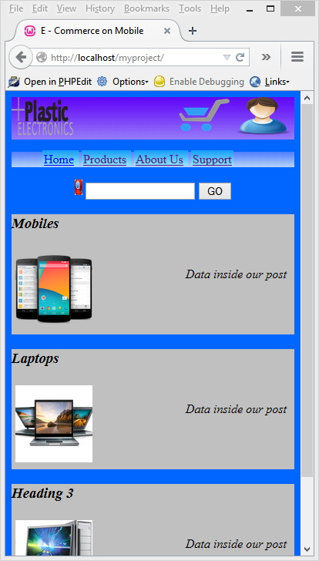
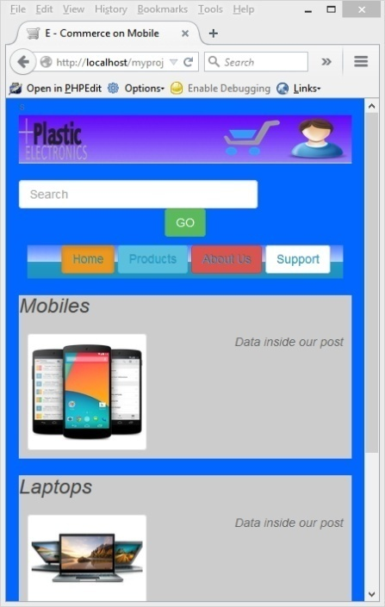
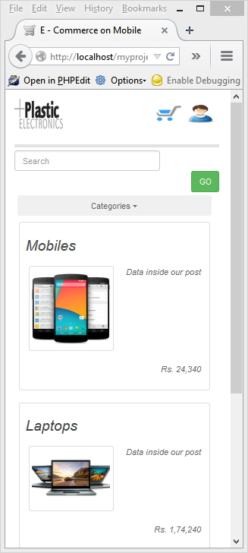
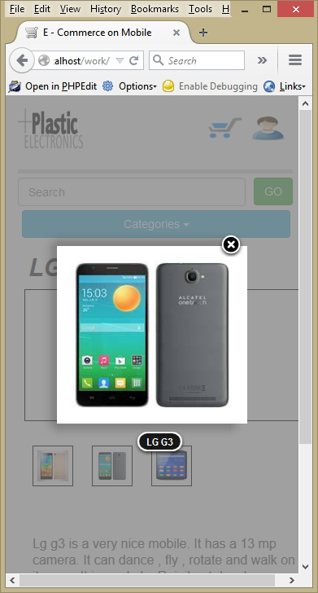
Phases
.
index.php
details.php
details.php

Slide 10
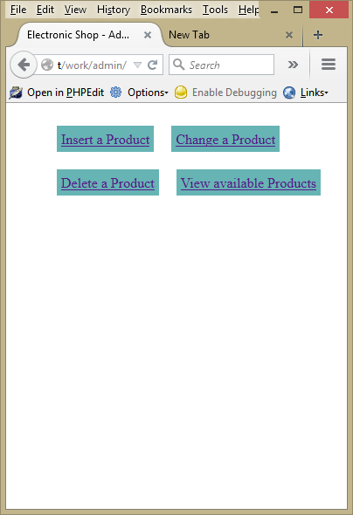
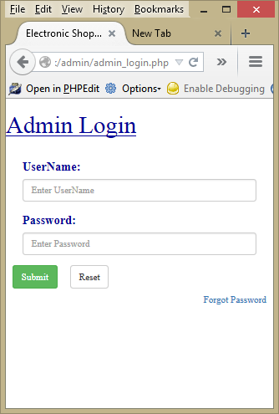
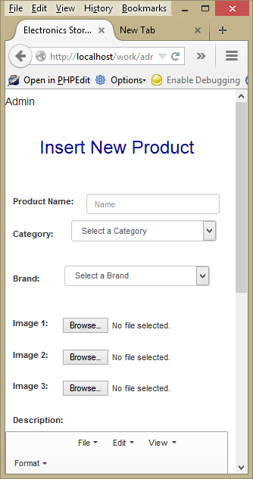
Pages
admin/index.php
admin/admin_login.php
admin/insert_product.php

Slide 11
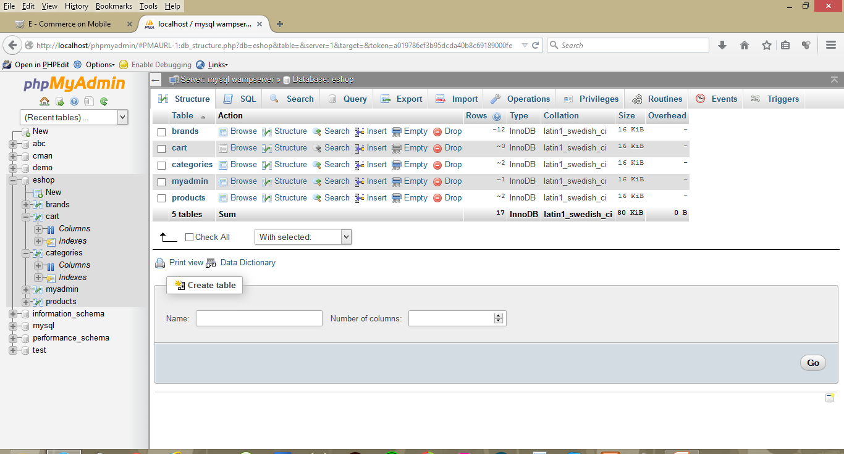
Database

Slide 12
Work Progress
UI / Template
Database
Main Page
Admin Login Form
Insert Product Form
Details Page
Search Bar
Admin Panel*

Slide 13
What Next ?
Shopping Cart
Customer Account Manager
Session Tracking both Admin and Customer
Delete Products (Admin Panel)
View existing products (Admin Panel)
Speech to Text in Search Bar
Polymer for UI

Slide 14
REFERENCES
PacketHub E-commerce - http://www.packtpub.com/php-5-e-commerce-development/book
PHP and MySQL Development 3rd Edition – Sams Publishing
Tutorials Point Ebook – Ecommerce Tutorial
Tutorials Point Ebook – Bootstrap Tutorial
JavaScript & jQuery: The Missing Manual, Second Edition by David Sawyer McFarland
HTML5 Programming with JavaScript Published by John Wiley & Sons

Slide 15
THANK YOU

