Slide 1
The benefits of R Markdown in research and reporting
Phillip Winston Miller

Slide 2

Objectives
R Markdown Overview
Under-the-hood
Show and Tell
Automation

Slide 3
Sources
https://bookdown.org/yihui/rmarkdown/
https://rmarkdown.rstudio.com/index.html
https://stackoverflow.com/questions/tagged/r-markdown
https://pandoc.org/MANUAL.html#pandocs-markdown

Slide 4
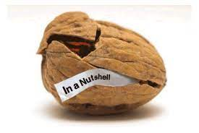
What is R Markdown?
A method of mixing
Formatted plain text
Code
Output of Code
Packaged with Rstudio (rmarkdown)
PLAIN TEXT DOCUMENT ending in .Rmd
Outputs a clean formatted .html file
(or .pdf, or .pptx, or .docx, etc.)

Slide 5
Why use it?
R Markdown allows for the construction of a narrative adjacent to and inseparable from the analysis
The ability to “knit” to immutable output formats allows for easy “freezing”
The output makes it easy to distribute your work to colleagues or presentations

Slide 6
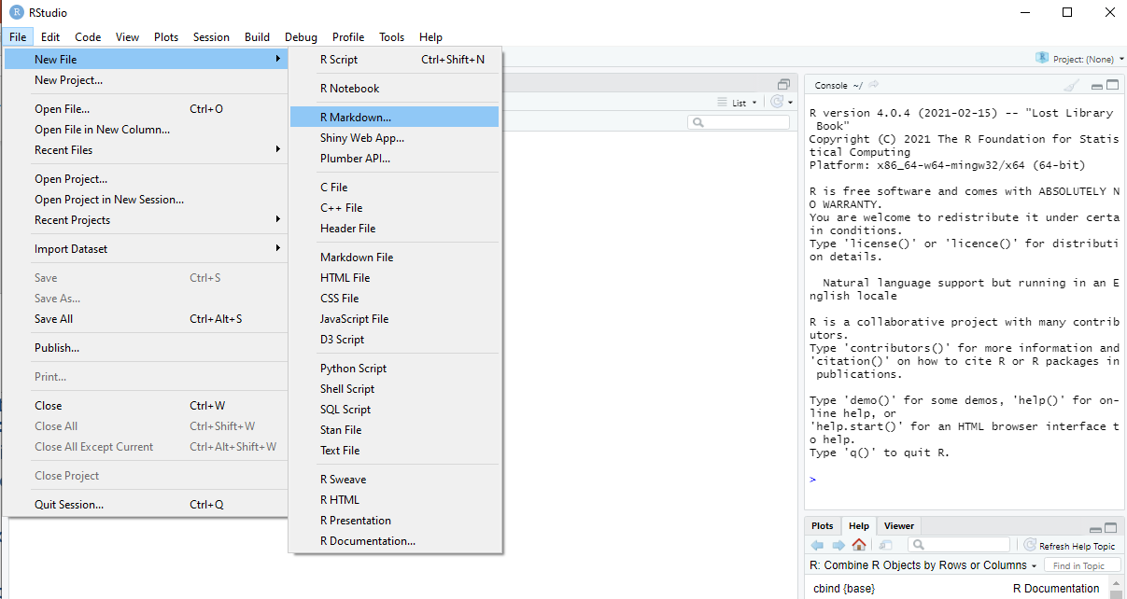
How does it work?

Slide 7
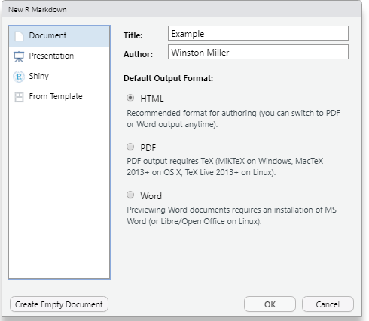
How does it work?

Slide 8
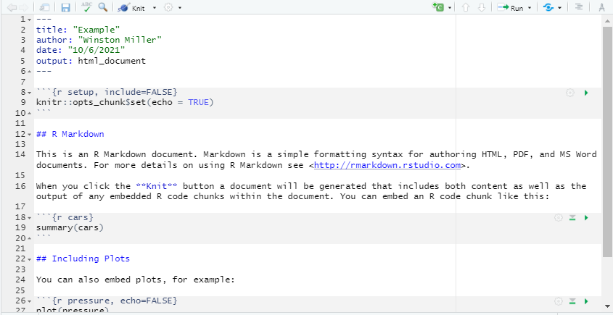
How does it work?

Slide 9
How does it work?
4 Parts:
The YAML Header
The Setup Chunk (Optional)
The Plain Text
R Code Chunks
These parts are then knitted to generate the output document.

Slide 10

How does it work?

Slide 11
What if RStudio is impractical
CRAN
‘install.packages(“rmarkdown”)’
PANDOC
Download the PANDOC package
https://pandoc.org/installing.html
Create
Generate the appropriately formatted .rmd document
R Call
Call rmarkdown::render(“name of document.rmd”)

Slide 12
Under the Hood
R package “rmarkdown”
R package “knitr”
Pandoc

Slide 13
Automation
Remember how I said a .rmd is just a plain text document? What is in a plain text document?
CHARACTERS!!!!

Slide 14

Automation
What is a character to R?
“MOST anything inside these double quotes”
These are some exceptions to this
Like “\n”, “\t”
“A ‘single quote’ can be nested inside a double quote”

Slide 15
Examples
“---”
“title: 'Example 1’”
“Author: ‘Winston Miller’”
“---”
“Above is a the YAML Header <br>”
“Below is some R Code”
“```{r, echo=TRUE}”
“library(ggplot2)”
“```”

