Slide 1
DCGAN
Deep-Convolution GAN
201600779
김영민

Slide 2
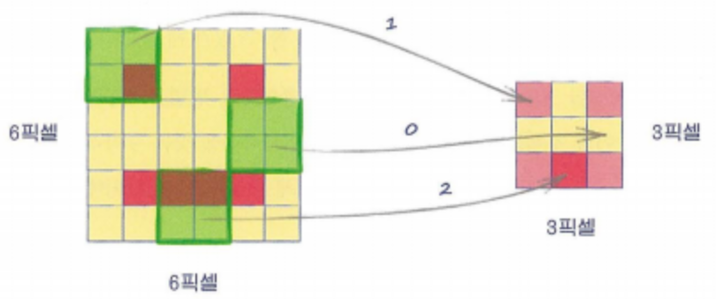
Convolution
Convolution Filter
Filter를 통해 Image의
Locality를 찾아냄
Convolution Filter를 통과함으로써 이미지의 해당 부분을 압축한 정보를 보냄

Slide 3
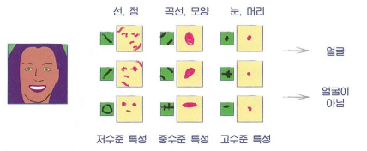
Convolution
Feature map
압축한 정보들을 Feature Map이라고 함
Convolution layer 통과 횟수

Slide 4

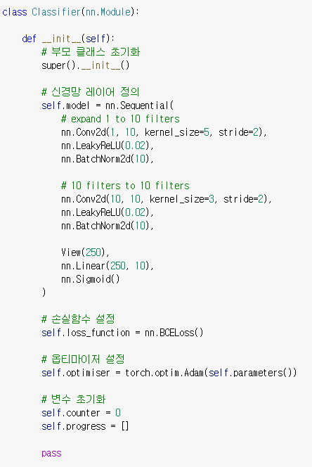
CNN
MNIST CNN
In_channel : 1
Out_channel : ->10
5x5 filter size
Stride = 2
(28-5)//2 +1 -> 12x12
(12-3)//2 +1-> 5x5
5x5x10(number of filter map) = 250
https://pytorch.org/docs/stable/generated/torch.nn.Conv2d.html

Slide 5
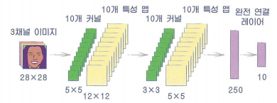
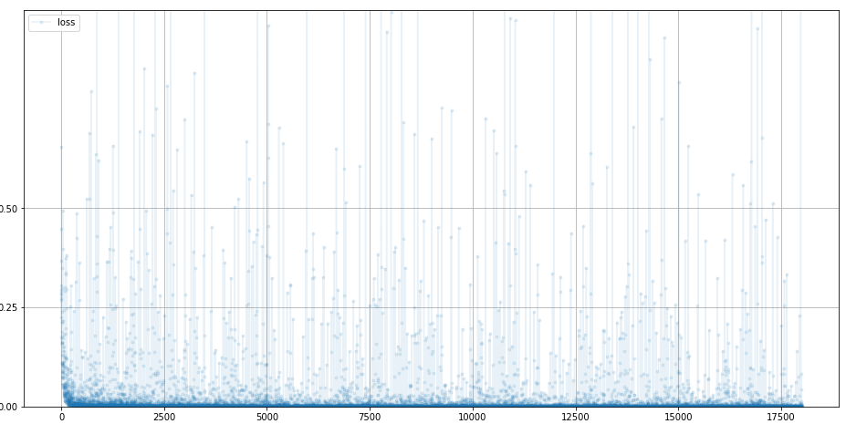
CNN
MNIST CNN Architecture
Loss Function
Accuracy : 97.93%

Slide 6
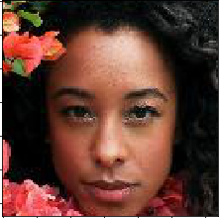
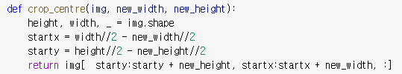
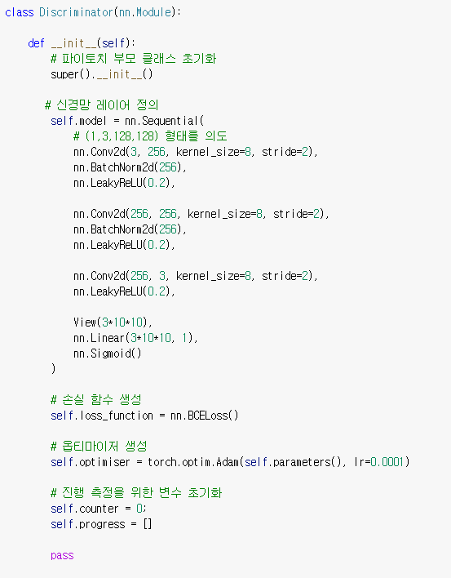
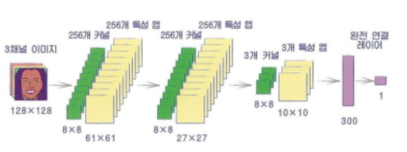
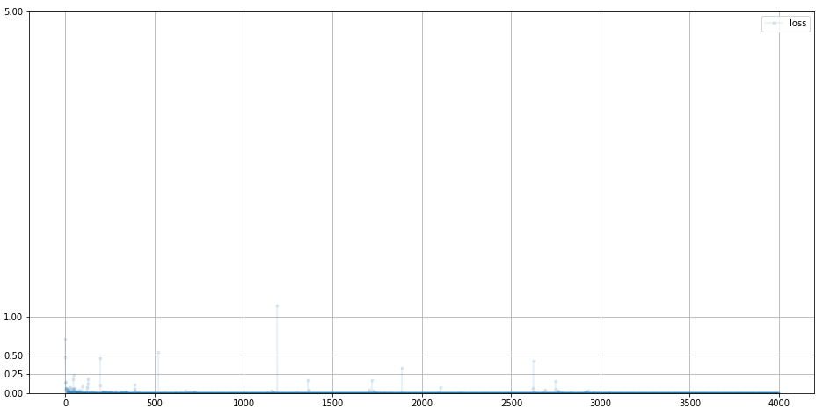
DCGAN
CelebA Discriminator
Image Cropping
Loss 0으로 수렴

Slide 7
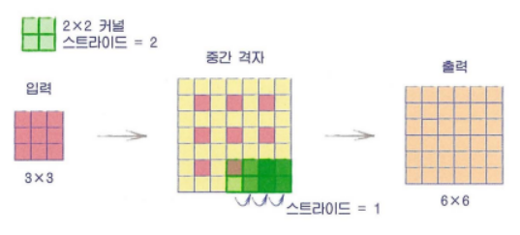
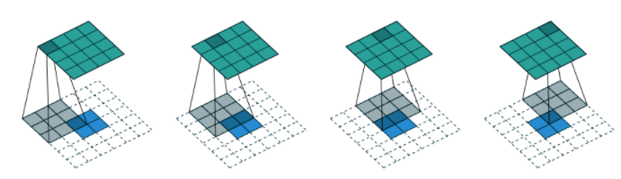
DCGAN
Transposed Convolution
Transposed Convolution을 이용하여 이미지를 복원
https://simonjisu.github.io/deeplearning/2019/10/27/convtranspose2d.html
https://pytorch.org/docs/stable/generated/torch.nn.ConvTranspose2d.html

Slide 8
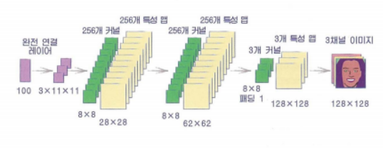
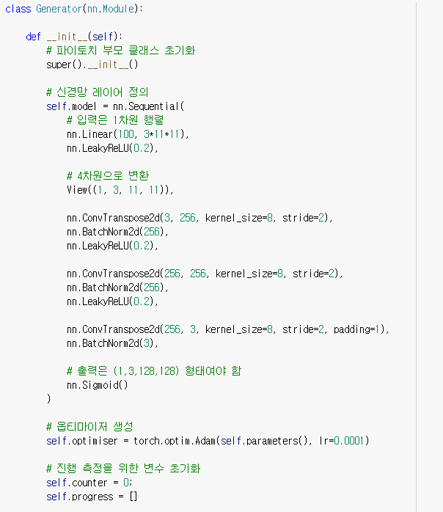
DCGAN
Generator
$$O=\left(I−1\right)S −2P+\left(K−1\right)+1$$
(11-1)*2 +(8-1)+1 = 28 -> 28x28x256
(62-1)*2 +-2+(8-1)+1 -> 128x128x3
https://pytorch.org/docs/stable/generated/torch.nn.ConvTranspose2d.html

Slide 9
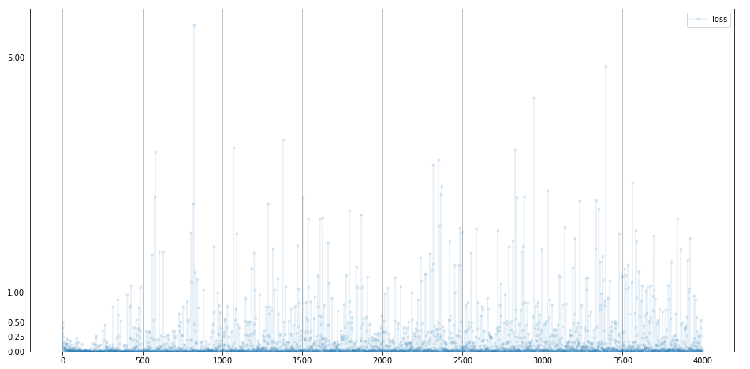
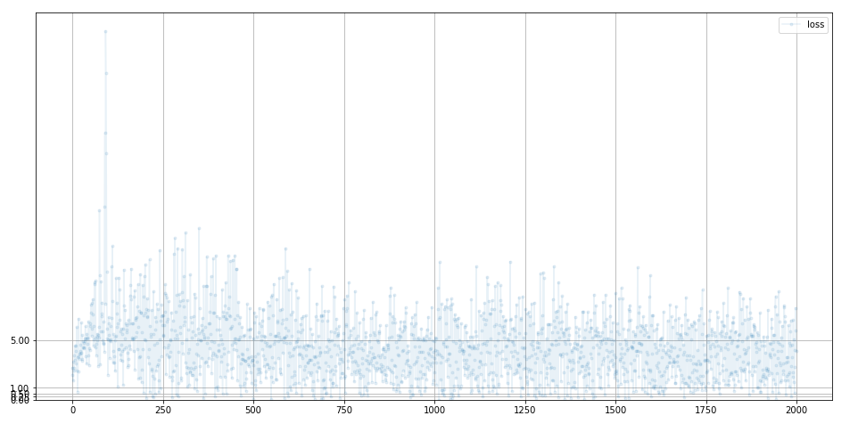
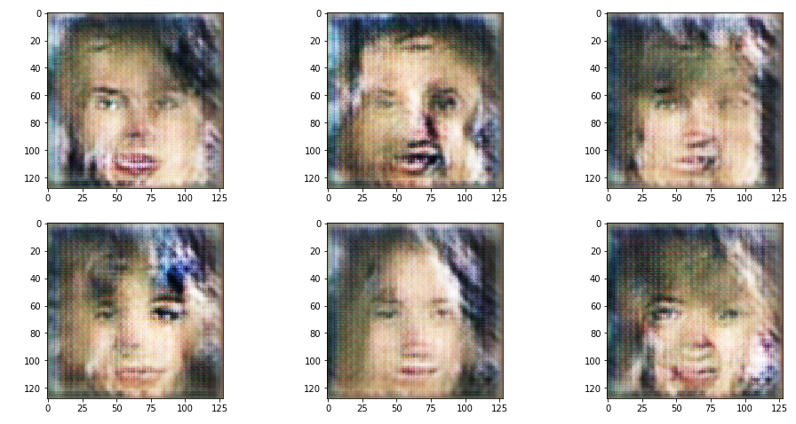
DCGAN
Result
Discriminator Loss
Generator Loss
Result

Slide 10
감사합니다 ^^

