Slide 1






Building Age Classification
ZAS · DATA SCIENCE REGIONAL HACKATHON 2026
Abstract
We classify the construction-age class of 30 m Landsat pixels from 42-year time series, training on Madrid and transferring to Amsterdam with few labels. Rebuilding the input — removing broken scenes and saturated values, and replacing the first-photo rule with a warm-season median composite — cut year-to-year noise by 40–46 %. We engineered 321 label-free features (spectral indices, robust trends, one- and two-break construction change-points, relative and spatial-context features) and standardised each city with its own statistics. A LightGBM–XGBoost–Random Forest ensemble reaches macro F1 0.652 ± 0.026 on Madrid under strict spatial-block cross-validation. For Amsterdam, a CatBoost base model is adapted by recalibration, weighted fine-tuning and self-training on unlabelled pixels, then ensembled, prior-corrected when labels suffice, and spatially smoothed. Macro F1 rises from 0.654 (n = 5) to 0.687 (n = 25) and 0.757 (n = 200), beating the organisers' starter baseline by 0.09–0.15.
Group 2
ZINGSA · 5–8 October 2026
0.652
0.687
0.757
Madrid F1
Amsterdam · 25 labels
Amsterdam · 200 labels
ZINGSA
host
Notes:
PRECIOUS (GIS) · 0:00–0:30 · Introduce Group 2 and the four members, then the project in one breath: we read the age of buildings from 42 years of satellite images, learn it in Madrid and move it to Amsterdam with very few labels. Thank the organisers and partners on the logos.

Slide 2




Reading a city from orbit
30 m pixels
Four age classes
every city block, seen from Landsat
Madrid
42 summers of imagery
C1
C2
C3
C4
1984 – 2025 · Landsat 5, 7, 8, 9
1960
1984
2004
Amsterdam
6 spectral bands
C1
C2
C3
C4
visible · near-infrared · short-wave infrared
1945
1984
2004
76,263 + 25,992 pixels
Learn in Madrid → adapt to Amsterdam
with only 5 · 25 · 50 · 100 · 200 labels per class
Madrid (train) · Amsterdam (transfer)
Notes:
PRECIOUS (GIS) · 0:30–1:05 · Each pixel is a 30 m square; Landsat has imaged it every summer since 1984 in six bands. Classes 3 and 4 were built while the satellite was watching. The task: learn in Madrid, then adapt to Amsterdam with very few labelled pixels.

Slide 3
What the data told us
3
broken satellite scenes passed the quality flag
31 %
of Amsterdam photos are summer images
60 %
of clean photos ignored by the starter pipeline
87 %
of neighbouring pixels share the same age
We rebuilt the input → year-to-year noise −46 %
Notes:
PRECIOUS (GIS) · 1:05–1:30 · Our data audit: three whole Landsat scenes were broken; photos come from all seasons; the starter kept only the first photo of each year; and age is strongly clustered by district. Fixing the input cut noise by almost half. Hand over to Prof Tanaka.

Slide 4

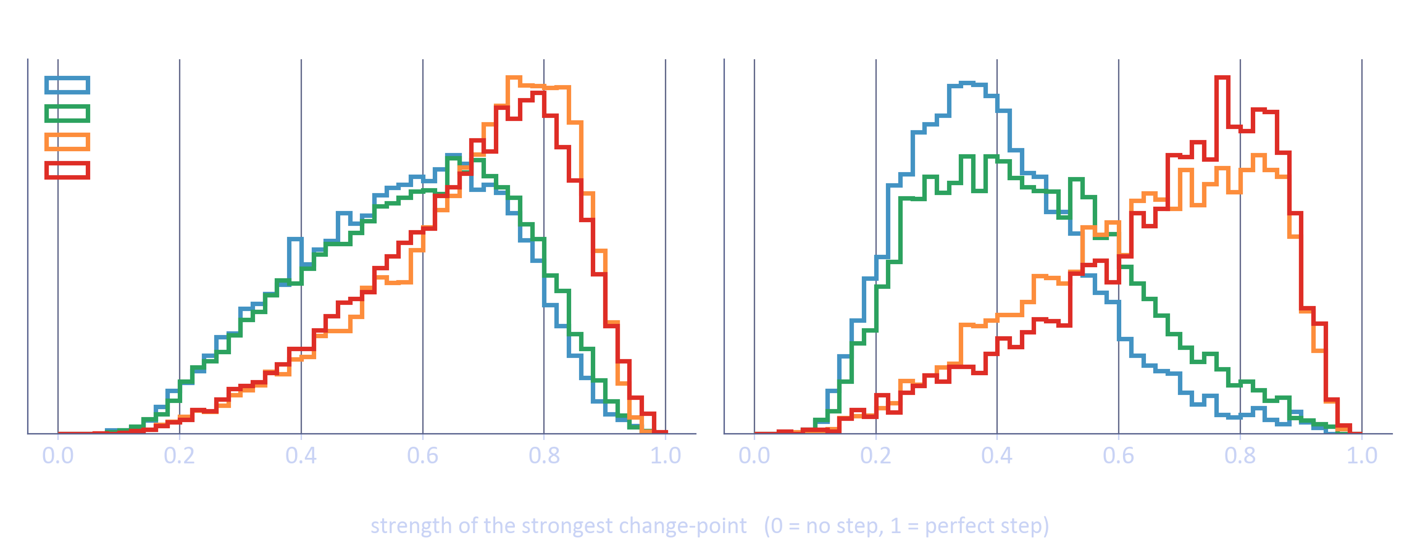



The physics of building age
Materials reflect light differently
brick · concrete · glass · vegetation
Construction leaves a step
vegetation → bare soil → new roof
Ratios cancel sunlight
indices remove sensor and climate effects
Strength of the main jump in each pixel's history
Describe change, not brightness
Built after 1984 (C3, C4): strong steps · Built before (C1, C2): flat — clearest in Amsterdam
the signal that travels between cities
Notes:
PROF TANAKA (Physics) · 1:30–2:45 · Every material has a spectral fingerprint. When a building is erected the pixel's reflectance jumps: vegetation disappears, soil appears, then a new roof. Band ratios cancel illumination and sensor differences. The chart: newer classes show strong steps, older ones do not — even more clearly in Amsterdam. So we describe change, not brightness. Hand over to Natali.

Slide 5




How we built it
Clean
Engineer
Scale per city
Model
Validate
warm-season median
3 broken scenes removed
321 label-free features
9 groups
each city on its own curve
no labels used
6 algorithms
+ ensemble
2 km spatial blocks
10 draws per n
Fixed seeds
CPU = GPU ± 0.003
18 min end-to-end
Predicts unseen pixels
Notes:
NATALI (Computer science) · 2:45–4:15 · Five steps: clean the photos into one robust value per year; engineer 321 features without labels; scale each city on its own; train and compare models; validate honestly with 2 km spatial blocks and 10 random draws per sample size. Everything is reproducible: fixed seeds, CPU and GPU agree within 0.003, 18 minutes end to end, and the code can predict pixels it has never seen. Hand over to Winston.

Slide 6
From baseline to best model
0.574 → 0.652
Madrid: starter baseline → our ensemble
0.593
CatBoost travels best → our Amsterdam base
Notes:
WINSTON (Data science) · 4:15–4:50 · We started from the organisers' baseline, a Random Forest at 0.574 under spatial validation. We tested six algorithms; gradient boosting won and an ensemble of LightGBM, XGBoost and Random Forest reaches 0.652. CatBoost is mid-table in Madrid but transfers best to Amsterdam with no labels, 0.593, so it is the base of our transfer model.

Slide 7

Transferring to Amsterdam
Recalibrate
re-read with n labels
Madrid model
Ensemble
Class-mix check
Smooth
CatBoost
per-city scaled
Fine-tune
average of the three
only when n ≥ 25
with neighbours
Madrid + weighted labels
Self-train
confident unlabelled pixels
With only 5 labels per class, Amsterdam already matches Madrid (0.654 vs 0.652)
Notes:
WINSTON · 4:50–5:25 · The starter's prototype ignores the Madrid model. We reuse it three ways — recalibrate it with the few labels, fine-tune it on Madrid plus heavily weighted Amsterdam labels, and let it teach itself from thousands of confident unlabelled Amsterdam pixels. We average, correct the class mix only when we have at least 25 labels, and smooth with neighbours.

Slide 8
Results: baseline vs best
Setting (macro F1) | Starter baseline | Group 2 | Gain | Unseen half *
Madrid — spatial CV | 0.574 ± 0.030 | 0.652 ± 0.026 | +0.078 | —
Madrid — random CV | 0.618 ± 0.005 | 0.736 ± 0.003 | +0.118 | —
Amsterdam — no labels | 0.334 | 0.624 | +0.290 | —
Amsterdam — n = 5 | 0.502 ± 0.047 | 0.654 ± 0.021 | +0.152 | 0.652 ± 0.031
Amsterdam — n = 25 | 0.593 ± 0.018 | 0.687 ± 0.019 | +0.094 | 0.705 ± 0.008
Amsterdam — n = 50 | 0.607 ± 0.011 | 0.723 ± 0.004 | +0.116 | 0.717 ± 0.011
Amsterdam — n = 100 | 0.617 ± 0.008 | 0.740 ± 0.004 | +0.123 | 0.729 ± 0.008
Amsterdam — n = 200 | 0.615 ± 0.004 | 0.757 ± 0.002 | +0.142 | 0.748 ± 0.004
Amsterdam — average | 0.587 | 0.712 | +0.125 | 0.710
* Stricter check after the method was frozen: labels from one half of Amsterdam (2 km blocks), scored only on the other half
Notes:
WINSTON · 5:25–6:05 · Same folds, same ten draws for both. Madrid: 0.574 to 0.652. Amsterdam: we beat the baseline at every sample size, by 0.09 to 0.15 — 0.687 with 25 labels, 0.757 with 200, average 0.712. The last column is a stricter check we ran afterwards: labels only from one half of the city, scored on the other half — the average is still 0.71.

Slide 9
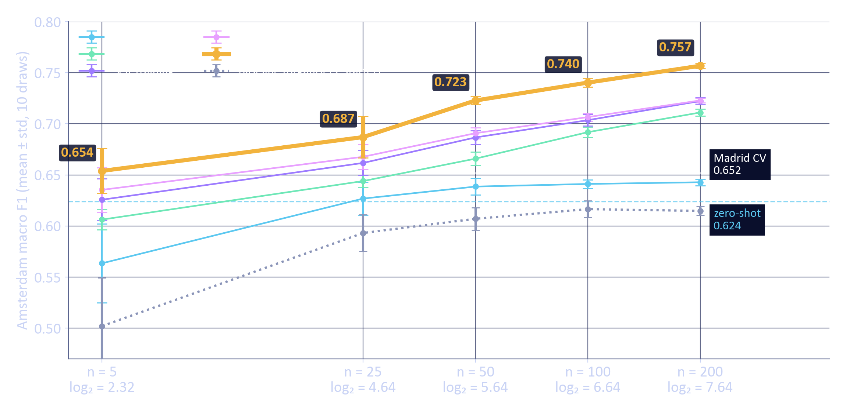
Macro F1 vs log₂(labels per class)
Notes:
WINSTON · 6:05–6:30 · Mean and standard deviation over ten draws against log2 of the labels per class. Our method in amber is best at every size with small error bars; the grey dotted line is the organisers' baseline.

Slide 10


What worked · what didn't · honest check
Worked
Didn't (measured change)
0.710
Cleaner yearly composite
−46 % noise
Class-mix at every n
−0.003
unseen half of Amsterdam — reported 0.712
Change-point features
steps
BBSE class-mix
−0.003
0.65–0.76
Per-city scaling
no labels
Label-noise weights
+0.001
pixels ≥ 1 km from any label
Self-training
unlabelled
Pseudo-label agreement
0.000
Spatial smoothing
+0.020
TabPFN
+0.003
8 → 0
Class-mix rule
n ≥ 25
CORAL alignment
−0.05
ideas tested, none adopted
Notes:
WINSTON · 6:30–7:20 · Left: what earned its place — cleaner yearly photos, change-point features, per-city scaling, self-training, spatial smoothing (+0.02) and the class-mix rule from 25 labels. Middle: what we tested and dropped; each number is the measured change in macro F1, and values like +0.001 are inside the error bars. Right: our honest check — after freezing the method, labels came only from one half of Amsterdam and we scored only the other half: 0.710 against the reported 0.712, pixels more than a kilometre from any label score just as well, and none of eight new ideas passed our pre-set rules.

Slide 11
Thank you
Group 2 · Questions welcome
Zimbabwean Astronomical Society
African Astronomical Society
IAU Office of Astronomy for Development
Inter-University Institute for Data Intensive Astronomy
Development in Africa with Radio Astronomy
Notes:
WINSTON · 7:20–7:45 · Thank the Zimbabwean Astronomical Society, ZINGSA, AfAS, OAD, IDIA and DARA, and invite questions.

