Slide 1


Decrease margins
Increase Size
Decrease Size
Decrease margins

Slide 2


Slide 3

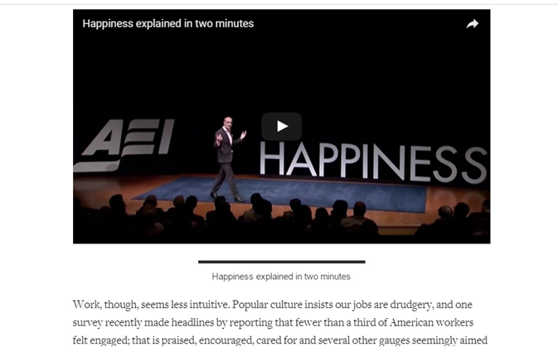
Shrink
Vertical
Height
Captions for
Elements

Slide 4


Drop Caps
Delete
Gray
Line
Margins at auto setting
Margins at auto setting
Text Container

Slide 5
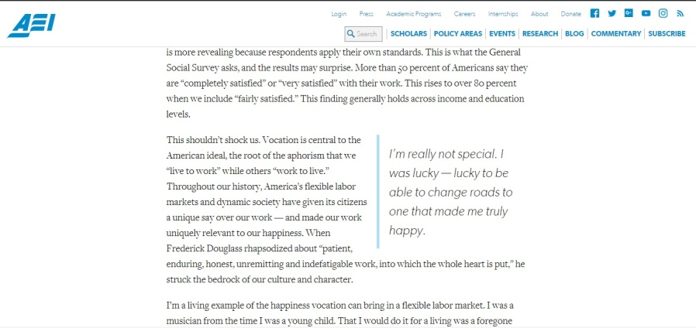
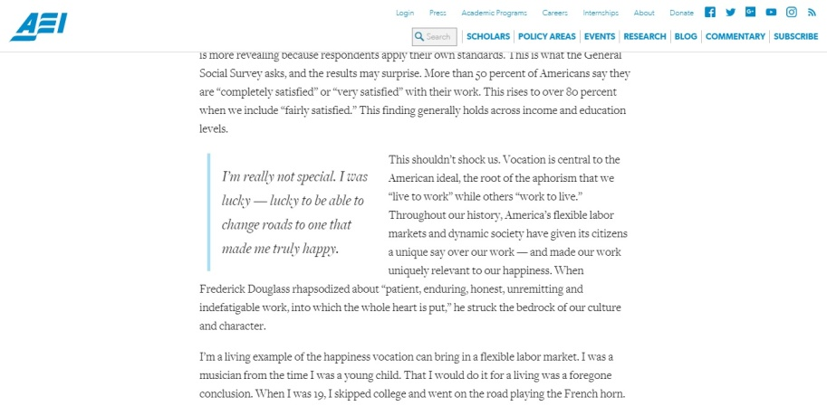
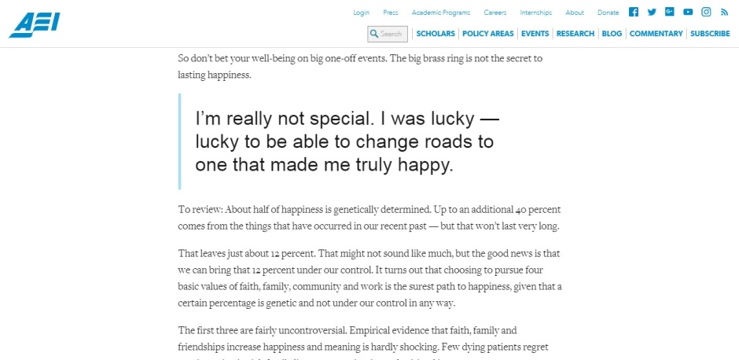
Easily embeddable quotes

Slide 6

BE PREPARED FOR HIGH RESOLUTIONS

