Slide 1


CASE COMPETITION 2016
“GlobalFund.gov”
Group: ADT Joshua Abreo Winston Du
Ananya Tinaikar

Slide 2
Introduction
Our Understanding of the Situation
Approach
The Solution
Goals addressed and technical solution features
Project schedule, budget, and delivery method
Training, maintenance, and operations
Future enhancements

Slide 3
Project Description
The American Philanthropic Association (APA) wants to create a crowdfunding application that would connect entrepreneurs in developing countries with funding from American citizens.
Hope to improve economies in developing countries and reduce poverty rates
Incentivize American citizen to invest in international economies
Our Goal/Success Criteria
To create a crowdfunding product that is:
Effective
Low Risk
Cost Efficient

Slide 4
Approach
Use a website as method of crowdfunding
A median of 44% of surveyed populations access the internet, including half or more in 13 countries
Highly unlikely to create a risk-free mobile app across international boundaries
2. Key Risks associated with crowdfunding
The entrepreneurial venture is illegitimate
Money is lost after donating
Information may be taken without authorization
Entrepreneur will not deliver on project

Slide 5
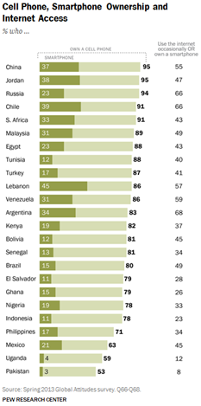
Reasons to Prefer Website Approach
1. Reach:
Difficult to create applications over global networks
“Nations are still implementing even the most basic instances of mobile technology”
Internet availability is much higher in developing nations than smartphone ownership
Modern apps are run on smartphones.
2. Cost of implementation:
“A minimum of 399 different use devices is a necessity to ensure [an] application is functional on unique mobile devices.”
A properly built website has much less testing requirements.
3. Security risks:
“78% of top … applications have been hacked.”
Websites have limited data footprint versus applications
Applications requires user to update, website doesn’t.

Slide 6
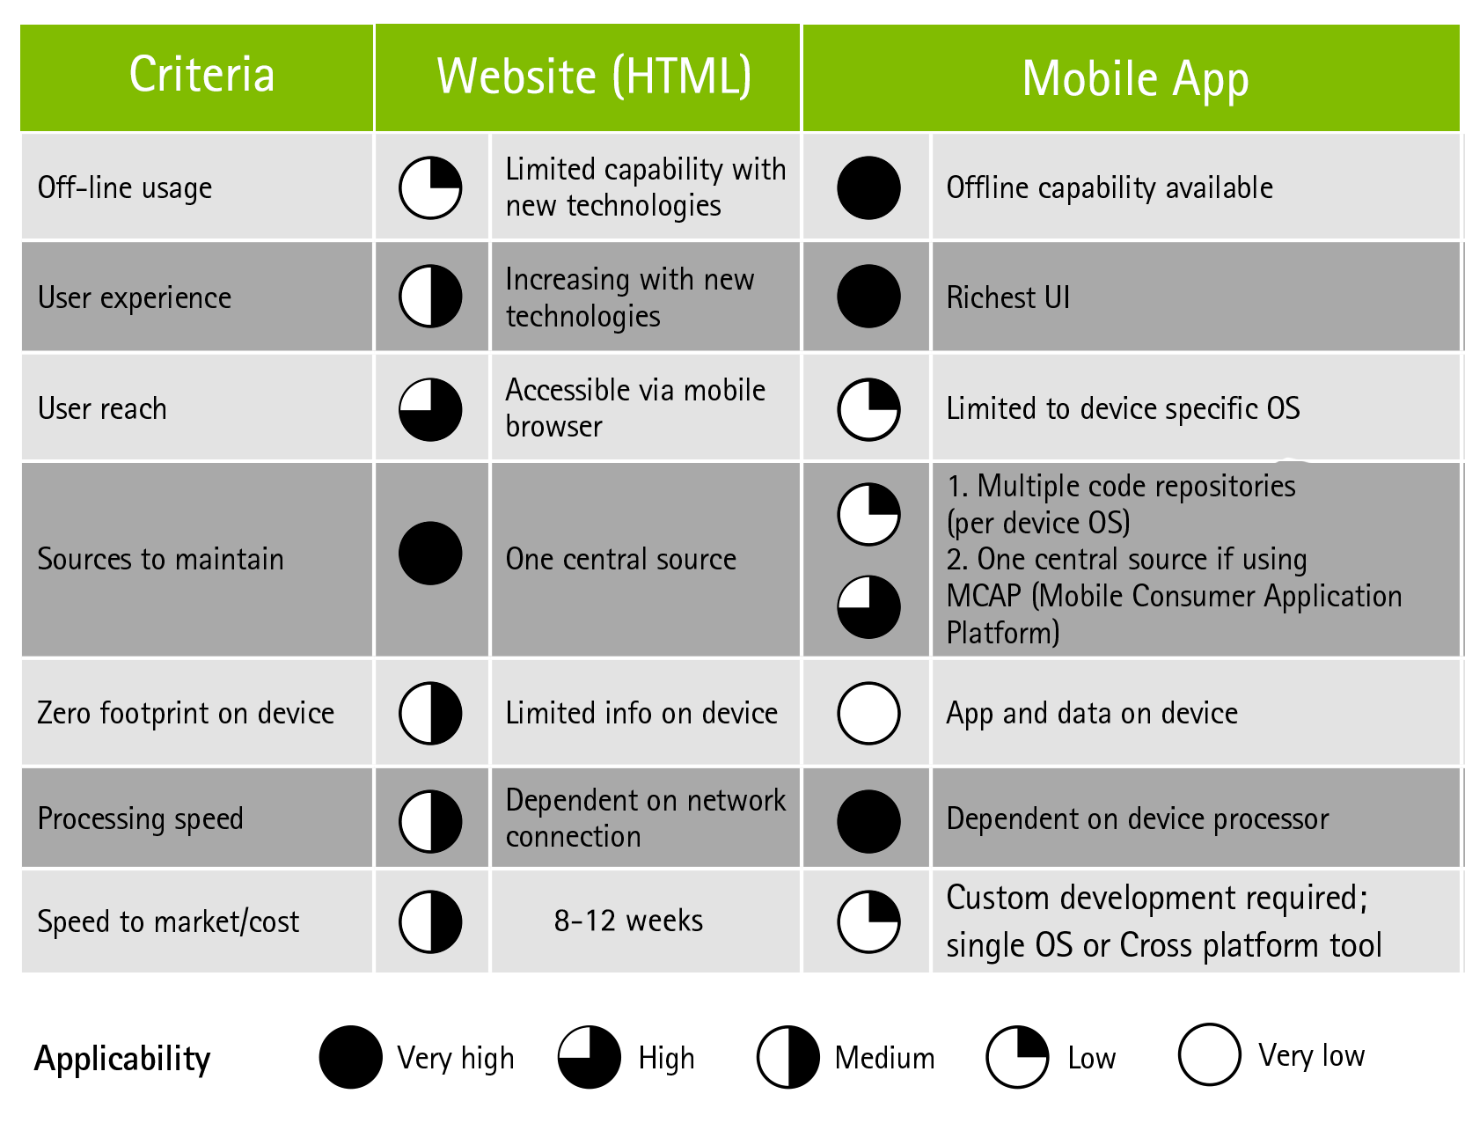
Side-by-side comparison: Site vs. App
Adopted from: 1. Case materials
2. Accenture Federal Services, Mobile Device Platform and Application Development for Federal Agencies

Slide 7
The Solution: Crowd-Funding Website
Website Model:
Project Creators can propose an idea
Submit a proposal which includes background, experience, manufacturing plan, and functional prototype [where applicable]
Provide funding goal
Website staff filters the idea based on
Feasibility of implementation
Likelihood of funding
Risk
Budget Details
3. Project Creators must set a deadline and minimum funding goal
If goal is not met by deadline, no funds are collected
Donations can exceed the funding goal by 10%
Maximum funding deadline is 90 days
4. Creators give regular updates, reiterating the mission of their cause
Use existing APA capabilities like APATrack to monitor progress
Partner with local authorities to confirm progress

Slide 8
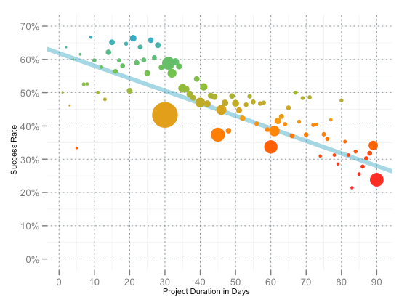
A Closer Look: Project Creator Setup
Creators Submit a Project Proposal
Criteria of proposal screening based off of existing local Crowdfunding websites such as Kickstarter and GoFundMe
Develop new criteria over time via pilot then phased roll-out
Maximum Project Funding Deadline is 90 days
Kickstarter analysis showed that shorter project time length resulted in higher success rates
Notes:
Ananya

Slide 9
A Closer Look: Project Creator Setup
Funding minimum is 500$ [can be negotiated with APA]
Protects donors from small scams
$500 is enough [across exchange rates] to start a small-scale project in Top 5 developing nations’ economies (China, Philippines, Kenya, India, Indonesia)
“All or Nothing” Funding
If project doesn’t reach funding goal by deadline, no funds are collected
Protects pledgees from losing money
Ensures creators are committed to success of the project
Donations can exceed funding by 10%
Stops projects from collecting too much money
Pledgers may still pledge money to the project after 10%
Based on number of pledgers post 10%; creators can submit request to increase funding goal

Slide 10
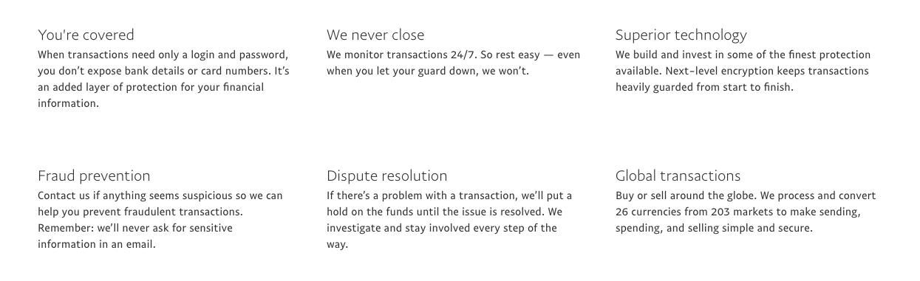
A Closer Look: Transactions
Use Paypal as method of Transaction
Operates in 203 markets, allows customers to be paid in 100 currencies, withdraw funds in 57 currencies and hold balances in 26 currencies
Existing security measures
International transaction charges are based on the exchange rate of the senders funds [can be negotiated using APA non-profit status]
Notes:
Ananya

Slide 11
A Closer Look: Efficient Funding
Utilize a bot function to scan for keywords within project proposals
If Creator’s project is relevant to the mission of another philanthropic organization, website can pair both parties
Receive funding from major philanthropic organizations if funding goal is at a minimum of 10,000$ [i.e. large scale]
Use APA database and resources for pairing system
Utilize APATrack or Google Analytics to gauge project success
Collect data from existing projects in first two years
Determine what are the signs/patterns seen with unsuccessful projects
Revamp screening criteria accordingly
Notes:
Ananya

Slide 12
Technology Risks Breakdown
Major concerns and solutions
Risk | Solution
Malicious URL (Phishing) | Utilize .gov URL since APA is a government organization (This will drastically reduce fake URL scams) Registration of a .gov domain will not exceed $1000* Always advertise as .gov Create modules to educate users about phishing
Financial Transactions | Securitize by partnering with existing financial transaction companies (such as PayPal®) Global reach: PayPal has 203 markets and 26 currencies** No additional investment in financial security measures from APA Cost: ~3-5% for each online transaction Use non-profit organizational status to negotiate rates down (PayPal in particular offers discounts***)
Internal/Server Side Security | Vet code developers Encourage code development to happen on-site to reduce security risks Phased roll-out to identify early problems Employee sign-on/sign-off on moderator systems on-site Train employees in proper security protocols to avoid cyberattacks Periodic active drills for contingencies
*-https://www.dotgov.gov/portal/web/dotgov/policy
**-https://www.paypal.com/webapps/mpp/country-worldwide
***- https://www.paypal.com/webapps/mpp/donations

Slide 13
Target Countries
Criteria for selection
1. Economic Climate:
Crime, corruption, and low economic freedom decreases impact of nonprofits like APA and increases risk.
Other societal problems offer opportunities for APA to make an impact (APA’s core mission: ending poverty and promoting democratic societies through strategizing and enacting international development initiatives.)
2. Technological Infrastructure:
Significant internet access
Significant technology growth potential
3. Entrepreneurship culture and community:
APA can most make an impact in countries where opportunities are perceived to be bountiful and entrepreneurs are willing to take on risks.
Culture of failure acceptance is crucial

Slide 14
Crime and corruption top the list of problems in emerging and developing nations.
-Pew Research

Slide 15
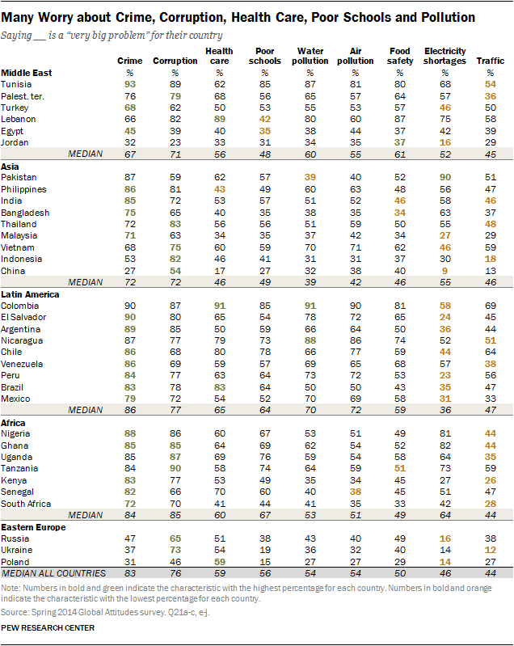
Target Countries
Notes:
Winston

Slide 16
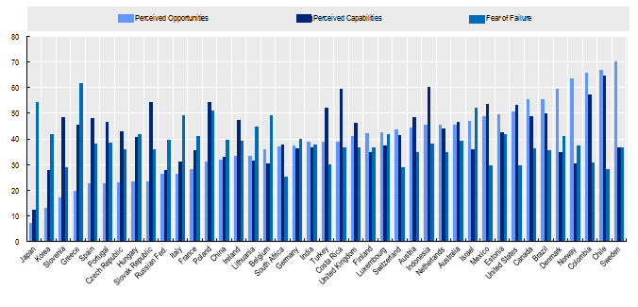
Target Countries
Figure A. Entrepreneurial perceptions
OECD. (2015), "Culture: Entrepreneurial perceptions and attitudes", in OECD., Entrepreneurship at a Glance 2015, OECD Publishing, Paris.
DOI: http://dx.doi.org/10.1787/entrepreneur_aag-2015-29-en

Slide 17
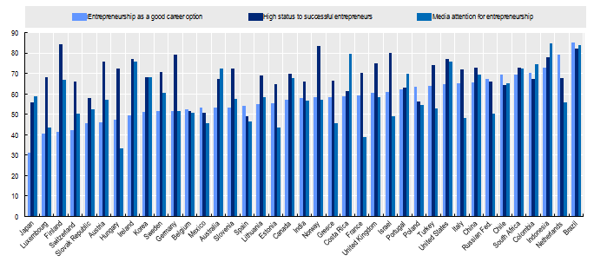
Target Countries
Figure B. Attitudes towards Entrepreneurship
OECD. (2015), "Culture: Entrepreneurial perceptions and attitudes", in OECD., Entrepreneurship at a Glance 2015, OECD Publishing, Paris.
DOI: http://dx.doi.org/10.1787/entrepreneur_aag-2015-29-en

Slide 18
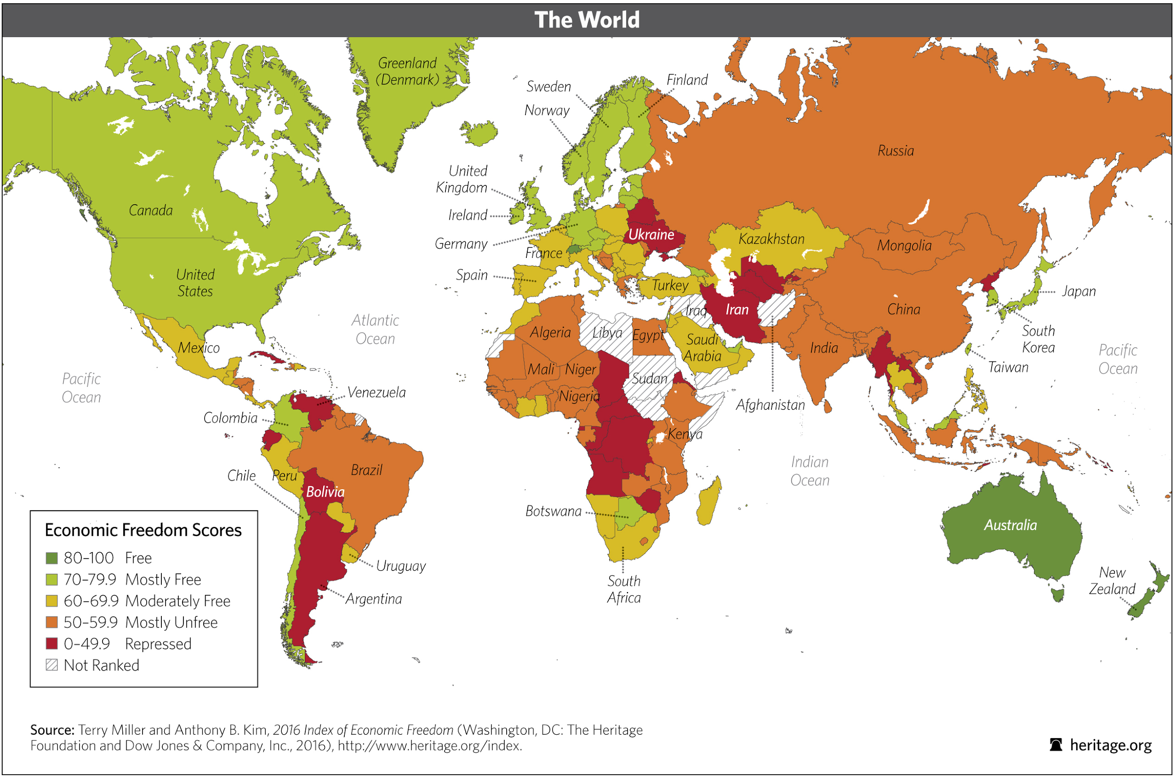
Target Countries

Slide 19
Target Countries
Suggested pilot countries
1. Chile:
Low perception of corruption (68%, lowest surveyed in Latin America)
High need (Still developing country)
Significant reach (66% internet access)
Economically Free (“Mostly Free,” 77.7/100)
Entrepreneurship culture (Entrepreneur societal status: 64.43%)
Low cultural fear of failure (Fear of failure: 28.39%)
2. South Africa:
Significantly lower perception of crime (72%, lowest surveyed in Africa)
High need (Developing country)
Significant reach (43% internet access)
Low Economic Regulations (“Moderately Free,” 61.9/100)
Entrepreneurship culture (Entrepreneur societal status: 64.43%)
Low cultural fear of failure (Fear of failure: 25.37%)

Slide 20
Training
Employees

Slide 21
Millennials have surpassed Gen Xers as the largest generation in U.S. Workforce
-Pew Research

Slide 22
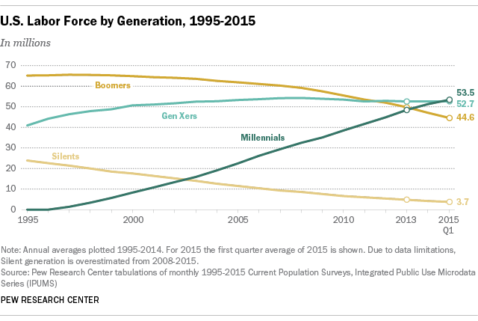
Training

Slide 23
Training
Methods and Implementations
Method | Time/Implementation
Pre-site launch: Hands-on training | Intensive two week-long training pre-launch: ~$50,000 for 18 back-end specialists “it does present a large amount of information to people in a short amount of time.” “set up the training earlier on so that [APA is] more familiar with the software before it hits the market” “it’s an inexpensive way to learn basic information”
Throughout: E-learning | Average cost of $10,000 – $15,600 for entire program Mobile learning: encourage users to progress through material in pieces Appeals to/Attracts tech-savvy millennials (Now majority of workforce*) Gamification: ->Increases long-term retention rates by up to 10 times** ->Illustrates and identifies top performers
Post-launch: Multi-purpose online forum | Low cost channel ($190-$200 a year) Allows users to bounce ideas off each other and voice their opinions Share media, allow peer-to-peer coaching Eventually move to more complex platforms like Sharepoint
*-http://www.pewresearch.org/fact-tank/2015/05/11/millennials-surpass-gen-xers-as-the-largest-generation-in-u-s-labor-force
**-Meister, Jeanne C.; Corporate Universities: Lessons in Building a World-class Work Force; 1998; McGraw-Hill.

Slide 24
Implementation
Timeline
Early 2017 | Late 2017 | Early 2018 | Late 2018 | Early 2019 | Late 2019 | Early 2020 | Late 2020
App
Dev.
Pilot Test (~3 countries)
Full, Phased-Roll Out
Global go-live
Training
Expansion
Connect with other nonprofit agencies
Increase publicity in other countries

Slide 25
Benefits of Implementation
Effective Allocation of Philanthropic Resources
Potential donors open up the application and see hundreds of causes which they can donate to
Eliminates the time necessary to find an appropriate charity – all crowdfunding projects have been screened
Efficient allocation of resources – all the money donated goes directly to the project
Method for Smaller Projects to Gain Traction
Traditionally, philanthropies have been connected to big projects and fund these primarily
This application will allow anyone with a project goal of at least $500 to get the opportunity for funding from US citizens/taxpayers.
Notes:
Josh

Slide 26
Success Criteria - Key Performance Indicators
Total Number of Funded Initiatives
Percentage of Initiatives Completed Through Web Application
Year by Year Funding Increase
Retention Rate of Users
Metrics Tracked:
Frequency of page visits
% conversion - likelihood of donating after visiting the application
Average Donation
Social Media Traction
Notes:
Josh

Slide 27
Estimated Costs and Impact
Costs
Initial Costs
Website Development - $100,000
Hands On Training - ~$50,000
Operating Costs
3% Paypal Service Fee
Continuous E-Learning - $15,000 annually
Web Forum - $200 annually
Impact
Increases in Real GDP
Decrease in Poverty
Increases in Standard of living
Development of sustainable markets
Higher percentage utilization of human capital
Notes:
Winston

Slide 28
Questions?

Slide 29


