Slide 1




Planix
Project & Activity Orchestration Engine: A lightweight web platform designed for intuitive task structuring, team visibility, and deliverable tracking.
Julian Vance
Mateo Rivera
Lucas Silva
Lead Developer
Backend Architect
Frontend & UX Lead

Slide 2


Executive Project Overview
Unified Project Storage
Operational Well-Being
Planix implements an integrated system that captures, structures, and manipulates projects and sub-activities in real time based on user demands.
By transforming fragmented tracking into an intuitive visual workflow, the platform significantly reduces administrative friction and work anxiety.
The platform eliminates cognitive clutter by providing centralized repositories for personal initiatives, corporate operational tasks, and academic schedules.
Users gain transparent execution timelines, rapid status toggles, and seamless activity delegation without steep onboarding hurdles.

Slide 3
Problem Statement & Gaps
Critical Deadline Slippage: Target users consistently reported chronic friction in scheduling milestones, resulting in missed delivery targets and unbalanced workloads.
Lack of Lightweight Tooling: Mainstream enterprise project software is often over-engineered, slow to configure, and cost-prohibitive for smaller operational teams and students.
Prevalence of Fragile Manual Methods: Over 60% of surveyed professionals still rely on paper notebooks, improvised spreadsheets, or informal messaging threads to track key tasks.
Absence of Centralized Visibility: Fragmented communication leaves stakeholders without a clear single source of truth regarding deliverable status and task progression.

Slide 4






Strategic Objectives
Intuitive Simplicity
Adaptive Control
Execution Freedom
Deliver an uncluttered, accessible user interface that allows any user or organization to organize projects within seconds without extensive training.
Provide complete flexibility to register, configure, inspect, and update granular project deliverables and dependent tasks on the fly.
Equip teams with real-time status indicators, clean activity views, and automated exportable reports to drive faster decision-making.

Slide 5





Product Engineering Method
01. Research
03. Wireframing
05. Final Build
Conducted user interviews to identify daily workflow breakdowns and pain points.
Designed user flows and low-fidelity screen layouts to test navigation logic.
Engineered production database, relational schemas, and responsive UI components.
02. Ideation
04. Prototyping
Held architecture sprints and produced conceptual sketches for database modeling.
Released functional beta modules to gather targeted pilot user feedback.

Slide 6
Target Audience Personas
Academic & Students
Operations Teams
Freelance Consultants
Individuals needing to track coursework, research phases, group submissions, and exam schedules with zero setup overhead.
Companies requiring streamlined supervision of inventory cycles, facility checklists, and recurring operational deliverables.
Independent professionals managing multi-client initiatives, billable milestones, and daily project execution goals.

Slide 7
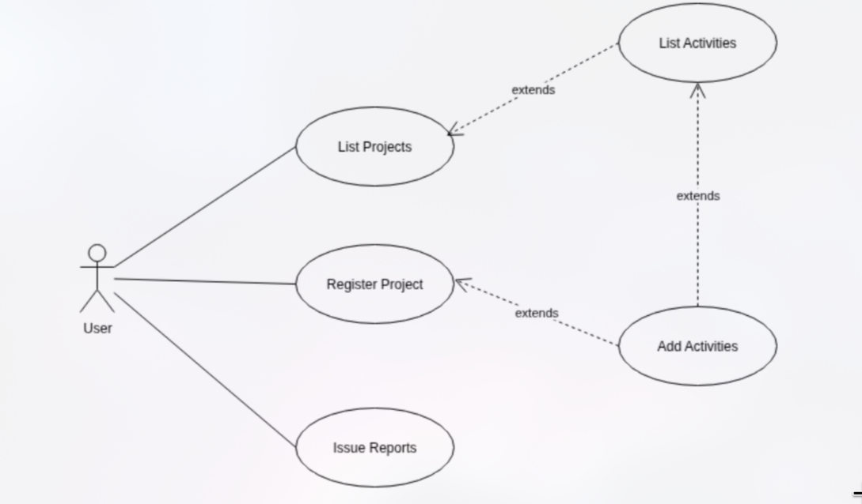
Core Use Case Architecture

Slide 8
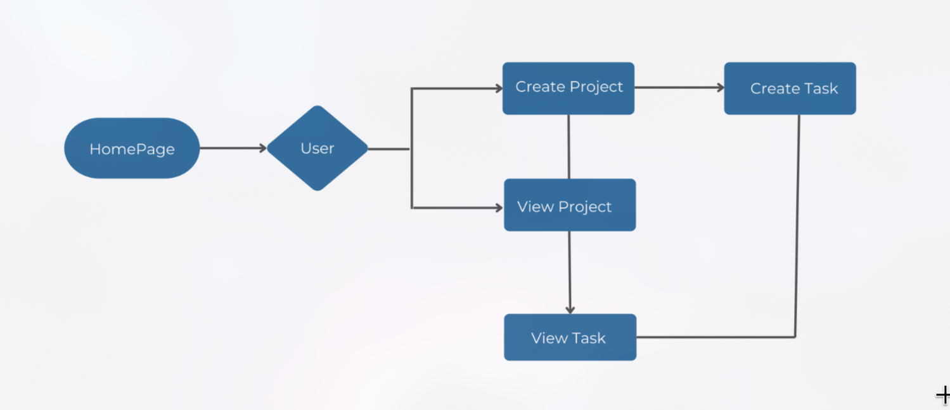
System Process Workflow
The system adheres to an intuitive, state-driven user lifecycle that eliminates dead ends:
•
Entry Point: User lands on Portal Homepage and authenticates securely into their personal workspace.
•
Branching Action: The operator chooses either to register a new initiative or browse existing portfolios.
•
Task Decomposition: Within an active project view, users append granular activities with specific deadlines.
•
Continuous Oversight: Real-time task inspection allows single-click status updates and activity filtering.

Slide 9

Technology Infrastructure
Architectural Layer | Core Technology | Technical Rationale | Deployment Benefit
Backend Core | Python 3.11 Runtime | High computational clarity and robust standard library | Rapid development velocity
Web Framework | Django Framework | Built-in ORM, secure authentication, and MVC scaffolding | Enterprise-grade security
Relational Database | SQLite / PostgreSQL | ACID-compliant storage supporting nested task relationships | Lightweight, zero-latency queries
User Interface | HTML5 + CSS3 + Bootstrap | Responsive grid system optimized for desktop and tablet screens | Clean, accessible styling
Client Interactivity | Vanilla JavaScript (ES6+) | Asynchronous modal updates and immediate status feedback | Friction-free UX without bloat

Slide 10
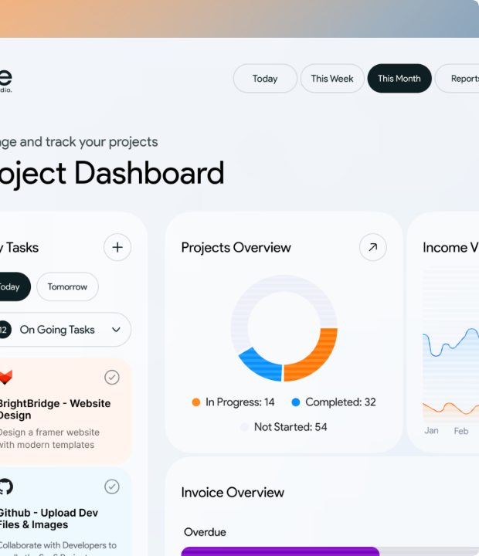
Interactive System Prototype
Modernized Web Interface
The clean dashboard view manages real-world workflows like the OmniLogistics Hub, Clinical Operations Suite, and Campus Portal.
Users inspect project metadata, update active milestones, and view nested task dependencies within an uncluttered single-page view.

Slide 11
Anticipated Project Impact
3.5x
Expected Operational Contributions
Enhanced Productivity & Coordination: Eliminates duplicate communication channels and guarantees real-time synchronicity across team members.
Superior Decision-Making Control: Dynamic project health indicators and structured activity breakdowns empower stakeholders to allocate resources with precision.
Increased Task Visibility

Slide 12
Questions & Discussion
Thank you for your time. We invite feedback on the Planix architecture and deployment roadmap.
Planix Project Suite
Metropolitan Institute of Technology
Academic Year 2026

