Slide 1


Nurturing a Product Idea

Slide 2



The Seed and the Soil
Seed is Imperfect: Early ideas are rarely polished. Protect them.
Active Reflection: Probe user friction and challenge assumptions.
Core Intuition: Capture the root problem before debates cloud it.

Slide 3






External Signals
1. Friends
2. Customers
3. Competitors
Test instant clarity. If you can't explain it in 20 seconds, it is muddled.
Observe actions, not words. Look for friction rather than faster horses.
Watch bloat and complexity. Feature creep is your open window.

Slide 4

The Dual Filter
FILTER 01 • INTERNAL
FILTER 02 • EXTERNAL
Honor the Vision
Genuine Craving
Does this feature advance the singular promise and soul of what you are making?
Does it solve immediate user friction, or is it merely intellectual decoration?

Slide 5

The Discipline to Cut
Complexity Masks Insecurity: Teams add menus when they lack conviction in the core loop.
Radical Simplicity: If a feature is not essential to the primary outcome, discard it.
True Leadership: Great product teams are measured by what they decline to build.

Slide 6
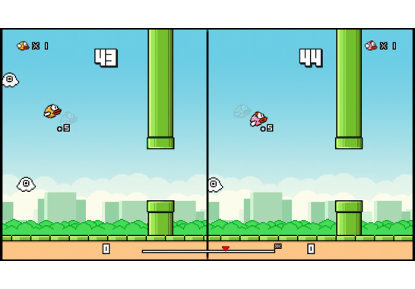
Flappy Bird: Power of Less
One Mechanic: Tap anywhere to flap. No tutorial, no skill trees.
Instant Mastery: Players understood stakes and gameplay in 3 seconds.
50M Users: Outperformed multi-million dollar complex game engines.

Slide 7
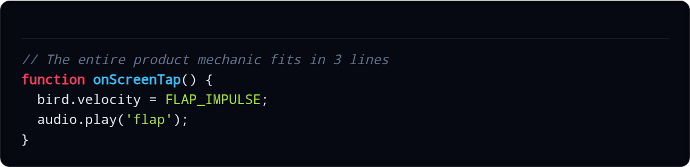
Code: The Flappy Core Loop
core-loop.js
True conviction fits into a single input handler.

Slide 8




Tactile vs Complex
Cookie Clicker
The Complex Trap
One target, instant tactile feedback, and zero onboarding friction.
Overloaded stats and menu systems that fragment user attention.

Slide 9

Zero Guarantees
0%
The Market Reality
Immaculate code and textbook interviews never guarantee traction. Execution is merely the price of admission.
Guaranteed Outcomes

Slide 10



Anchor to the Vision
Stick to Core
Move Fast
Nurture Weekly
Do not dilute your product to appease every voice in the room.
Momentum beats endless consensus and architectural paralysis.
Revisit the root problem statement every week as you build.

Slide 11

PRACTICE
Transform raw intuition into an unshakeable product core.

Slide 12

Workshop Playbook
01
02
03
04
Big Idea
Draft 4 Features
Force Rank
Peer Approval
Define your core product idea in one clear sentence.
List the initial four capabilities you want to build.
Rank items 1 to 4 and ruthlessly discard the bottom.
Pitch and vote on features that solve real friction.

