Slide 1
MARKET STALL ALLOCATION SYSTEM
Design and Implementation of a Public Service Database System Using MySQL
SDG 11 · SUSTAINABLE CITIES & COMMUNITIES
BBIT1201F • GROUP 1
Limkokwing University of Creative Technology, Sierra Leone

Slide 2
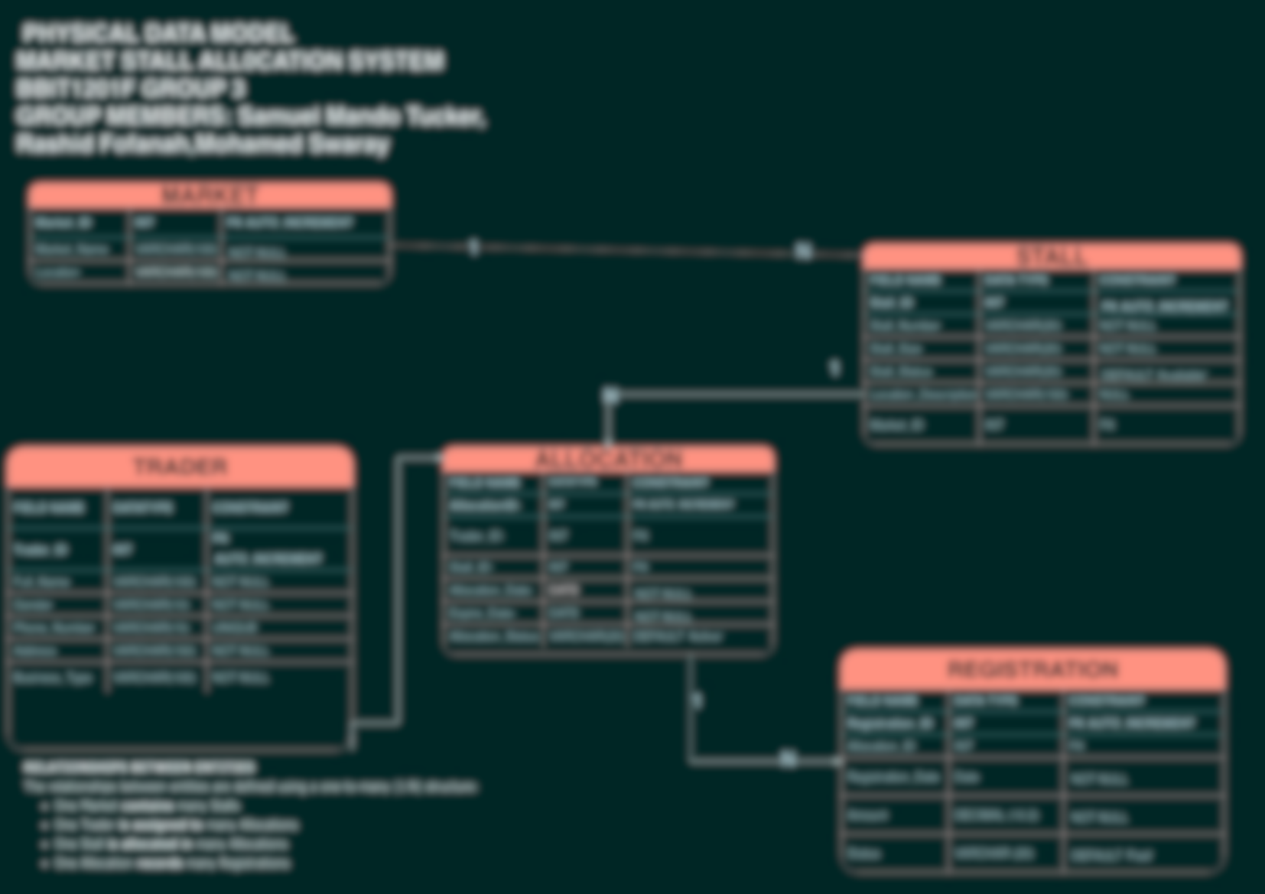
What We'll Cover
01
The Problem
Manual market record-keeping in Sierra Leone
BBIT1201F
02
Our Design
Refined Physical Data Model, five linked tables
03
Implementation
MySQL build, sample data & data manipulation
Querying & Security
Group 3
04
SQL reporting, JOINs & user management
COMP 102 — Introduction to Database
Final Project Presentation
05
Impact
Benefits, SDG alignment & conclusion
Market Stall Allocation System · SDG 11
BBIT1201F GROUP 3 | MARKET STALL ALLOCATION SYSTEM
2

Slide 3
The Challenge in Sierra Leonean Markets
Today: Manual Record-Keeping
Our Solution: A Relational Database
Misplaced paper records of traders and stalls
One central MySQL database for the whole market
Duplicate or conflicting stall allocations
Primary & foreign keys prevent duplicate allocations
Slow trader registration with no central record
Structured trader registration with unique IDs
No reliable way to track who owes registration fees
Instant SQL reports on payments & balances
Difficult, time-consuming administrative reporting
Role-based accounts protect sensitive data
BBIT1201F GROUP 3 | MARKET STALL ALLOCATION SYSTEM
3

Slide 4
RELEVANCE TO SUSTAINABLE DEVELOPMENT GOALS
SDG 11
How This System Helps
Promotes accountability in public resource management
Sustainable Cities
and Communities
Reduces corruption risk through auditable records
Markets are a primary source of livelihood for thousands of Sierra Leonean traders. A well-managed, transparent market is a foundation of a sustainable, inclusive community.
Supports transparent, data-driven local governance
Strengthens trust between traders and market authorities
BBIT1201F GROUP 3 | MARKET STALL ALLOCATION SYSTEM
4

Slide 5
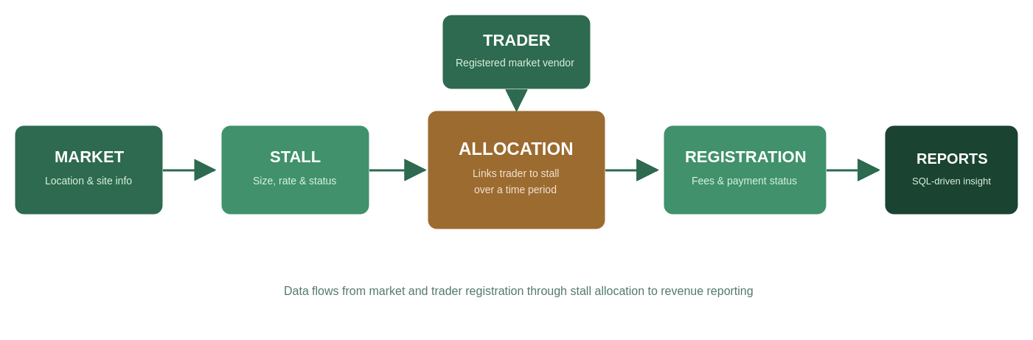
System Overview
How information flows through the Market Stall Allocation System
Register
Allocate
Collect
Report
Traders & markets
Stalls to traders
Registration fees
Via SQL queries
BBIT1201F GROUP 3 | MARKET STALL ALLOCATION SYSTEM
5

Slide 6
Refining the Physical Data Model
From five individual Assignment 1 designs to one agreed, group-refined model
1
2
3
4
Compare
Reconcile
Strengthen
Agree
Each member presented their individual CDM, LDM & PDM from Assignment 1
Resolved naming, data-type, and constraint inconsistencies across designs
Added UNIQUE, DEFAULT and explicit referential-action constraints
Finalised one refined Physical Data Model for implementation
BBIT1201F GROUP 3 | MARKET STALL ALLOCATION SYSTEM
6

Slide 7
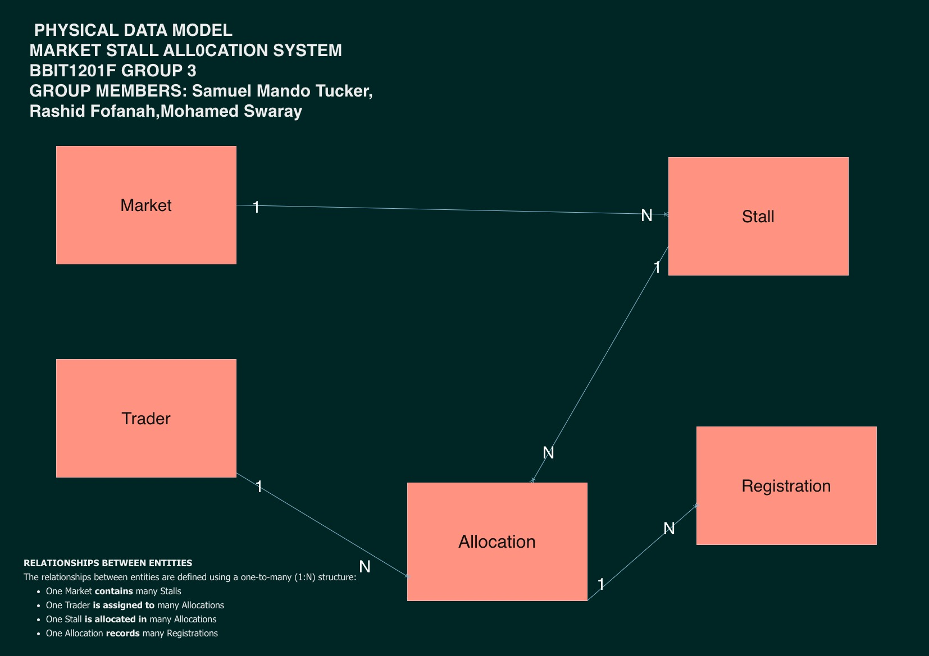
Conceptual Data Model (Assignment 1)
The high-level entity relationships that anchor the refined design
BBIT1201F GROUP 3 | MARKET STALL ALLOCATION SYSTEM
7

Slide 8
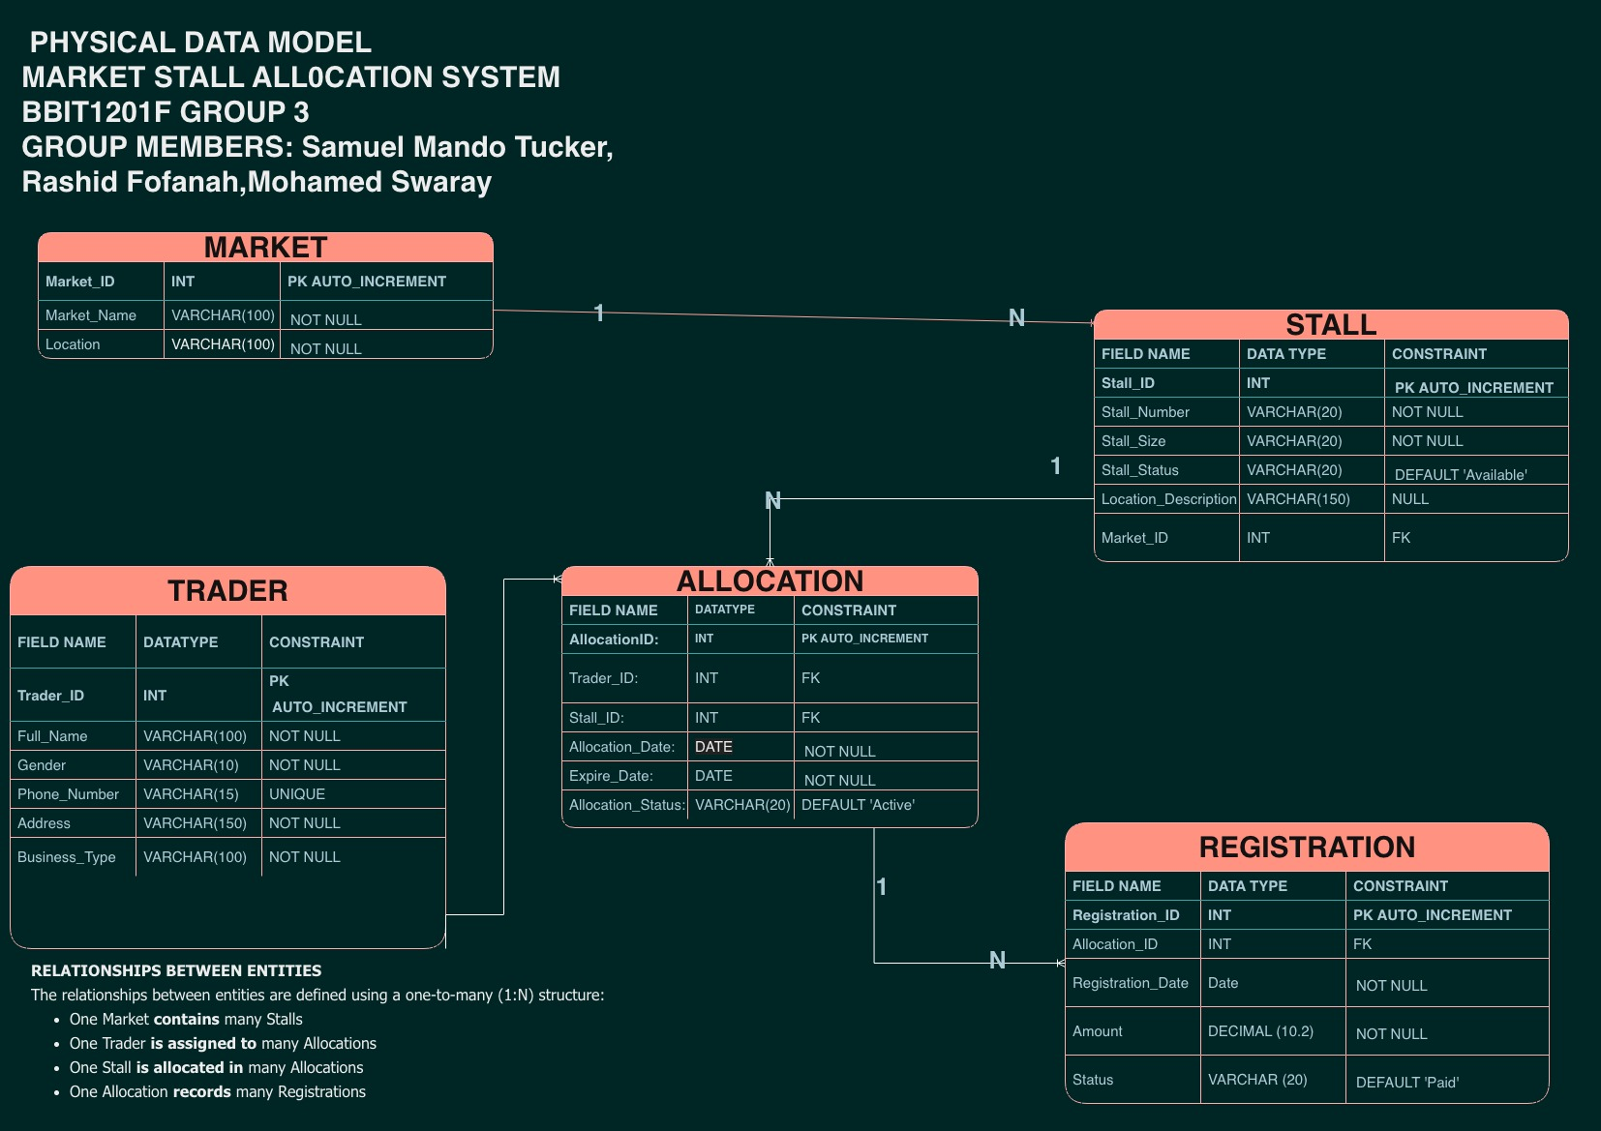
Refined Physical Data Model
Five tables, full key structure, agreed by the group for implementation
BBIT1201F GROUP 3 | MARKET STALL ALLOCATION SYSTEM
8

Slide 9
Five Tables, One Connected System
market_id, market_name, location, market_type, contact_phone
market
trader_id, full_name, phone_number, business_type, national_id
trader
stall_id, market_id (FK), stall_number, monthly_rate, status
stall
allocation_id, trader_id (FK), stall_id (FK), dates, status
allocation
registration_id, allocation_id (FK), amount, payment status
registration
BBIT1201F GROUP 3 | MARKET STALL ALLOCATION SYSTEM
9

Slide 10
Key Design Decisions
INT
VARCHAR
DATE
DECIMAL(10,2)
Primary keys
Text fields
Time fields
Money fields
AUTO_INCREMENT guarantees unique, automatic record identifiers
Flexible-length storage for names, addresses & status labels
Reliable storage for allocation, expiry & payment dates
Exact precision for stall rates & registration fees — no rounding errors
Constraints applied throughout: PRIMARY KEY · FOREIGN KEY · NOT NULL · UNIQUE · DEFAULT · ON UPDATE CASCADE / ON DELETE RESTRICT
BBIT1201F GROUP 3 | MARKET STALL ALLOCATION SYSTEM
10

Slide 11
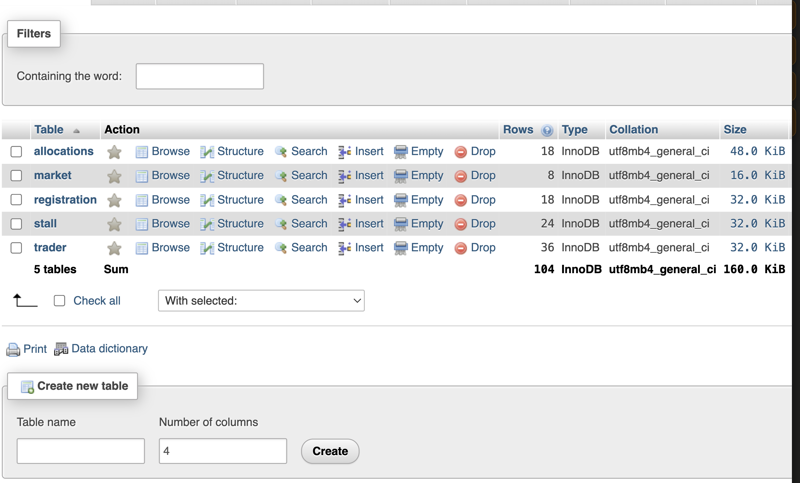
Database Implementation
Built in MySQL via phpMyAdmin / XAMPP
CREATE DATABASE market_stall_allocation_system;
USE market_stall_allocation_system;
11

Slide 12
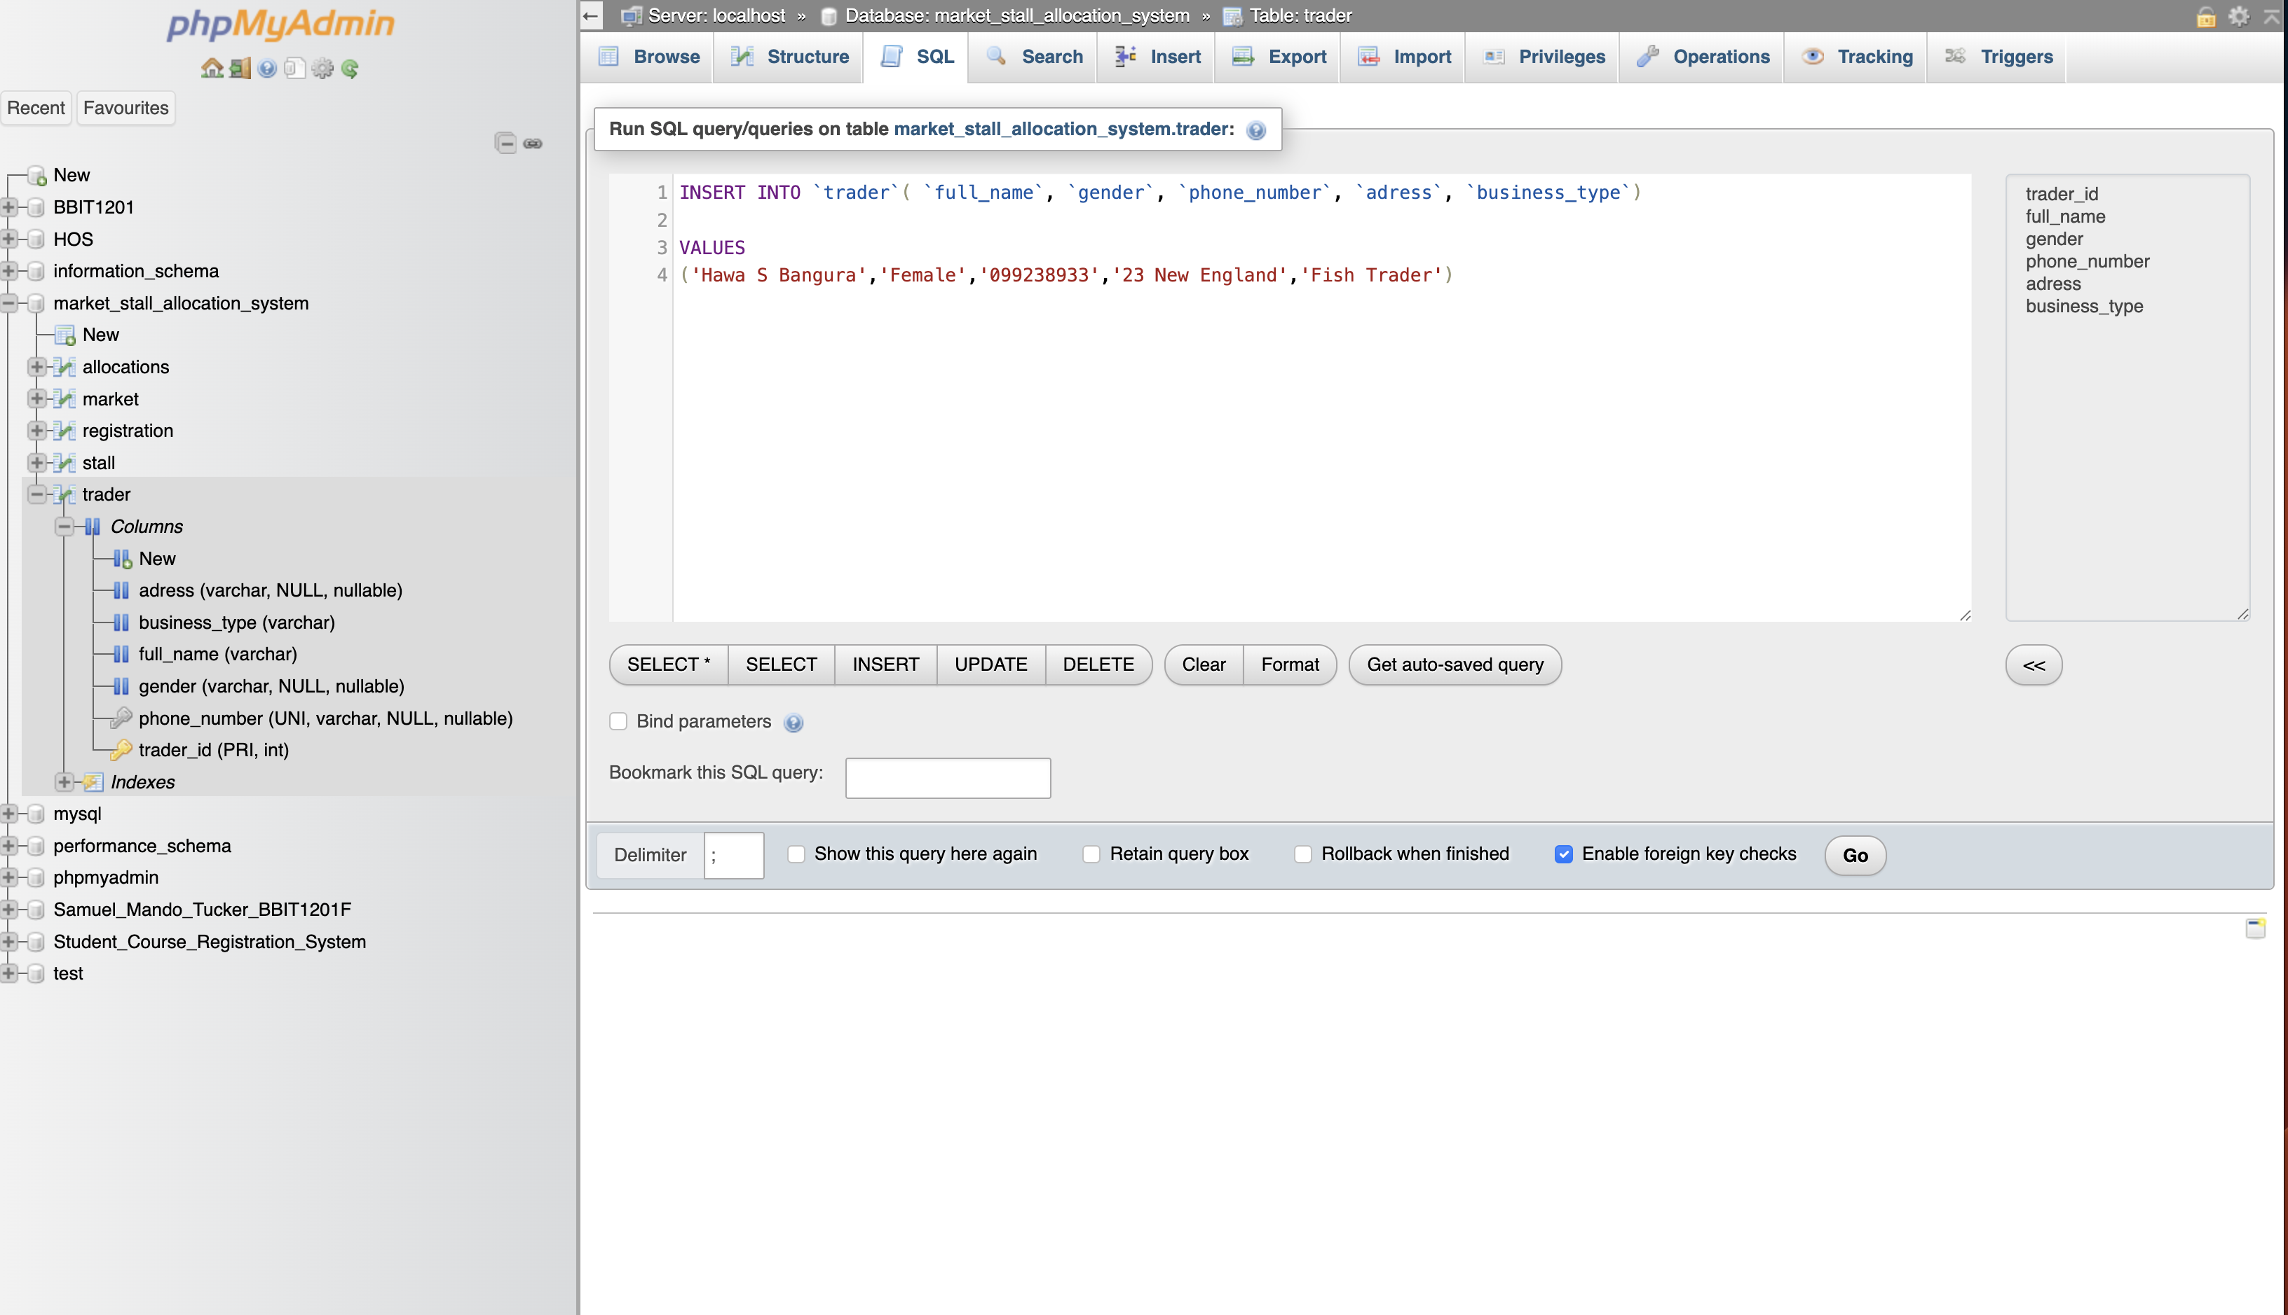
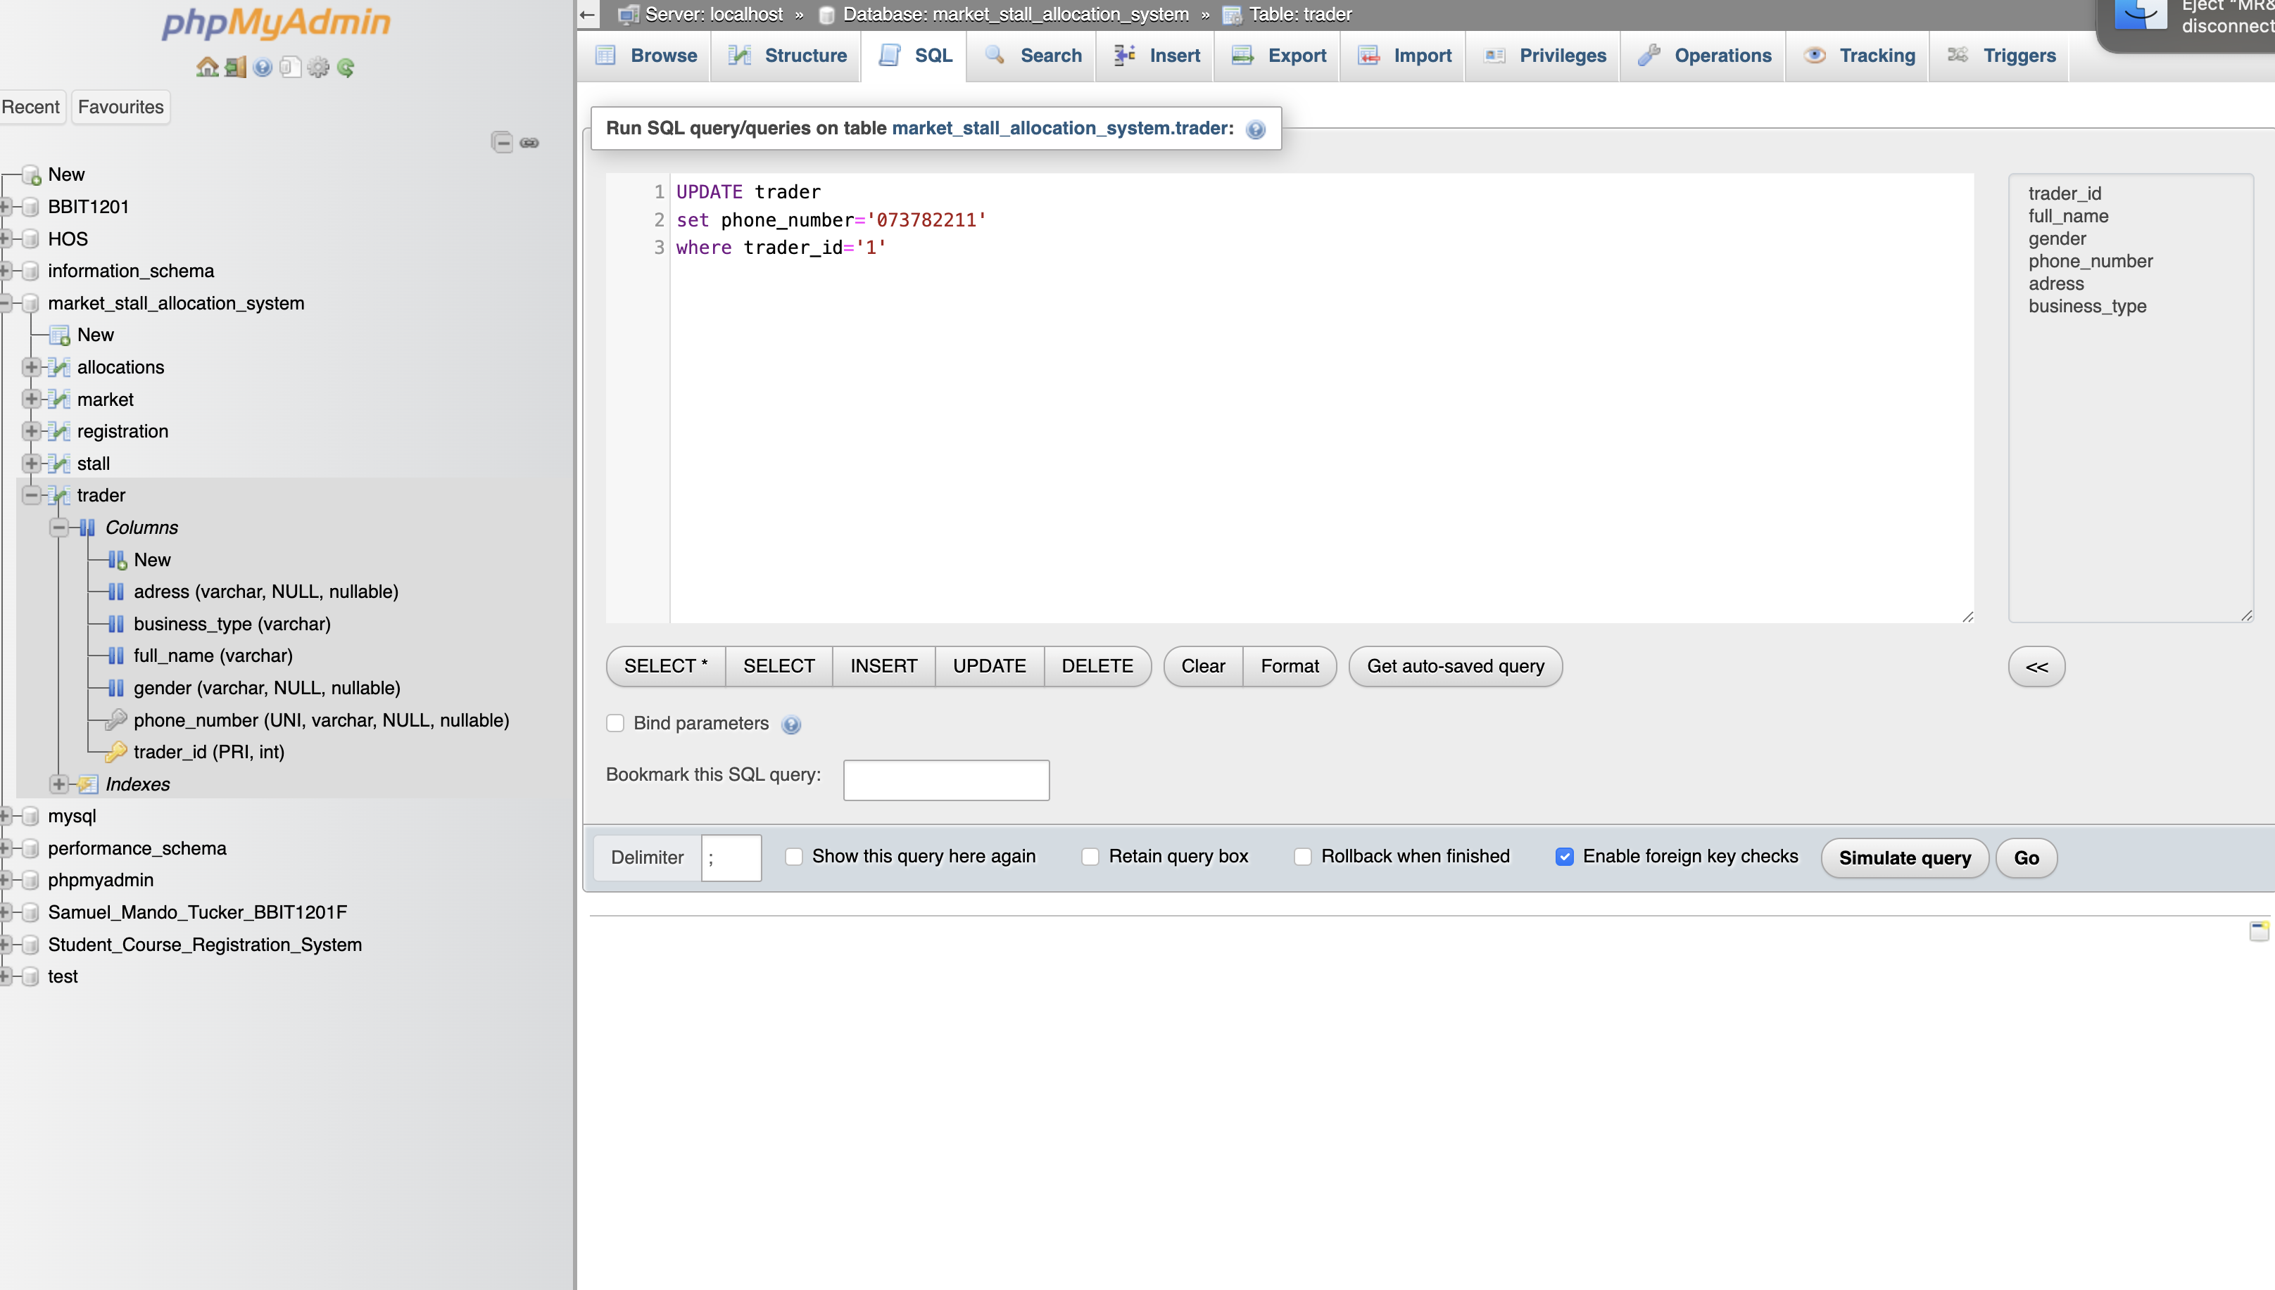
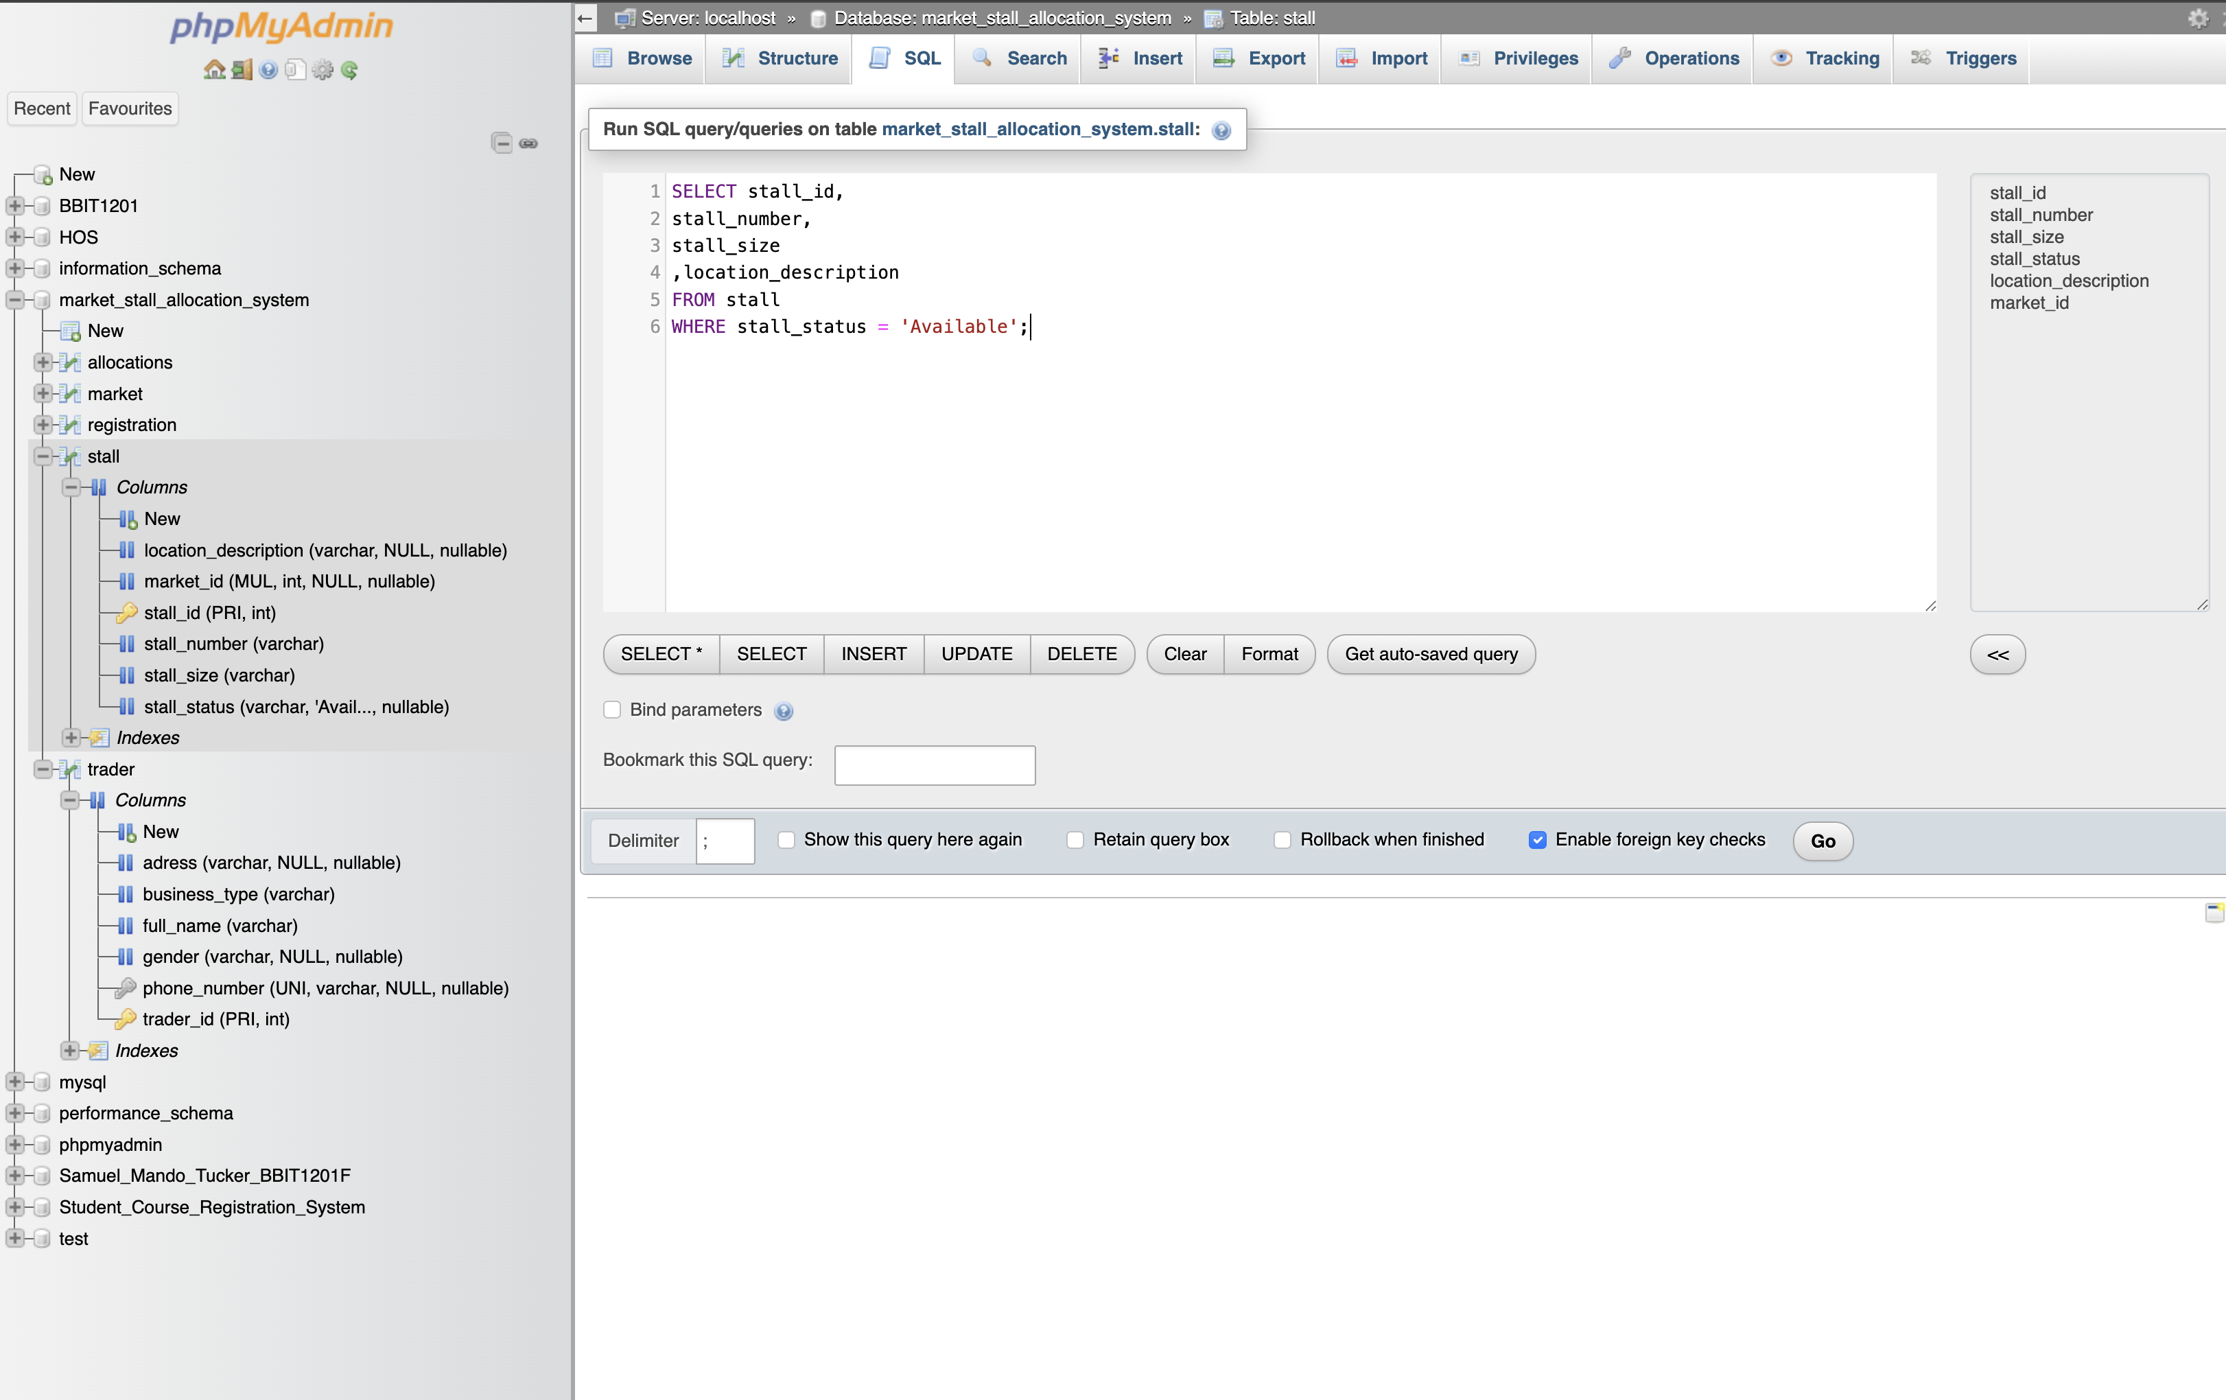
Data Manipulation
INSERT, UPDATE & DELETE demonstrated on live data
INSERT
UPDATE
DELETE
Add a new trader record
Correct a trader's phone number
Remove an erroneous expired record
INSERT INTO trader (full_name, phone_number, ...)
VALUES ('Tucker Samuel Doe', '079000111', ...);
UPDATE trader
SET phone_number = ' 073782211'
WHERE trader_id = 1;
DELETE FROM allocation
WHERE allocation_id = 17
AND allocation_status = 'Expired';
12

Slide 13
Querying the Database
Filtering, sorting, aggregating and limiting results for real reporting needs
SELECT
WHERE
ORDER BY
COUNT
All trader records
Available stalls only
Traders, alphabetically
Total registered traders
SUM
AVG
LIMIT
JOIN
Total registration revenue
Average stall rate per market
First 5 traders registered
Full cross-table allocation view
BBIT1201F GROUP 3 | MARKET STALL ALLOCATION SYSTEM
13

Slide 14
Featured Query: Full JOIN
Combining all five tables into one operational view
SELECT t.full_name AS trader_name, m.market_name AS market,
s.stall_number AS stall, a.allocation_status AS status,
a.allocation_date AS allocated_on
FROM allocation a
JOIN trader t ON a.trader_id = t.trader_id
JOIN stall s ON a.stall_id = s.stall_id
JOIN market m ON s.market_id = m.market_id
ORDER BY a.allocation_date DESC;
[ INSERT SCREENSHOT: Full JOIN Query Output ]
Trader, market, stall and allocation status combined in a single result set
BBIT1201F GROUP 3 | MARKET STALL ALLOCATION SYSTEM
14

Slide 15
User Management & Security
Role-based access for every group member
T
S
R
'Samuel’@’Samue123'
'Swaray’@’Swaray123'
'Rashid’@’Rashid23'
Full Privileges
Edit Access
Read Only
Project lead — complete administrative control
SELECT, INSERT, UPDATE — day-to-day data entry
SELECT only — reporting & presentation use
Why it matters: separate accounts make every change traceable, and least-privilege access limits the damage of any mistake or compromised login.
BBIT1201F GROUP 3 | MARKET STALL ALLOCATION SYSTEM
15

Slide 16
Benefits of the System
1
2
3
Faster Retrieval
No Duplicate Allocations
Reduced Redundancy
Instant access to trader & stall information
Foreign keys prevent conflicting assignments
Normalised tables eliminate repeated data
4
5
6
Reliable Reporting
Stronger Data Integrity
Better Decisions
SQL queries replace manual report compilation
Constraints enforce accurate, complete records
Real-time revenue & occupancy insight
BBIT1201F GROUP 3 | MARKET STALL ALLOCATION SYSTEM
16

Slide 17
CONCLUSION
A Practical Foundation for
Sustainable Market Management
This project translated a refined Physical Data Model into a fully working MySQL database — demonstrating primary and foreign keys, data manipulation, structured querying, and role-based security to solve a real administrative problem facing Sierra Leonean markets today.
Five tables · Full referential integrity · 10+ queries · Role-based access
Thank you

