Slide 1
Introduction to Website Development
Uploading to the Web Server

Slide 2
Web Server Login
Use the URL given in the email
Login with the username and password given in the email
Click the IT117 folder to open it
Click the upload button
Click browse to locate the index.html file on your computer
Select the index.html file
Upload
View your home (index.html) page via the URL given in your email

Slide 3
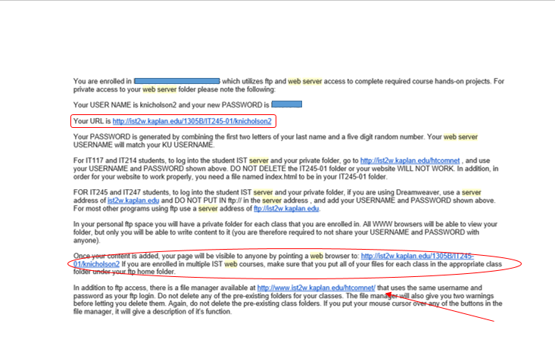
Web Server Access
Accessing your Web Server space
You will receive an email
Email will be sent to your email address
Read carefully
Different URLs for viewing page and uploading files

Slide 4
Web Server Login
Testing your Web Server space
Log in and locate the IT117 folder
Must upload page into IT117 folder

Slide 5
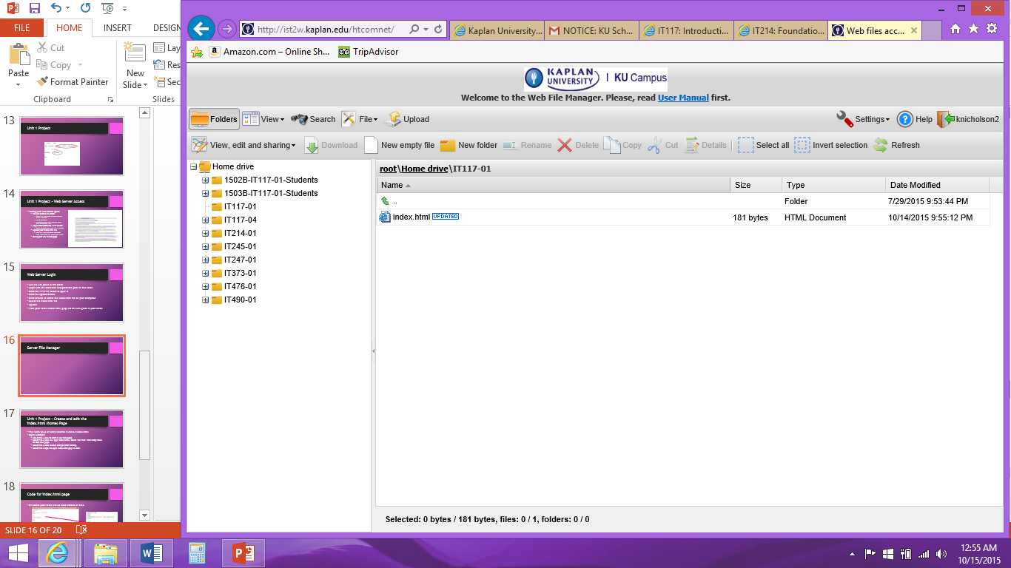
Server File Manager
Make sure you click the
IT117 folder to open it
before you upload

Slide 6
Server File Manager
Check the top bar to
ensure IT117-0x appears to
verify the folder is open

Slide 7
Server File Manager
Click the upload
button to upload
your page

Slide 8
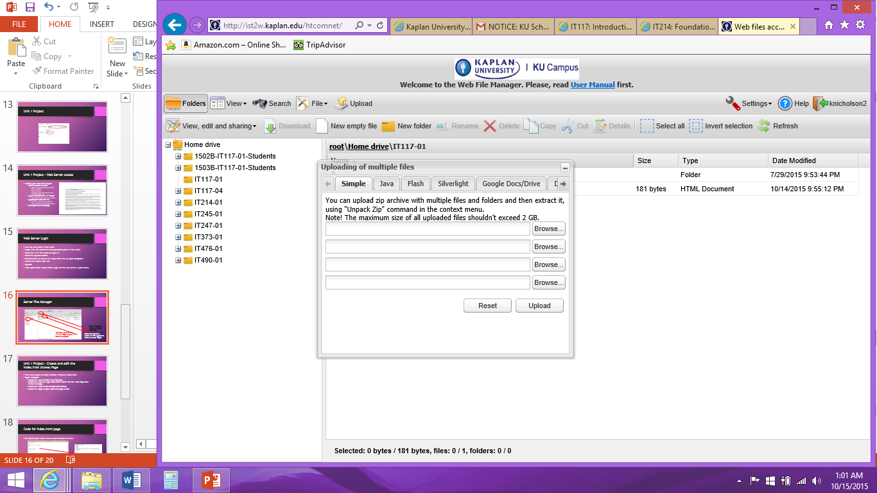
Upload Using the File Manager
Once you click the upload button, you be able to
Select HTML files from your computer to upload.

Slide 9
Uploaded index.html Page
Your uploaded pages will be listed
here with the file path above
(root\Home drive\IT117-0x).

Slide 10
Web Server Testing
Testing your Web Server space
Upload your index.html file
URL will give an error message until you have an index.html page
Go to your URL to test page

Slide 11
Page URLs
The URL given in the email points to your index.html page.
To view other pages, you need to add the page name on to the end of the original URL.
For example:
URL given in email: http://ist2w.Kaplan.edu/1602B/IT117-04/UserName/
URL for uploaded page named menu.html: http://ist2w.Kaplan.edu/1602B/IT117-04/UserName/menu.html

