Slide 1
C382 Final Project Team 1
Christopher Bueno, Ernaldo Kalaja, Claire Murray, Wen Xie, Winston Yue

Slide 2
ForexSphere
Simplifying Global Transactions
WY
ForexSphere is a currency exchange application that provides an intuitive platform for users to access real time exchange rates and perform currency exchanges. Developed with a focus on ease of use, it leverages a full stack Spring MVC architecture and software development best practices.
Key Features
Real-time currency exchange rates
Currency exchange operations
User specific exchange history tracker
Immediate exchange value calculations
Follows RESTful principles for API design

Slide 3
Tech Stack
WY
Database : Wen
MySQL
JDBCTemplate
Middle Java tier: Christopher, Ernaldo, Winston
SpringBoot
Spring DI
Frontend: Claire
React
JavaScript
Bootstrap

Slide 4
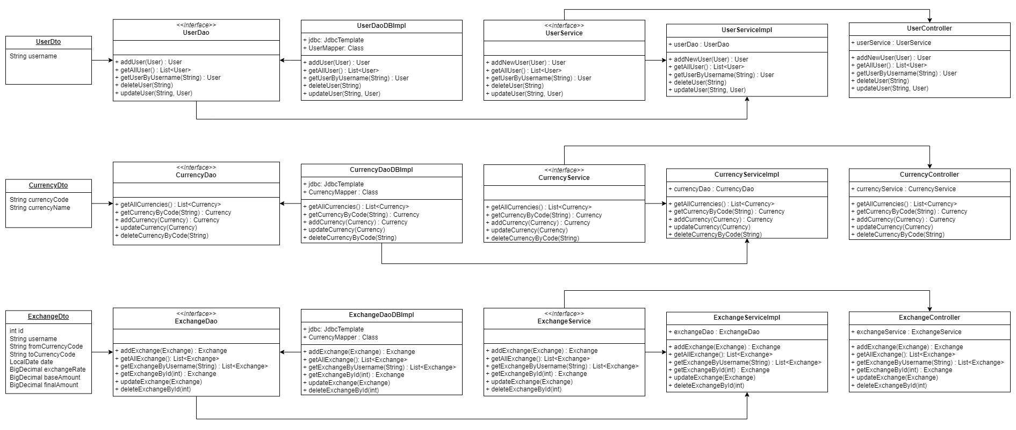
Architecture
WX
Notes:
We used 3 DTOs: User, Currency and Exchange, to transfer data between layers, and represented the structure of data exchanged within the application.
And the 3 DAOs are responsible for interacting with the database and performing CRUD operations on database entities.
The service layers orchestrates data access and manipulations and acts as an intermediary between the controller and DAO layers.
Finally, the controllers, which handles incoming HTTP requests and maps requests to appropriate service methods.

Slide 5
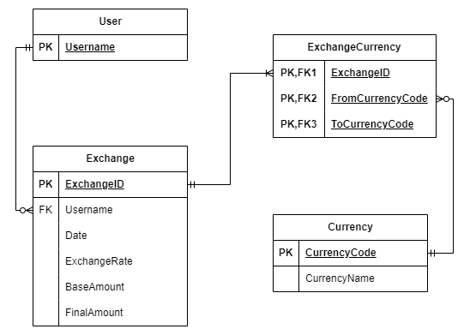
Database
WX
Notes:
Here is our ER diagram.
Let’s start with the User table. The Users table has a single field, username, which is defined as the Primary Key, to ensuring each user has a unique username.
Next, we have the Currency table. This table holds information about various currencies supported by our application. The currencyCode field is defined as the Primary Key, which matches with the currency code of the third party api.
Then, the Exchanges table. This table records information about currency exchange transactions.It consists of several fields with ExchangeId as the Primary Key, and Username as the foreign key from the User table.
Alongside our main tables, we have a bridge table: ExchangeCurrency. This table acts as a bridge between exchange transactions recorded in the Exchanges table and the currencies participating in those transactions. The three fields form a composite Primary Key, ensuring each currency pair within an exchange transaction is unique.

Slide 6
DAOs
WX
Encapsulate the logic for interacting with the database
UserDao
CurrencyDao
ExchangeDao
Notes:
In this project, the DAOs encapsulate the logic for interacting with the database, including querying, inserting, updating, and deleting data.
The UserDao handles user-related operations, such as user management and retrieval and enables us to add new users, retrieve all users, get users by username, delete users, and update usernames.
With CurrencyDao, we can retrieve all currencies, add new currencies, update existing ones, and get or delete currencies by their code.
Similarly with the ExchangeDao, we can add, update, get and delete exchanges using exchangdId.
And now, I will pass to Christopher to talk about the functionalities of our service layers.

Slide 7
Service Layers
CB
3 Services to Communicate with the 3 Daos
User, Exchange, Currency
Business logic implementation
User Input
Error handling
Currency Service- Fetched exchange rates from API.

Slide 8
Controllers
CB
3 Controllers- User Controller, Exchange Controller, and Currency Controller
Receive requests, Interpret requests, Processes requests, Generates responses
Springboot Mapping Annotations

Slide 9
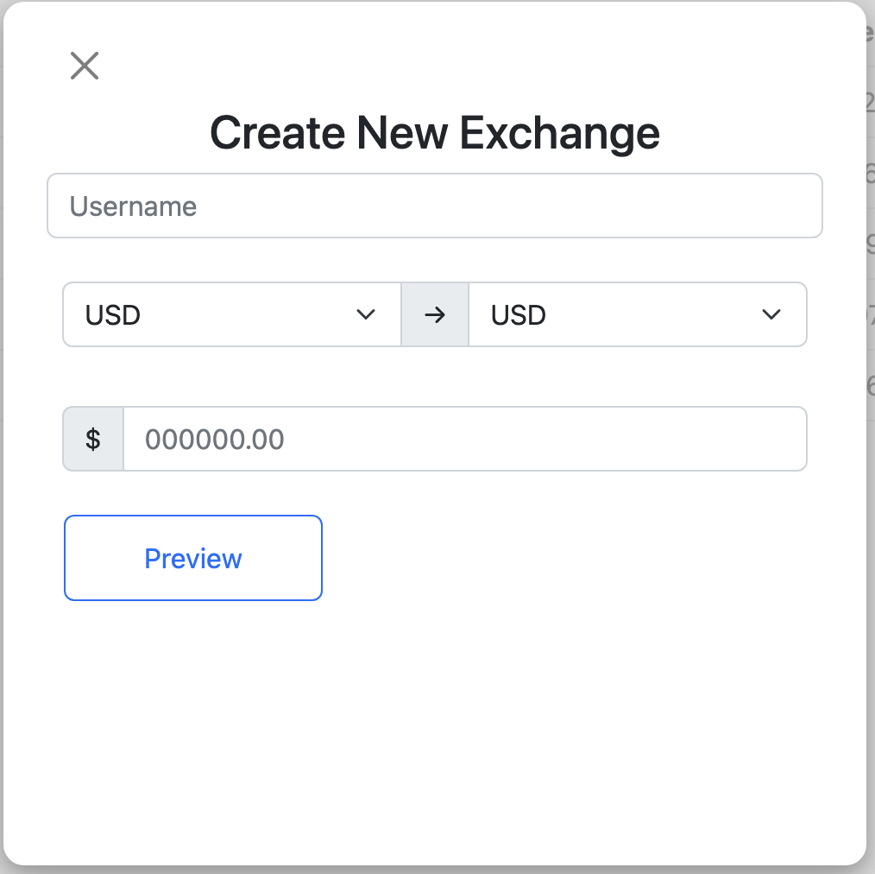
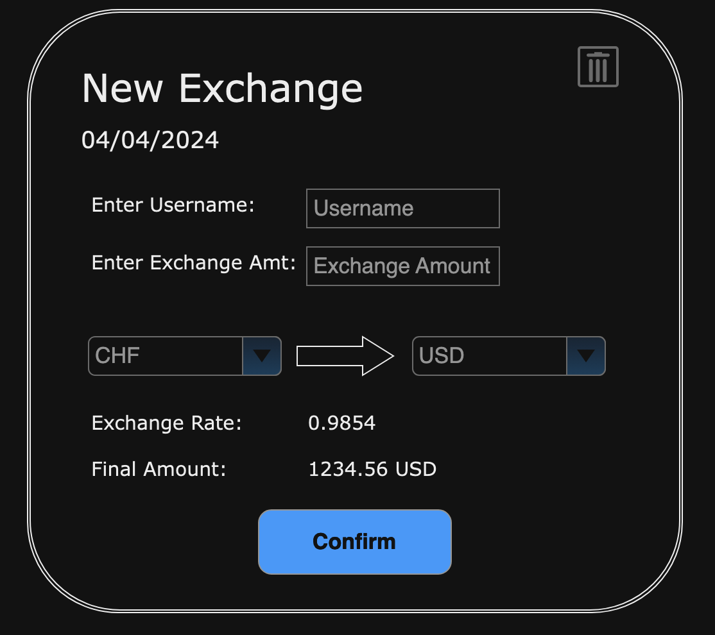
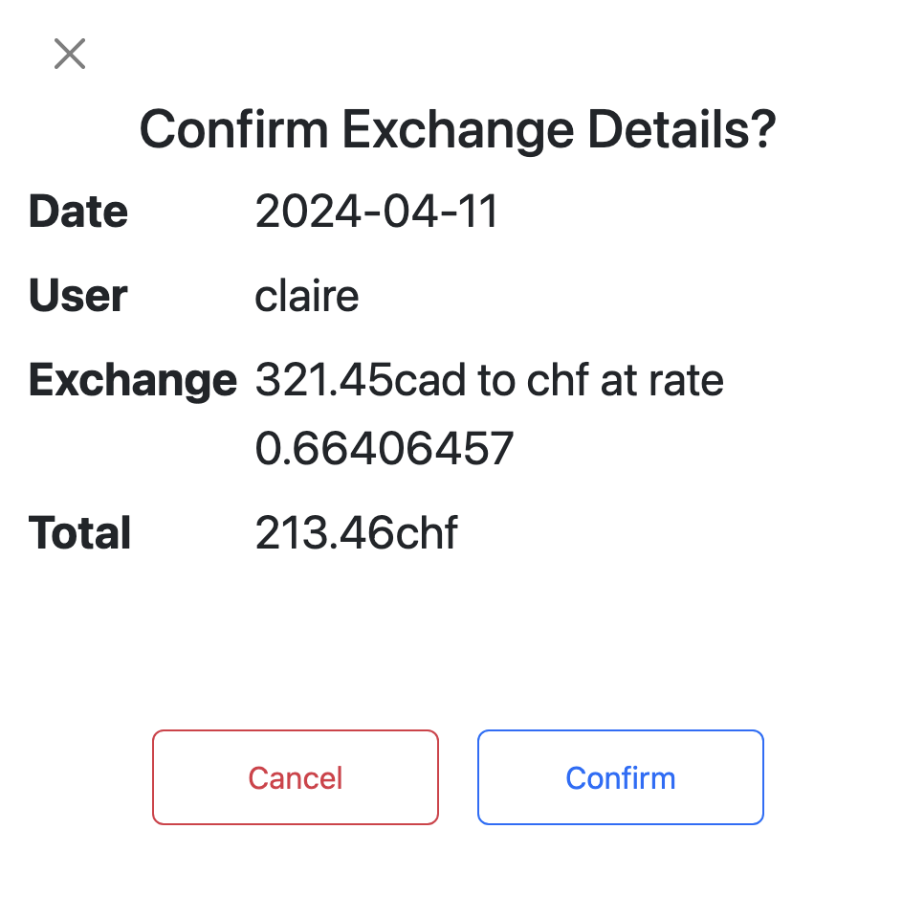
Demo
CM
Simple UI Concept
Fast and Responsive
Easy styling via BootStrap

Slide 10
Challenges and Learning Opportunities
EK
Initial Project Scope
Missed some potential use cases / requirements during initial planning
Had to be flexible with the plan to allow for a complete final product
Collaboration
Ran into some initial trouble working out of the same repository
Used Git branching and pull requests to manage code changes
React Frontend
Experienced some delays when dealing with learning new technologies
Able to seek external assistance to resolve roadblocks

Slide 11
Model 2.0
EK
Login control, using password
Expanded dashboard
Show balance for each currency of an user
Business rules to restrict exchanges based on user balances
Expand currency support on frontend

Slide 12
Q&A

Slide 13
Thank You
Project Description………2-3
Architecture………………4
Database…………………5
Middle Tier……………….6-7
Frontend………………….8
Retrospective……………9-10

