Slide 1
SPARELINE
A rescue must work for both routes.
DATANOVA 2026 / DN-OR-01
DELAYED ROUTE
When a delivery route
falls behind, know
exactly what to move.
SYNCHRONIZED
HANDOFF
A dispatch decision tool for late-route recovery.
HELPER ROUTE
WORKING PRODUCT • SPARELINE-STEEL.VERCEL.APP
SPARELINE / DATANOVA 2026
HISTORICAL ROUTES • SIMULATED DISRUPTIONS
01

Slide 2
01 / PROBLEM
The hard decision starts after the plan fails.
One van is running late. Another driver could help, but the wrong rescue spreads the delay to a second route.
01
02
03
A route slips
Someone offers to help
The dispatcher decides
Unexpected delay changes the remaining arrival times.
A second van has its own parcels, limits and commitments.
Which packages move, where do drivers meet, and who becomes late?
The question:
Can a rescue save the late route without breaking the helping route?
Problem anchor: public accounts from delivery drivers sent on rescues, and delivery-operations research. Not customer interviews.
SPARELINE / DATANOVA 2026
PROBLEM & USER
02

Slide 3
02 / WHY IT IS DIFFICULT
Rescue is a two-route decision.
Moving a parcel only helps if two vehicles can meet and still finish feasible schedules.
01
Capacity
DONOR VEHICLE
Can the helper actually carry the transferred load?
02
Timing
MEETING POINT
Can both vans arrive at the same place?
03
Windows
Do customers still get parcels inside their delivery window?
04
Side effects
Does the helper now miss its own deliveries?
HELPER VEHICLE
Diagram is illustrative. In the product, meeting time, handoff duration and both revised routes are calculated by the solver.
SPARELINE / DATANOVA 2026
RESCUE CONSTRAINTS
03

Slide 4
03 / SOLUTION
One rescue recommendation. All consequences visible.
Spareline turns a route disruption into an actionable, checkable handoff plan.
INPUT
OPTIMIZE
OUTPUT
01
02
03
Identify risk
Evaluate transfers
Issue instructions
→
→
Replay each van to now, apply the delay, and find the stops that will miss a window or the end of the shift.
Try each helper van, meeting point and group of stops. Check van space and both new routes.
Compare with doing nothing and with the nearest van, then export both drivers’ new stop lists.
It can also return “no safe rescue” or “low confidence”: it withheld a transfer in 280 of 354 at-risk evaluation scenarios.
SPARELINE / DATANOVA 2026
PRODUCT MECHANISM
04

Slide 5
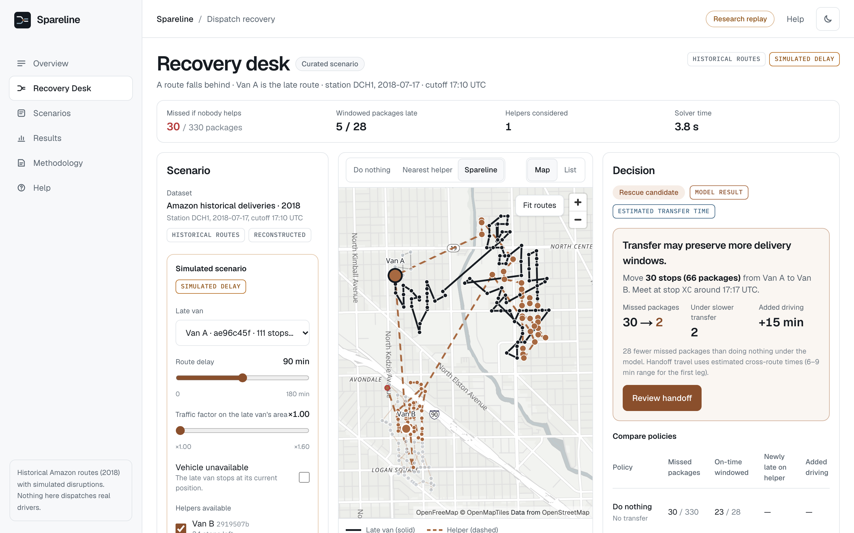
04 / PRODUCT EXPERIENCE
Designed for the dispatcher’s next action.
An operations desk, not a chatbot. The live optimization result drives every status and instruction.
REAL CAPTURE • spareline-steel.vercel.app • SCENARIO A
01
Map and decision from one run
Donor solid, helper dashed, meeting point and moved stops marked; stop table as fallback.
02
Three policies side by side
Doing nothing, nearest van and Spareline, with run ID and data source.
03
Labelled provenance
Historical, reconstructed, simulated, estimated and model results are tagged.
SPARELINE / DATANOVA 2026
RECOVERY DESK
05

Slide 6
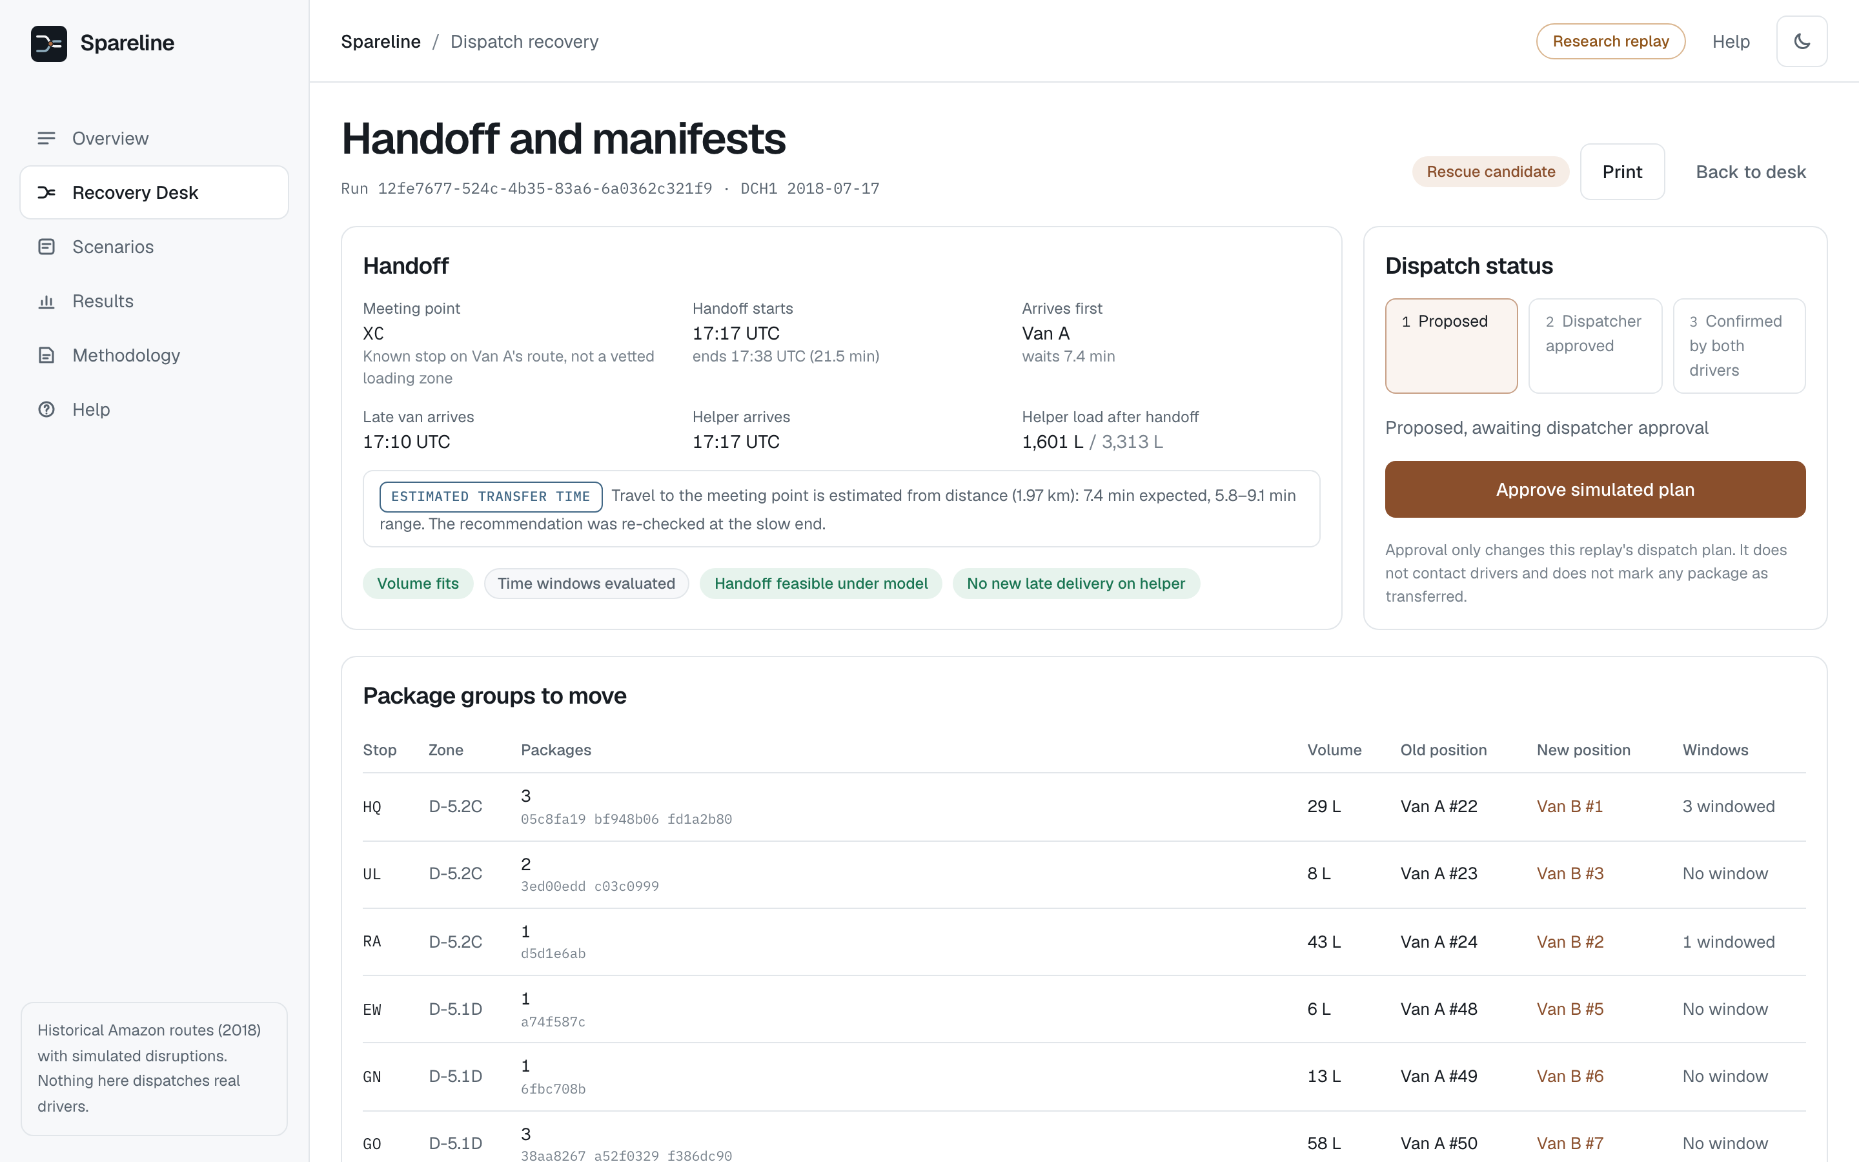
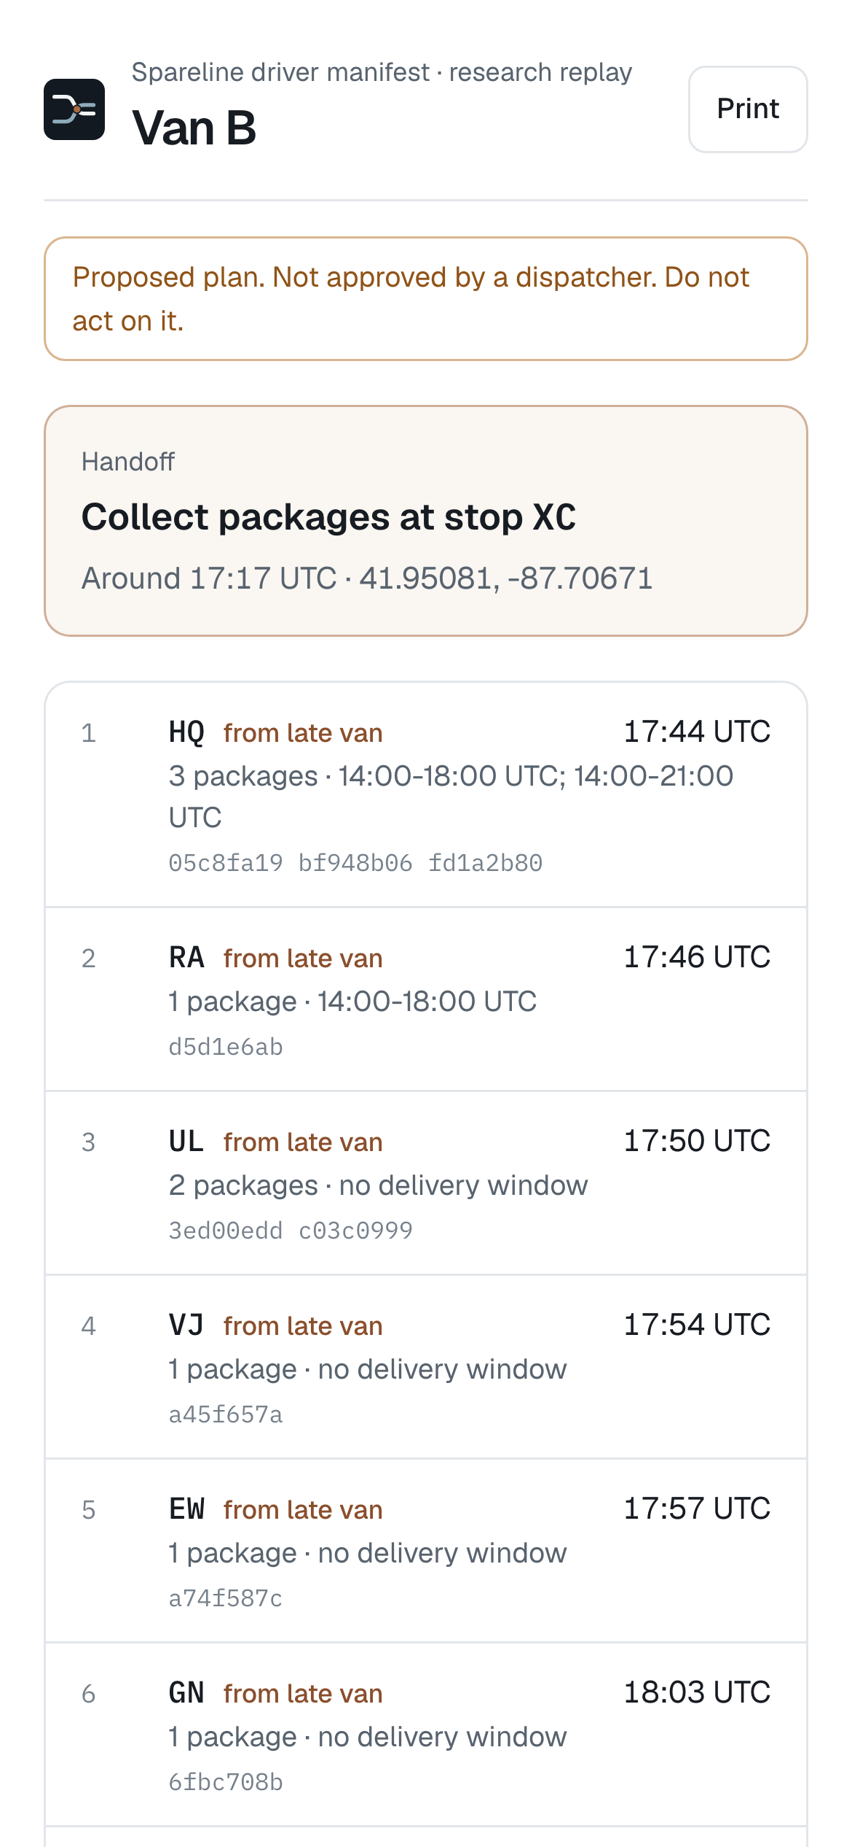
05 / LIVE WALKTHROUGH
Inside one recommended rescue.
Scenario A in production: what the dispatcher approves and what the helper driver receives.
Meet at stop XC
Van A arrives first and waits; the handoff takes 21.5 min for 66 parcels.
30 stops move
Missed packages: 30 → 2. The helper gains no missed package.
Two-step sign-off
Dispatcher approves, then both drivers confirm. Only then is anything marked transferred.
SPARELINE / DATANOVA 2026
HANDOFF & DRIVER MANIFEST
06

Slide 7
06 / DATA FOUNDATION
Real historical routes. Explicitly simulated disruptions.
The source data is not a recording of vehicle failures, live GPS or actual rescue operations.
397
Observed in the dataset
Stops, packages, time windows, capacity, recorded sequence and within-route travel times. Only 7.1% of packages carry a window; service time repeats per package, so a stop takes the max.
historical routes used, in 160 groups
Constructed for evaluation
54,405 stop records · 94,229 packages
Same-depot, same-day groups of 2–4 routes; van progress reconstructed from each route’s own matrix; between-route travel estimated (held-out MAE 60 s, q10–q90 coverage 81.1%).
Amazon / MIT Last Mile Routing Research
Challenge, evaluation split (9,184 routes
published in total)
Simulated on purpose
Delays, area slowdowns and van failures, labelled wherever shown. 60-min shift limit and handoff time are declared assumptions.
2018 · RESEARCH DATA
Source: registry.opendata.aws/amazon-last-mile-challenges/ (evaluation split, downloaded 2026-11-10) • CC BY-NC 4.0; research use, not unrestricted commercial reuse.
SPARELINE / DATANOVA 2026
DATA & PROVENANCE
07

Slide 8
07 / TECHNICAL APPROACH
A feasible plan is better than a confident guess.
A real optimization engine determines what can move, when vehicles can meet and what happens afterwards.
01
02
03
04
05
RECONSTRUCT
→
GENERATE
→
SOLVE
→
VERIFY
→
DECIDE
Replay to cutoff
+ simulated shock
Helpers × meeting
points × stop groups
OR-Tools re-sequence
+ synchronized handoff
Invariant checker
+ q90 travel re-check
Recommend, no safe
rescue, low confidence
Optimization core
Both vans must reach the same stop location; the handoff starts when the later one arrives and lasts 5 min + 15 s per parcel. OR-Tools re-sequences the helper with soft window and shift penalties while a rank dimension keeps its own stops in observed order. An independent checker verifies conservation, capacity, synchronized arrival and forward time, then every cross-route leg is re-timed at its q90 estimate.
Objective: fewest missed packages on all vans → no new helper misses → fewest late minutes → least added driving and waiting.
SPARELINE / DATANOVA 2026
OPTIMIZATION ENGINE
08

Slide 9
08 / ENGINEERING
Built, deployed and tested end to end.
What runs behind the demo, and how we know it works.
Browser
Next.js app on Vercel, deployed with the CLI. Map, decision, manifests, results.
34
backend tests pass: data parsing, time zones, solver invariants, baselines, API flow, bad input
API
FastAPI on our VPS in its own Docker project. Solver runs in worker processes; repeat requests reuse the same run.
24
browser tests pass on the live site at 1440, 1024, 768 and 390 px
Solver
Python + Google OR-Tools. Independent invariant checker on every plan.
0
invariant violations in 456 evaluated plans
Data
Postgres with versioned migrations: routes, stops, packages, travel matrices, runs, approvals, evaluation rows.
409
returned for a second approval, a stale revision or an export before approval
Approval state is kept per browser session, so judges never see each other’s changes. Rate limits, input validation and CORS are on.
SPARELINE / DATANOVA 2026
ARCHITECTURE & QUALITY
09

Slide 10
09 / EVALUATION METHOD
Same scenario. Three policies. Both vehicles scored.
The test is built to find where the rescue fails, not to produce a nice win rate.
01
02
03
Do nothing
Nearest feasible helper
Spareline
Every van keeps its remaining observed order under the same disruption.
Closest van takes every at-risk stop at the late van’s position by cheapest insertion; must fit capacity and shift.
Optimize helper, meeting point, moved stops and order together; abstain when unsafe or uncertain.
456 predeclared scenarios, 114 held-out groups, 17 depots
4 shocks per group: 75 / 105 min delay, 1.6× slowdown, van failure; seed 2026
Measured: missed (late window or past shift), on-time windowed, helper harm
Also: added drive and wait minutes, solver latency, abstentions, invariant errors
Config fixed before the run (evaluations/config.json); 46 development groups used only for tuning and demo scenarios. Identical records, shocks, travel model and scoring for all policies; denominators and misses published.
SPARELINE / DATANOVA 2026
EXPERIMENTAL DESIGN
10

Slide 11
10 / JUDGE EXPERIENCE
Three scenarios. Three meaningful decisions.
Verified on the deployed application 2026-11-10. Each card is a live solver run; IDs shown for reproduction.
A rescue can help
Recommended. Missed packages: 30 doing nothing, 19 nearest van, 2 Spareline. 30 stops move; helper gains 0 misses.
A
DCH1, 2018-07-17 · 2 vans · donor 90 min behind (simulated)
scenario 8185981a · run 12fe7677
A rescue can hurt
No safe rescue. Every transfer that helps the late van makes the helper late (HELPER_WOULD_BE_LATE).
B
DLA3, 2018-09-13 · 2 vans · donor 90 min behind (simulated)
scenario d711b3d2 · run 6c66370c
No safe rescue exists
Low confidence. A transfer helps on mean travel but not with cross-route legs at q90; nothing is recommended.
C
DSE4, 2018-07-05 · 2 vans · donor 90 min behind (simulated)
scenario 17d3d1ff · run 12abbae1
Demo scenarios come from development groups and are not part of the aggregate results. Plans are advisory until a dispatcher approves and both drivers confirm.
SPARELINE / DATANOVA 2026
VERIFIED IN PRODUCTION
11

Slide 12
11 / RESULTS
What happened, including the misses.
Replay estimates under simulated disruptions · 456 scenarios on 114 held-out groups · eval_20261110T185425Z_21dfd2fe.
MEASURE
DO NOTHING
NEAREST VAN
SPARELINE
DENOMINATOR
Missed packages, all vans
24,474
24,889
23,593
195,279 remaining
Same, cross-route legs at q90
25,145
23,713
same cohort
On-time windowed packages
12,165
12,090
12,200
13,894 windowed
Helper packages newly missed (q90)
14 (129)
0 (0)
donor + helper scored
Better / tied / worse vs doing nothing
74 / 382 / 0
456 scenarios
Better / tied / worse vs nearest van
102 / 350 / 4
456 scenarios
881
missed packages avoided vs doing nothing; mean 1.932/scenario, 95% CI 1.474–2.434
74
rescues recommended; 280 of 354 at-risk scenarios abstained (76 low confidence)
3.65 s
p95 solver time (mean 1.87 s); 0 invariant violations, 0 errors
Misses: the nearest van beat Spareline in 4 scenarios; in 2 it stayed ahead at q90, where the strict helper rule or calibrated-range rule withheld a transfer. Most misses come from the 60-min shift-limit assumption. Not field performance.
SPARELINE / DATANOVA 2026
MEASURED, WITH DENOMINATORS
12

Slide 13
12 / ADOPTION PATH
Built for a narrow, practical dispatch decision.
A research prototype can be useful before it is proven ready for live fleet operations.
Today: controlled research
Deployed replay of historical routes with clearly marked artificial disruptions, checkable outputs and published misses.
Next: operator pilot
With consent, compare recommendations against actual multi-vehicle telemetry and dispatcher outcomes.
Then: operational rollout
Add licensed fleet data, verified cross-route travel, human-confirmed transfers and monitored decision quality.
Known limits: obfuscated coordinates • no observed cross-route transfers • reconstructed, not GPS, progress • simulated shocks • assumed shift limit • no field validation • noncommercial licence
SPARELINE / DATANOVA 2026
FEASIBILITY & LIMITATIONS
13

Slide 14

SPARELINE
Try the rescue decision.
The live demo runs the complete route-recovery loop: scenario, solver, decision, approval and manifests.
01
Open Scenarios and run A, B or C
02
Change the disruption and recalculate
03
Approve, confirm both drivers, export
Working demo URL
https://spareline-steel.vercel.app
Methodology: spareline-steel.vercel.app/app/methodology · Results: /app/results
Team: to be confirmed by project owner
Research: Amazon/MIT Last Mile Routing Research Challenge (CC BY-NC 4.0), Merchán et al., Transportation Science 2022 • Google OR-Tools
SPARELINE / DATANOVA 2026
LIVE LINKS
14

