Slide 1
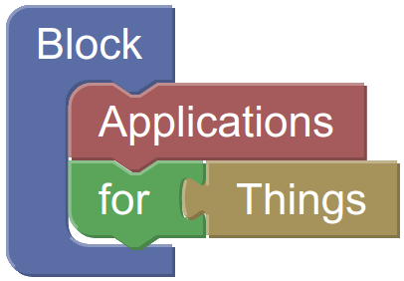
Designing Automations with BLAST
Andreas Harth
With Thomas Wehr, Christian Fleiner, Zhou Gui, Michael Freund, Yongxu Ren, Tobias Berner
December 2021

Slide 2
Describing and Executing System Behaviour
Goal: describe the behaviour of systems involving devices (sensors and actuators) and execute the behaviour
Example: smart doorbell for new parents
If button pressed, then ring the bell
But not between 13:00 to 15:00 when the baby sleeps
Then, if button pressed, then blink a light
Ideally, the smart doorbell automation can be shared

Slide 3
Democratising Programming
The automations should access devices (“things”) and online services
Common interfaces to devices and online services
Casual users should be empowered to design automations
Easy to use programming paradigm
Based on the Web of Things abstraction to devices…
…we consider the following programming paradigms:
Event-Condition-Action Rules
Dataflows and Reactive Programming
Processes and Workflows
And finally present BLAST (Block Applications for Things)

Slide 4
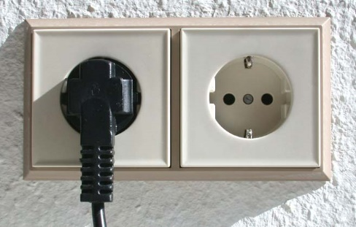




Providing Common Interfaces
There are many protocols to interact with devices
Biblical story: everybody speaks, nobody understands
High integration effort (for each device or online service)
Idea: a common abstraction to devices
W3C Web of Things abstraction: Things, Properties, Actions, Events
Data propagation via push or pull model or both
Device-level protocols: Bluetooth Low Energy (BLE), Universal Serial Bus (USB)
Idea: a common abstract to online services
Online services accessible via REST Application Programming Interfaces (APIs)
Data propagation via pull model
Application-layer protocol: Hypertext Transfer Protocol (HTTP)

Slide 5
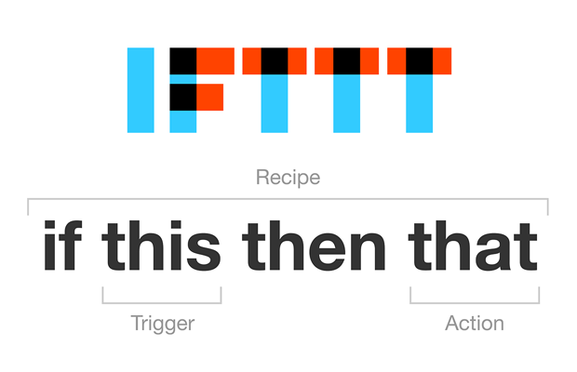
Paradigm 1: Event-Condition-Action Rules
E.g., If-this-then-that (ifttt.com), Stanford Genie (“when something if something, do something”)
Simple programs (“recipe”) that consist of a single rule
A rule consists of a trigger (equivalent of WoT read property, WoT event) and an action (equivalent of WoT write property, WoT action)
Execution in the cloud platform of IFTT

Slide 6
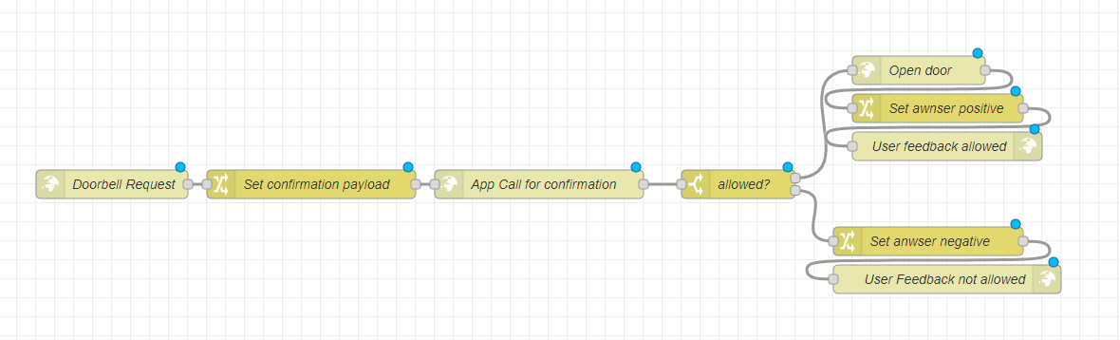
Paradigm 2: Dataflows and Reactive Programming
E.g., Node-RED, Apache Beam, Apache Flink, Apache Spark
View computer programs not as functions/operations that produce some output for some inputs and then terminate
But rather as long-running applications that react to events
Represent programs (“flows”) as graph (directed, acyclic) of operations, with data flowing between operations
Execution in the Node-RED execution engine

Slide 7
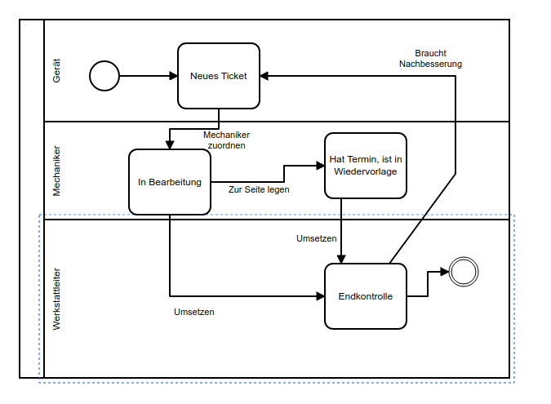
Paradigm 3: Processes and Workflows
E.g., Business Process Model and Notation (BPMN), UML State Diagrams, UML Activity Diagrams, Ereignisgesteuerte Prozessketten (EPK), Petri Nets…
Programs are represented as “process models”
States (sometimes boxes) – read WoT Properties
Activities/transitions (sometimes arrows) – write WoT Properties, invoke WoT Actions and react to WoT Events
Control patterns (sequence, parallel split, exclusive choice…)
Many process formalisms describe behaviours graphically
Without an operational semantics, the formalisms lack the information to execute behaviours

Slide 8
BLAST: Block Applications for Things
Multi-paradigm, visual programming language based on blocks
Two to three person-years development effort
Describe behaviours involving devices viewed with the Web of Things abstraction
Read/write WoT Properties
Invoke WoT Actions
React to WoT Events
Additionally, include access to HTTP APIs
BLAST programs/behaviours are translated to JavaScript code and executed in the browser
Other execution environments possible
BLAST Demo: Smart Doorbell

Slide 9
Current State
Input/output features
Things: seven devices (of different types) integrated
Services: five services integrated
Language features
Stable language that allows for combining things and services
Execution environment
Chromium/Chrome browsers on Windows, Android and Linux

Slide 10
Next Steps
Input/output features
Adding more devices and services, ideally involving a community
Integrating more standards related to the Web of Things
Language features
Extending the functionality of the BLAST language (based on 20 use cases)
Formalising syntax and semantics of BLAST language
Extending the language to include process monitoring constructs
Execution environment
Implementing additional execution environments
Conducting more usability studies
Applying BLAST in additional research projects and industry projects

