Slide 1
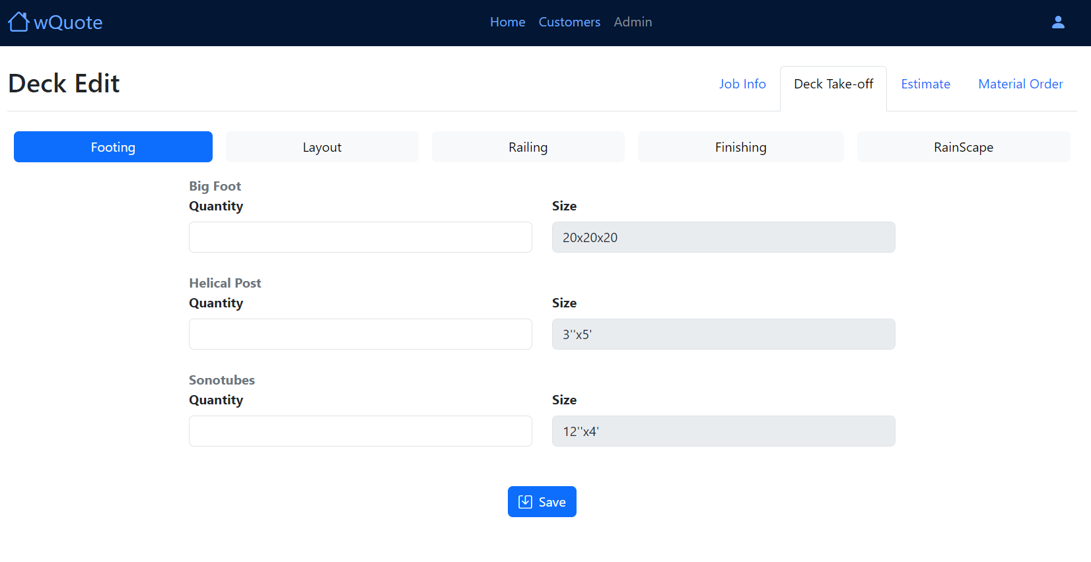
22” x 16.5” x 22”
Bigfoot (qty)
28” x 20” x 28”
Helical Post (qty)
12” x 48’
Sonotube (qty)
8” x 48’

Slide 2
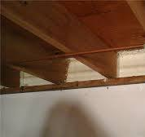
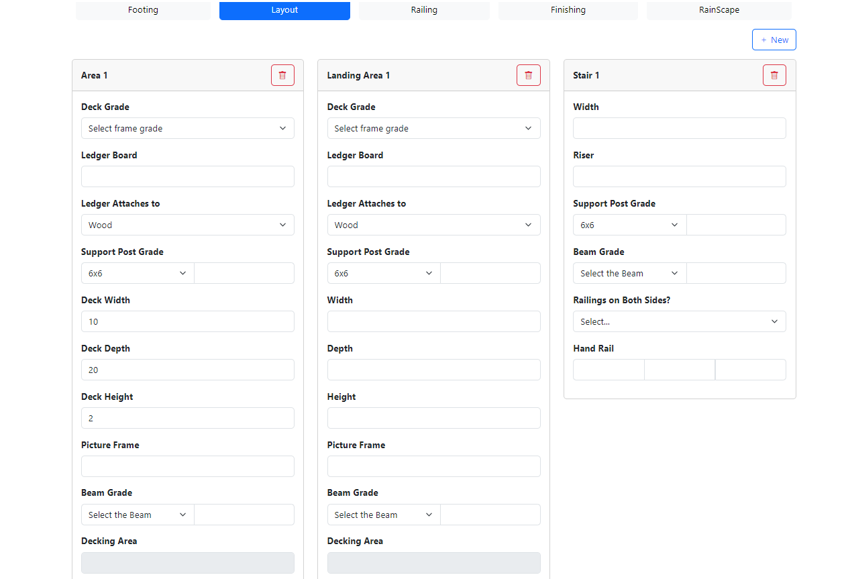
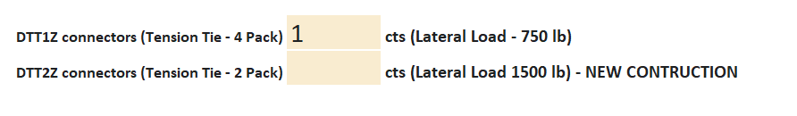
2x6 Frame
2x8 Frame
2x10 Frame
2x12 Frame
2x6 Frame
2x8 Frame
2x10 Frame
2x12 Frame
(FT)
(LFT)
2x8 Frame
2x10 Frame
2x12 Frame
(LFT)
2x8 Frame
2x10 Frame
2x12 Frame
Total Riser
(FT)
Double by 6 Triple by 6
Double by 8 Triple by 8
Double by 10 Triple by 10
Double by 12 Triple by 12
(LFT)
Rim Joist
Concrete
Rim Joist
Concrete
4x4
6x6
4x4
6x6
(LFT)
4x4
6x6
(LFT)
(LFT)
(FT)
(FT)
Yes, both sides
No, just one side
(FT)
(FT)
(FT)
(FT)
Double by 6 Triple by 6
Double by 8 Triple by 8
Double by 10 Triple by 10
Double by 12 Triple by 12
(LFT)
(LFT)
Double by 6 Triple by 6
Double by 8 Triple by 8
Double by 10 Triple by 10
Double by 12 Triple by 12
(LFT)
(LFT)

Slide 3
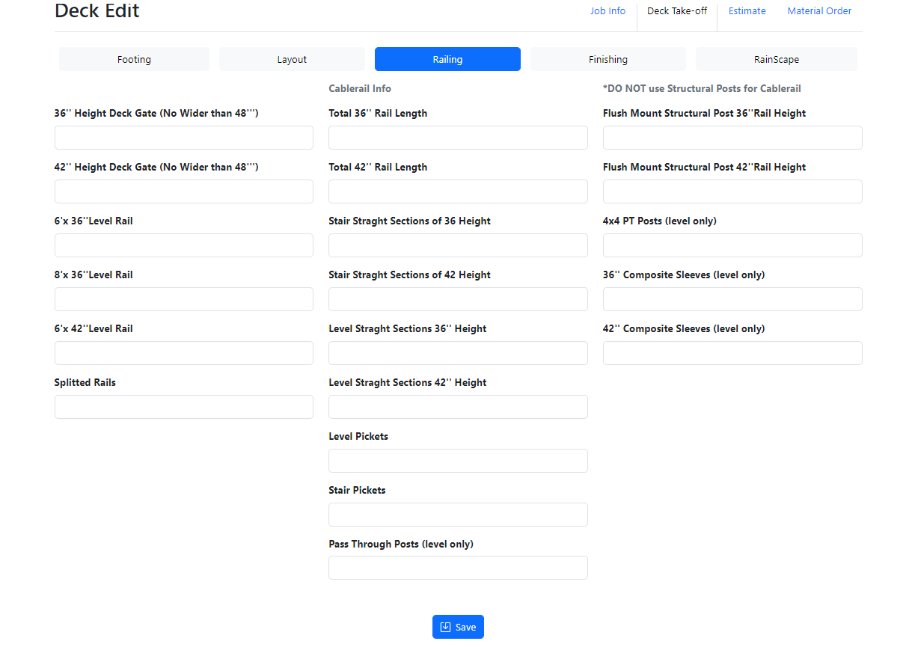
Info for cable rail only
Info for cable rail only
(Qty)
(LFT)
(qty)
(Qty)
(LFT)
(qty)
(Qty)
(qty)
(qty)
(Qty)
(qty)
(qty)
(Qty)
(qty)
(qty)
(Qty)
(qty)
(qty)

Slide 4
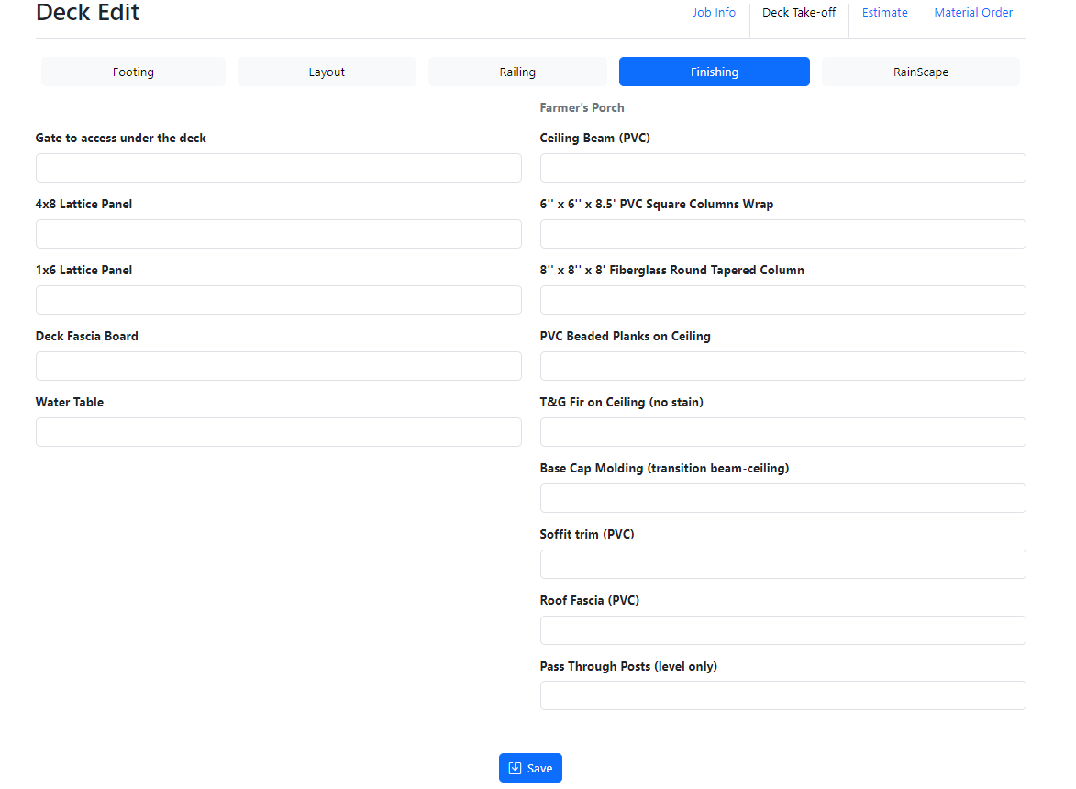
(qty)
Farmer's Porch Info Only
(ln.ft)
(qty)
(qty)
1x6 Lattice Trim
(LFT)
(qty)
(LFT)
(sq.f)
(LFT)
(sq.f)
(LFT)
(LFT)
(LFT)

Slide 5
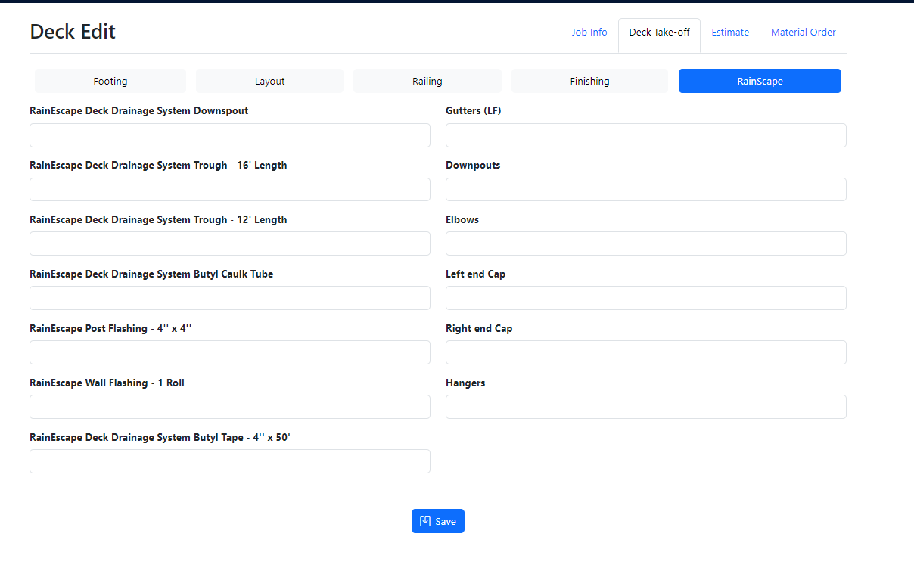
(QTY)
(LFT)
(QTY)
(QTY)
(QTY)
(QTY)
(QTY)
(QTY)
(QTY)
(QTY)
(QTY)
(QTY)
(QTY)

Slide 6
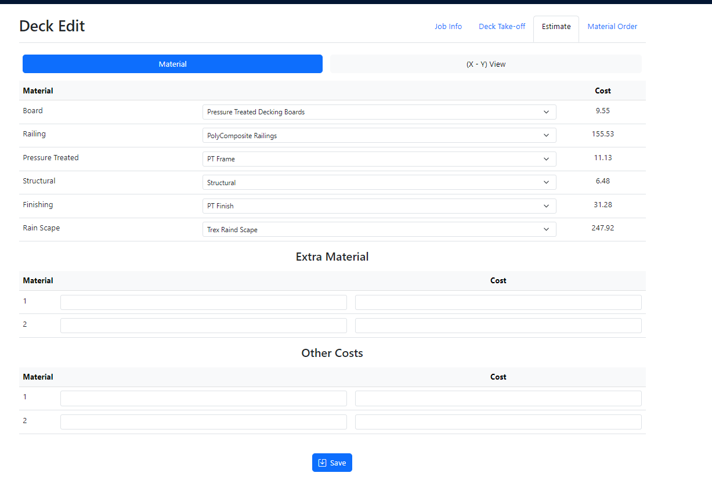
Varias opcoes
Varias opcoes
PT Frame
No Frame
Structural
No Structural
PT Finish PVC Finish
With RainScape
No RainScape
Total
Tax
+
Total Cost
Item Description
Labor Cost
Total
+
Other Cost
Item Description
Total
Disposal
Building Permit
Porta Potty
+
Quote Summary
Materials
$ 100
Labor
$ 100
Other Costs
$ 100
Total Cost
$ 100
Profit
35 %
$ 100
Project Value
$ 100

Slide 7
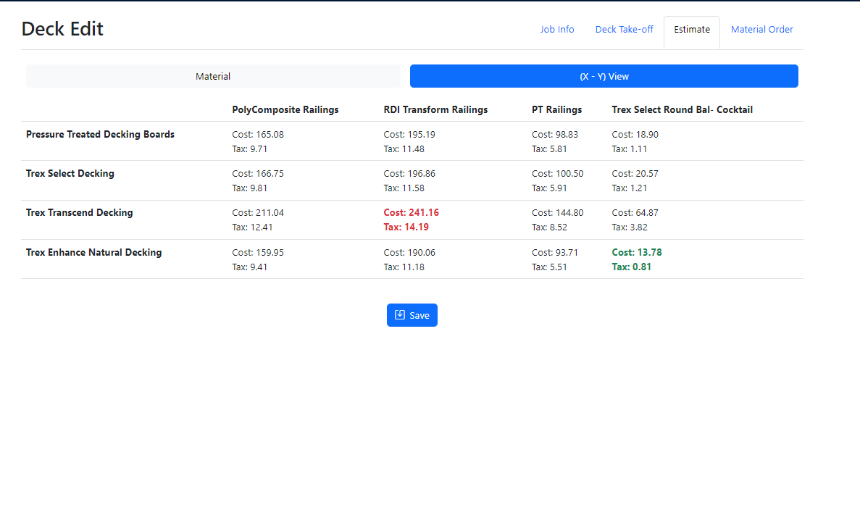
Nao Precisa mostrar o tax

Slide 8
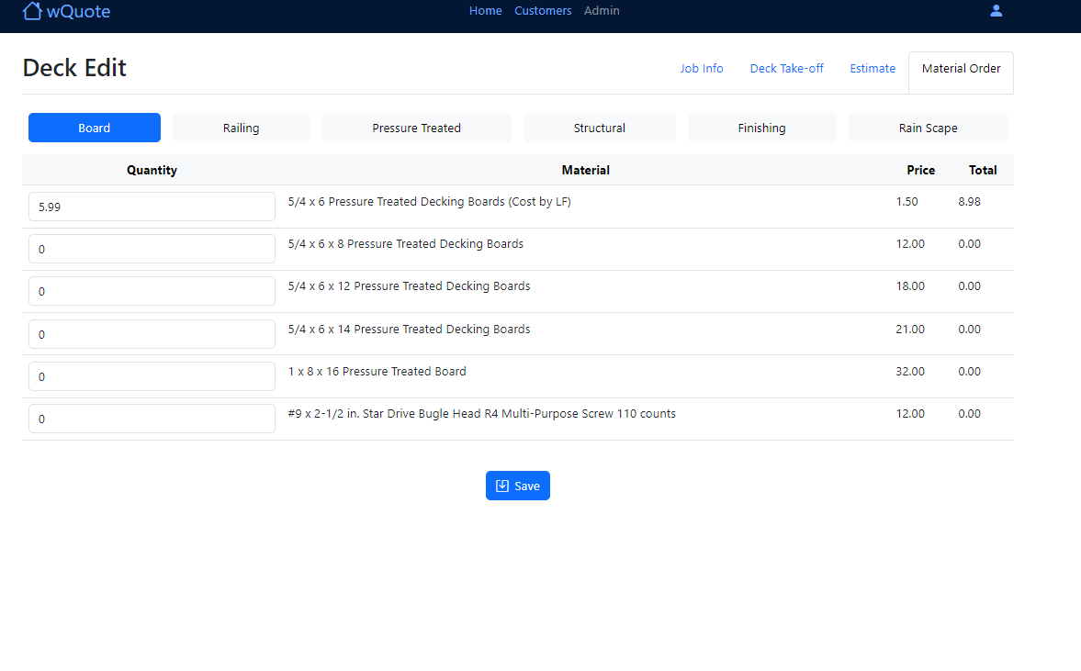
?
Tax
Total

Slide 9
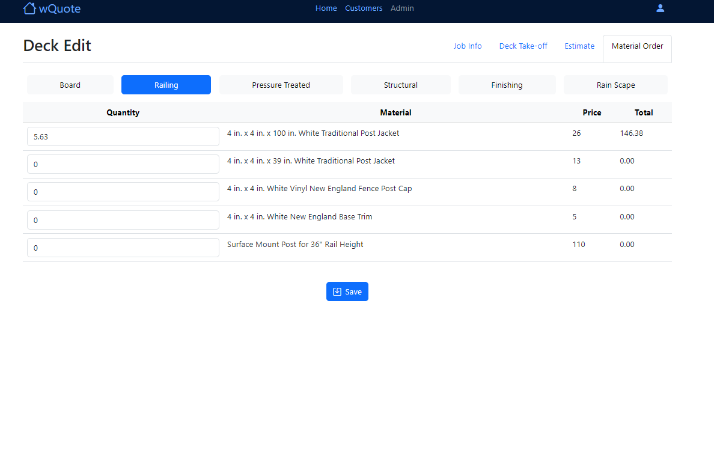
Quantity to Order
?
Tax
Total

Slide 10
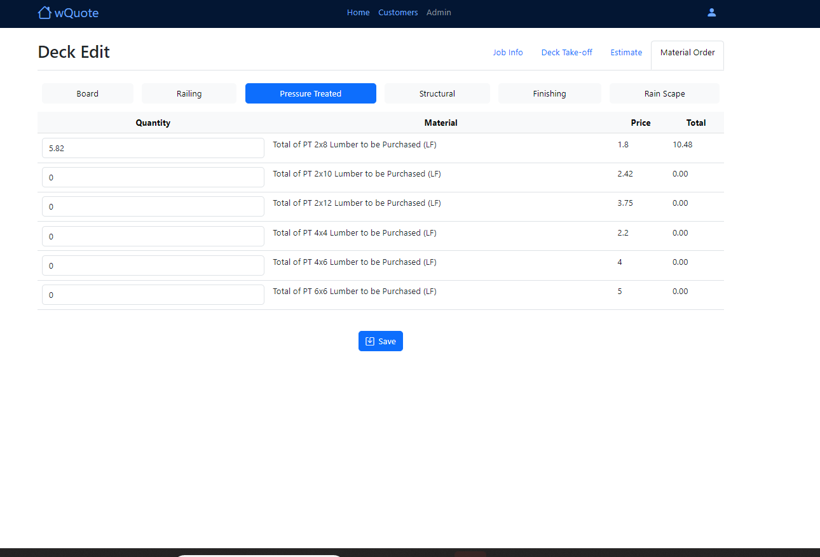
LEDGER BOARD
QTY
Description
Unit Price
Total
+
JOISTS
QTY
Description
Unit Price
Total
+
RIM JOISTS
QTY
Description
Unit Price
Total
+
BEAM
QTY
Description
Unit Price
Total
+
STRINGERS
QTY
Description
Unit Price
Total
+
SUPPORT POST
QTY
Description
Unit Price
Total
+
RAILING POST
QTY
Description
Unit Price
Total
+
LATTICE FRAME
QTY
Description
Unit Price
Total
+
Tax
Total

Slide 11
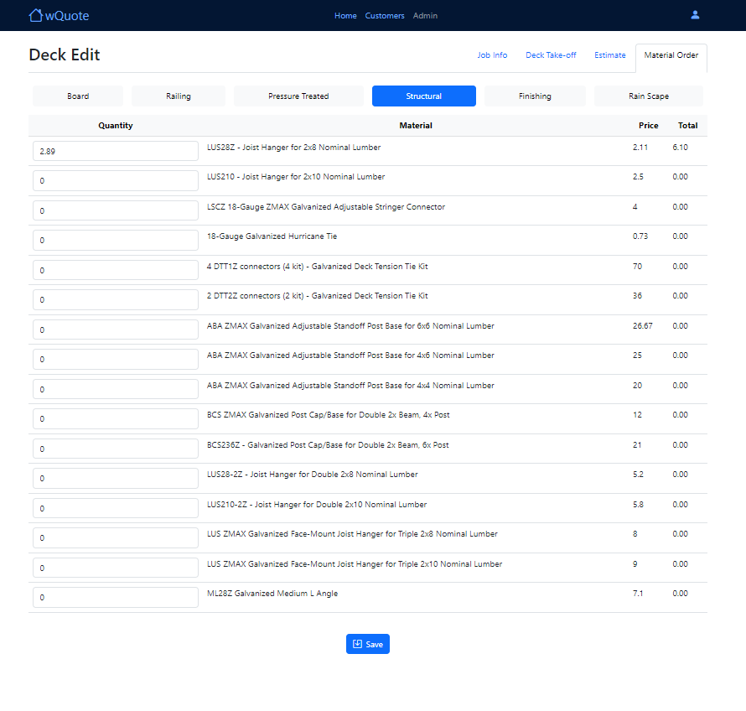
Confirmar na planilha
Quantity to Order
Tax
Total

Slide 12
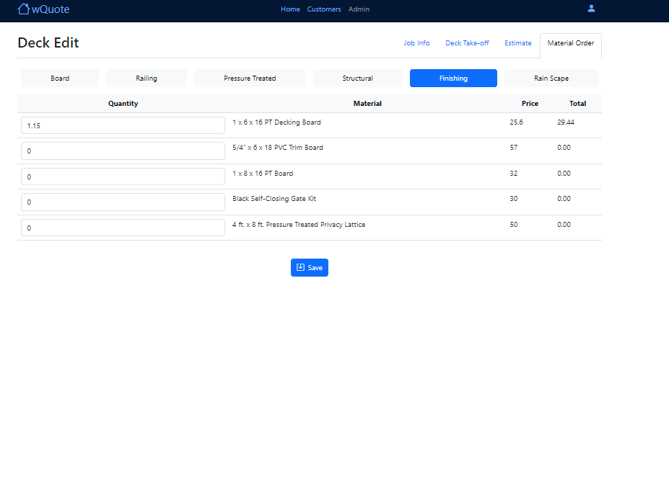
Quantity to Order
Tax
Confirmar na planilha
Total

Slide 13
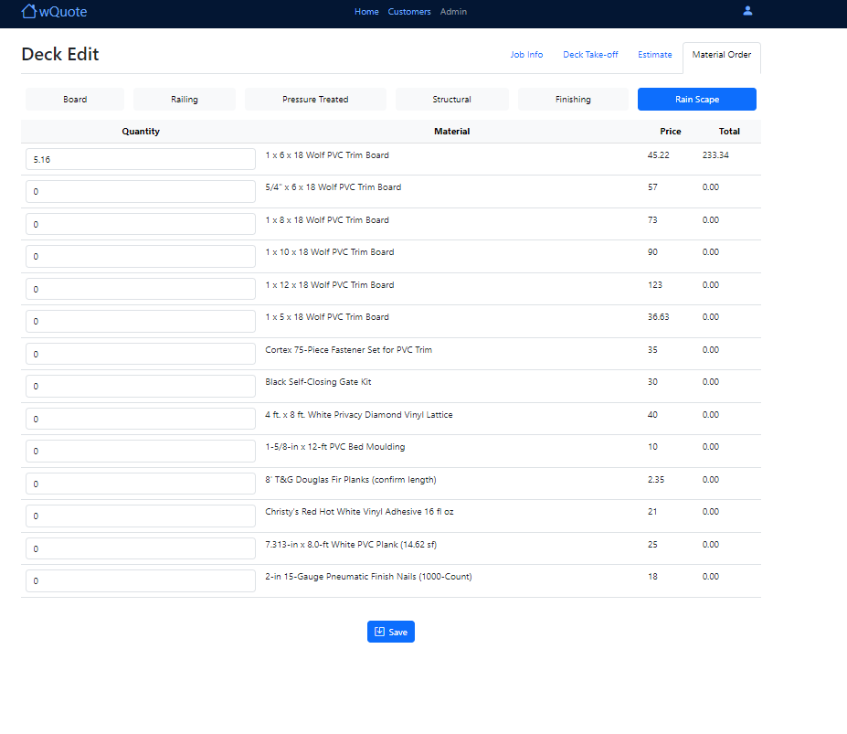
Quantity to Order
Ta errado. Confirmar na planilha

