Slide 1
Multiscale Techniques Applied to Material Irradiation Damage Analysis
Bruce Berry
MEEG 591V

Slide 2
Outline
Motivations
Mechanisms
Review of methods
Application

Slide 3
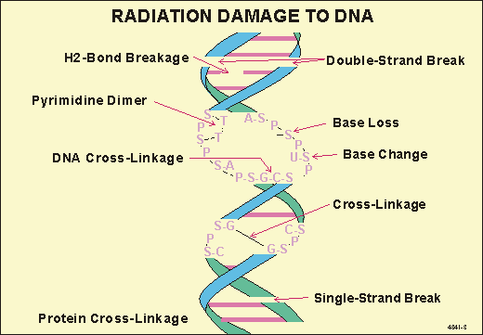
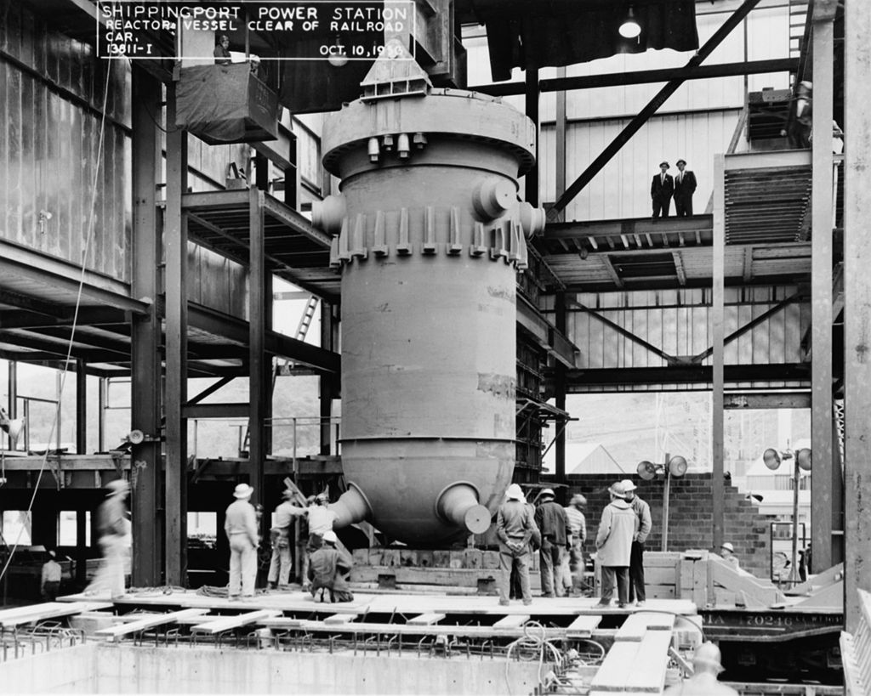
Motivations
Understand mechanicsms by which radiation interacts with materials
Produce materials and procedures that better take account of this behavior
Multiple length and time scales important!
- Radiation Sources and effects. <http://www.radiation-scott.org/radsource/3-0.htm>. Retrieved 12/2/15.
- <https://en.wikipedia.org/wiki/Reactor_pressure_vessel#/media/File:Shippingport_LOC_135430pu.jpg>

Slide 4
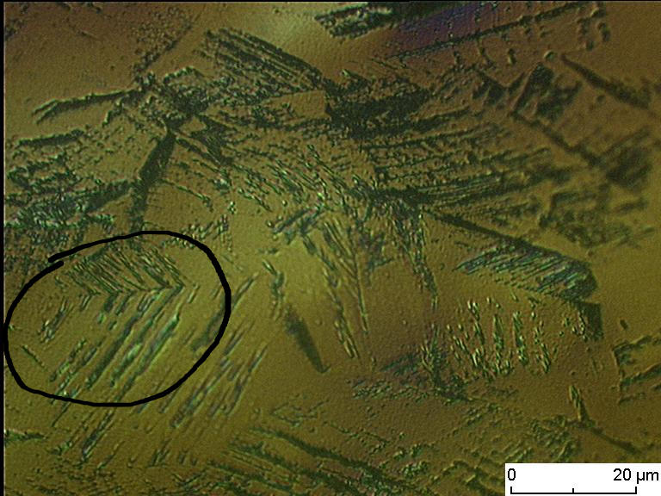
Mechanisms of Interactions in Metals
Primary Knock-On Atoms (PKA's)
Count dependent on radiation type/energy
  Neutrons produce many
  electrons produce few
[1]
Austentite (FCC) → Martensite (BCT)

Slide 5
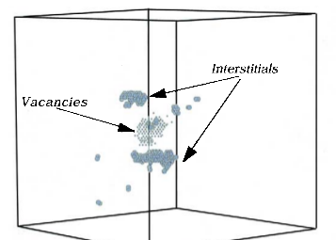
Defects and Interstitials
PKA's result in displacement of secondary atoms
“Cascade” of displacements

Slide 6
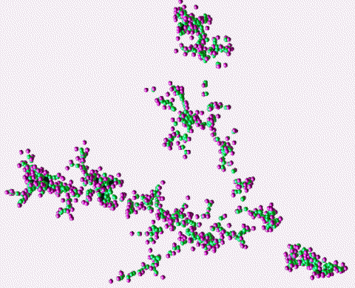
Property changes
Defects (Dislocations) build up and result in property changes
  Work hardening
  Embrittlement
  Loss of ductility
- Atomistic Simulations of Radiation Damage in Metals. <http://cmcsn.phys.washington.edu/book/export/html/507>. Retrieved 12/2/15.

Slide 7
Methods
In reactor steels, engineering decisions are often made using empirical relations.
  Extrapolation is dangerous!
  Performing experiments to model a new system can be difficult
Experiments do not show events at the atomic scale
MD simulations provides a window to atomic interaction events
Dislocation Dynamics Simulations predict changes in material properties

Slide 8
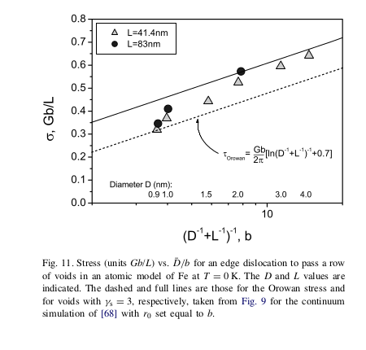
Some Results
Matches continuum theoretical models in some cases, not in others
[3]

Slide 9
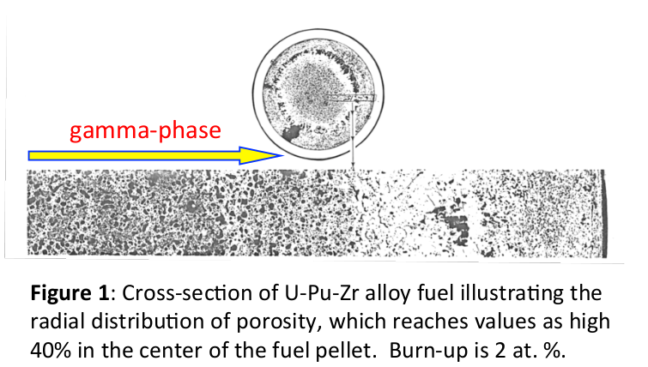
An application
Understand the mechanisms that drive microstructure change due to irradiation in metallic Uranium fuels
Computational and Experimental Studies of Microstructure-Scale Porosity in Metallic Fuels for Improved Gas Swelling Behavior. Millet Research Group.

Slide 10
References
[1] M. Smaga, AG Eifler, FB MV, TU Kaiserslauter.
[2] Free-energy calculation for many-body iron potentials. <http://merapi.physik.uni-kl.de/~finished/engin/>. Retrieved 12/2/15.
[3] mscale_bacon.pdf

