Slide 1
Feature Extraction and Feature Space Analysis

Slide 2
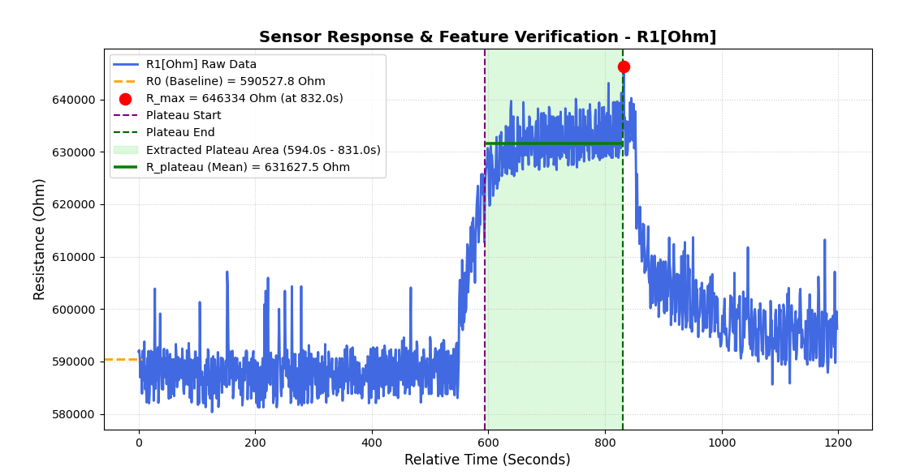
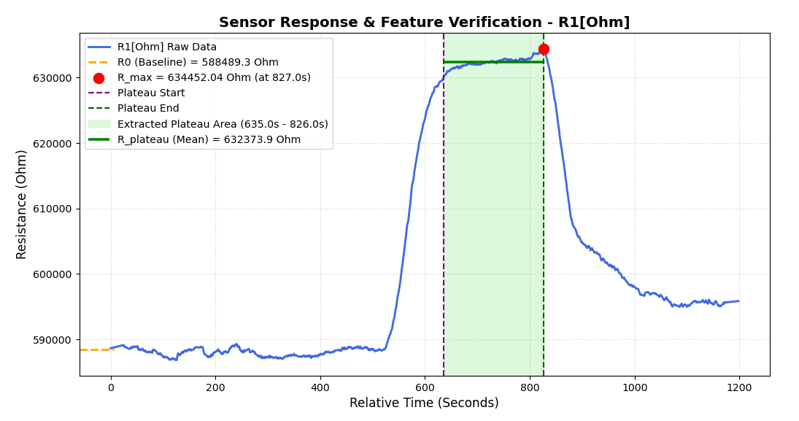
Preprocessing: Savitzky–Golay Filter

Slide 3
Feature Extraction
62 sensors
Each sensor provides 5 features: R₀, R_{max}, (R_{max}- R₀)/ R_{0 ,} R_{plateau ,}AUC
62*6 features for each gas
Dataset: zenodo_long_term_drift
  62 sensors
  700 time-series * 12 months
  Diacetyl(0.1ppm,1ppm), phenylethanol(200ppm,1000ppm), ethanol(2 unknown concentration)

Slide 4
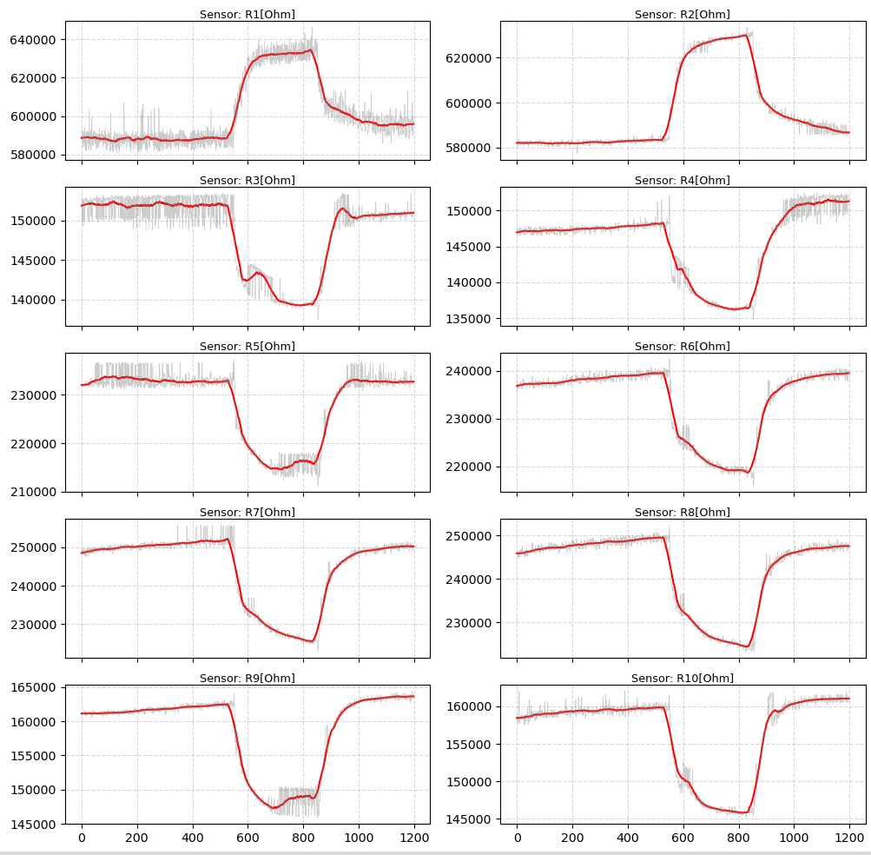
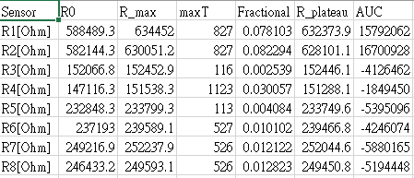
Feature table

Slide 5
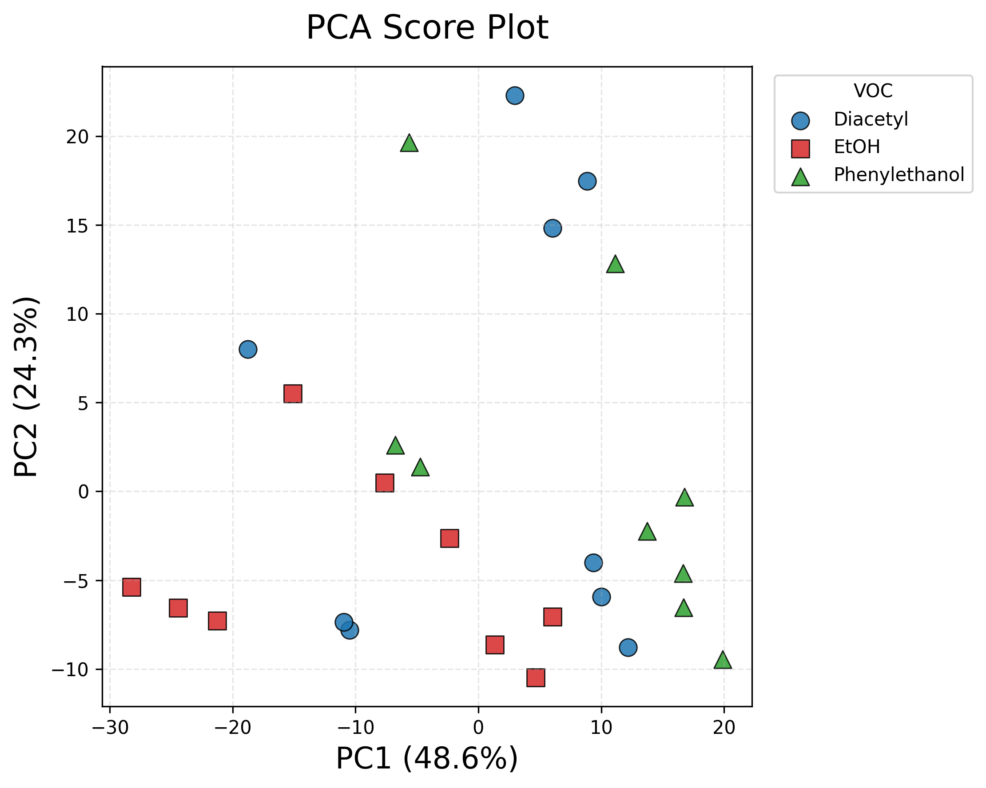
PCA Analysis: Influence of Concentration Variation (Day 1)

Slide 6
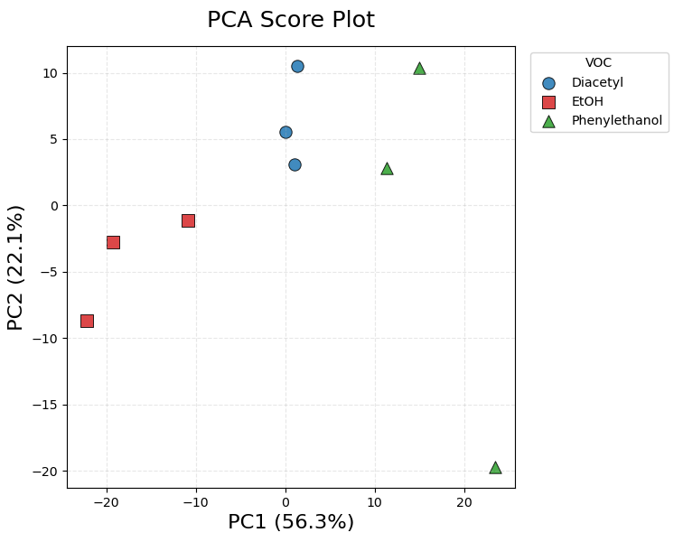
PCA Analysis: Removing Concentration Variation (Day 1)

Slide 7
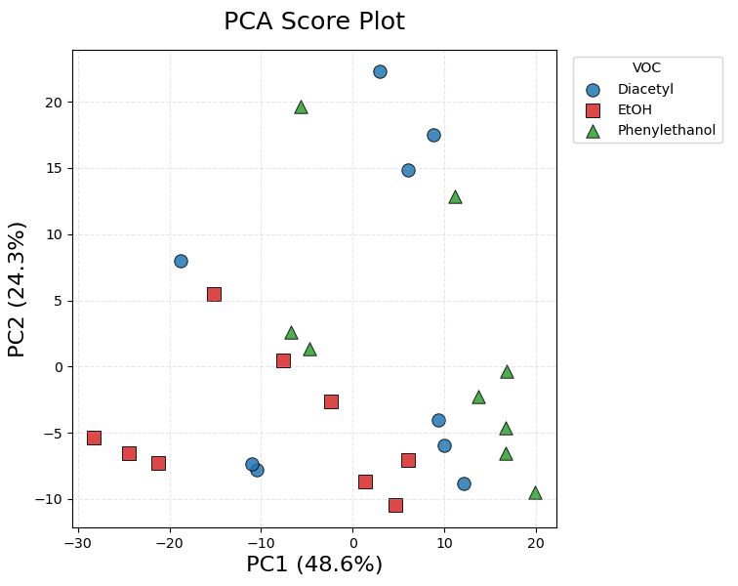
PCA Analysis: Effect of Long-term Drift (Day 1–3)

Slide 8
Future Work:
Classification pipeline
Raw Sensor Response
│
▼
Feature Extraction
(372 features)
│
▼
Feature Validation
(Response curve + PCA)
│
▼
Baseline Drift Analysis
(PCA Loading)
│
▼
Feature Screening
(Remove drift-sensitive features)
│
▼
310 features
│
├────────────────┐
│ │
▼ ▼
SVM-RFE MDIP
(Wrapper) (Classifier-independent)
│ │
▼ ▼
Selected Selected
Features Features
│ │
└────────┬───────┘
▼
Classifier
(SVM )
│
▼
Future-day Validation
(Day-based split)

