Slide 1
Feature Screening

Slide 2
Based Feature Screening
R_{0​} was removed due to temporal baseline drift
  Strongly affected by sensor aging and measurement-day variation.
  May cause the model to learn day-dependent patterns instead of VOC characteristics.
  Retained only for calculating normalized features.
R_{max}⁡​ was removed due to redundancy
  Highly correlated with R_{plateau}​.
  More sensitive to transient noise and signal spikes.
  R_{plateau}​ was retained as a more stable steady-state feature.
Screening outcome
  PC1: 48.6% → 59.9%
  PC1 + PC2: 72.9% → 81.2%
  Reduced unstable and redundant information in the feature set.

Slide 3
Feature Extraction
62 sensors
Each sensor provides 5 features: (R_{max}- R₀)/ R_{0 ,} R_{plateau ,}AUC, max+min slope
62*5 features for each gas
Dataset: zenodo_long_term_drift
  62 sensors
  700 time-series * 12 months
  Diacetyl(0.1ppm,1ppm), phenylethanol(200ppm,1000ppm), ethanol(2 unknown concentration)

Slide 4
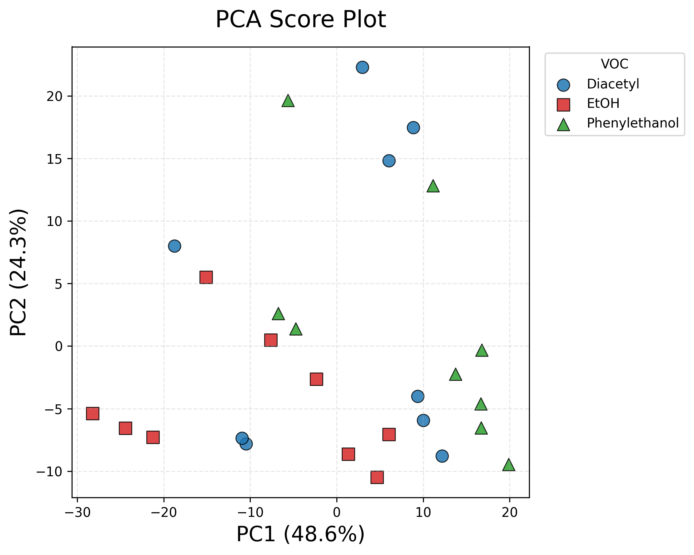
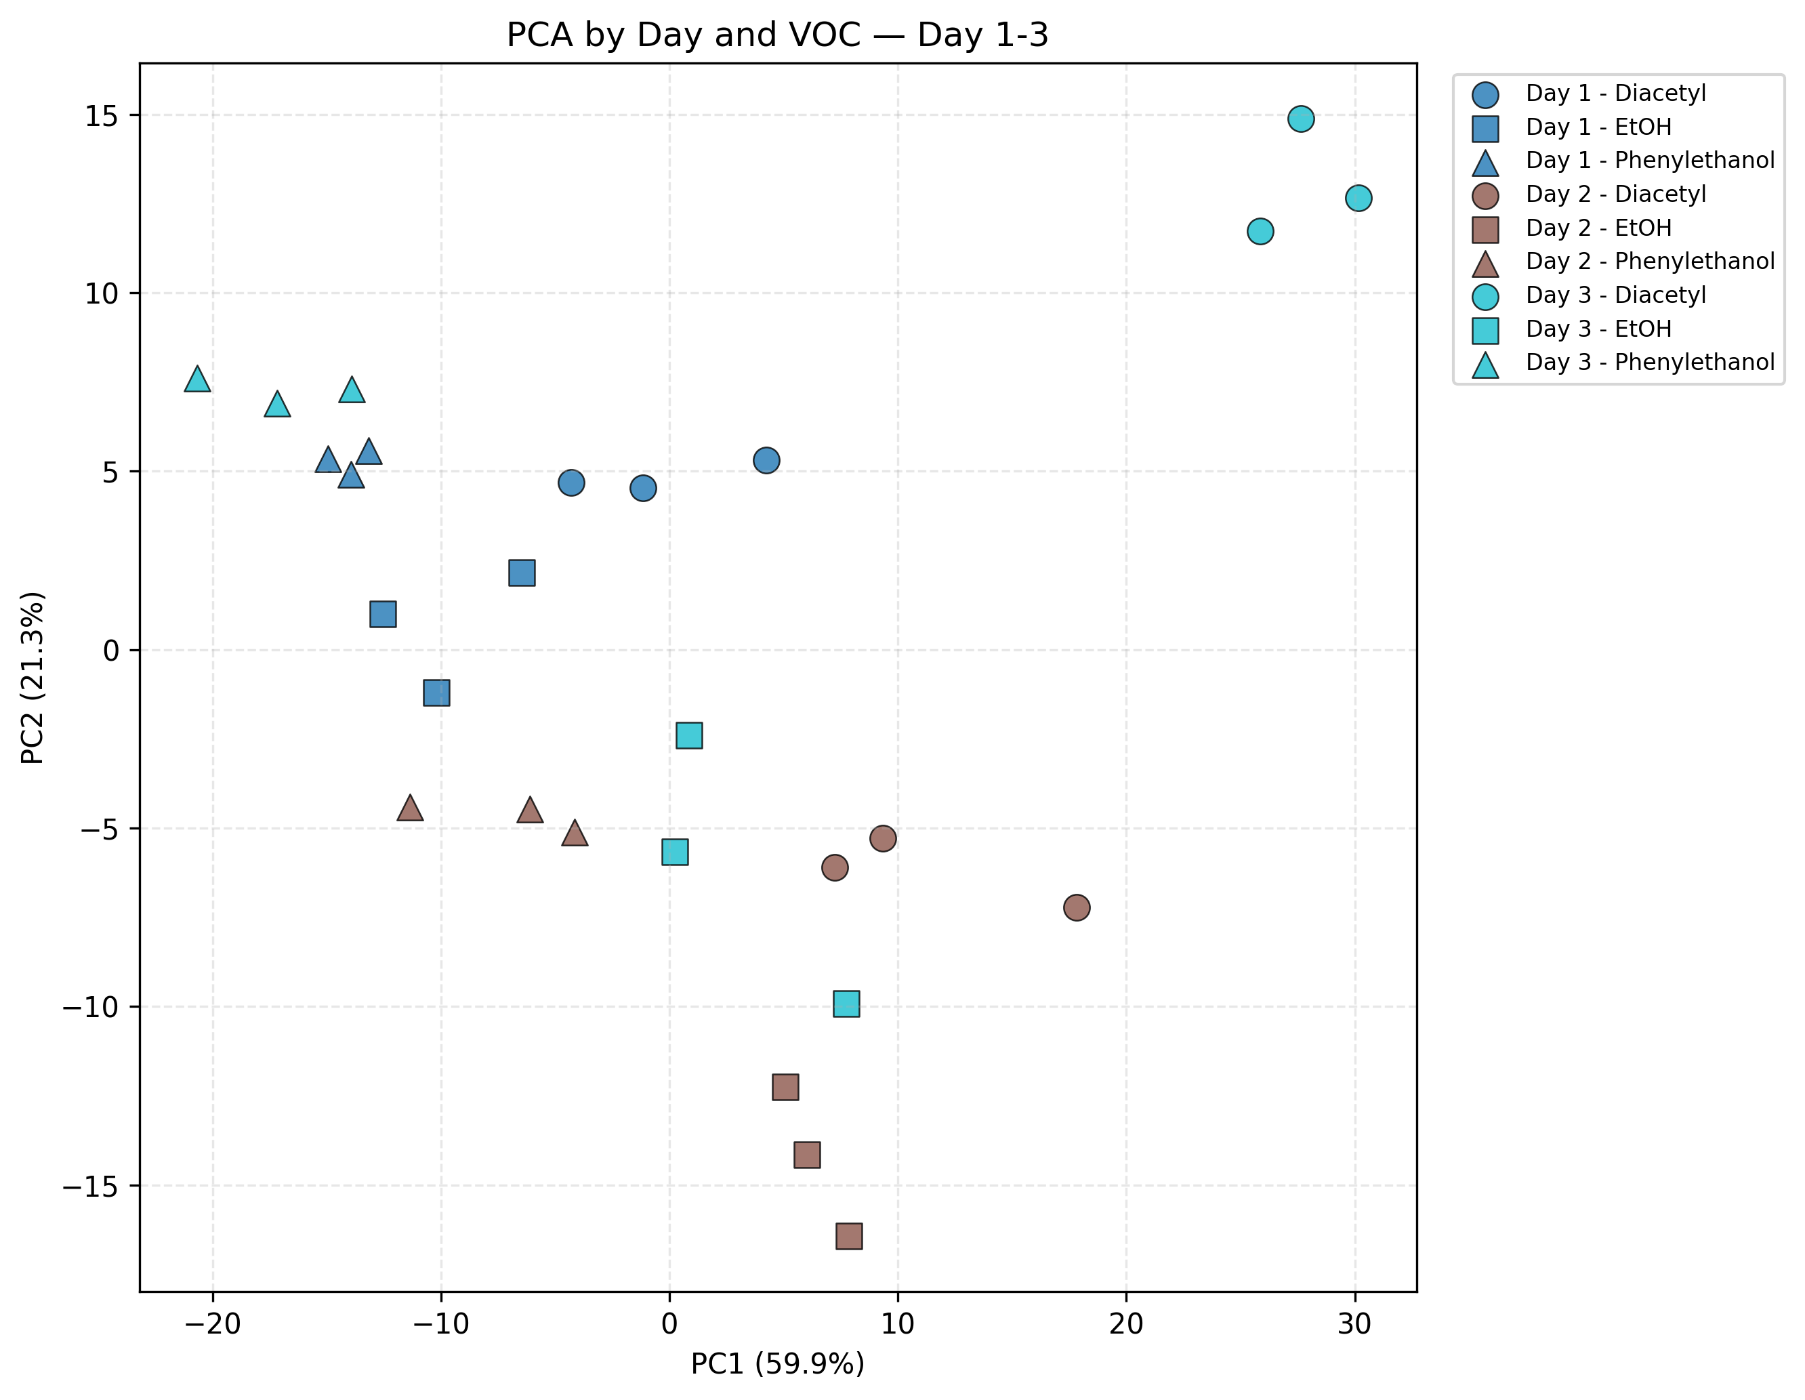
PCA Day1-3 result comparison
All feature
Removed Ro, Rmax

Slide 5
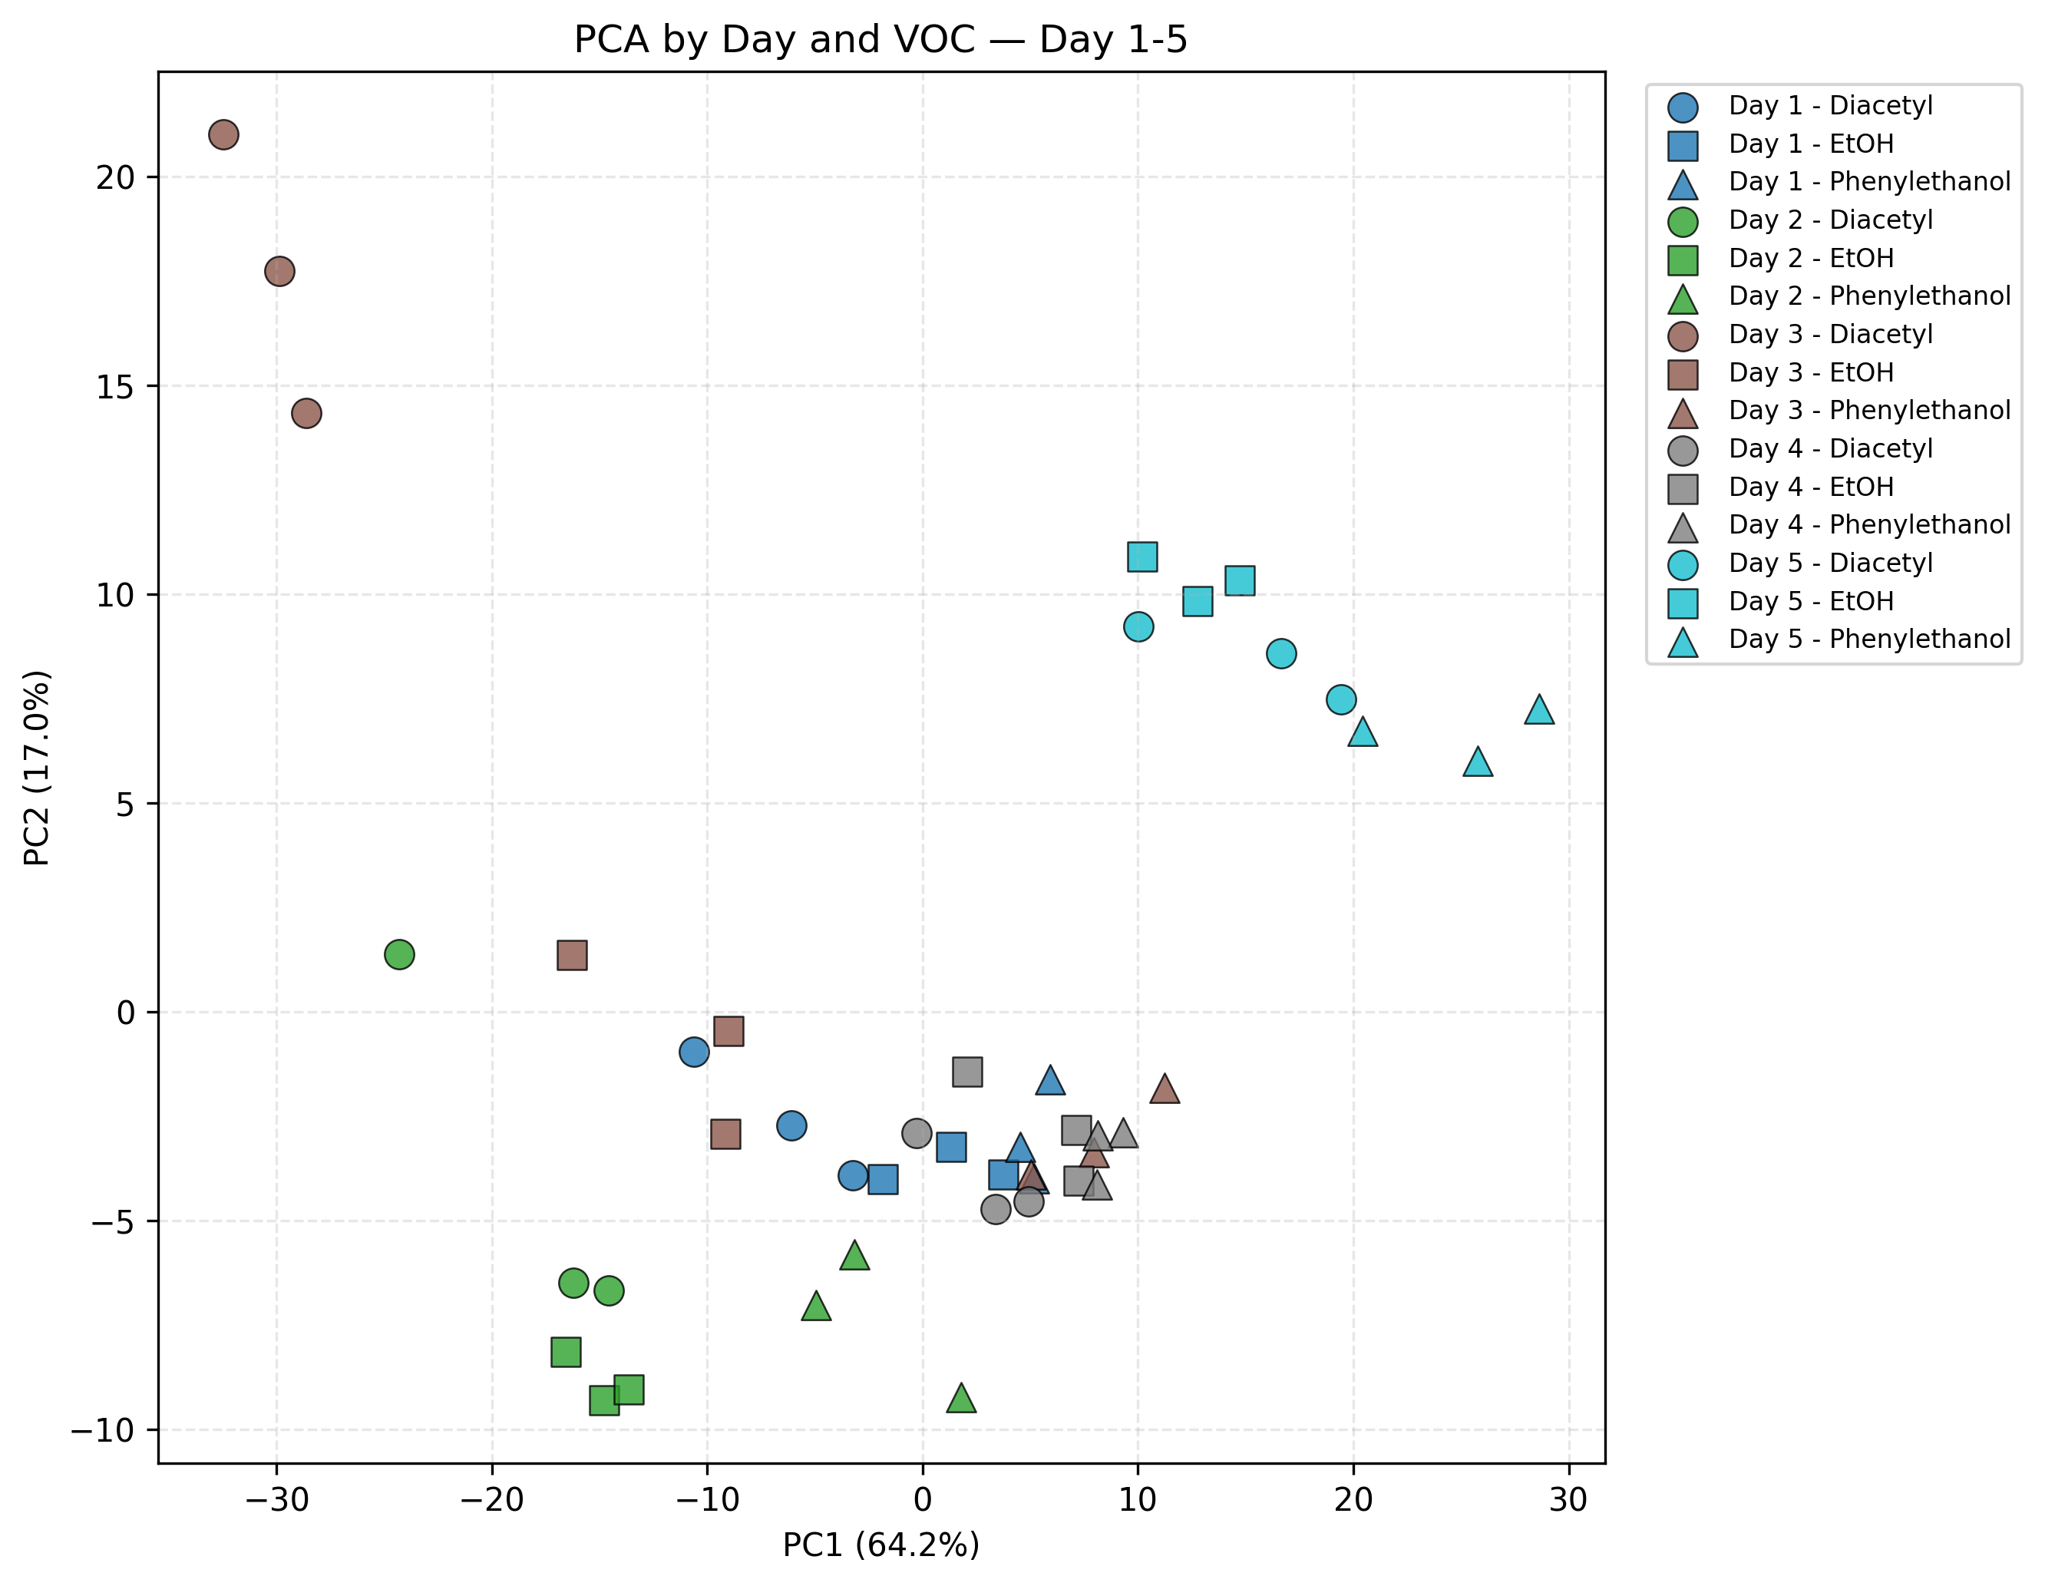
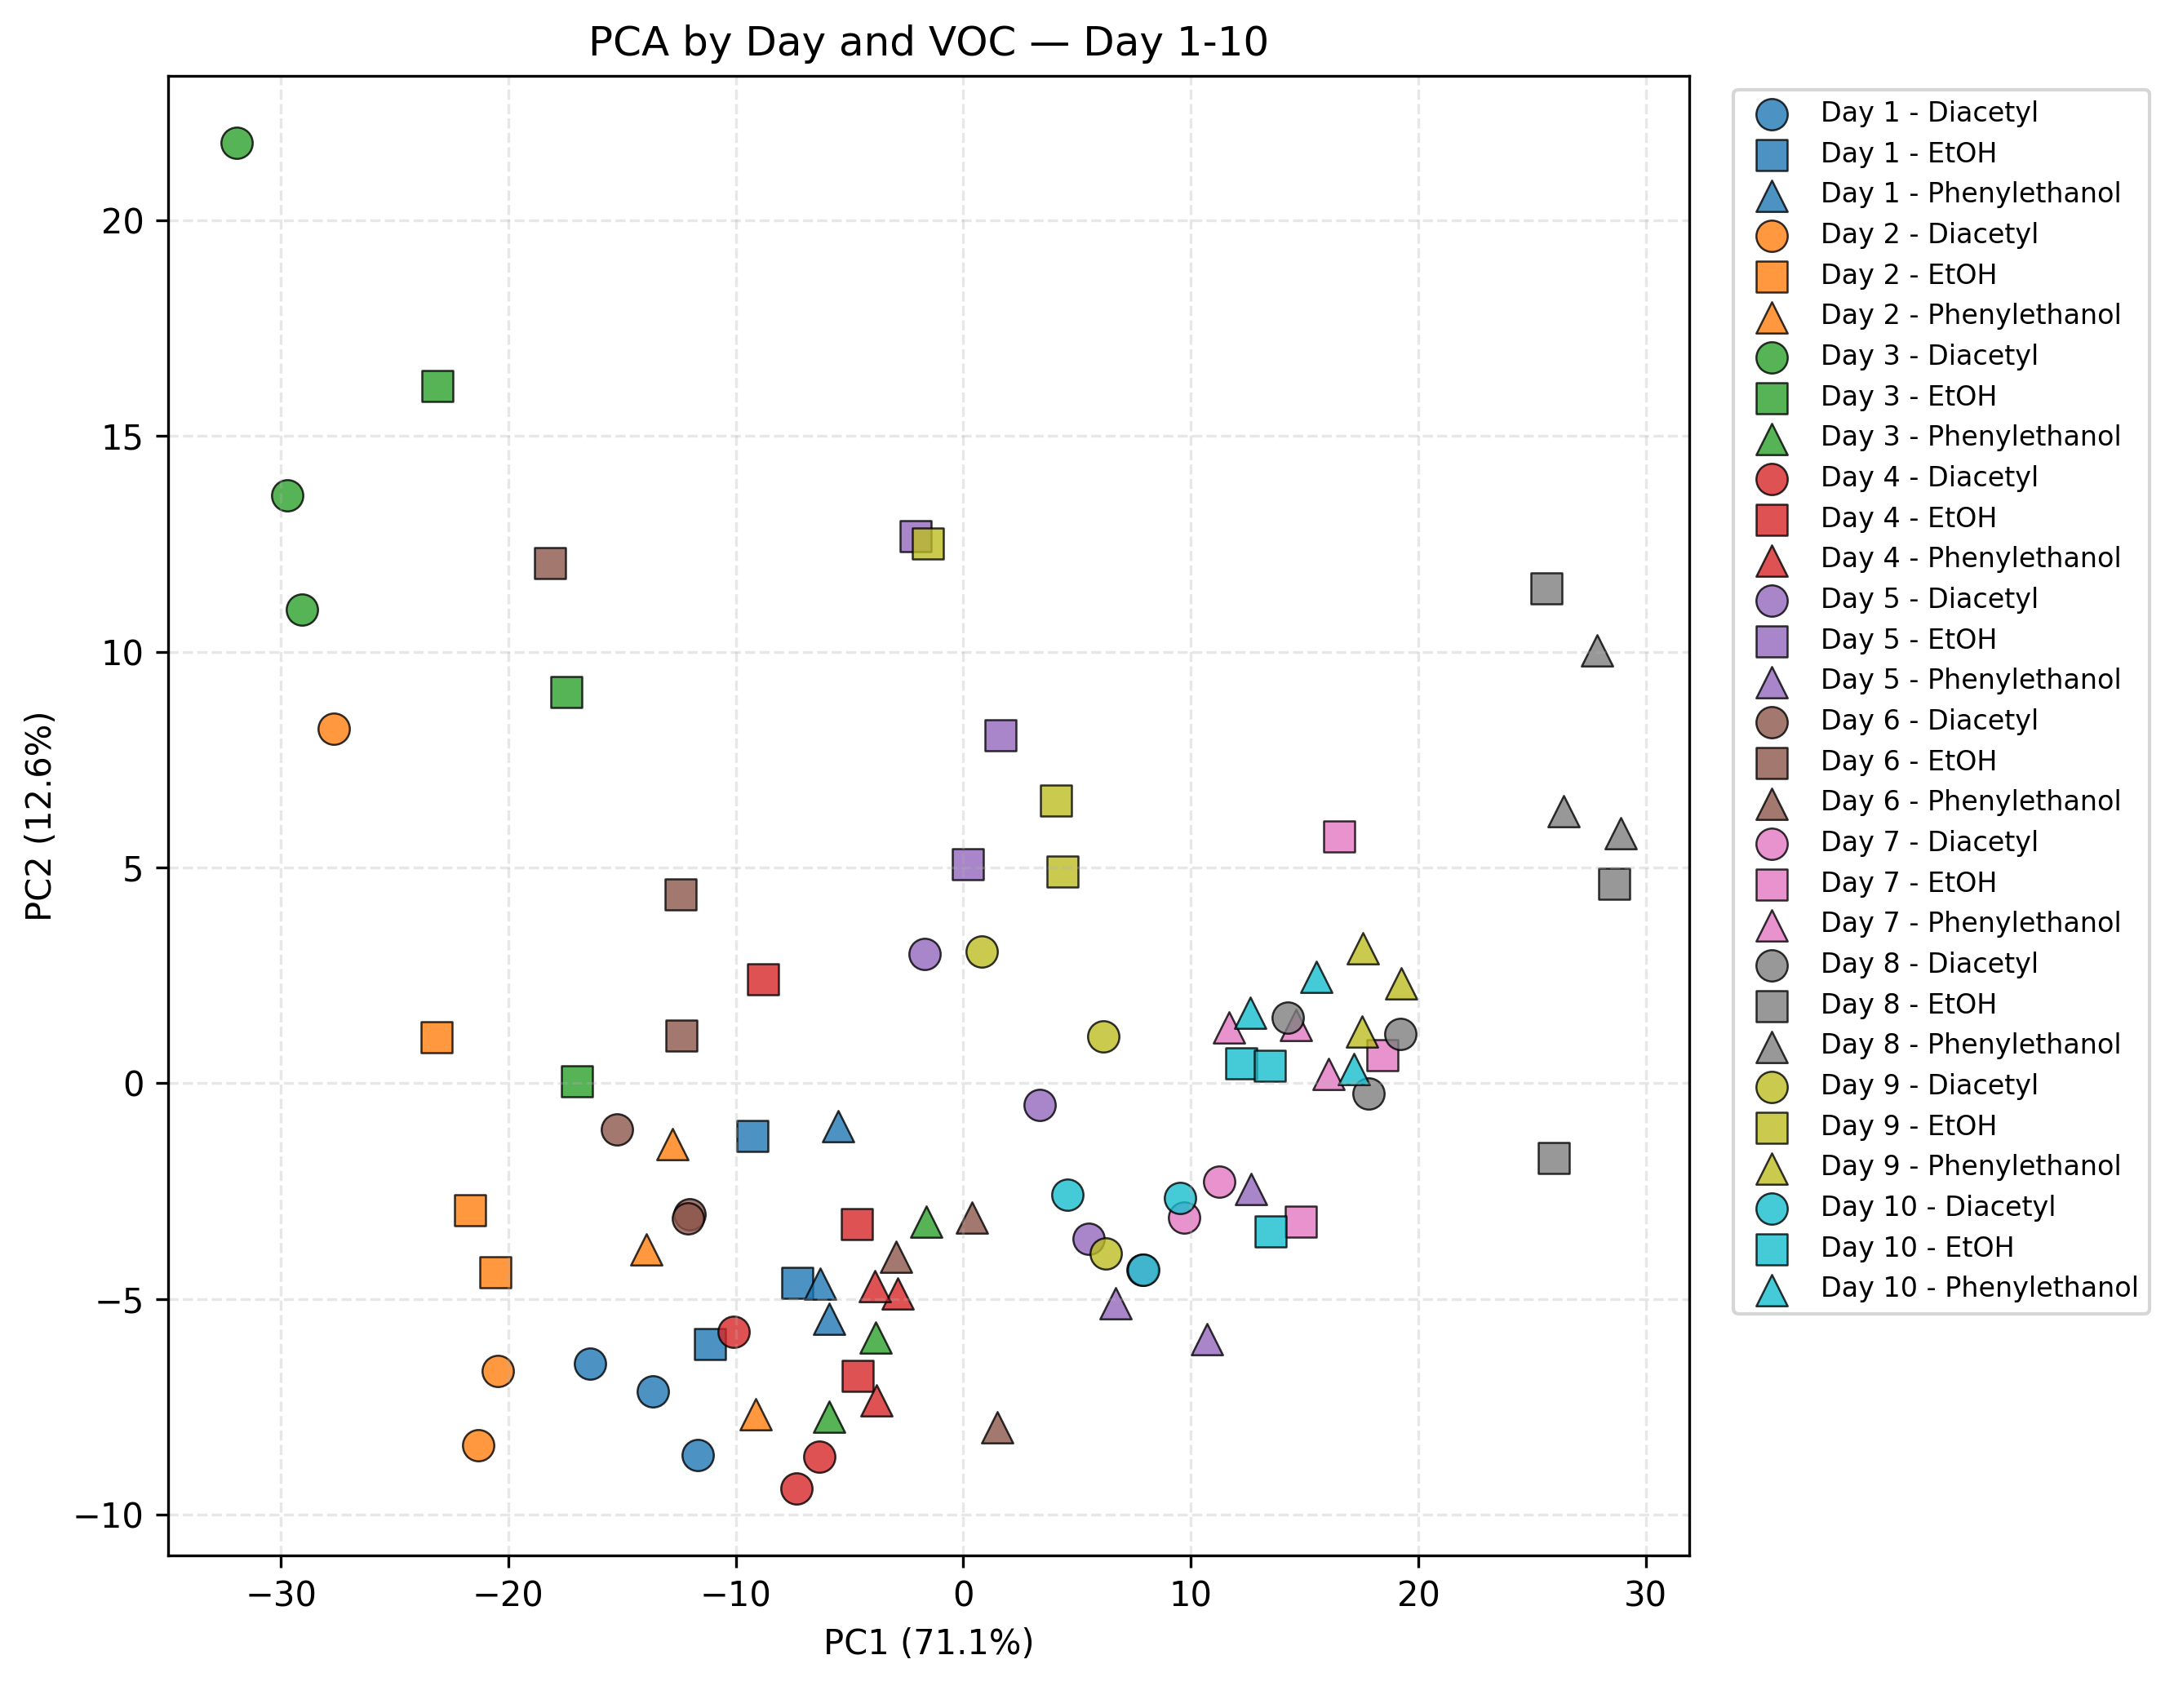
PCA evaluation after base screening

Slide 6

Correlation-Based Redundancy Screening
  Pearson correlation
  multiple R_{plateau}​ features
  large groups of AUC features
  several Max Slope features
  These results indicate severe feature redundancy and multicollinearity.
  Correlation was used to identify feature clusters rather than immediately remove individual features.
  Final representative features will be selected based on stability, class discrimination, and RANSAC performance.

Slide 7
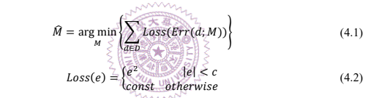


RANSAC-Based Inlier Identification
Randomly sample 50% of the training data.
Estimate a candidate center using the median.
Compute residuals
Apply truncated squared loss:
Repeat up to 1,000 times.
Select the model with the minimum loss.
Threshold determination:
Inlier identification:

Slide 8
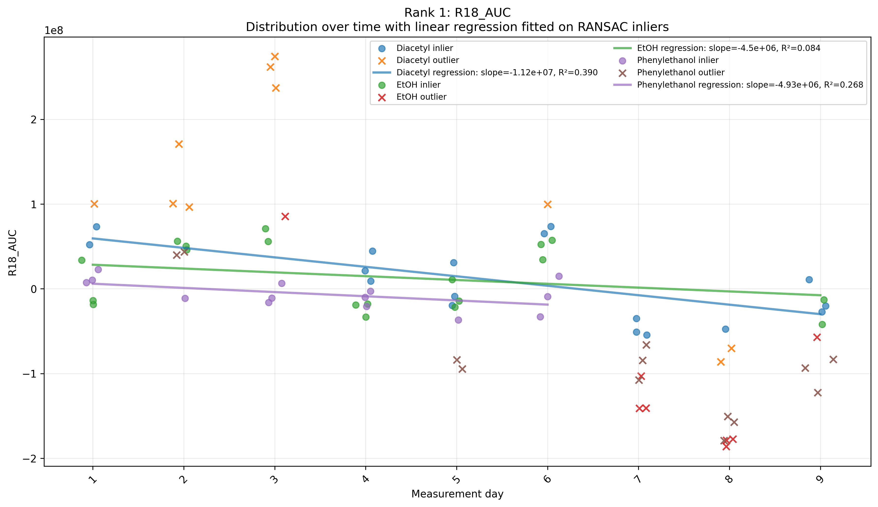
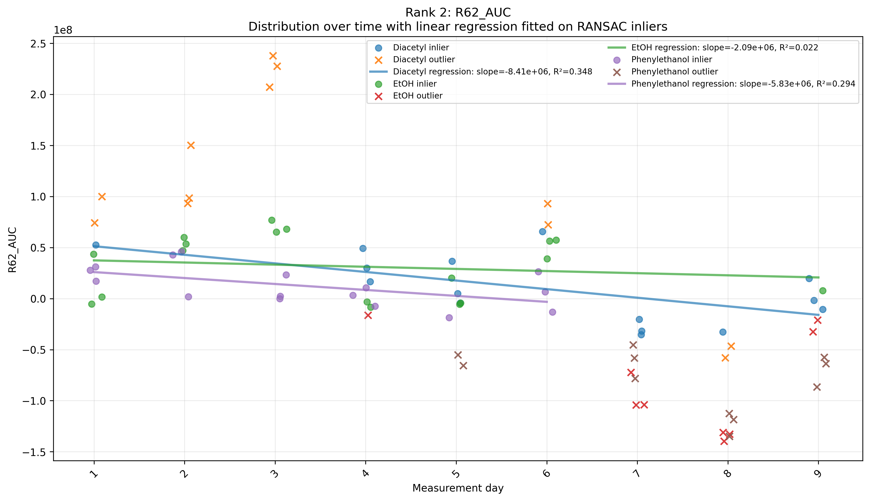
RANSAC results: Top2 feature

Slide 9
Conclusion
The maximum inlier ratio was approximately 0.68, indicating only moderate within-class consistency.
Many feature–VOC combinations contained substantial numbers of outliers.
Several top-ranked features still exhibited clear temporal trends.
The fixed-center RANSAC model could not fully describe features with time-dependent drift.
Therefore, RANSAC was mainly used to reveal unstable observations and estimate inlier probability, rather than confirm feature stability.

Slide 10
Future Work
Complete the MDIP calculation :
  RANSAC-derived inlier probability
  minimum distance between VOC class centers.
Rank all features according to their MDIP scores.
correlation-based cluster reduction to remove highly redundant features.
Try the linear RANSAC rather than fixed-center RANSAC.
Use Day 1–9 as the training dataset and later measurement days as validation data.
Validate the selected features on longer-term data, including Day 20, Day 30, and Day 40.

Slide 11
Future Work:
Classification pipeline
Raw Sensor Response
│
▼
Feature Extraction
(372 features)
│
▼
Feature Validation
(Response curve + PCA)
│
▼
Baseline Drift Analysis
(PCA Loading)
│
▼
Feature Screening
(Remove drift-sensitive features)
│
▼
310 features
│
├────────┐
│ │
▼ ▼
SVM-RFE MDIP
(Wrapper) (Classifier-independent)
│ │
▼ ▼
Selected Selected
Features Features
│ │
└────────┬───────┘
▼
Classifier
(SVM )
│
▼
Future-day Validation
(Day-based split)

