Slide 1

Two-Stage MDIP Feature Selection for Electronic-Nose VOC Classification
陳柏臻

Slide 2
Outline
Literature Review
Experiment
Two-Stage MDIP
Experimental Results
Drift Analysis
Conclusion

Slide 3
A Minimum Distance Inlier Probability (MDIP) Feature Selection Method to Improve Gas Classification for Electronic Nose Systems
YEN-TUNG LIU AND KEA-TIONG TANG , (Senior Member, IEEE)
IEEE VOLUME 8, 2020

Slide 4
Problem Statement
E-nose extract many features from multiple sensors, but only informative features should be selected, those that are both stable and discriminative for gas classfication.
General method of feature selection:
  PCA
    Maximizes data variance
    Ignores class discrimination
    Sensitive to sensor drift
  SVM-RFE
    Classifier-dependent
    Feature ranking varies with the classifier
Notes:
PCA是能把資料整體分最開的方向 不是分群的方向

Slide 5
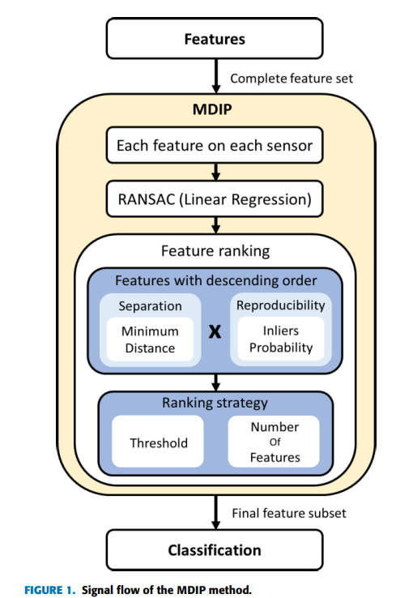
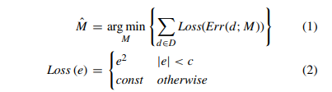
Methodology
1. RANSAC regression: reduce the influence of outlier
2. Inlier probability(IP): Feature stability
IP = num(inlier)/num(total)
3. Minimum distance(MD): Class separability
Score = IP x MD
Notes:
RANSAC 實際流程
雖然這段沒有寫完整流程，但實際演算法大致如下：
隨機挑選最少數量的樣本（例如做直線回歸只需要 2 個點）。
用這些點建立一條候選回歸線。
計算所有資料點到這條線的殘差（Residual）。
根據門檻 ccc 將資料分成 inliers（殘差小於 ccc）和 outliers（殘差大於等於 ccc）。
重複上述步驟很多次，每次都隨機抽不同的樣本。
選擇擁有最多 inliers（或等價地，具有最小總損失）的模型作為最佳模型，再用所有 inliers 重新估計回歸線。
若誤差小於 Threshold，正常計算平方誤差；若誤差過大，則給固定懲罰，不讓離群值主導回歸模型。
問題:找不到MD定義 可能也是取最小角度差或頭尾的差距和

Slide 6
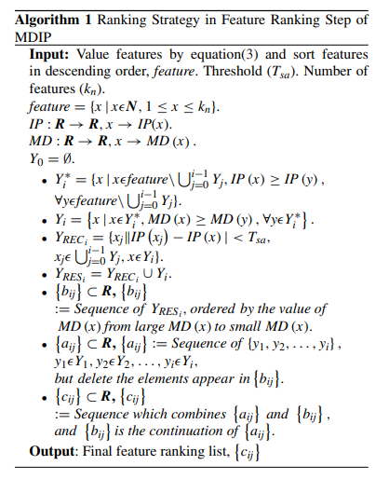
Algorithm- ranking strategy
Notes:
先把IP高的一群給挑出來(最大IP-最小IP<Tsa)
再用MD排序這群

Slide 7
Result
Long-term drift dataset
  16 MOS sensors (4 sensor types)
  6 gases, 13,910 samples
  10 batches collected over time
  128 features (8 features (steady, EMA of different gain )× 16 sensors)
Validation
  Train: Batch 1
  Test: Batch 2–10
  Evaluate long-term drift robustness

Slide 8
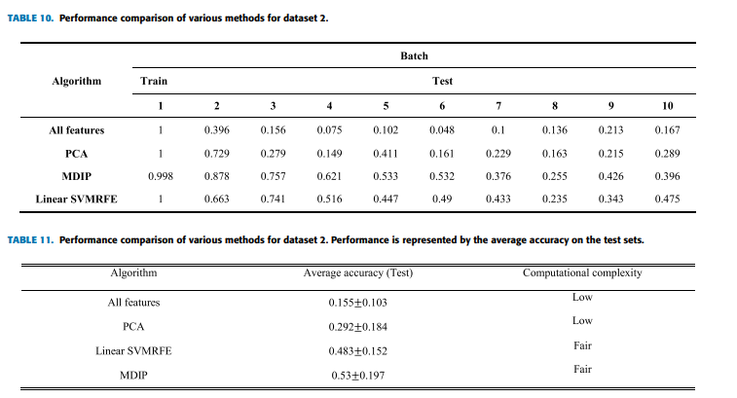
Result

Slide 9
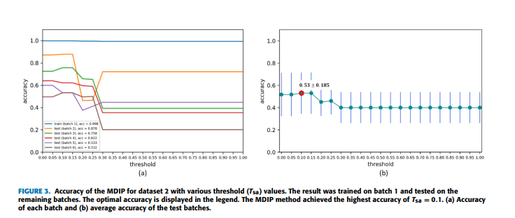

Slide 10
Conclusion
MDIP filters out redundant and unstable features, significantly enhancing the generalization and robustness of electronic nose systems against cross-board variations and long-term drift.

Slide 11
Experiment
Dataset Description
Extracted Features
Redundancy Removal Strategy
MDIP
2Stage-MDIP
Results

Slide 12
Feature Extraction
Dataset: zenodo_long_term_drift
  700 time-series * 12 months
  Diacetyl(0.1ppm,1ppm), phenylethanol(200ppm,1000ppm), ethanol(2 unknown concentration)
62 sensors
Each sensor provides 7 features:
R_{max},R_{0,}(R_{max}- R₀)/ R_{0 ,} R_{plateau ,}AUC, Max and Min Slope
Totally 62*7 features for each gas

Slide 13
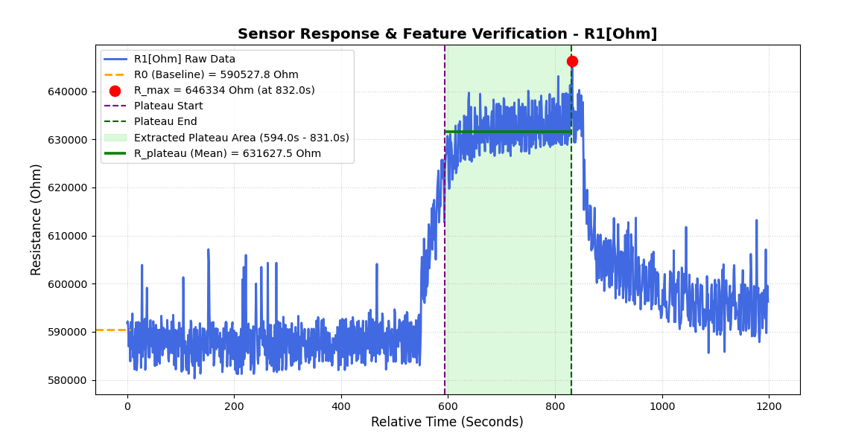
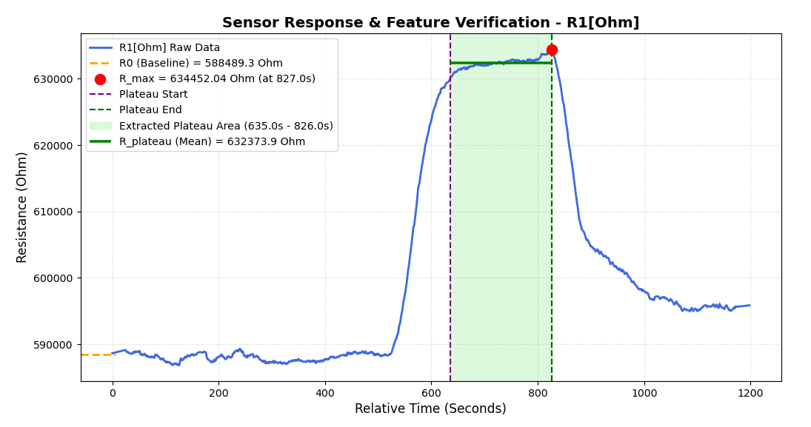
Preprocessing: Savitzky–Golay Filter

Slide 14
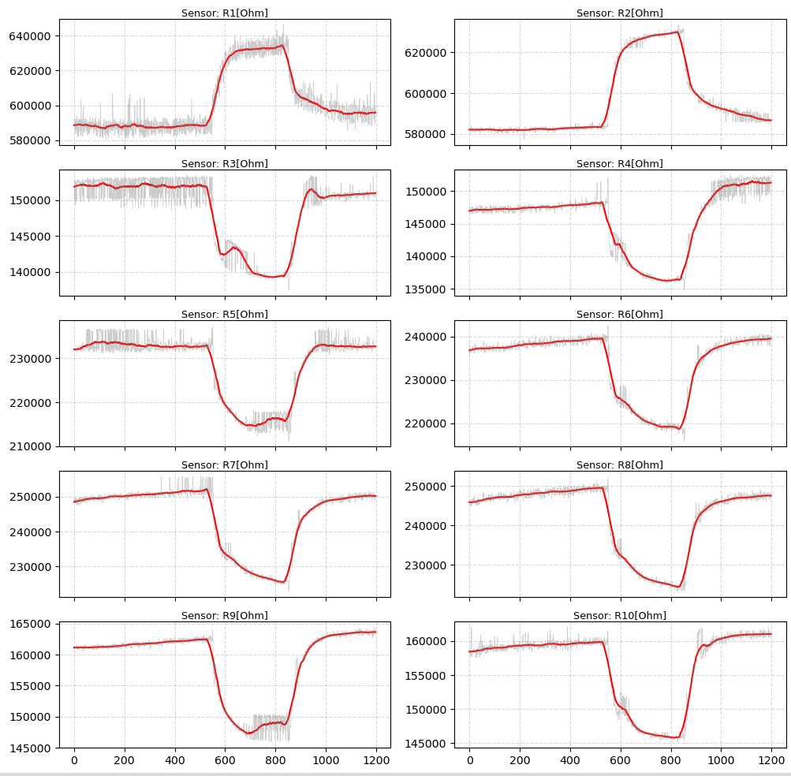
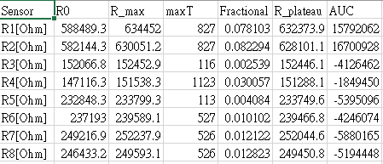
Feature table

Slide 15
Based Feature Screening
R_{0​} was removed due to temporal baseline drift
  Strongly affected by sensor aging and measurement-day variation.
  May cause the model to learn day-dependent patterns instead of VOC characteristics.
  Retained only for calculating normalized features.
R_{max}⁡​ was removed due to redundancy
  Highly correlated with R_{plateau}​.
  More sensitive to transient noise and signal spikes.
  R_{plateau}​ was retained as a more stable steady-state feature.
Screening outcome
  PC1: 48.6% → 59.9%
  PC1 + PC2: 72.9% → 81.2%
  Reduced unstable and redundant information in the feature set.

Slide 16
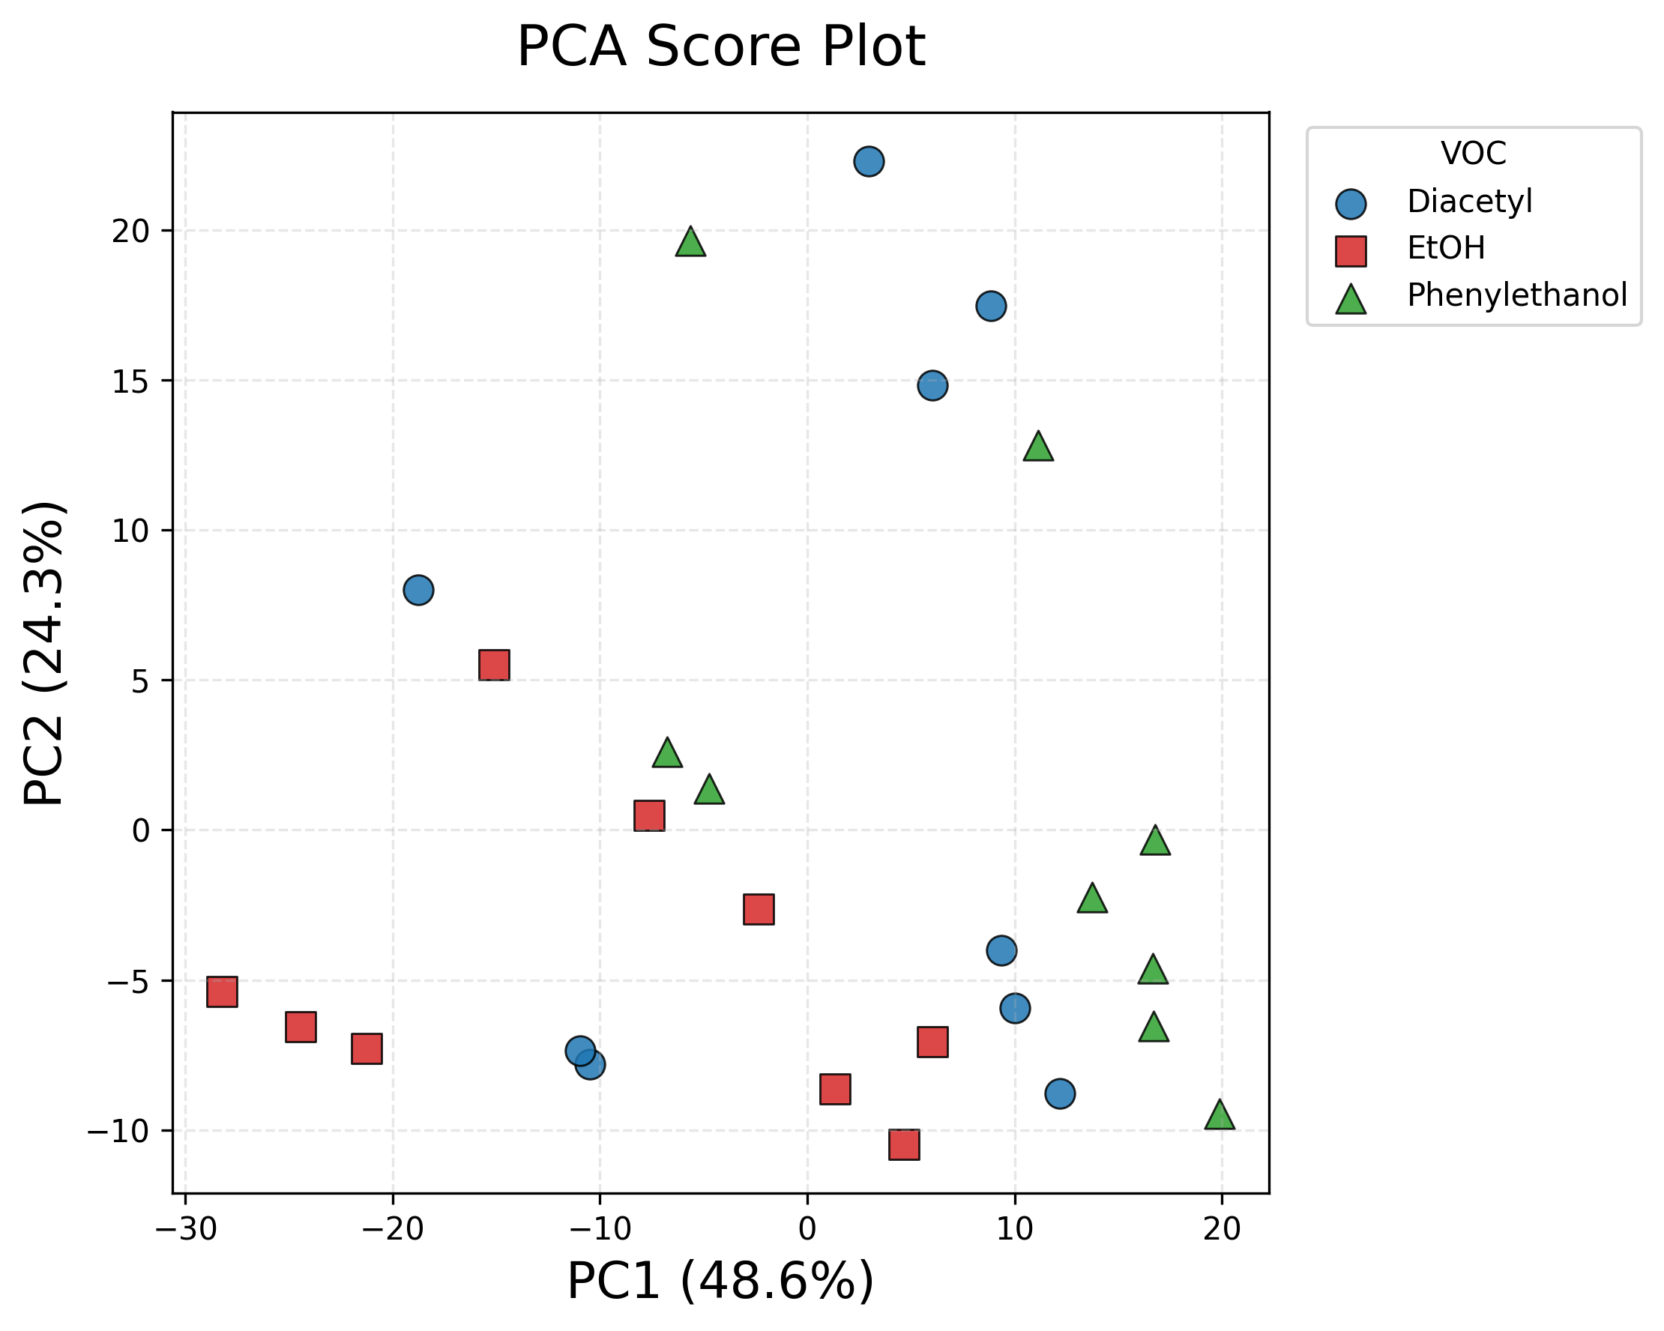
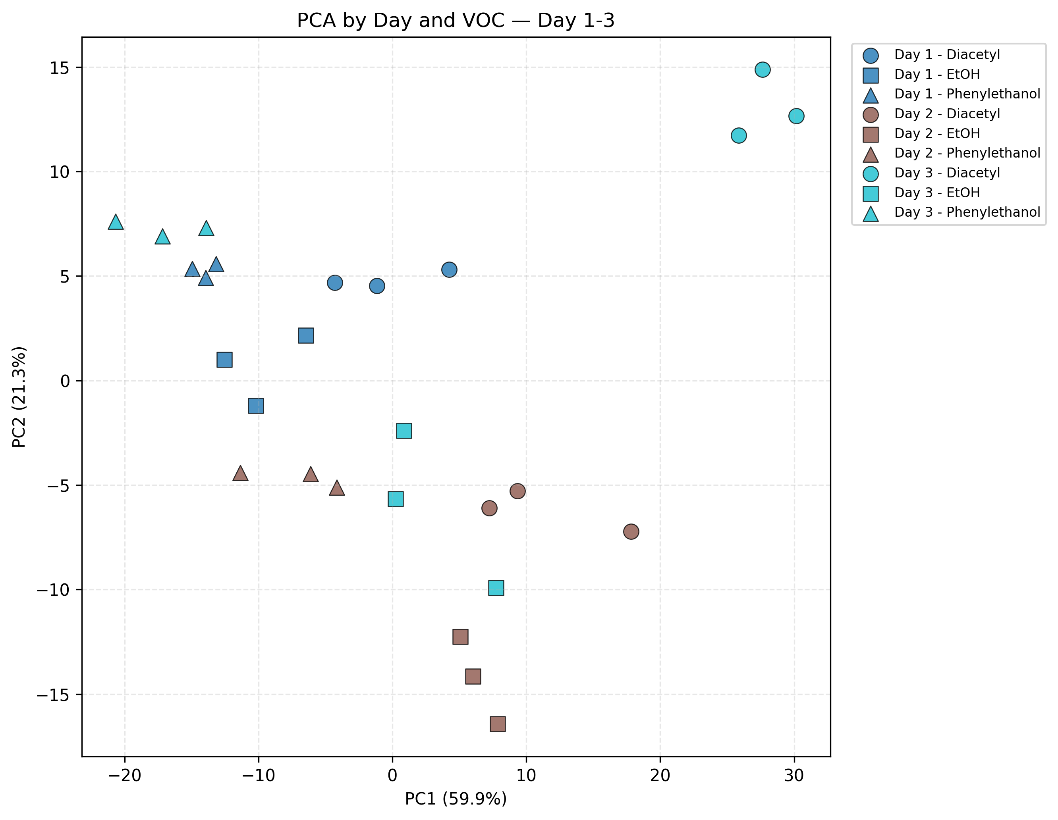
PCA Day1-3 result comparison
All feature
Removed Ro, Rmax

Slide 17

Correlation-Based Redundancy Screening
  Pearson correlation
Pearson correlation was calculated between corresponding features of each sensor pair.
A sensor pair was considered redundant when at least 4 of 5 features had |r|>0.92.
One representative sensor was retained from each redundant pair.
Redundant sensors were removed to reduce dimensionality and repeated information.
Finally retained sensors: R1, R3, R9, R19, R31, and R49 (reduced to 6*5=30 features).

Slide 18
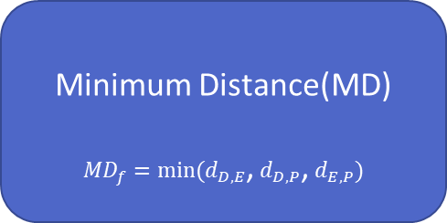
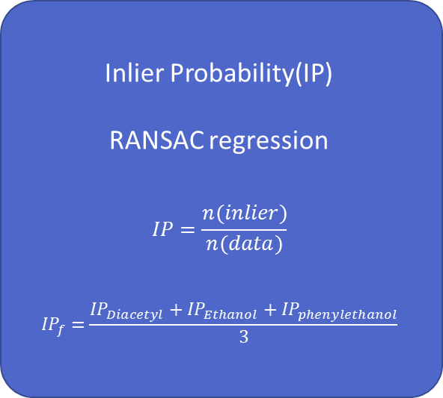
MDIP
$$MDIP=IP×normalized MD$$
Inlier Probability(IP)
RANSAC regression
$$IP=\frac{n(inlier)}{n(data)}$$
$${IP}_{f}=\frac{{IP}_{Diacetyl}+{IP}_{Ethanol}+{IP}_{phenylethanol}}{3}$$
Minimum Distance(MD)
${MD}_{f}=min⁡(d_{D,E}$, $d_{D,P}$, $d_{E,P})$
Rank | Feature | Mean IP | Standardized MD | MDIP Score
1 | R19_Min_Slope | 0.493 | 1.186 | 0.493
2 | R19_Max_Slope | 0.484 | 1.315 | 0.484
3 | R49_AUC | 0.535 | 0.804 | 0.424
4 | R1_Fractional_Change | 0.503 | 0.682 | 0.338
5 | R49_Min_Slope | 0.502 | 0.592 | 0.293

Slide 19
Training& Validation
Dataset | Days | Samples | Purpose
Training | Day 1–25 | 215 | Feature ranking and model training
Validation | Day 26–30 | 45 | Top-k and model selection
Training Procedure
Day 1–25
↓
Feature Selection
(All Features / Two-Stage MDIP Top-k)
↓
Standardization
↓
PCA
↓
Two-Stage Classifier
(Linear SVM / Random Forest)
Validation Procedure
Scaler.transform + PCA.transform
↓
Day 26–30 Validation
↓
Compare Top-k and Models
↓
Select Best Model
Validation Macro F1

Slide 20
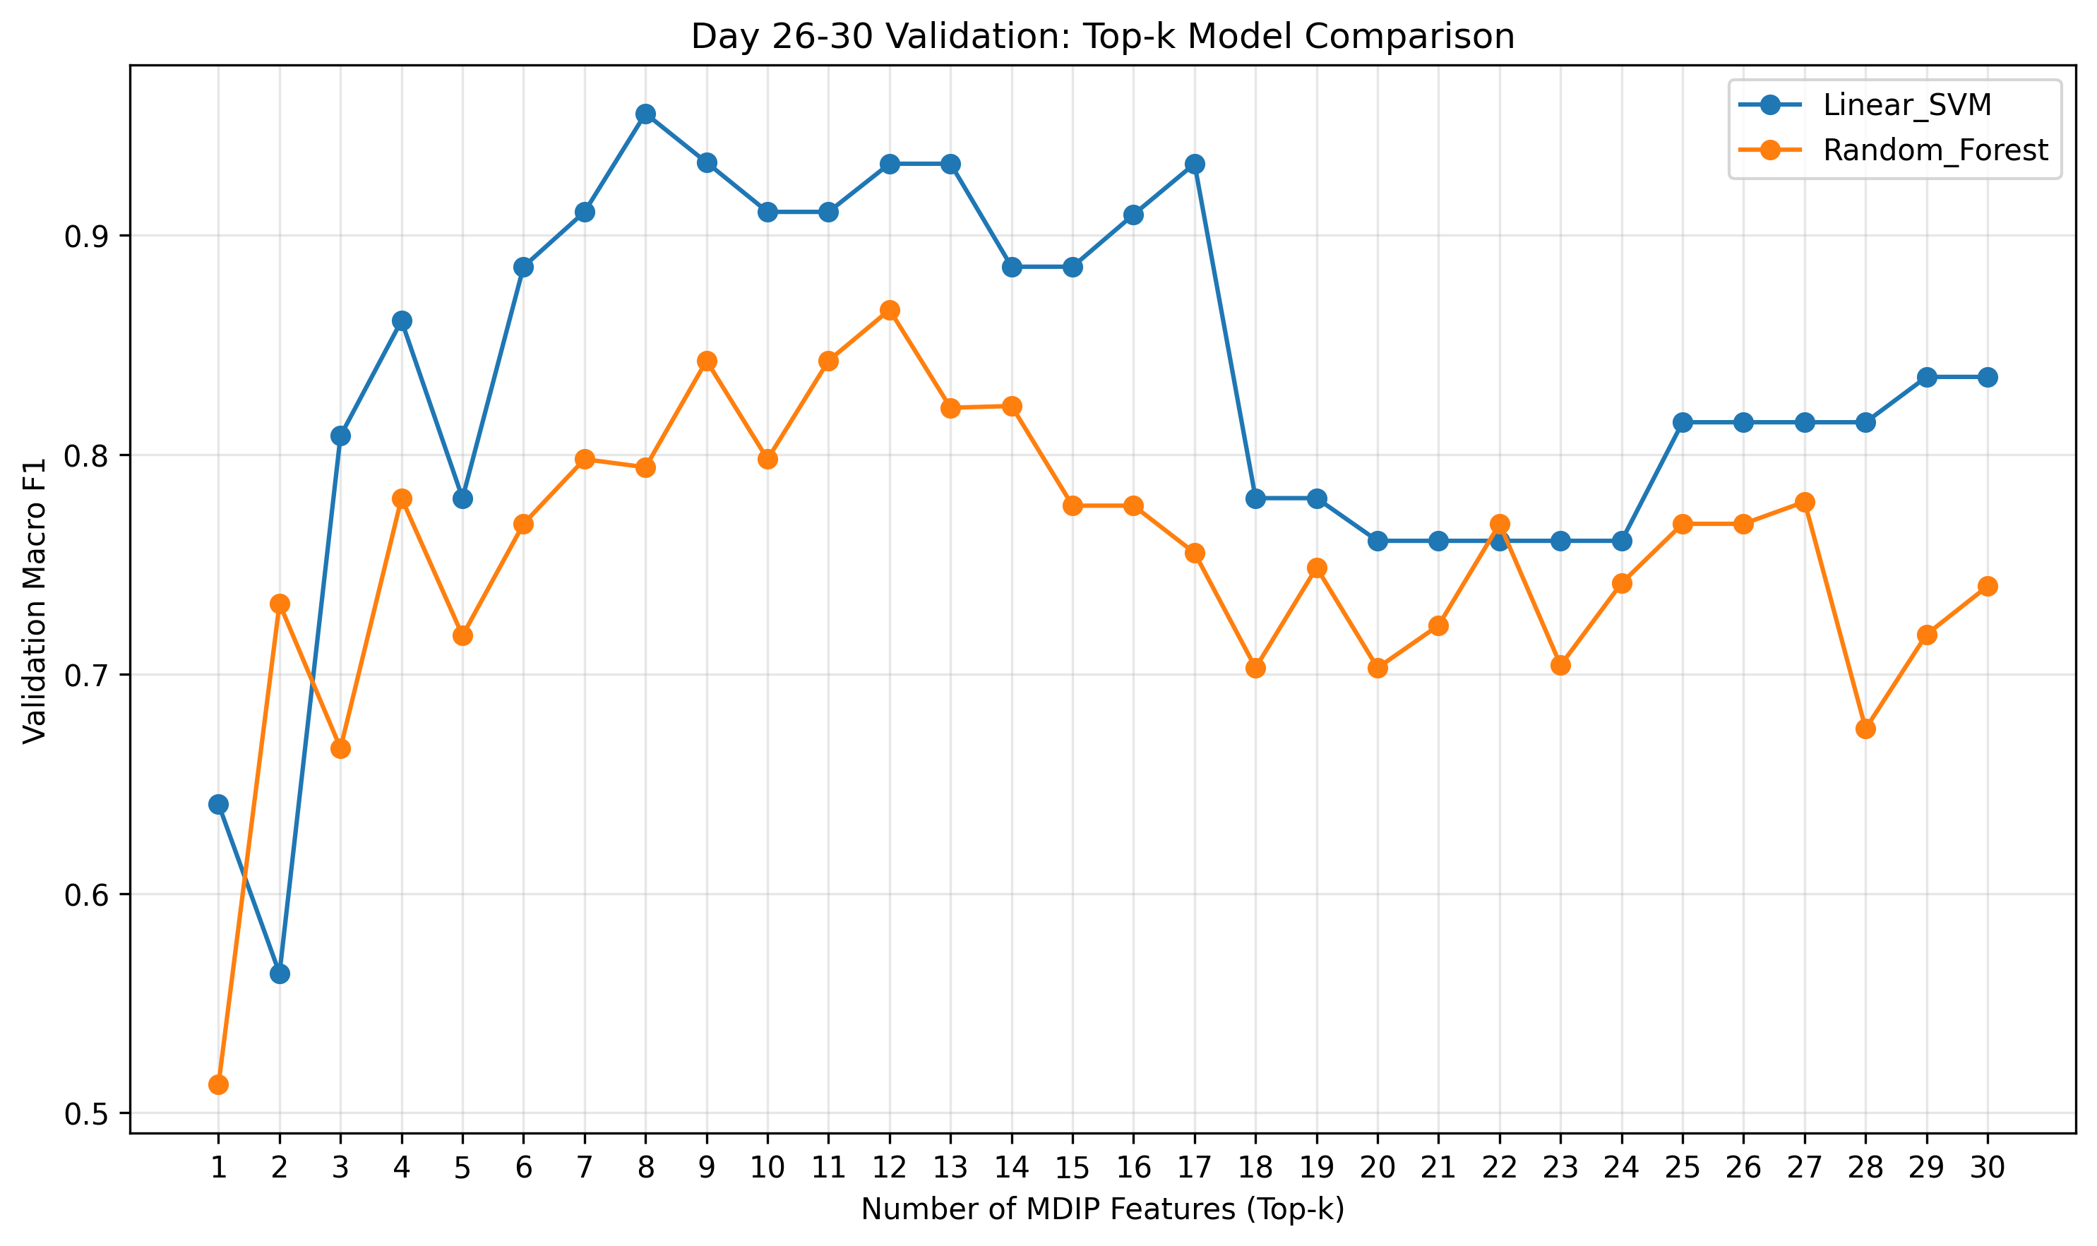
Top-8 Features Achieved the Best Validation Performance

Slide 21
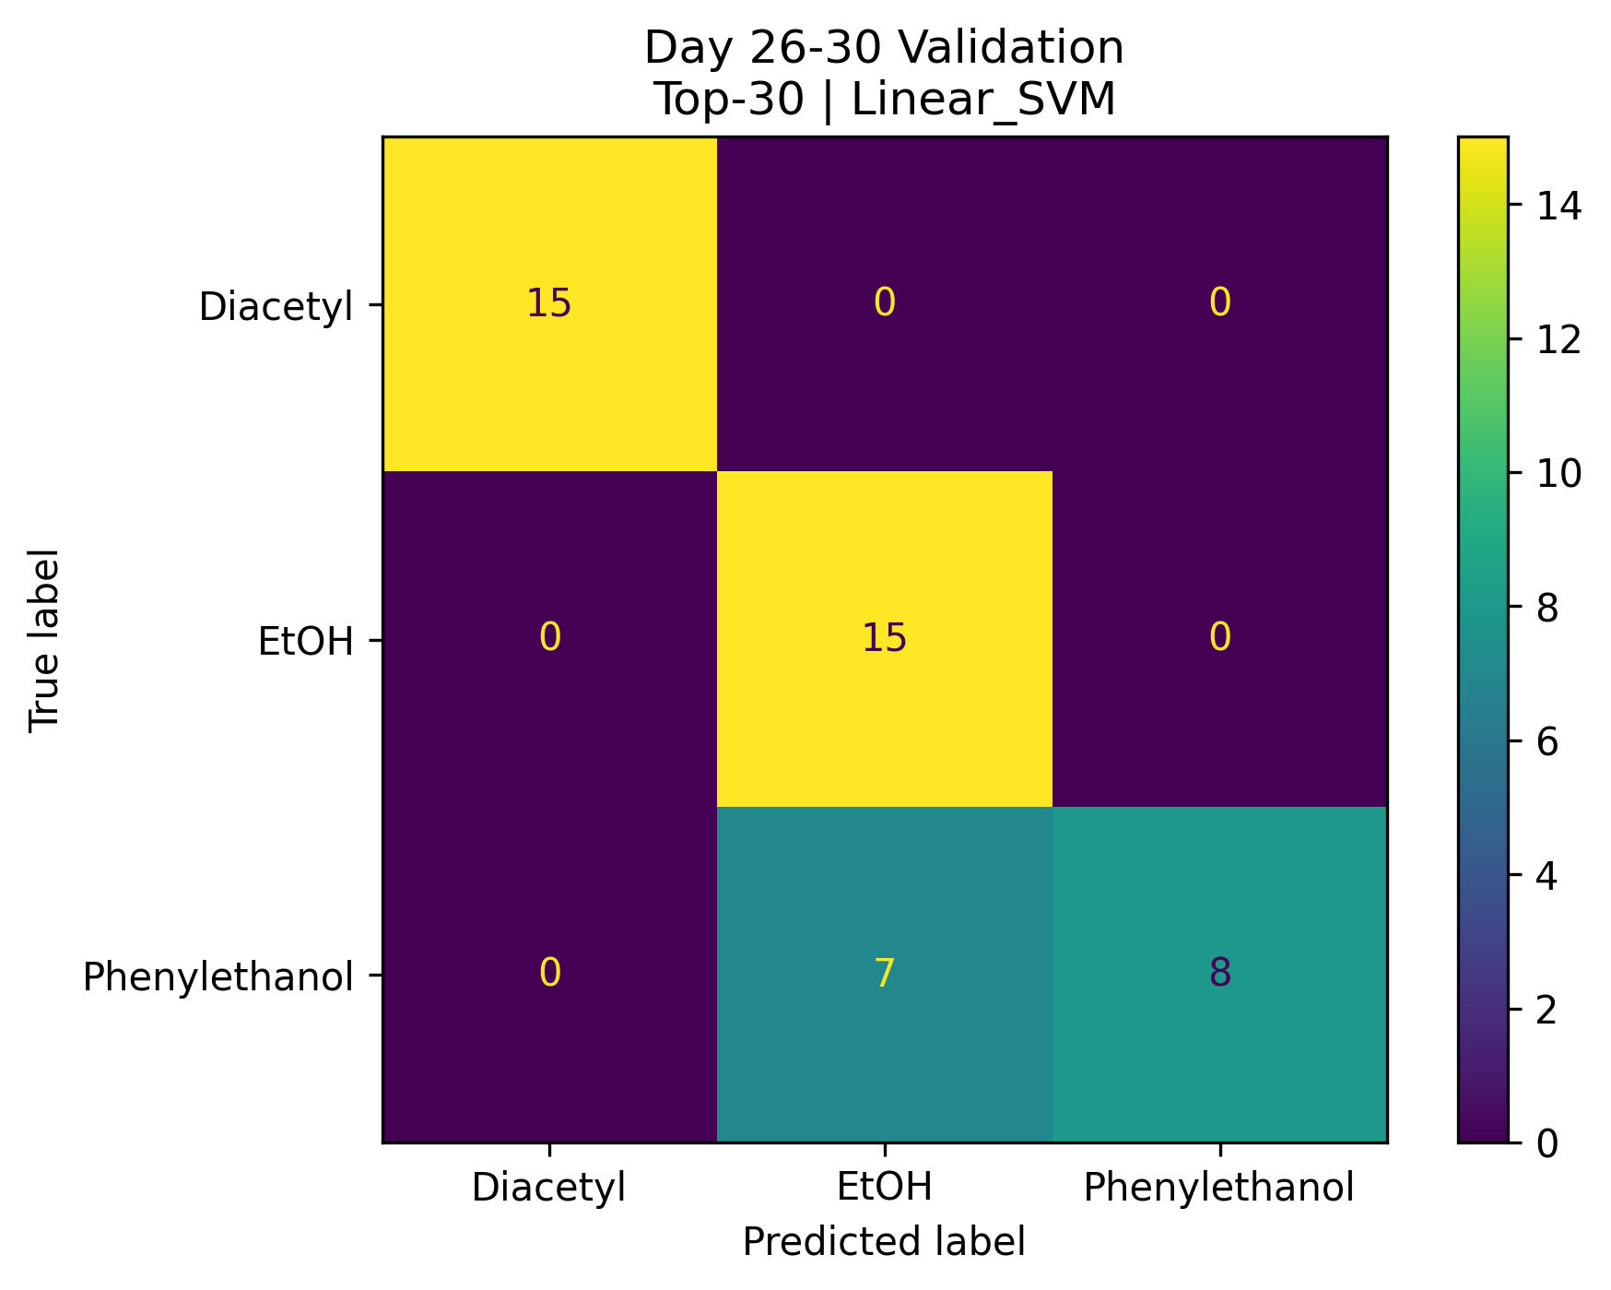
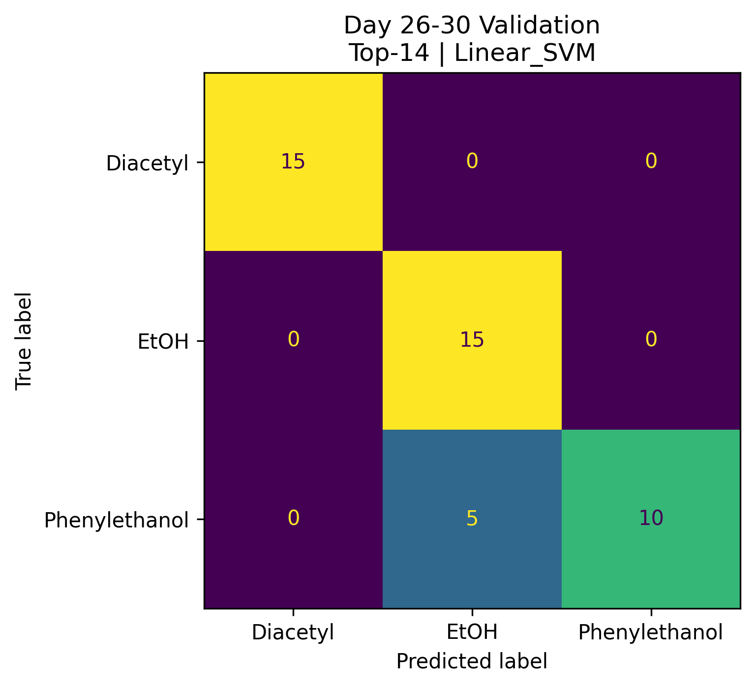
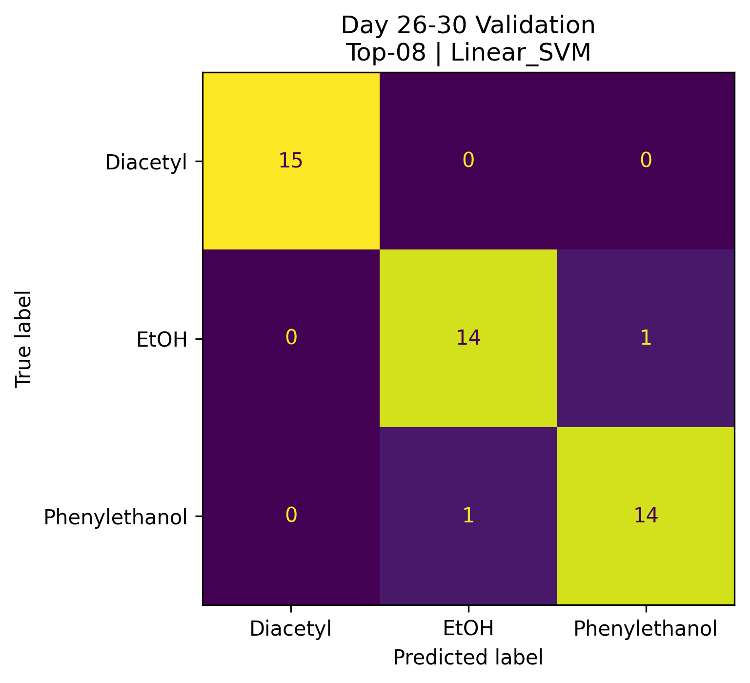
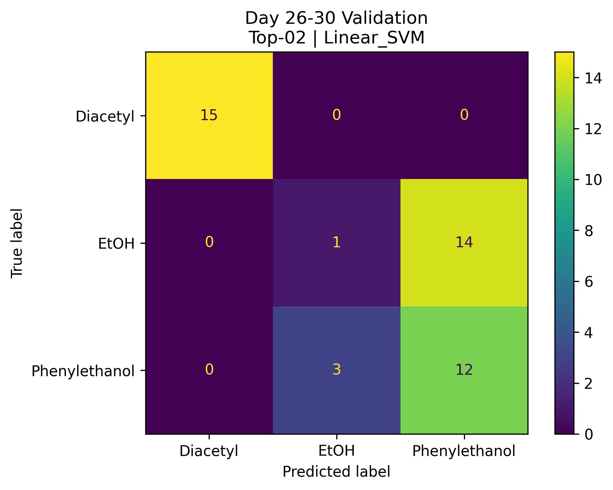
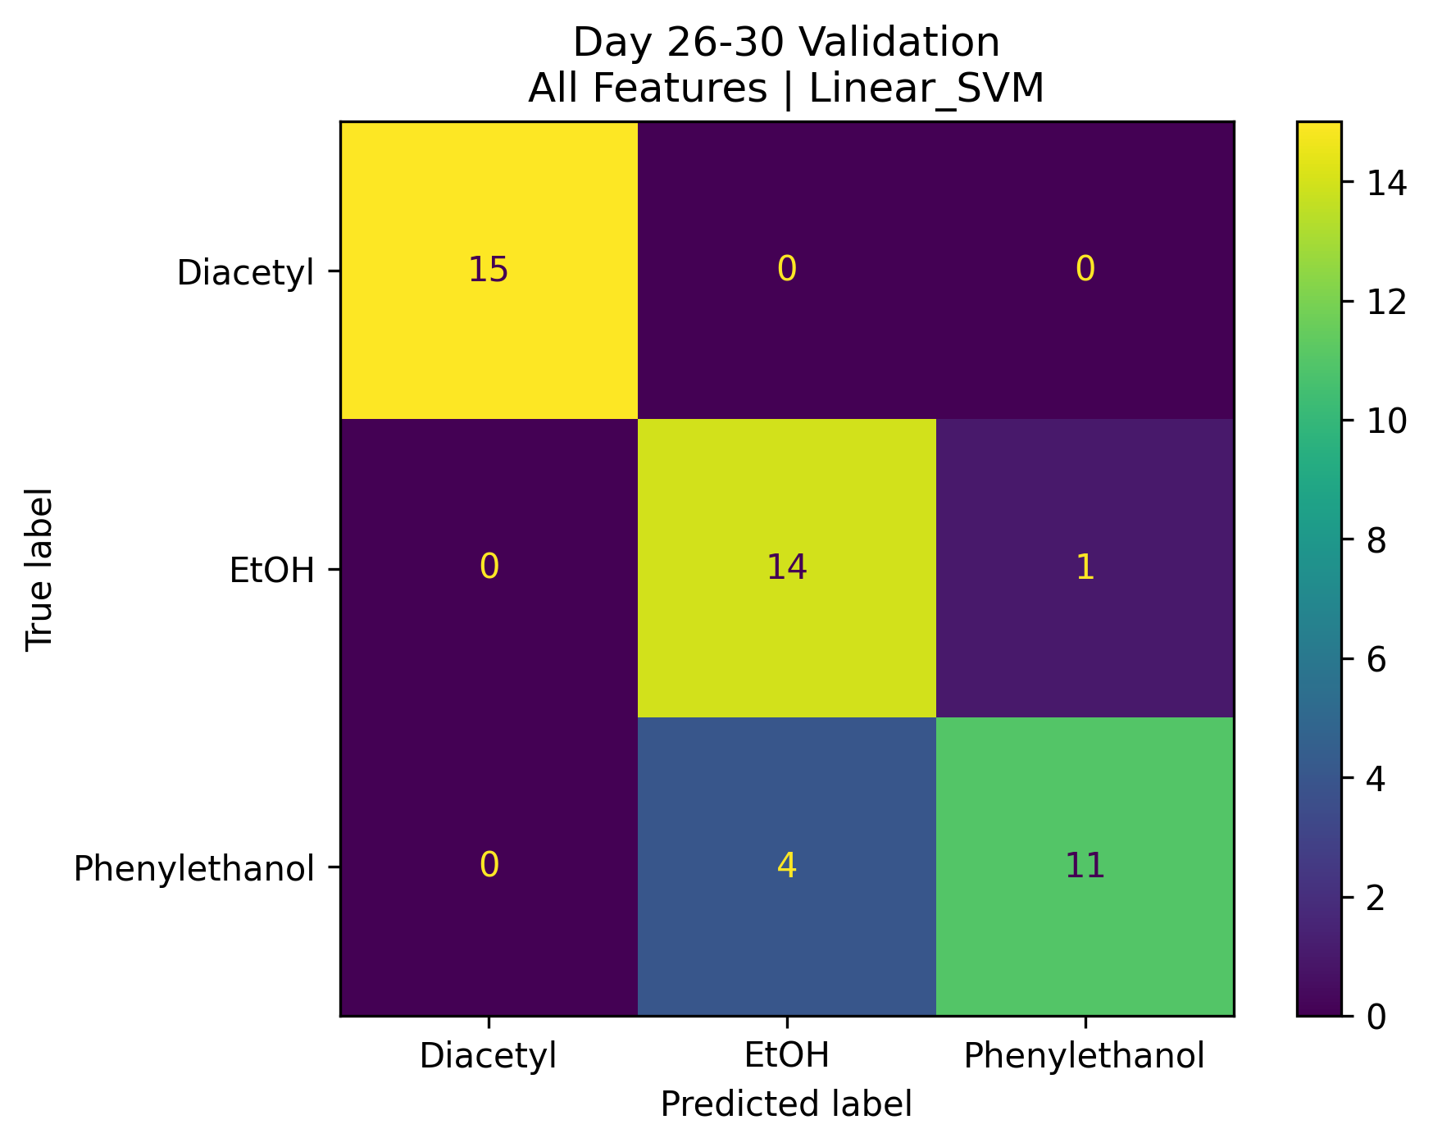
Different number of feature
Number of feature | Accuracy
310(all feature) | 0.89
30 | 0.84
14 | 0.82
8 | 0.96
2 | 0.62

Slide 22
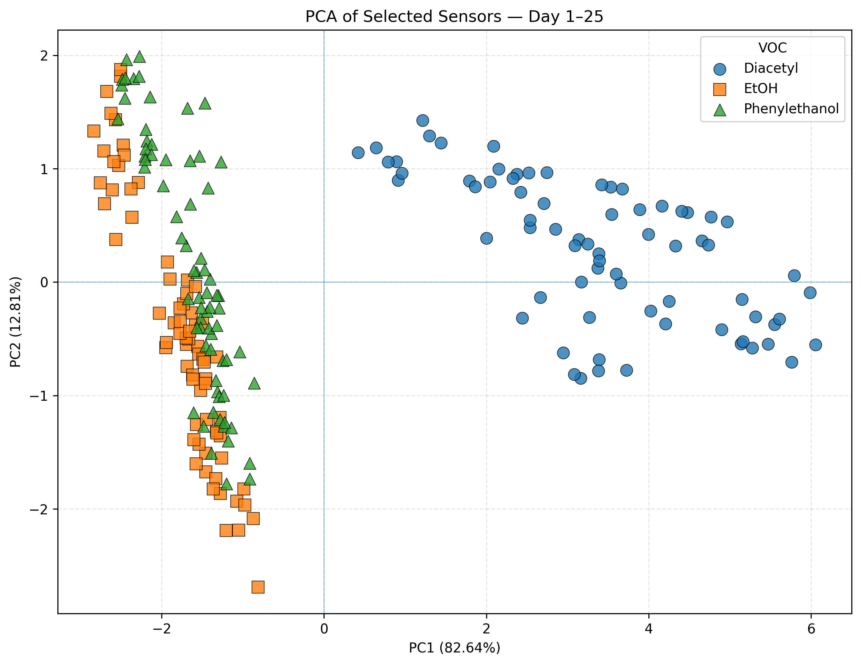
PCA Training result

Slide 23
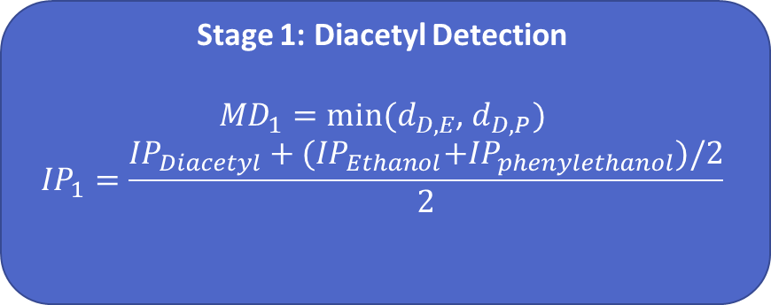
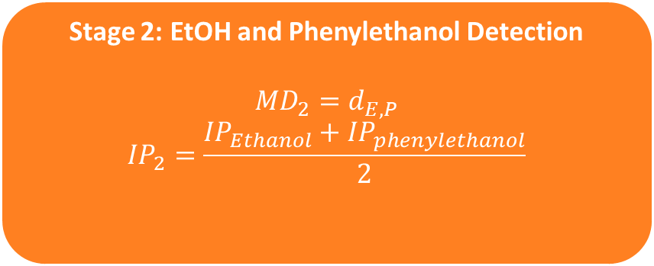
2-stage MDIP
The original MDIP used the minimum distance among all VOC pairs. However, the main classification difficulty was EtOH vs. Phenylethanol.
Stage 1: Diacetyl Detection
${MD}_{1}=min⁡(d_{D,E}$, $d_{D,P})$
$${IP}_{1}=\frac{{IP}_{Diacetyl}+{(IP}_{Ethanol}+{IP}_{phenylethanol})/2}{2}$$
$$MDIP=0.3MDIP1+0.7MDIP2$$
Rank | Feature | Stage 1 IP | Stage 1 MD | Stage 2 IP | Stage 2 MD | Stage 1 MDIP | Stage 2 MDIP | Final Score
1 | R1_Fractional_Change | 0.503 | 5.671 | 0.532 | 2.626 | 0.440 | 0.532 | 0.504
2 | R31_Fractional_Change | 0.503 | 4.754 | 0.532 | 1.695 | 0.369 | 0.532 | 0.483
3 | R49_AUC | 0.535 | 7.935 | 0.518 | 1.008 | 0.535 | 0.349 | 0.405
4 | R19_Fractional_Change | 0.554 | 3.592 | 0.539 | 1.216 | 0.307 | 0.441 | 0.401
5 | R1_Min_Slope | 0.544 | 4.801 | 0.510 | 0.858 | 0.403 | 0.291 | 0.325
$$MDIP1={IP}_{1}×{MD}_{norm,1}$$
Stage 2: EtOH and Phenylethanol Detection
$${MD}_{2}=d_{E,P}$$
$${IP}_{2}=\frac{{IP}_{Ethanol}+{IP}_{phenylethanol}}{2}$$
$$MDIP2={IP}_{2}×{MD}_{norm,2}$$

Slide 24
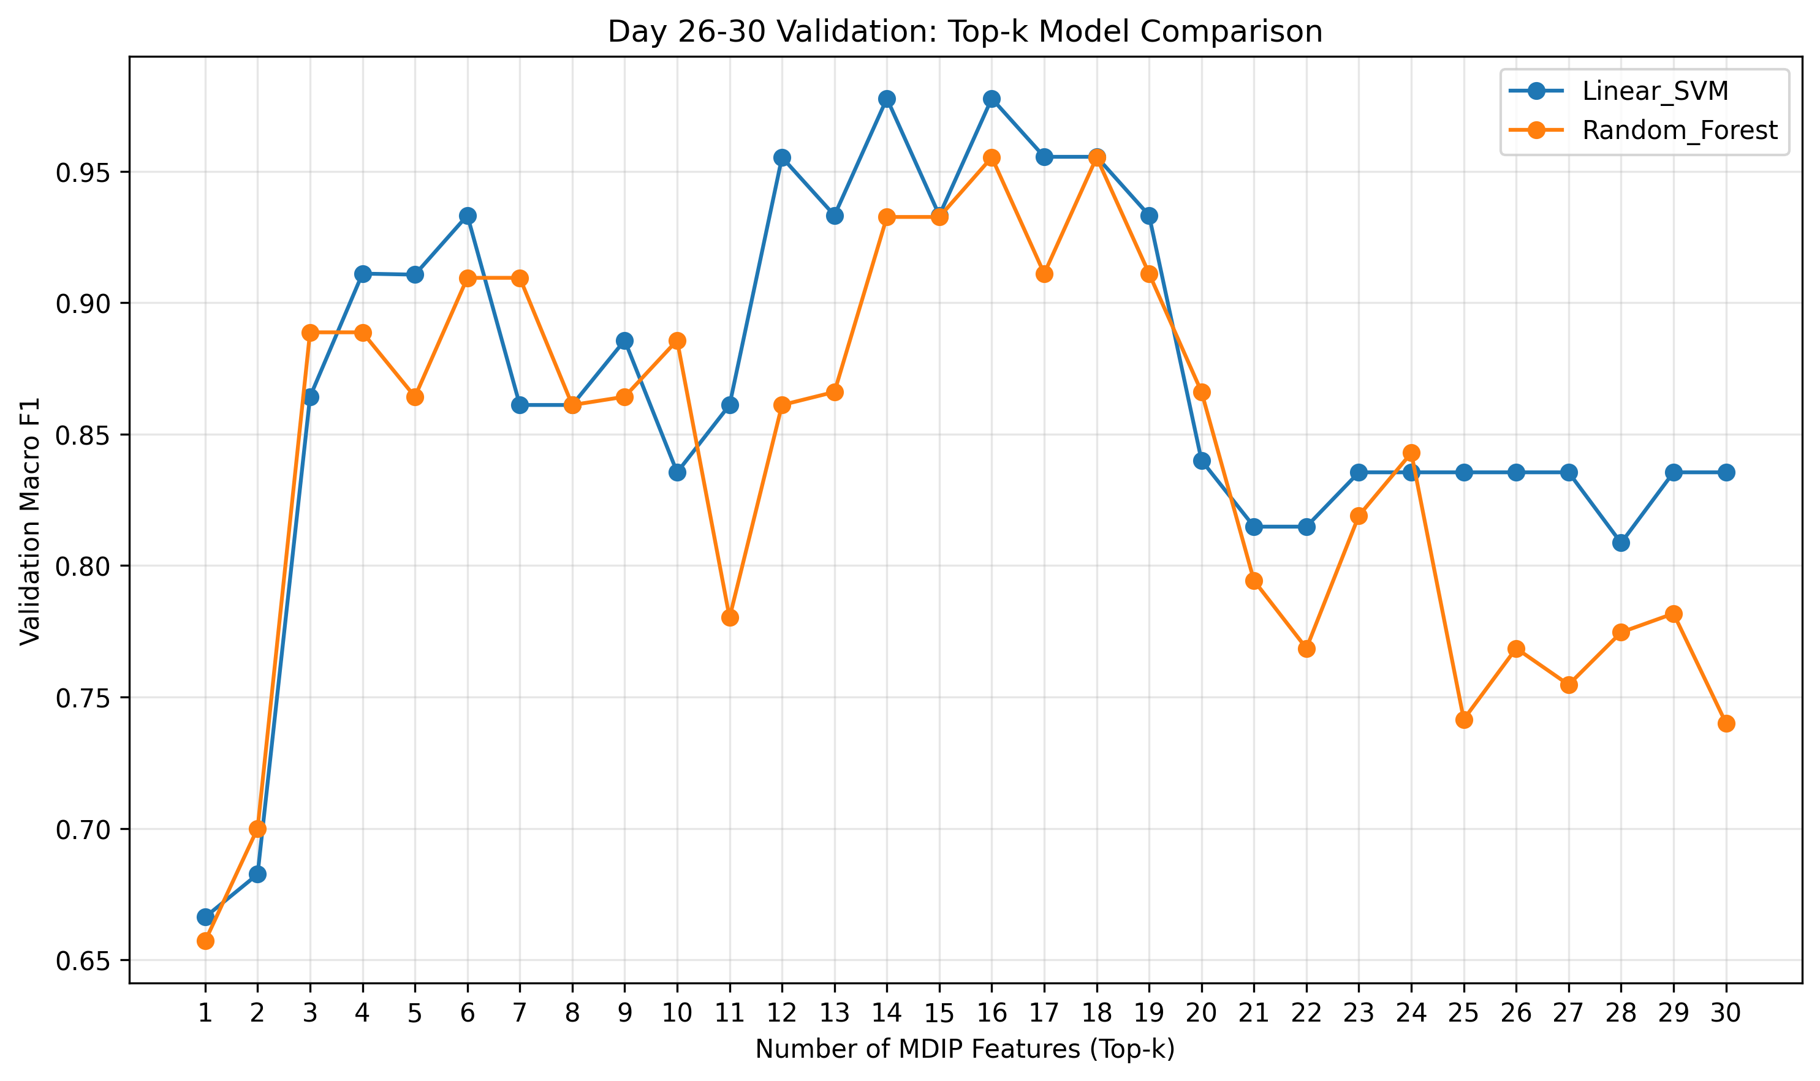
Top-14 Features Achieved the Best Validation Performance

Slide 25
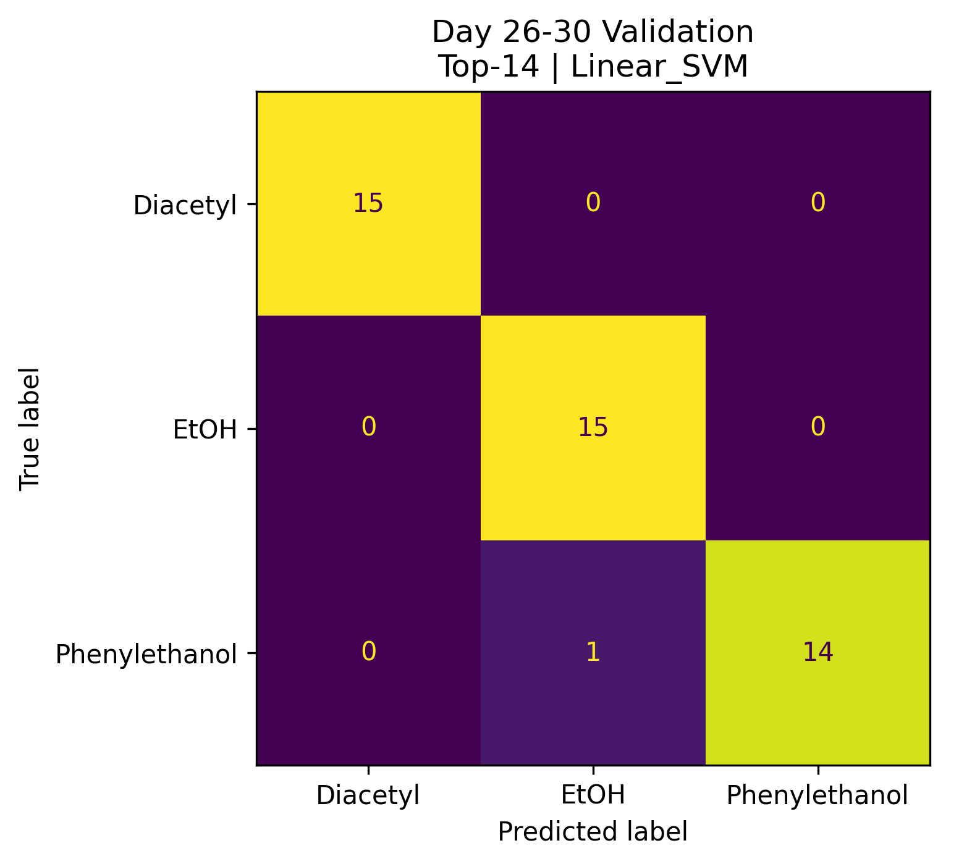
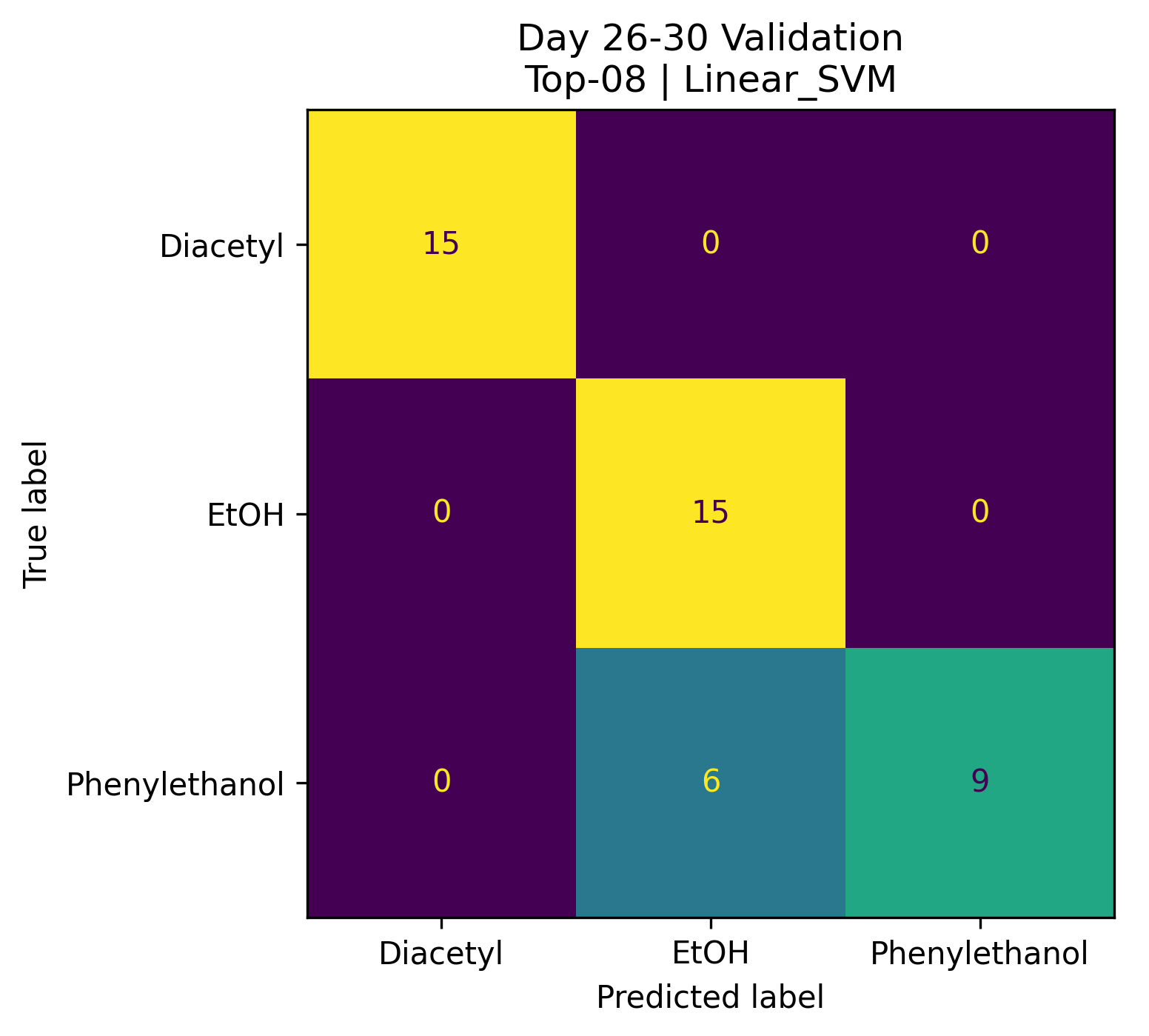
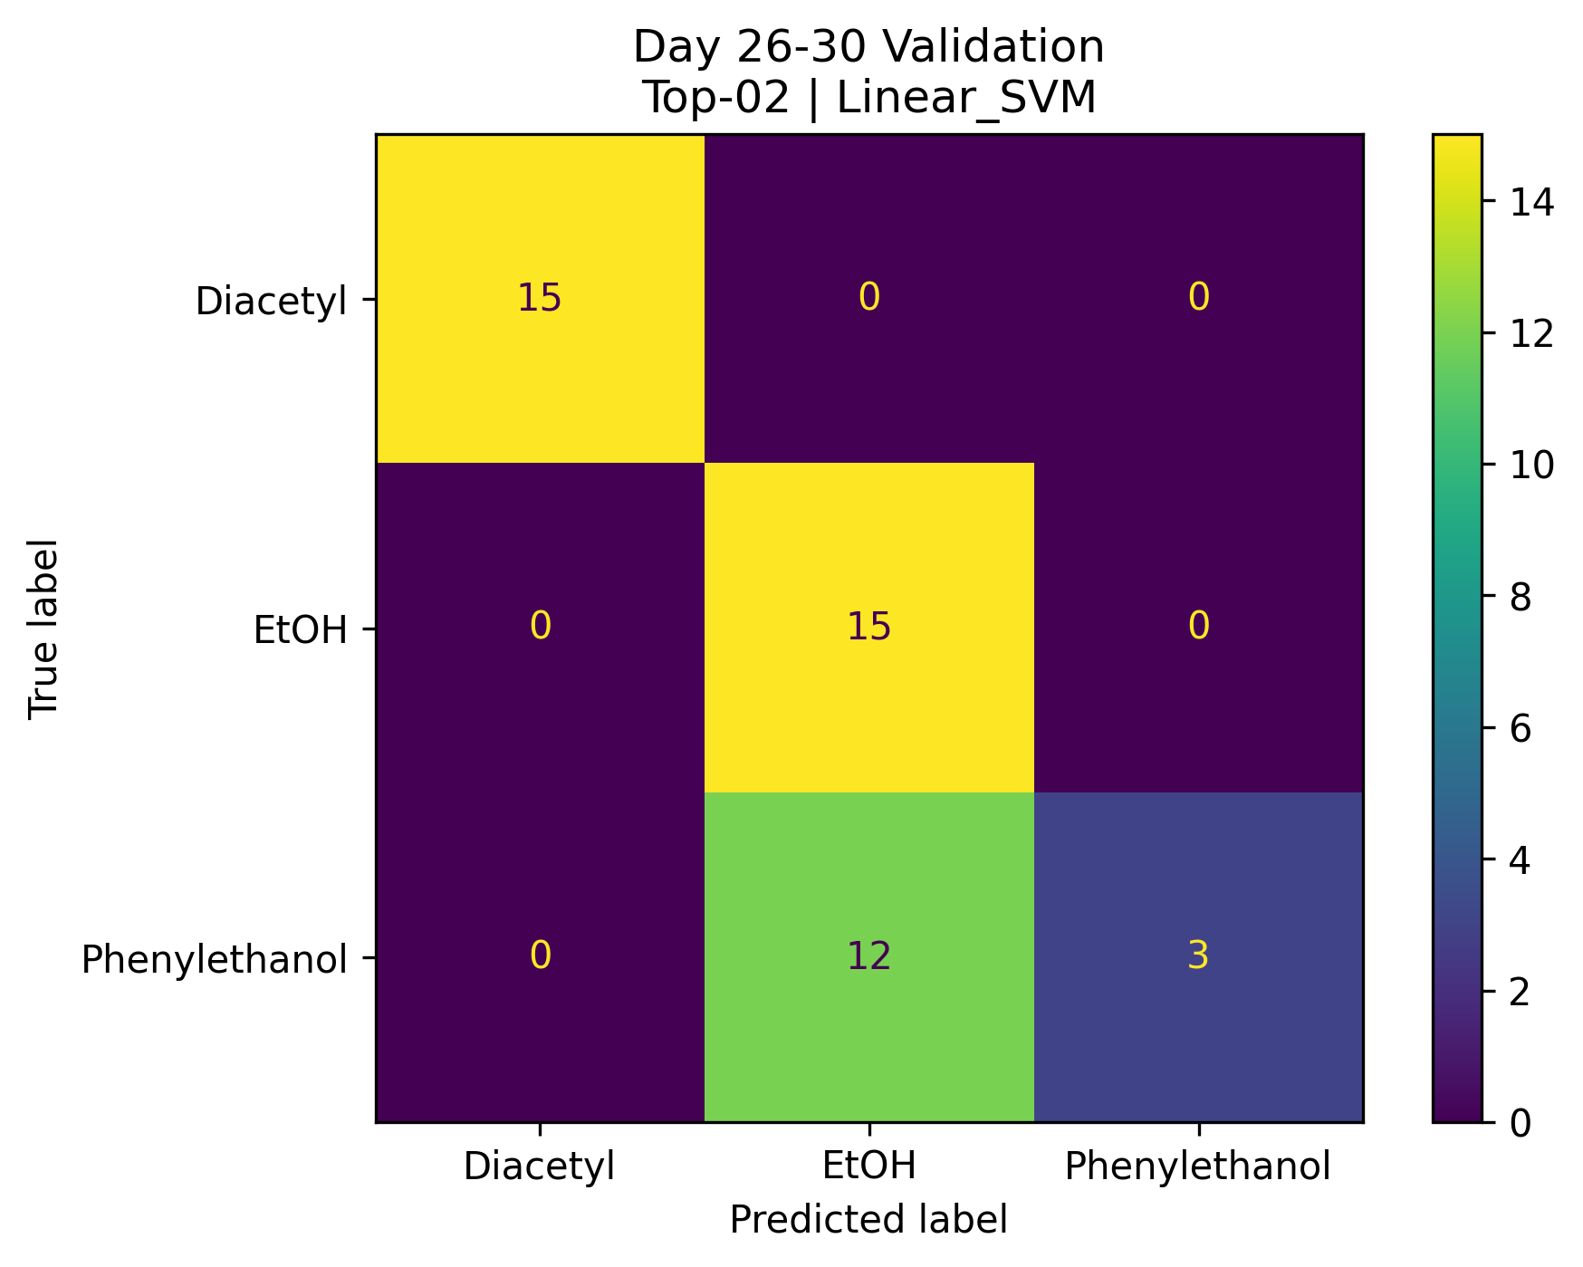
Different number of feature
Number of feature | Accuracy
310(all feature) | 0.89
30 | 0.84
14 | 0.98
8 | 0.86
2 | 0.73

Slide 26
Comparison
The proposed two-stage MDIP achieved the highest accuracy of 0.98 using 14 features.
Two-stage MDIP reduced the feature dimensionality by more than 95% compared with the all-feature baseline.
The result shows that stage-specific feature ranking improves VOC discrimination, especially between EtOH and Phenylethanol.
Feature selection | Number of feature | Accuracy
All feature | 310 | 0.89
MDIP | 8 | 0.96
2-stage MDIP | 14 | 0.98

Slide 27
Future Work
Develop drift-aware feature selection by considering both class separability and feature stability across different days.
Build separate feature sets for Stage 1 and Stage 2, instead of using the same selected features for both classification tasks.
Compare different dimensionality-reduction settings, including fixed two-component PCA, 95% explained variance, and classification without PCA.
Analyze the temporal drift of individual VOCs, particularly the shift of Phenylethanol toward the EtOH decision region.
Evaluate the proposed method on longer time periods and additional VOC concentrations to verify its long-term robustness and generalizability.

