Slide 1
Evaluation of General Data Augmentation Methods for e-Nose Gas Classification
學生 : 陳柏臻
指導教授 : 鄭桂忠 教授

Slide 2
Study Motivation
Data augmentation may improve robustness by introducing controlled variation during training.
With more diverse training patterns, the model may generalize bettter when the domain changes.

Slide 3
Dataset overview
TI- drift dataset
Raw recordings: 415 + 372 + 469 = 1256
3 batches and 5 devices
Each device is equipped with 14 sensors
5 target gases: EtOH, NH₃, NO₂, SO₂, Toluene
Multiple concentrations were included for each gas.

Slide 4
Model Inputs
Each raw recording contains repeated Dilute/Test cycles
One complete Test cycle was extracted as one model sample
Test segment length: 240 time points
Final input size: 14 sensors × 240 time points

Slide 5
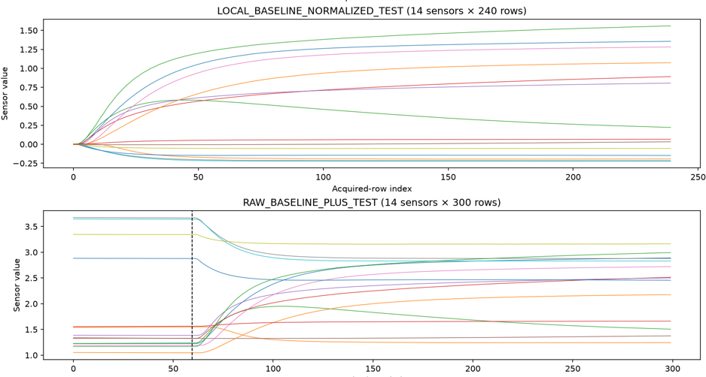

Baseline Normalization
Use the final 60 points of the preceding Dilute segment as the local baseline R₀
Normalize each sensor independently
$X_{i}\left(t\right)= \frac{R_{i}\left(t\right)−R_{0,i}}{R_{0,i}}$
Reduce local baseline variation before classification

Slide 6
Baseline: CNN and Evaluation Protocol
3-layer 1D CNN for five-class gas classification
Validation set used for checkpoint selection
Test set used only for final evaluation
Training setup
  Adam optimizer
  Learning rate = 0.001
  Batch size = 64
  Early stopping
Input
[14 x 240]
Conv1D
[32 x 120]
Conv1D
[64 x 60]
Conv1D
[128 x 60]
Global
Average
Pooling
[128 x 1]
Fully
Connected
128 → 64
Output
[5]
BN + ReLU + MaxPool
BN + ReLU
Notes:
Conv1D 增加 learned feature representations，Pooling 壓縮時間軸，BN 穩定每個 feature channel 的數值分布。

Slide 7
Evaluation Settings & Performance
In domain
  Train / Validation / Test from mixed know domains
Cross-Device
  Hold out one device for testing
Cross-Batch
  Hold out one complete batch for testing
Performance
Macro-F1
In-domain : 0.8884
Cross-device: 0.9115 ± 0.0687
Cross-batch : 0.7449 ± 0.0562
Notes:
這邊我設計了三種 evaluation setting。
第一個是 in-domain，也就是 training、validation 和 test 都來自混合的已知 domain，只是以不同 run group 做切分。
第二個是 cross-device，會完整留下一台 device 當 test，其餘 device 用來 training 和 validation，用來看模型能不能泛化到新的 physical device。
第三個是 cross-batch，完整留下一個 batch 當 test，另外兩個 batch 用來 training 和 validation，用來看模型對新的 acquisition batch 能不能保持 performance。
這三種 setting 測的是不同的 generalization 問題，而後面 augmentation 的重點主要會放在 cross-batch performance。

Slide 8
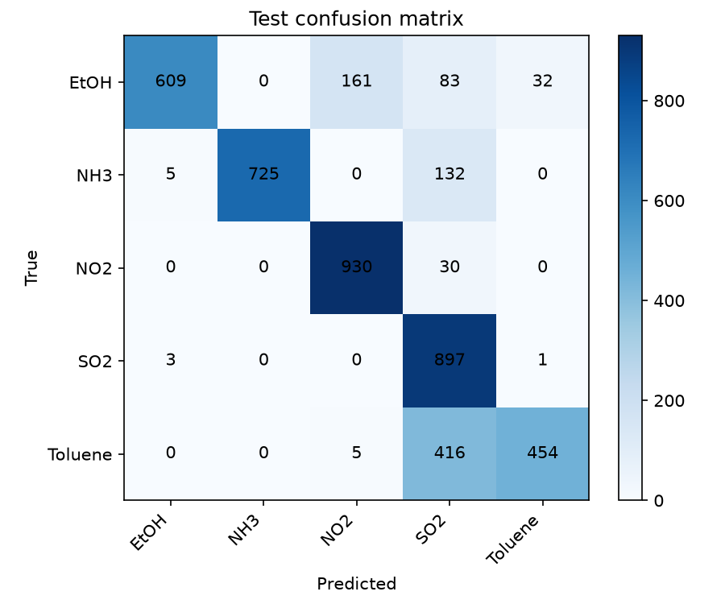
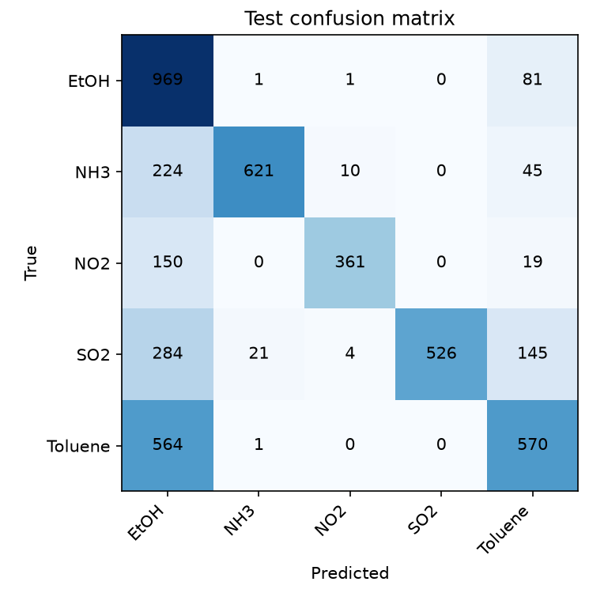
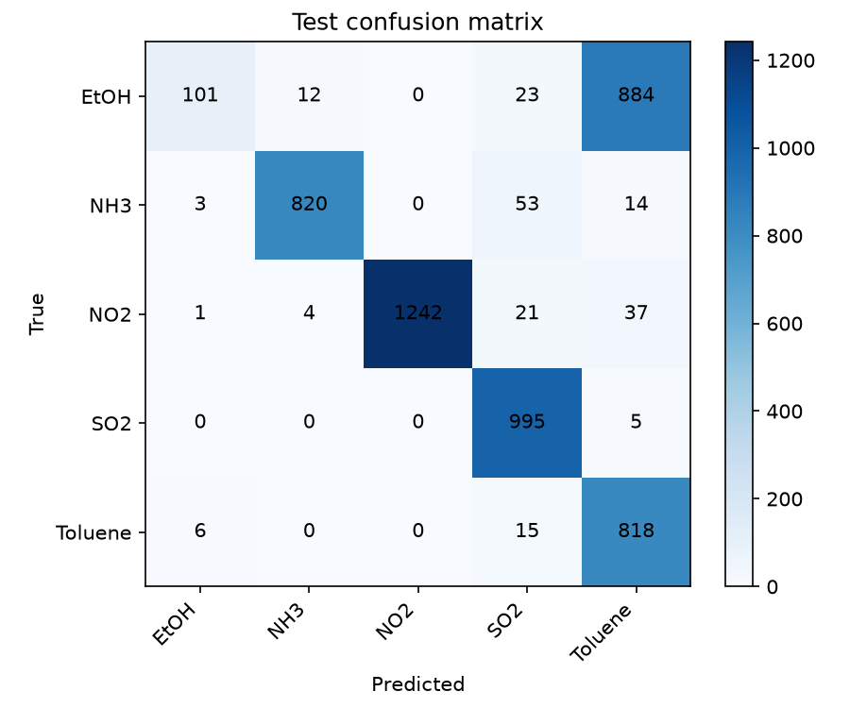
Baseline Cross-Batch Result
Test: Batch 1
Test: Batch 2
Test: Batch 3

Slide 9
General Data Augmentation Methods
 | A1 Gaussian Noise | A2 Channel Masking | A3 Window Slicing
Method | Channel - wise Gaussian noise | Randomly mask 1 of 14 sensor channels | Crop temporal window and resize back to 240 points
Purpose | measurement-like noise | temporary sensor-information loss | temporal variation
Strength | 20 / 30 /40 dB | one of 14 channels | 80% / 90% /95%
Notes:
這邊我選了三種比較 general 的 augmentation method。
A1 是 Gaussian noise，在每個 channel 上加入對應 30 dB SNR 的 noise，主要模擬 measurement-like perturbation。
A2 是 channel masking，每次隨機把 14 個 sensor 中的一個 channel 整段設為 0，用來模擬 sensor information loss。
A3 是 window slicing，把原本 240-point 的 response 隨機保留 90%，再 resize 回 240 points，用來模擬 temporal variation。
這三種 augmentation 都只會加在 training set，validation 和 test 都保持原始訊號。

Slide 10
Augmentation Results on Batch 3
Method | Batch 3 Macro-F1 | Δ vs. B0 | EtOH → Toluene
B0 — No Aug. | 0.7357 | — | 884
A1 — Gaussian Noise | 0.7407 | +0.0050 | 907
A2 — Channel Masking | 0.6992 | −0.0365 | 912
A3 — Window Slicing | 0.7354 | −0.0003 | 902
A1 slightly improved Batch 3 Macro-F1, while A2 degraded performance,
and A3 showed almost no change.
However, none of the augmentations reduced the dominant EtOH → Toluene confusion.

Slide 11
Parameter Tuning Results on Batch 3
A1 Gaussian Noise: 30 dB → 20 dB
A3 Window Slicing: 0.90 → 0.90
Batch 3 | Original | Tuned | Δ
A1 Gaussian Noise | 0.7271 ± 0.0105 | 0.7312 ± 0.0098 | +0.0041
A3 Window Slicing | 0.7336 ± 0.0249 | 0.7336 ± 0.0249 | 0.0000
Overall 3-Batch Mean | Original | Tuned | Δ
A1 | 0.7489 ± 0.0122 | 0.7471 ± 0.0118 | −0.0017
A3 | 0.7549 ± 0.0116 | 0.7455 ± 0.0091 | −0.0094

Slide 12
Conclusion and Next Direction
1. Cross-batch generalization remains the main challenge.
2. Generic augmentation provided only limited improvement and did not resolve the dominant Batch 3 EtOH → Toluene confusion.
3. Parameter tuning and concentration imbalance alone were insufficient to explain or solve the problem.
Next step: CDCNN
Contrastive Domain Generalization Convolution Neural Network (CDCNN)Chu et al., Sensors and Actuators A, 2024
Generate artificial domain variation from source data
Learn domain-robust representations using contrastive learning
Keep the target batch unseen during training
Notes:
綜合目前結果，baseline CNN 最主要的問題出現在 cross-batch generalization。三種 general augmentation 並沒有穩定解決這個問題，尤其 Batch 3 的 EtOH-to-Toluene confusion 仍然存在。進一步調整 augmentation strength 也沒有帶來一致的改善，而 concentration analysis 顯示 concentration 會影響錯誤程度，但不足以解釋整體 cross-batch degradation。
所以下一步我想從單純的 signal perturbation，轉向更 structured 的 domain generalization method。我們預計實作 CDCNN，它利用 feature generation 建立 artificial domain variation，再透過 contrastive learning 學習比較 domain-robust 的 representation。最後會用相同的 leave-one-batch-out protocol，比較 CDCNN 和目前 generic augmentation 的 unseen-batch performance。

