Slide 1


Starbucks
Social Media Analysis
Team Members:
Frank Consentino
Mengyi Gong
Hao Han
Lianze Ma
Pallavi Rastogi

Slide 2
Starbucks Company Profile
Starbucks was founded in 1971 and started out as a roaster and purveyor of whole bean, ground coffee, tea and spices with a single store in Seattle’s Pike Place Market.
Starbucks is named after the first mate in Herman Melville’s novel Moby Dick. The logo is inspired by the sea, featuring a twin-tailed siren from Greek mythology.
Starbucks is the largest coffee house company in the world, with just under 18,000 retail stores in 61 countries of which 11,000 are in the USA.
Starbucks considers these stores a neighborhood meeting place and as such designs an atmosphere conducive to friends and families gathering along with quality service , wireless access and of course a great cup of coffee.
Starbucks went public in June 1992 with a stock offering at $21.50 per share (split adjusted) and is currently trading at approximately $56 per share as of today.

Slide 3
Starbucks Company Profile
Products:
Starbucks offers a range of products that customers enjoy in stores, at home, and on the go.
Coffee: More than 30 blends and single‐origin premium coffees.
Handcrafted Beverages: Fresh‐brewed coffee, hot and iced- coffee beverages, Frappuccino®coffee and non‐coffee blended beverages, smoothies and Tazo® teas.
Consumer Products:
• Coffee and Tea: Whole bean and ground coffee (Starbucks and Seattle’s Best Coffee brands),
StarbucksVIA®, ReadyBrew, Starbucks®K‐Cup®,
• Ready‐to‐Drink (RTD: bottled) Frappuccino®coffee drinks, StarbucksDoubleshot® drinks
Competitors:
We chose to compare Costa coffee and DunkinDonuts with Starbucks. Each of these companies has a specialty which allows them to capture a certain portion of market share.
Costa coffee is a UK based company with the same atmosphere as Starbucks. It has 1,900 stores globally with 1,300 concentrated within the UK.
In contrast Dunkin Donuts is more of a coffee shop, less the Café atmosphere, However, it’s much larger than Costa with 17,000 stores globally and 11,000 concentrated in the USA.

Slide 4
Analysis
We have chosen to gauge the following:
Customer sentiment towards Starbucks, keyword: Starbucks
Customer sentiment towards Starbucks products: Macchiato, Latte, Frappuccino®, Mocha, Espresso, Skinny® beverages and the Americano, Keywords: Starbucks and each of the aforementioned products
Customer sentiment regarding the most popular coffee products: Latte and Mocha across all competitors, keywords: Latte and Mocha

Slide 5
Data Extraction
Our data was obtained from a twitter related website called Topsy (www..topsy.com). The site contains thousands of real-time tweets, however, extraction is limited to about one thousand at a time. This was our best alternative to the Twitter-API as the GetSearch function within Python-Twitter did not work very well.
Two main Python packages were utilized in our analysis: BeautifulSoup and urllib2 to crawl the website of Topsy. In the end, we collected about 10,000 tweets which is a larger amount than the tweets we could have collected from Twitter-API.
The reporting period of our data is 30 days prior to March 4th.

Slide 6
Techniques Applied in our Analysis
An exhaustive list of positive and negative words was created and brought into the Python code to identify and ring-fence positive and negative tweets .
Tweets were categorized in the following manner:
  If the ratio of positive words > ratio of negative words -> Positive
  If the ratio of positive words < ratio of negative words -> Negative
  If the ratio of positive words < ratio of negative words -> Neutral
For visualization purposes, neutral tweets were ignored.
Frequency analysis was utilized, wherein we calculated the total number of tweets for a
particular keyword.
All graphs and charts were created using Python.

Slide 7
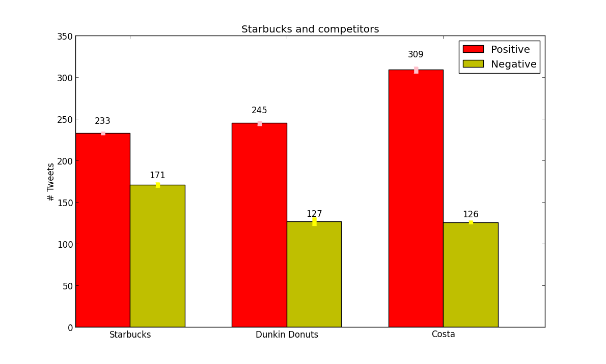
Customer Perception

Slide 8
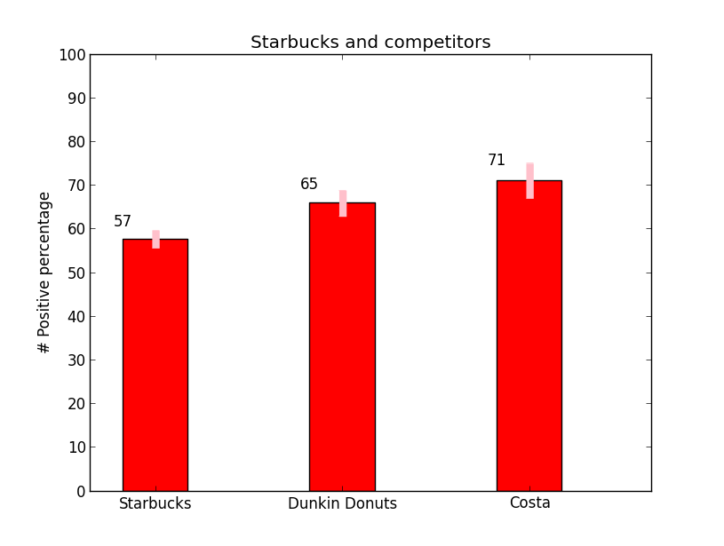
Competitor Analysis

Slide 9
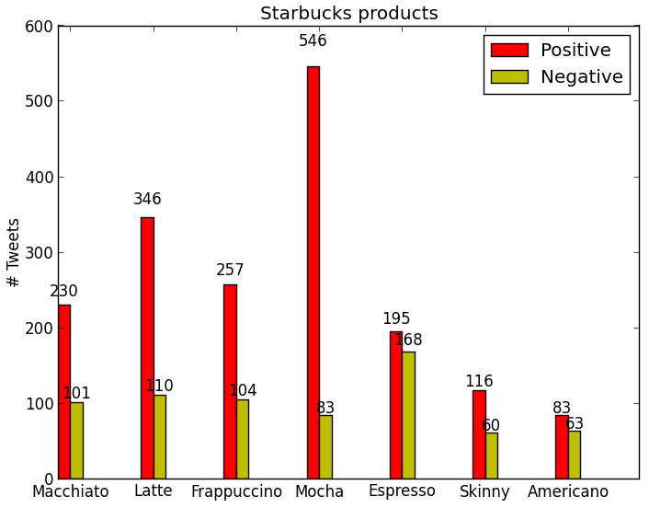
Starbucks Products Analysis

Slide 10
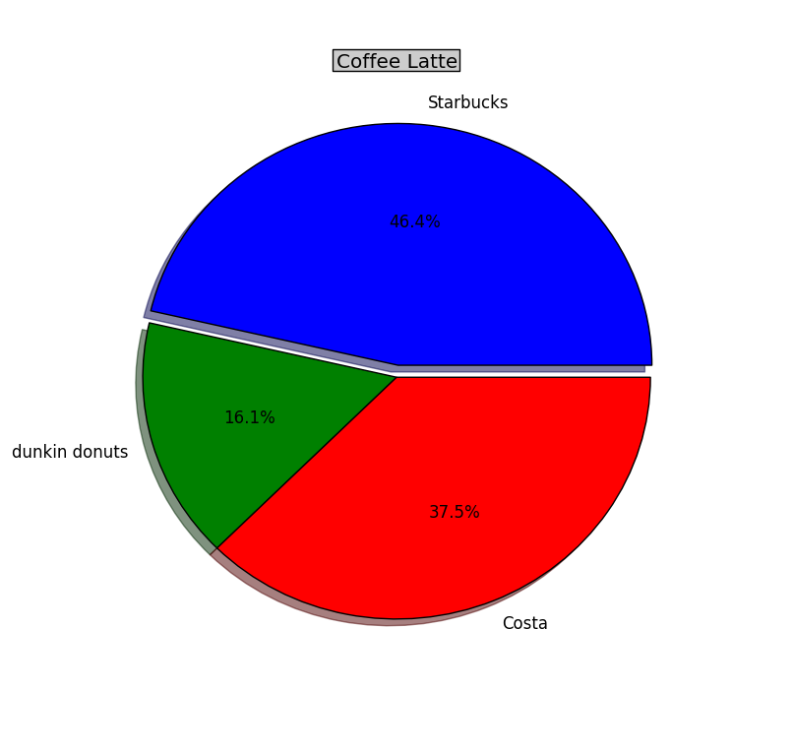
Latte by Competitor Analysis

Slide 11
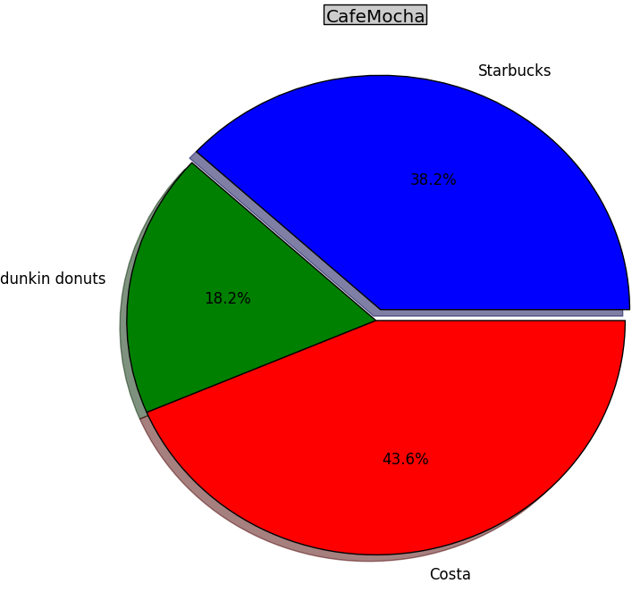
Mocha by Competitor Analysis

Slide 12
Conclusions
Costa Coffee appears to come out on top with regard to customer sentiment
Starbucks has a less positive perception in comparison to its competitors
Mocha is by far the most talked about and positively received Starbucks coffee. Second place belongs to the Latte.
  Work on the social media aspects of its most positive product
Espresso seems to be the least talked about and\or weakest of Starbucks product offerings
Starbucks’ latte appears to be more talked about than its competitors’ latte

Slide 13
References
An Introduction to Text Analysis with Python, Parts 1 through 3, Neal Caren, http://nealcaren.web.unc.edu/an-introduction-to-text-analysis-with-python-part-1
Dive into Python, Mark Pilgrim, http://diveintopython.org
Beginning Python from Novice to Professional, Magnus Lie Hetland
Topsy.com, source of Tweets
http://www.starbucks.com
http://www.dunkindonuts.com
http://www.costa.co.uk/

