Slide 1


Inferring Aspects of Social Media Users
Asaf Beasley, SNSC Student Presentation

Slide 2

Notes:
Joke: setup- say ‘All of us have gazed upon the stars and asked the question’

Slide 3
How can we improve Latent Attribute Inference on Twitter and Facebook?

Slide 4

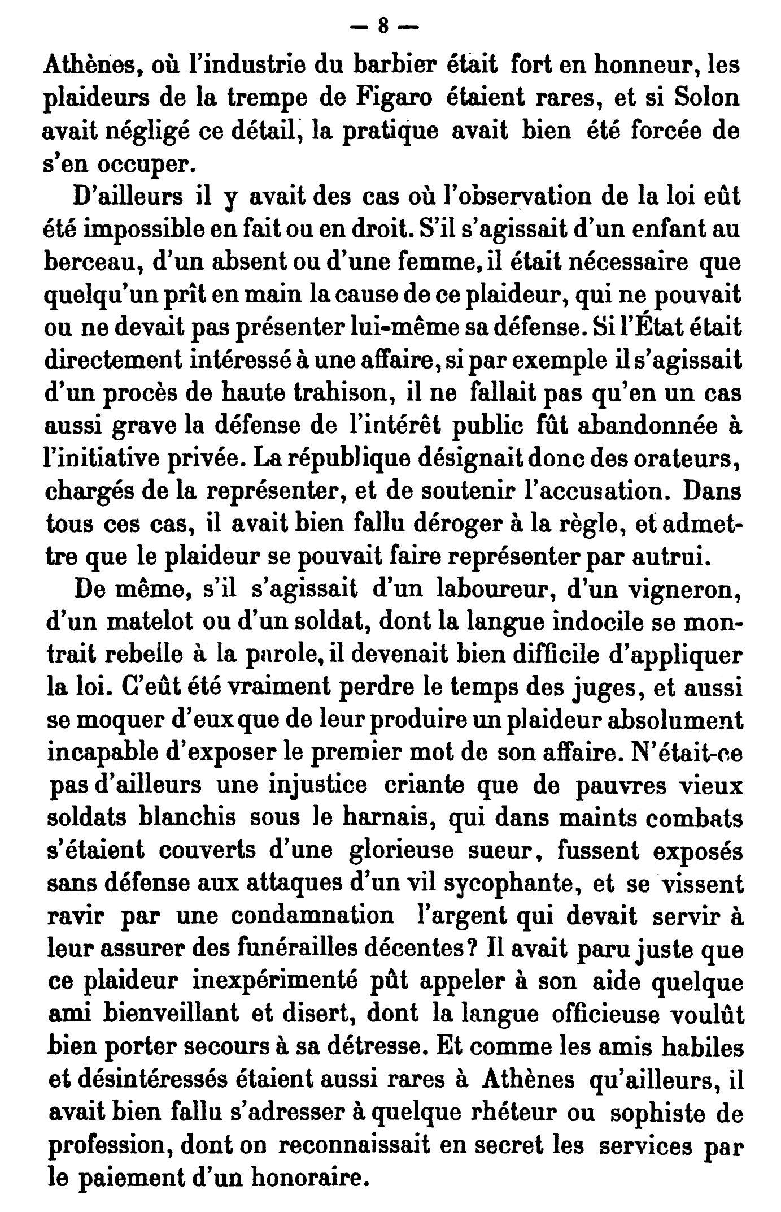



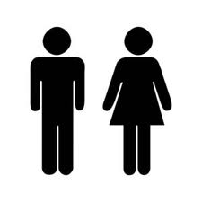
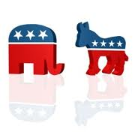
“Latent attribute inference"
Notes:
Latent Attribute Inference is an umbrella term for methods that start with unstructured data, usually on the web, and uses these to put people into categories like Male or Female, Democrat or Republican.

Slide 5
Significance
Recommender Systems
Advertising
Basic Social Science Research: Describe and isolate networks of different types of people
Notes:
Latent Attribute Inference is understandably a very hot area right now because if we can automatically tell things about people, we are in a better position to give them targeted recommendations and ads. This also has implications for basic social science research: describing attributes of people allows us to see how different types of people may react differently to events.
[Before moving to the next slide- say something like this]. The work I’m working on in this area has been greatly informed by a study I did with Dr. Winter Mason over a year ago- Move to next slide.

Slide 6
Replicating prior research on Twitter with a college sample
~ 1400 participants (Mostly Indiana University Students)
Completed surveys of political affiliation (strength of Identification, too). They gave us permission to mine their twitter accounts
And the highly predictive methods from prior work…
…didn’t work for our sample.
Notes:
We wanted to see if techniques that were successful inferring political affiliation of Twitter users in past studies could work on a general sample of mostly college students we recruited- this had never been demonstrated.

Slide 7
Insights
U.S. Political Identity is not dichotomous, e.g. Democrats vs. Republicans. Around 40% of the electorate is independent. People also differ in the strength of their identification.
We can expect different results for highly identified individuals (of the type used in past studies)
We might go beyond just trying to categorize EVERY person along a few, researcher-generated labels. Majority of people have many self-aspects.
Notes:
1)Why didn’t it work? First of all, we were able to replicate people’s results on the types of samples they used, but it turns out there were some important things that researchers overlooked. Previous studies have imposed a dichotomy on political party affiliation (Republican vs. Democrat) that doesn’t accurately depict the population- nearly 40% of the electorate classifies themselves as independent. This portion is larger than any one party. The 40% of people who don’t see themselves as Democrats or Republicans may also some of the most important people to target from a political campaign standpoint- ‘swing voters’.
2)Not only have the category labels been off with past studies- within categories, strength of identity is continuous. Past work has utilized highly identified people who do things like use political hashtags, list themselves on other websites as Twitter users who are Democrat or Republican, often politicians or political bloggers, or who can identified by an external rater as belonging to a particular party. We found that typical college students, however, never tweeted about anything overtly political. We were dealing with a very different sample. (I might add that recent work by Cohen and Ruths found that common techniques that had seen success in past studies didn’t even work for people who occasionally tweeted about political things).
So, if college students aren’t necessarily expressing political identities in social media, what might they be expressing? What is important to them? Considerable work in social psychology has demonstrated that people have many ‘Self-Aspects’, these can be thought as important domains of their life where they may exhibit different traits. So, for example [Go to next slide]

Slide 8
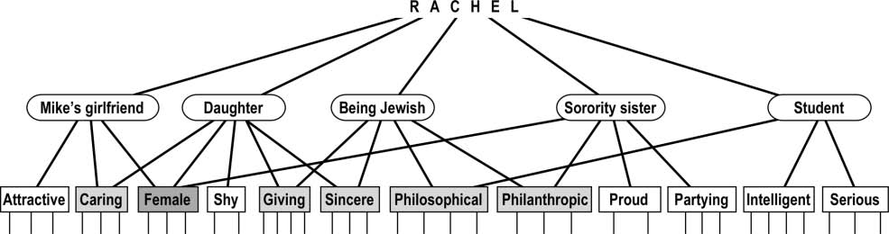
Example from McConnell 2011
Notes:
A hypothetical person ‘Rachel’ might be able to isolate a number of important areas of her life. Describe the diagram.
Emphasize that some of these self aspects may never be expressed in social media- for example her ‘Daughter’ self aspect, but others might be expressed more. Furthermore, she might express different self-aspects on different platforms. For instance, her Facebook account might be a place where she really showcases her relationship with her boyfriend Mike, whereas Twitter might be a place where she posts a lot about Sorority events and expresses her triumphs and frustrations as a student.
Fortunately there are well-established methods of having people generate these self-identities, and coding schemes for describing them. For instance:

Slide 9
Example of Categories of Self-Aspects
Situations: When I’m a crowded situation, Meeting new people
Relationships: With my boyfriend, with my family
Roles: Daughter, as a student
Affective: When I’m freaking out, My positive qualities
Goal: Who I ought to be, Who I’m afraid I’ll become.
Notes:
Read some of these example, mention that there are other categories, this is just to give the flavor. So, in my dissertation study, I want to explore self aspects. Here’s the plan for the first study (There may be a few more iterations)

Slide 10
Initial Study Plan
Recruit 1500 participants (easy because IU Psych Resources)
Have them answer a number of questions about their self-aspects: an established measure shown to be predictive + other questionnaire items.
Importantly, they authorize Twitter and Facebook Apps that let us mine their accounts
Notes:
Then we’ll try many features and classification techniques based on what has been successful in prior work in latent attribute inference to this rich data set.

Slide 11
Risks/Rewards
Might be hard to classify certain self-aspects, or they might be anecdotal (But… it’s good to know what doesn’t work since this has never been tried and bets are hedged because we include pre-defined categories – like political affiliation, gender, or self-esteem in specific domains like family, academics, appearance, religion).
Demographics of college students at a Midwest university is special. But…
Compare Twitter and Facebook in a new way
Generate lists of self-aspects that people claim to express in social media- can be used in other studies
Notes:
On the college demographic- it’s still a very important demographic and we care more about variance in self-aspects and identity strength for the pre-set categories. Other samples were problematic in part because identity strength was likely at the extremes.
No one has ever compared Twitter and Facebook through the framework of self-aspects and other validated psychological measures in this way. Nor is it common to have both Twitter and Facebook media data, so we can see which platform is more predictive of which types of self-aspects as well as situations where combined you might be able to infer more than when using either platform alone.

Slide 12
Summary
This is an uncommon approach that relies on
recruiting human subjects to get ground truth labels
Having people authorize apps from both Twitter and Facebook to get richer media data
3) Allowing people to generate categories of importance to them using psychologically validated procedures.
4) Uses some pre-set categories (e.g. political affiliation), but gets dimensions (like identity strength) to allow us to see where a classifier might be successful.

Slide 13
Overall this is a more opportunistic approach:
Focus is on what we can tell from someone’s account; we are not necessarily trying to say whether everyone is Democrat or Republican- casting a broader net by letting people express their self-aspects and tell us the degree to which they express them on Twitter and Facebook.
Potentially more sensible approach when one wants to make inferences about more ordinary people than are often studied in other work.

Slide 14
Acknowledgements
Collaborators: Winter Mason, Eliot Smith
Funding: NSF IGERT and GRFP

