Slide 1
Statistics Lesson 1
BT221
Professor Winter Mason

Slide 2
Course Overview
You
Me
Your textbook
This course
Classroom policies
Attendance
Grading & Homework
Cheating
Notes:
Classroom policies: #1. Respect me and your fellow students. Do not disrupt the class: no cellphones—keep it on vibrate, take it outside; food, if it’s quiet;

Slide 3
This week
Introducing statistics
Statistics in every day life
Why you should learn them
What they are (exactly)
How they are used
Describing data
Data sources
Variables and Elementary units
Typology of data

Slide 4
Lies, Damn Lies, & Statistics
Statistics are often used in persuasive messages:
Pharmaceuticals
Product endorsement
Political endorsement
Without an understanding of what the numbers mean and how they are generated, they can be misleading
In fact, some use statistics as evidence because they assume you won’t understand.
Notes:
Show examples here

Slide 5
Lies, Damn Lies, & Statistics
The pregnancy test is 99% accurate
Notes:
Show examples here

Slide 6
Lies, Damn Lies, & Statistics
Linda is a 32 year-old-woman who enjoys going to coffee shops where she orders flavored lattés and reads the New York Times on her iPad. Which is more likely?
Linda is a garbage collector
Linda is a garbage collector and a member of the Democratic Party
Notes:
Show examples here

Slide 7
Lies, Damn Lies, & Statistics
Which investment would you rather make:
The bond with an interest rate that is 50% better than your current rate of 3% per annum
The bond that earns 5% per annum
Notes:
Show examples here

Slide 8
Why learn statistics?
So you won’t be a dummy, dummy
Probability can be counter-intuitive. It is also the most practical math, and central to statistics.
It is the best way to see the big picture
It will help you win (more) at the casino

Slide 9
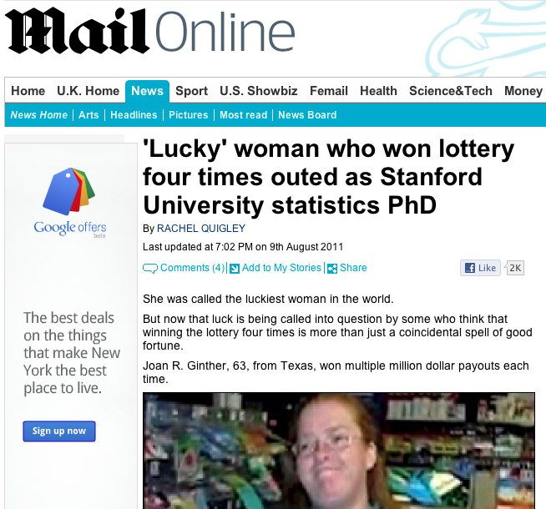

Slide 10
What are statistics?
“Ok, I have a bunch of numbers, now what?”
A statistic is a quantity calculated from a set of data
Statistics are used to answer questions with data
Identifying and understanding patterns in the data
Testing hypotheses about the data
Creating models of the data
Making predictions about unknown (or uncollected) data

Slide 11
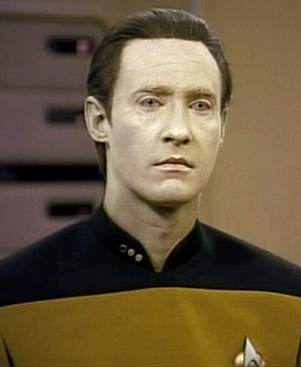
What do you mean, data?
Information recorded
Systematically
For some purpose
Data is typically a list of values corresponding to variables of interest
Data is usually collected to understand the big picture. This is where statistics come in.
NOT this guy

Slide 12
About you

Slide 13
Other Examples

Slide 14
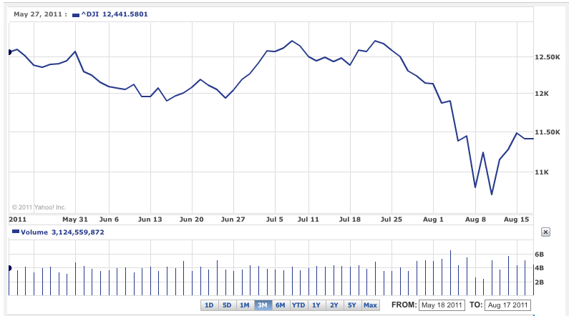

Slide 15
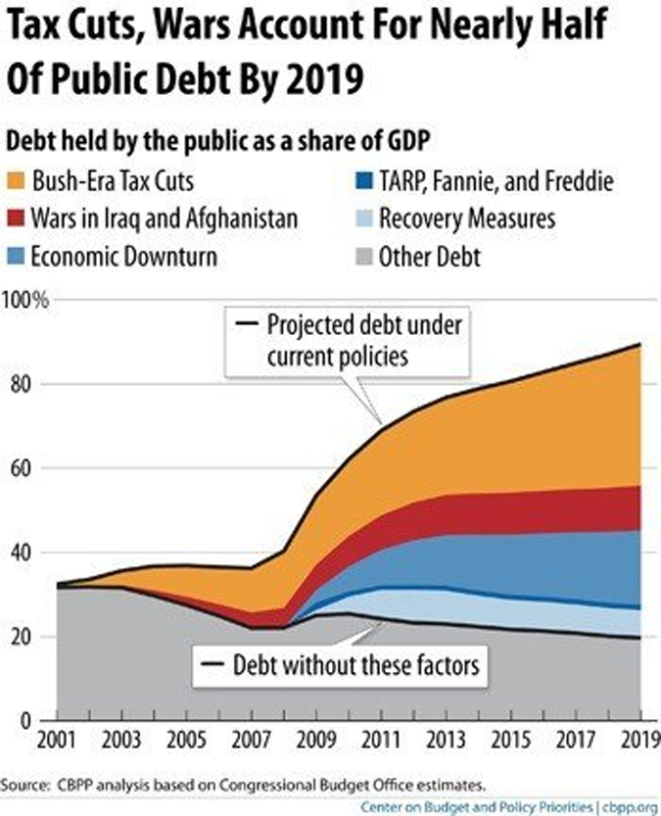

Slide 16
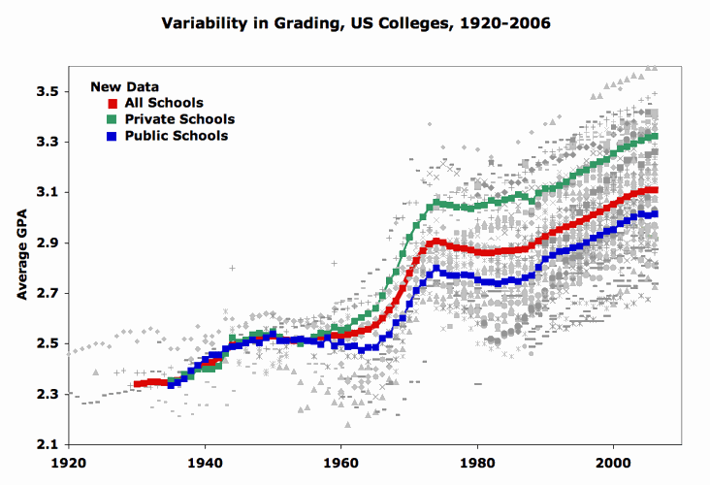

Slide 17
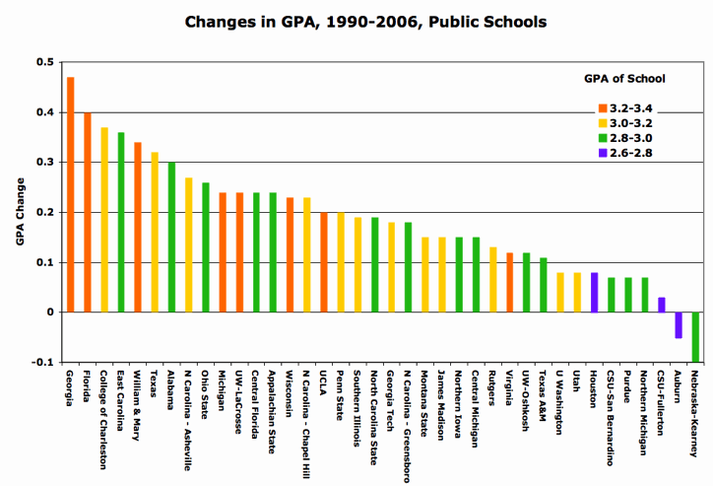

Slide 18
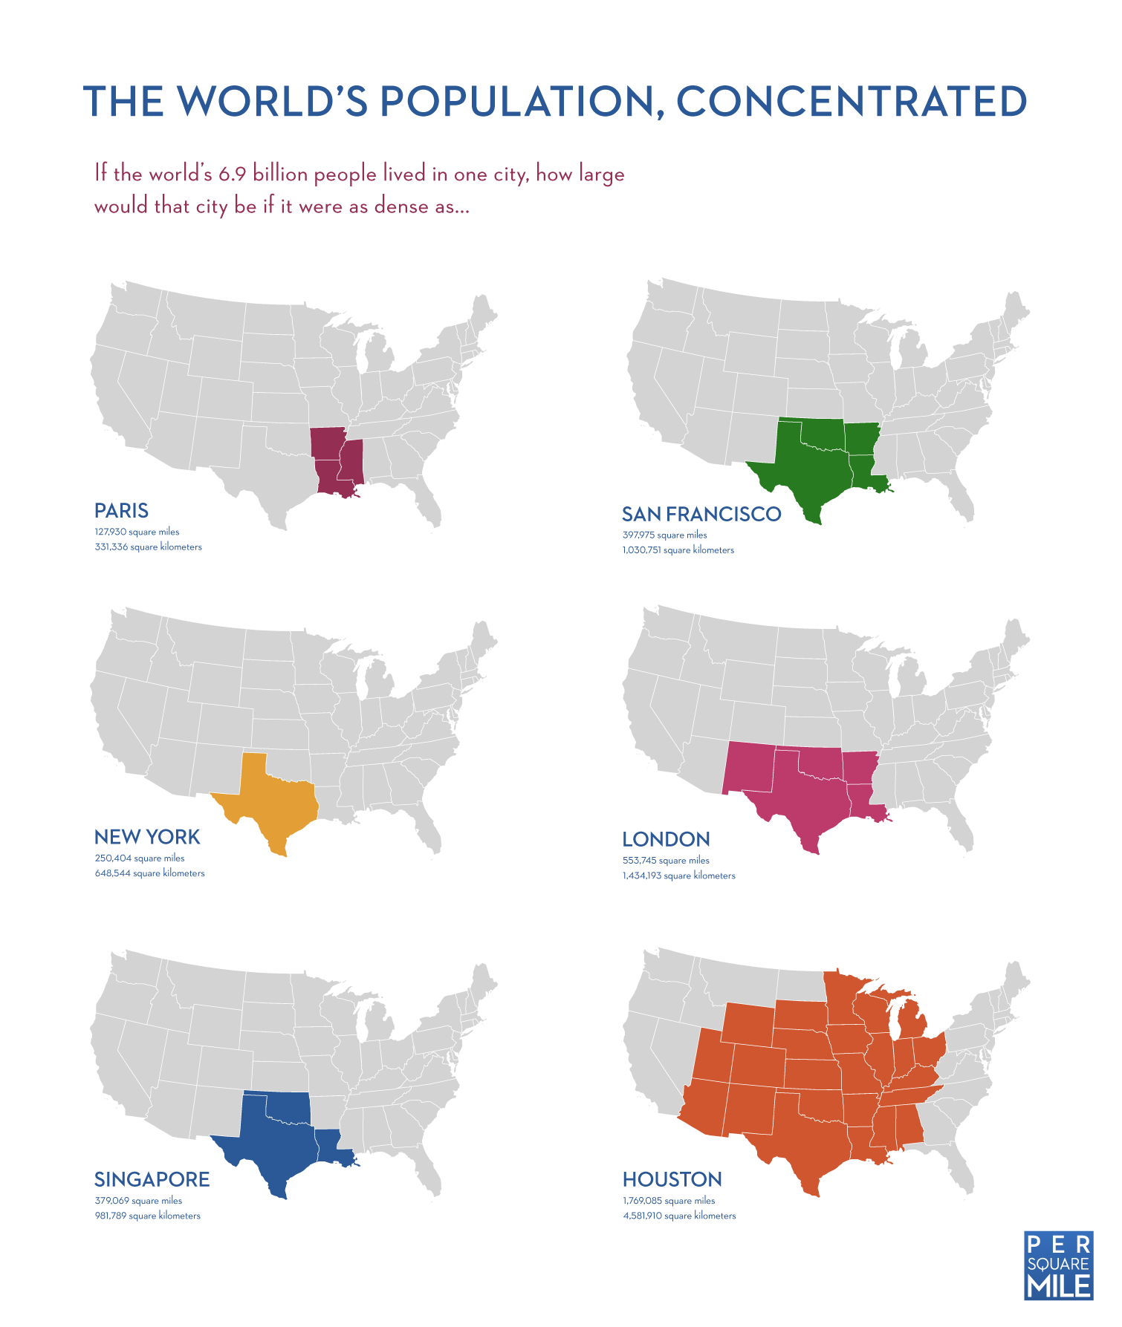

Slide 19
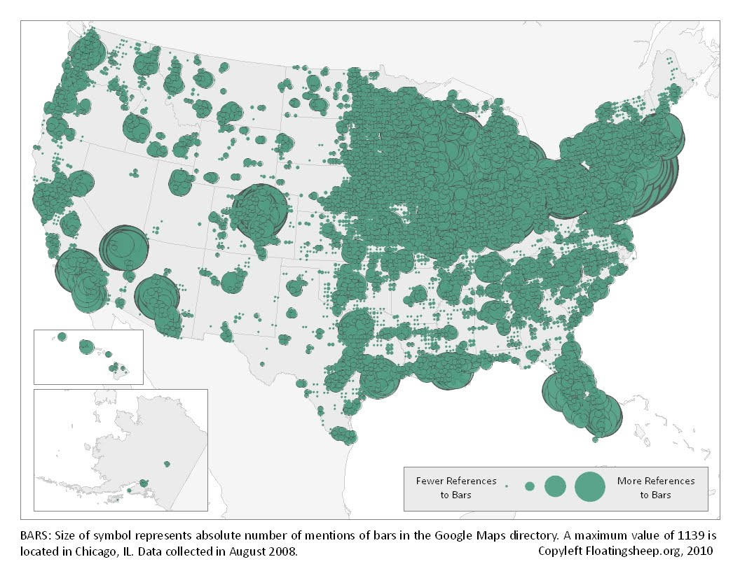

Slide 20
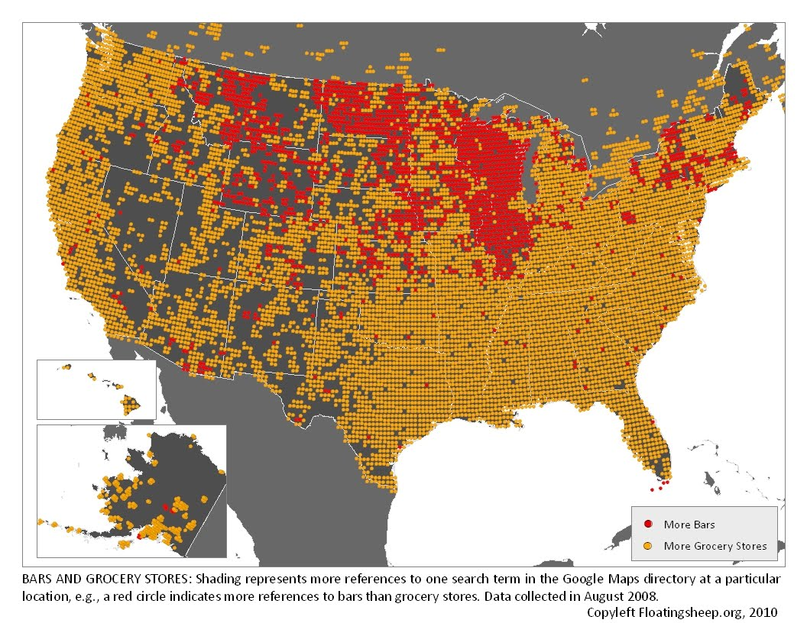

Slide 21
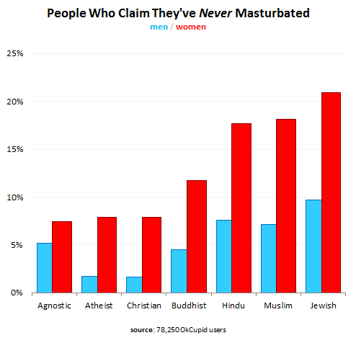

Slide 22
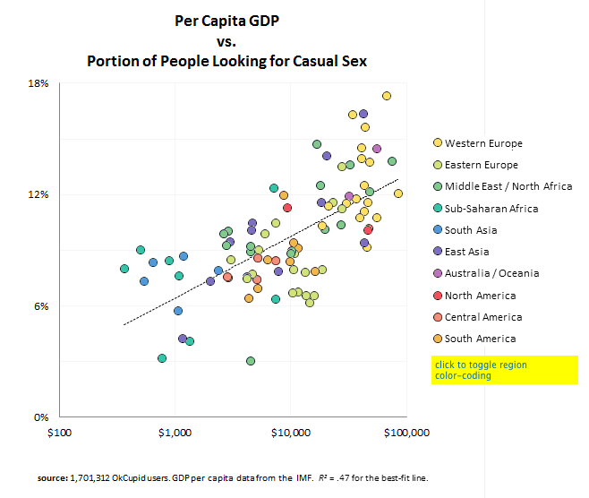

Slide 23
Data mining?
Statistics, machine learning, and big data
As the size of the data set grows, the techniques and infrastructure required for analysis changes
What do you do when you have more data than can fit on your hard drive?
Artificial intelligence today goes by “Machine learning” (think IBM’s Watson in Jeopardy)
Machine learning today is mostly statistical learning

Slide 24
Sources of Data
Primary data
Data collected by you
Any situation in which you decided how to collect the data
Secondary data
Data obtained from another source
Especially important when you do not know how the data was collected.
Notes:
Like hearing things first- or second-hand

Slide 25
Variables & Elementary Units
Elementary units are the fundamental items for which data is recorded
a.k.a. units of analysis
a.k.a. statistical units
a.k.a. instances or instantiations
Variables are the features that are measured / recorded for each elementary unit
In a spreadsheet, elementary units are typically shown on the rows & variables are typically shown in the columns

Slide 26
Qualitative Variables
Nominal or Categorical variables
Labels with no meaningful order or distance
Ordinal or Rank variables
Labels with a natural ordering
Temporal variables
Dates & times
Geographic variables
Locations on a map

Slide 27
Quantitative Variables
Meaningful numbers, typically with meaningful distance between values
Usually values in specific units (e.g., lbs., cm, number of trees)
Quantitative variables come in two types:
Integer values
Whole numbers, usually for counting
Continuous values
Possibly fractional values

Slide 28
About you

Slide 29
Computers
Brand | Processor | Speed (GHz) | RAM (GB) | Hard Drive (TB) | PC mag ranking
Apple | Intel Core i7 | 3.2 | 4 | 2 | 2
DELL | Pentium D | 3.0 | 8 | 1 | 3
DELL | Pentium 4 | 2.8 | 4 | 1 | 5
HP | Pentium D | 3.0 | 4 | 2 | 4
HP | Pentium 4 | 2.8 | 4 | 2 | 6
Lenovo | Intel Core i7 | 3.4 | 8 | 2 | 1
Sony | Intel Core i7 | 2.4 | 2 | 4 | 7

Slide 30
Cities
Name | Location (Lat,Lon) | Continent | Pop. (M) | Area (km²)
New York | 40.717, -74.0 | 1 | 8.175 | 1214.4
London | 51.507, -0.127 | 3 | 7.825 | 1572.1
Paris | 48.857, 2.351 | 3 | 2.193 | 20807
Tokyo | 35.7, 139.7 | 5 | 13.01 | 5847
Beijing | 39.914, 116.392 | 5 | 19.61 | 16801
Delhi | 28.61, 77.23 | 5 | 16.75 | 1483
São Paulo | -23.55, -46.63 | 2 | 11.24 | 1523
Johannesburg | -26.2, 28.05 | 4 | 3.89 | 1645
Sydney | -33.86, 151.21 | 6 | 4.57 | 12145

Slide 31
From the internet
Notes:
Search for “country populations” : http://www.worldatlas.com/aatlas/populations/ctypopls.htm
Search for “movie box office results” : http://boxofficemojo.com/alltime/domestic.htm

Slide 32
Up Next…
Summarizing data
Typical values

