Slide 1
Statistics Lesson 13
BT221
Professor Winter Mason

Slide 2
Outline
Multiple Regression
Nonlinear effects
Polynomial
Logarithmic
Categorical predictors
Dummy coding
Orthogonal coding
Interaction effects
General Linear Model

Slide 3
Multiple Regression
Idea: Examine the linear relationship between
1 dependent (y) & 2 or more independent variables (x_{i})
Population model:
Y-intercept
Population slopes
Random Error
Estimated multiple regression model:
Estimated
(or predicted)
value of y
Estimated
intercept
Estimated slope coefficients

Slide 4
Multiple Regression Model
Two variable model
y
Sample observation
y_{i}
<
y_{i}
<
e = (y – y)
x_{2i}
x₂
x_{1i}
<
The best fit equation, y ,
is found by minimizing the
sum of squared errors, Σe²

Slide 5
Example
A distributor of frozen desert pies wants to evaluate factors thought to influence demand
Dependent variable: Pie sales (units per week)
Independent variables: Price (in $)
Advertising ($100’s)
Data are collected for 15 weeks

Slide 6
Pie Sales Model
Week | Pie Sales | Price ($) | Advertising ($100s)
1 | 350 | 5.50 | 3.3
2 | 460 | 7.50 | 3.3
3 | 350 | 8.00 | 3.0
4 | 430 | 8.00 | 4.5
5 | 350 | 6.80 | 3.0
6 | 380 | 7.50 | 4.0
7 | 430 | 4.50 | 3.0
8 | 470 | 6.40 | 3.7
9 | 450 | 7.00 | 3.5
10 | 490 | 5.00 | 4.0
11 | 340 | 7.20 | 3.5
12 | 300 | 7.90 | 3.2
13 | 440 | 5.90 | 4.0
14 | 450 | 5.00 | 3.5
15 | 300 | 7.00 | 2.7
Multiple regression model:
Sales = b₀ + b₁ (Price)
+ b₂ (Advertising)
Correlation matrix:
 | Pie Sales | Price | Advertising
Pie Sales | 1
Price | -0.44327 | 1
Advertising | 0.55632 | 0.03044 | 1

Slide 7
Multiple Regression Output
Regression Statistics
Multiple R | 0.72213
R Square | 0.52148
Adjusted R Square | 0.44172
Standard Error | 47.46341
Observations | 15
ANOVA | df | SS | MS | F | Significance F
Regression | 2 | 29460.027 | 14730.013 | 6.53861 | 0.01201
Residual | 12 | 27033.306 | 2252.776
Total | 14 | 56493.333
 | Coefficients | Standard Error | t Stat | P-value | Lower 95% | Upper 95%
Intercept | 306.52619 | 114.25389 | 2.68285 | 0.01993 | 57.58835 | 555.46404
Price | -24.97509 | 10.83213 | -2.30565 | 0.03979 | -48.57626 | -1.37392
Advertising | 74.13096 | 25.96732 | 2.85478 | 0.01449 | 17.55303 | 130.70888

Slide 8
Using The Model to Make Predictions
Predict sales for a week in which the selling price is $5.50 and advertising is $350:
Note that Advertising is in $100’s, so $350 means that x₂ = 3.5
Predicted sales is 428.62 pies

Slide 9
Goodness-of-Fit

Slide 10
R² and Adjusted R²
R²
Adjusted R²
Questions:
Why do we care about the adjusted R² ?
Is adjusted R² always better than R² ?
What’s the relationship between R² and adjusted R² ?

Slide 11
Nonlinear Models
How does your skill at throwing darts change as you consume more beer?
Measure the distance from the bulls-eye for a sample of 15 throws throughout the night
Beer | Distance
0 | 6
0 | 5
0 | 3
1 | 1
1 | 2
2 | 1
3 | 0
4 | 0
4 | 1
4 | 0
5 | 1
6 | 3
6 | 4
6 | 5
8 | 11

Slide 12
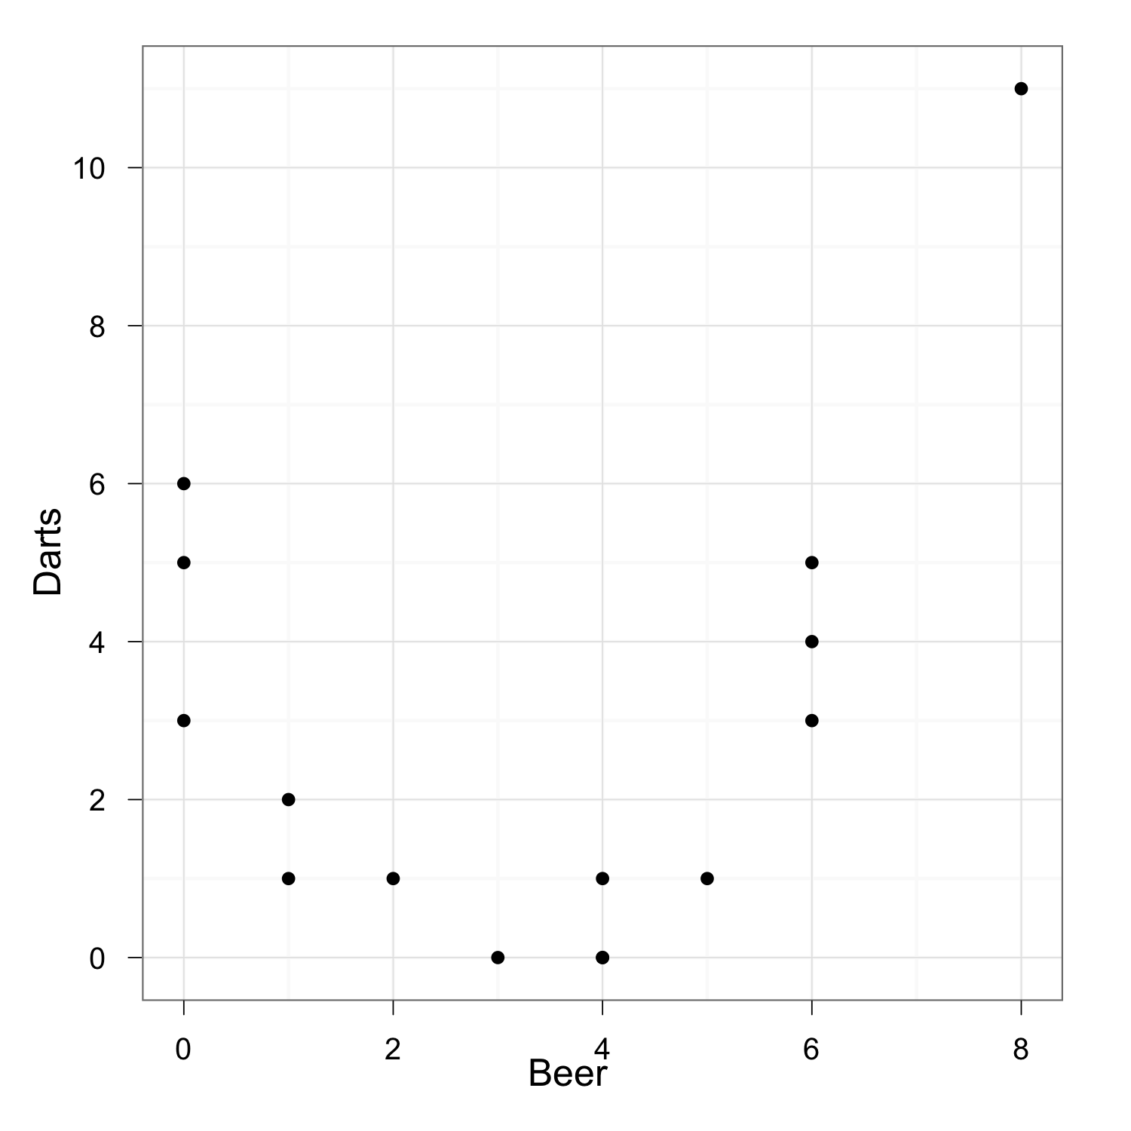
Visualization
A good place to start is with a scatterplot of Beers by Distance

Slide 13
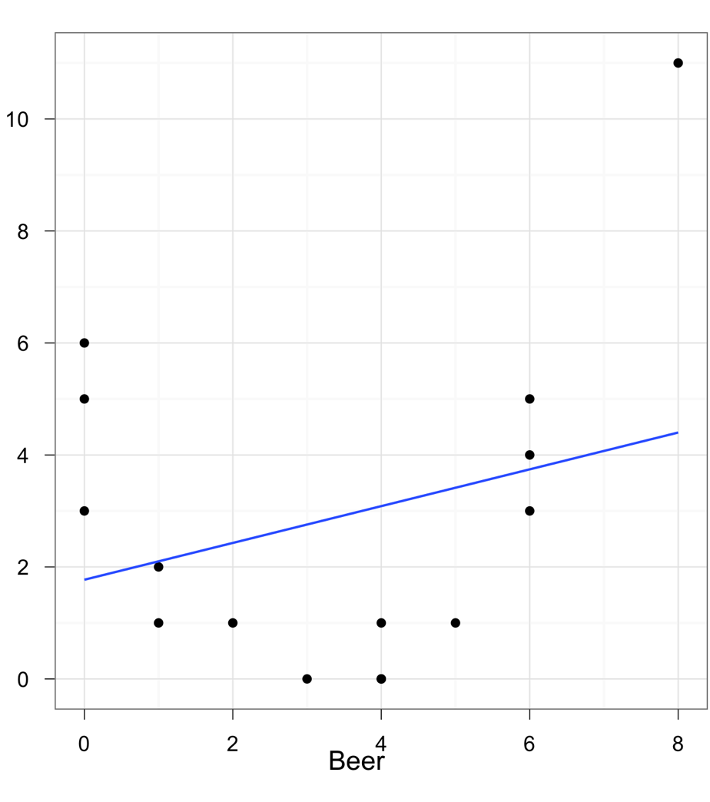
Regression
There is a slight positive linear relationship between the variables
Correlation = 0.283
R² = 0.08
But maybe an alternative model would work better

Slide 14
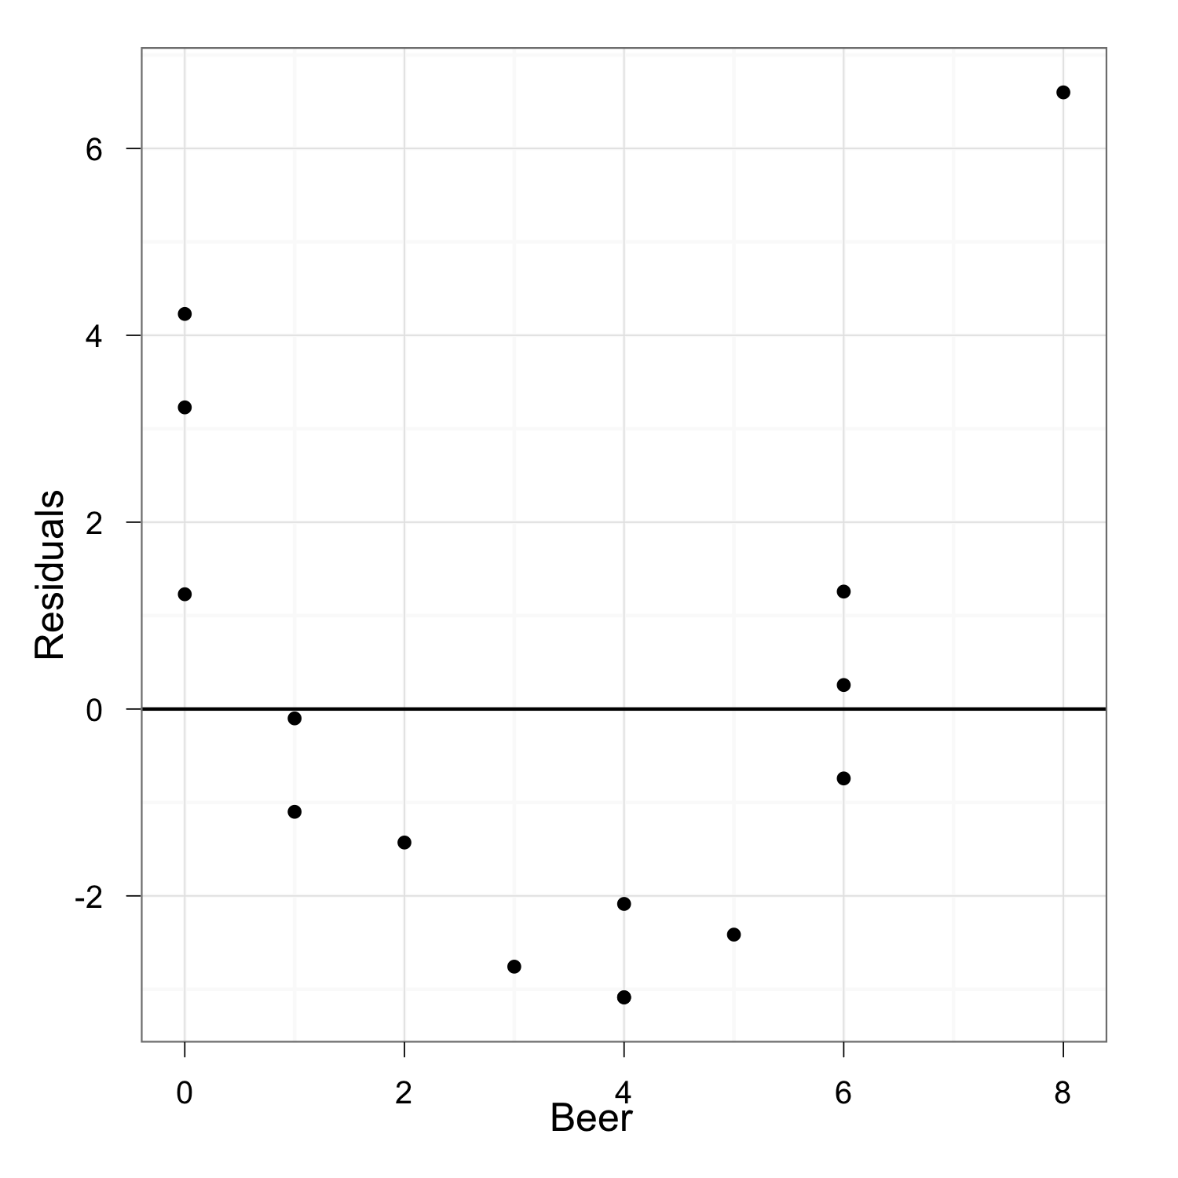
Residuals from a Straight-Line Fit

Slide 15
Nonlinear Models
The negative-positive-negative behavior of the residuals suggests a parabola; that is, a quadratic equation with the square of Beer included in the equation.
Distance = b₀ + b₁Beer + b₂Beer²

Slide 16
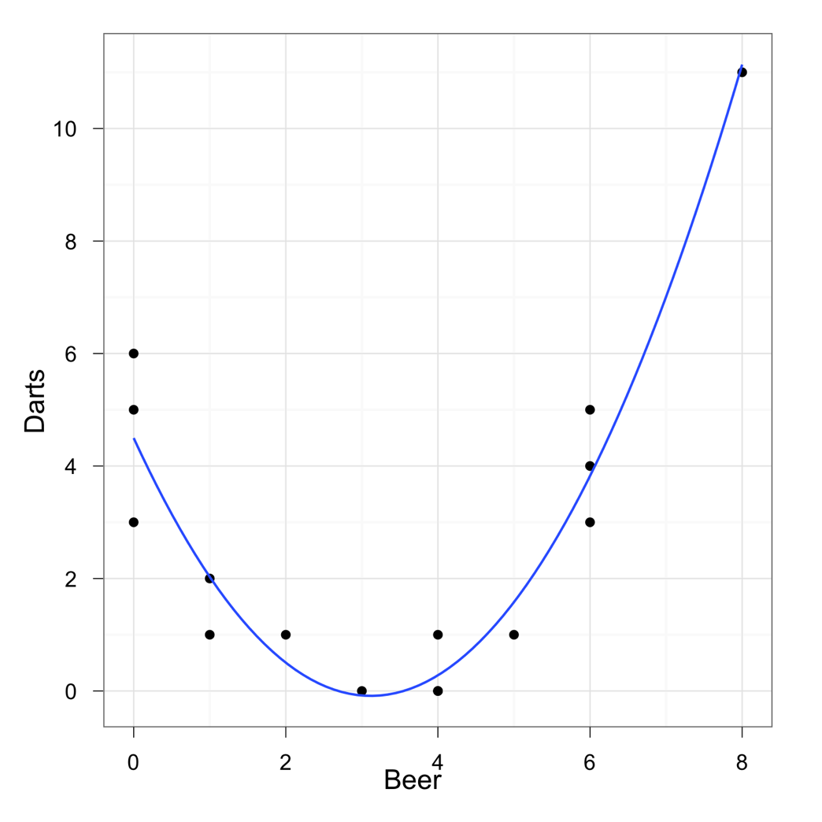
Nonlinear Models
Using multiple regression, estimate the equation for Distance with both explanatory variables, Beer and Beer², included.
The best fitting line is:
Distance = 4.5 – 2.94*Beer + 0.47*Beer²
R² increases to 0.9147

Slide 17
Nonlinear Models
How does the mass of radioactive materials change over time?
Measure the mass of a sample of uranium over the course of 10 years
Year | Mass
1 | 0.610
2 | 0.370
3 | 0.240
4 | 0.150
5 | 0.081
6 | 0.051
7 | 0.027
8 | 0.040
9 | 0.011
10 | 0.029

Slide 18
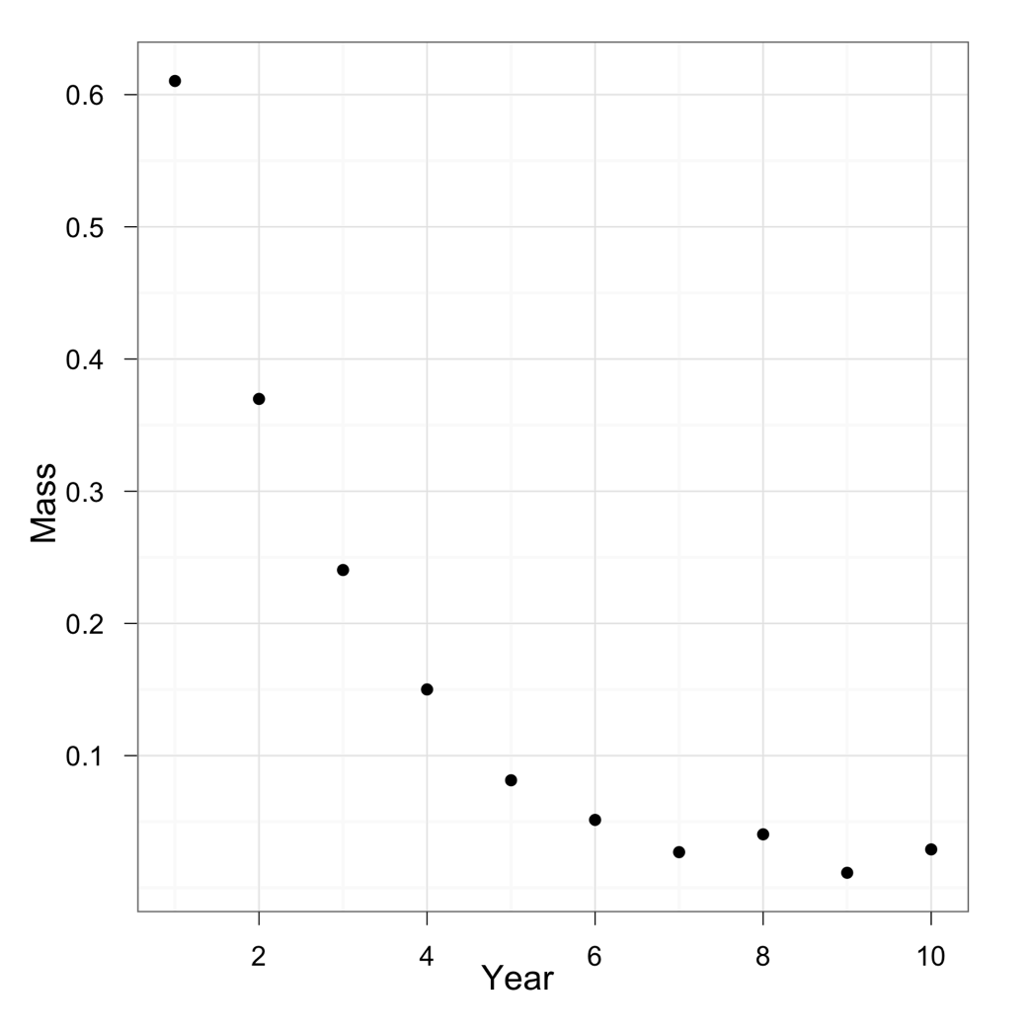
Visualization
A good place to start is with a scatterplot of the mass over years

Slide 19
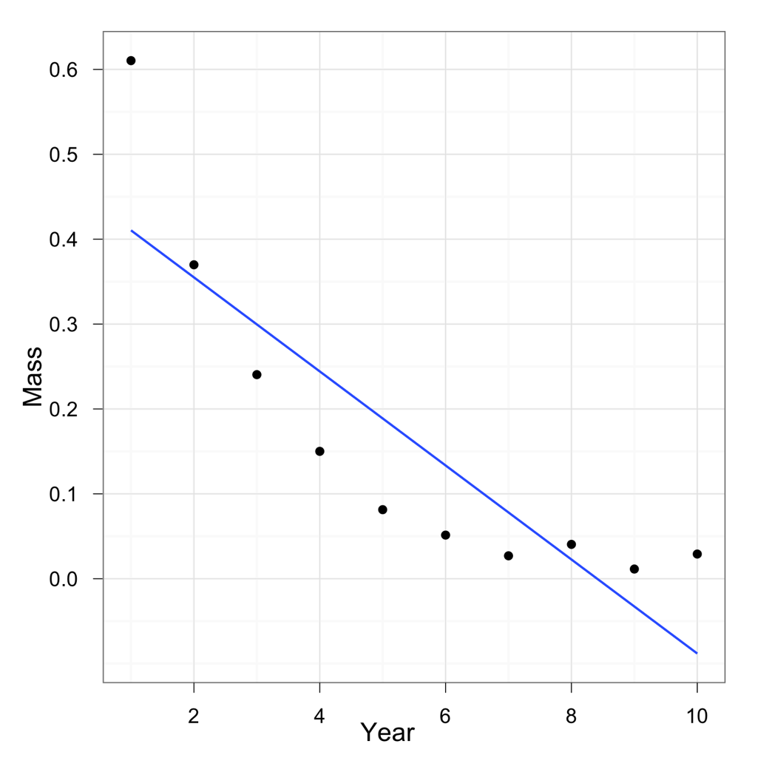
Regression
There is a strong negative relationship between mass and time
Correlation = -0.86
R² = 0.74

Slide 20
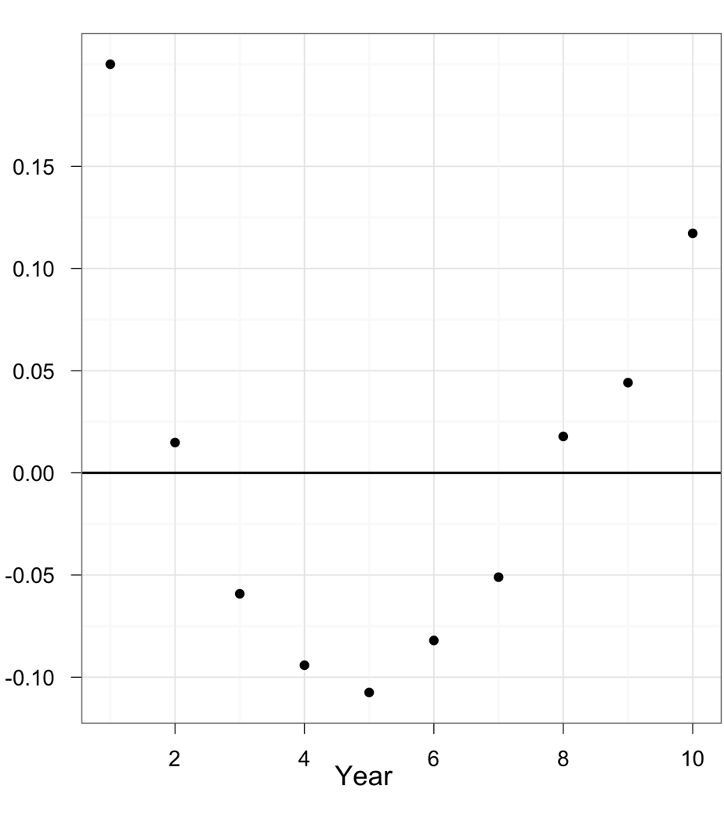
Residuals from a Straight-Line Fit
The residuals are not uniformly distributed across time
This suggests a linear model is not the best

Slide 21
Nonlinear Models
The decaying relationship between mass and time suggests a logarithmic relationship
Mass = b₀ + b₁*Year + b₂*log(Year)

Slide 22
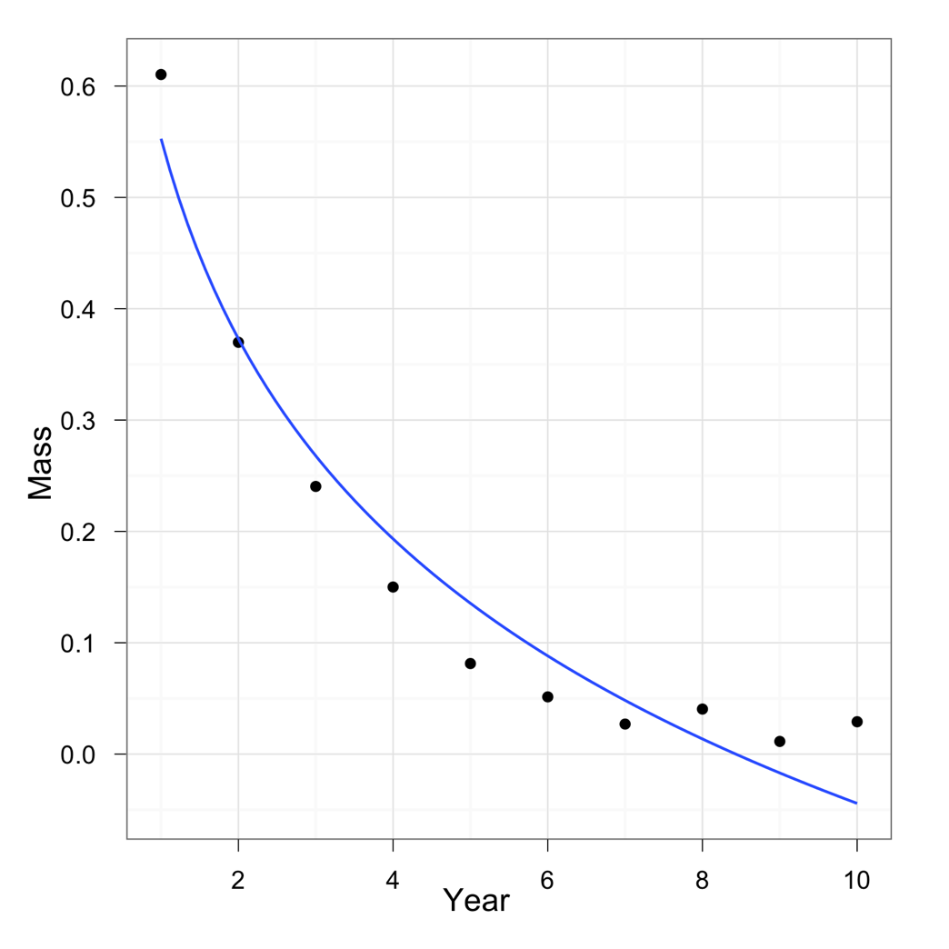
Nonlinear Models
Using multiple regression, estimate the equation for Mass with both explanatory variables, Year and log(Year), included.
The best fitting line is:
Mass = 0.57 + 0.046*Year- 0.44*log(Year)
R² increases to 0.997

Slide 23
Pie Sales Model 2
Week | Pie Sales | Price ($) | Season
1 | 350 | 5.50 | Spring
2 | 460 | 7.50 | Spring
3 | 350 | 8.00 | Spring
4 | 430 | 8.00 | Spring
5 | 350 | 6.80 | Spring
6 | 380 | 7.50 | Summer
7 | 430 | 4.50 | Summer
8 | 470 | 6.40 | Summer
9 | 450 | 7.00 | Summer
10 | 490 | 5.00 | Summer
11 | 340 | 7.20 | Autumn
12 | 300 | 7.90 | Autumn
13 | 440 | 5.90 | Autumn
14 | 450 | 5.00 | Autumn
15 | 300 | 7.00 | Autumn
Multiple regression model:
Sales = b₀ + b₁ (Price)
+ … ?

Slide 24
Coding options
Dummy coding
Effect coding
Orthogonal coding

Slide 25
Dummy coding
Group | Satisfaction | V1 | V2 | Group Mean
Single | 25 | 1 | 0
Single | 28 | 1 | 0
Single | 20 | 1 | 0
Single | 26 | 1 | 0
Single | 25 | 1 | 0 | 24.8
Married | 30 | 0 | 1
Married | 28 | 0 | 1
Married | 32 | 0 | 1
Married | 33 | 0 | 1
Married | 28 | 0 | 1 | 30.2
Divorced | 20 | 0 | 0
Divorced | 22 | 0 | 0
Divorced | 28 | 0 | 0
Divorced | 25 | 0 | 0
Divorced | 24 | 0 | 0 | 23.8
Grand Mean | 26.27 | 0.33 | 0.33
One new variable for each of the levels of the categorical variable except one
The regression formula becomes:
Ŷ = b₀ + b₁V1 + b₂V2

Slide 26
Dummy coding
Group | Satisfaction | V1 | V2 | Group Mean
Single | 25 | 1 | 0
Single | 28 | 1 | 0
Single | 20 | 1 | 0
Single | 26 | 1 | 0
Single | 25 | 1 | 0 | 24.8
Married | 30 | 0 | 1
Married | 28 | 0 | 1
Married | 32 | 0 | 1
Married | 33 | 0 | 1
Married | 28 | 0 | 1 | 30.2
Divorced | 20 | 0 | 0
Divorced | 22 | 0 | 0
Divorced | 28 | 0 | 0
Divorced | 25 | 0 | 0
Divorced | 24 | 0 | 0 | 23.8
Grand Mean | 26.27 | 0.33 | 0.33
Solving for the best-fitting line,
the regression formula becomes:
Ŷ = 23.8 + 1*V1 + 6.4*V2

Slide 27
Dummy coding
Solving for the best-fitting line, the regression formula becomes:
Ŷ = 23.8 + 1*V1 + 6.4*V2
The intercept is the mean for the divorced
Setting V1 to zero and V2 to one gives the mean of the single people
Setting V2 to zero and V1 to one gives the mean of the married people

Slide 28
Effect coding
Group | Satisfaction | V1 | V2 | Group Mean
Single | 25 | 1 | 0
Single | 28 | 1 | 0
Single | 20 | 1 | 0
Single | 26 | 1 | 0
Single | 25 | 1 | 0 | 24.8
Married | 30 | 0 | 1
Married | 28 | 0 | 1
Married | 32 | 0 | 1
Married | 33 | 0 | 1
Married | 28 | 0 | 1 | 30.2
Divorced | 20 | -1 | -1
Divorced | 22 | -1 | -1
Divorced | 28 | -1 | -1
Divorced | 25 | -1 | -1
Divorced | 24 | -1 | -1 | 23.8
Grand Mean | 26.27 | 0 | 0
One new variable for each of the levels of the categorical variable except one
The regression formula is still:
Ŷ = b₀ + b₁V1 + b₂V2

Slide 29
Effect coding
Group | Satisfaction | V1 | V2 | Group Mean
Single | 25 | 1 | 0
Single | 28 | 1 | 0
Single | 20 | 1 | 0
Single | 26 | 1 | 0
Single | 25 | 1 | 0 | 24.8
Married | 30 | 0 | 1
Married | 28 | 0 | 1
Married | 32 | 0 | 1
Married | 33 | 0 | 1
Married | 28 | 0 | 1 | 30.2
Divorced | 20 | -1 | -1
Divorced | 22 | -1 | -1
Divorced | 28 | -1 | -1
Divorced | 25 | -1 | -1
Divorced | 24 | -1 | -1 | 23.8
Grand Mean | 26.27 | 0 | 0
Solving for the best-fitting line,
the regression formula is now:
Ŷ = 26.27 – 1.47*V1 + 3.93*V2

Slide 30
Effect coding
Solving for the best-fitting line, the regression formula becomes:
Ŷ = 26.27 – 1.47*V1 + 3.93*V2
The intercept is the grand mean
Setting V1 to zero and V2 to one gives the mean of the married people
Setting V2 to zero and V1 to one gives the mean of the single people

Slide 31
Orthogonal coding
Group | Satisfaction | V1 | V2 | Group Mean
Single | 25 | -1 | 1
Single | 28 | -1 | 1
Single | 20 | -1 | 1
Single | 26 | -1 | 1
Single | 25 | -1 | 1 | 24.8
Married | 30 | 1 | 1
Married | 28 | 1 | 1
Married | 32 | 1 | 1
Married | 33 | 1 | 1
Married | 28 | 1 | 1 | 30.2
Divorced | 20 | 0 | -2
Divorced | 22 | 0 | -2
Divorced | 28 | 0 | -2
Divorced | 25 | 0 | -2
Divorced | 24 | 0 | -2 | 23.8
Grand Mean | 26.27 | 0 | 0
Allows you to make specific, planned comparisons
The regression formula is still:
Ŷ = b₀ + b₁V1 + b₂V2

Slide 32
Orthogonal coding
Group | Satisfaction | V1 | V2 | Group Mean
Single | 25 | -1 | 1
Single | 28 | -1 | 1
Single | 20 | -1 | 1
Single | 26 | -1 | 1
Single | 25 | -1 | 1 | 24.8
Married | 30 | 1 | 1
Married | 28 | 1 | 1
Married | 32 | 1 | 1
Married | 33 | 1 | 1
Married | 28 | 1 | 1 | 30.2
Divorced | 20 | 0 | -2
Divorced | 22 | 0 | -2
Divorced | 28 | 0 | -2
Divorced | 25 | 0 | -2
Divorced | 24 | 0 | -2 | 23.8
Grand Mean | 26.27 | 0.33 | 0.33
Solving for the best-fitting line,
the regression formula is now:
Ŷ = 26.27 + 2.7*V1 + 1.23*V2

Slide 33
Orthogonal coding
Solving for the best-fitting line, the regression formula becomes:
Ŷ = 26.27 + 2.7*V1 + 1.23*V2
The intercept is still the grand mean
The parameters (b₁ & b₂) test the specific comparisons indicated:
b₁ shows the difference between single and married people
b₂ shows the difference between divorced people and the other two groups

Slide 34
Orthogonal coding
When choosing contrasts, a few rules must be followed:
No more than K–1 contrasts (K is the number of levels in the variable)
The mean of the coding variable must always be zero.
The correlations between all of the coding variables must also be zero

Slide 35
Interaction Terms
An interaction variable algebraically is the product of two variables. Its effect is to allow the effect of one of the variables on Y to depend on the value of the other variable.
The interaction term allows the slope of the regression line to differ between two categories.

Slide 36
Multiple Regression
Idea: Examine the linear relationship between
1 dependent (y) & 2 or more independent variables (x_{i})
Population model:
Y-intercept
Population slopes
Random Error
Estimated multiple regression model:
Estimated
(or predicted)
value of y
Estimated
intercept
Estimated slope coefficients

Slide 37
Is the Model Significant?
F-Test for Overall Significance of the Model
Shows if there is a linear relationship between all of the x variables considered together and y
Use F test statistic
Hypotheses:
H₀: β₁ = β₂ = … = β_{k} = 0 (no linear relationship)
H_{A}: at least one β_{i} ≠ 0 (at least one independent
variable affects y)

Slide 38
F-Test for Overall Significance
Test statistic:
where F has (numerator) D₁ = k and
(denominator) D₂ = (n – k – 1)
degrees of freedom

Slide 39
F-Test for Overall Significance
(continued)
Regression Statistics
Multiple R | 0.72213
R Square | 0.52148
Adjusted R Square | 0.44172
Standard Error | 47.46341
Observations | 15
ANOVA | df | SS | MS | F | Significance F
Regression | 2 | 29460.027 | 14730.013 | 6.53861 | 0.01201
Residual | 12 | 27033.306 | 2252.776
Total | 14 | 56493.333
 | Coefficients | Standard Error | t Stat | P-value | Lower 95% | Upper 95%
Intercept | 306.52619 | 114.25389 | 2.68285 | 0.01993 | 57.58835 | 555.46404
Price | -24.97509 | 10.83213 | -2.30565 | 0.03979 | -48.57626 | -1.37392
Advertising | 74.13096 | 25.96732 | 2.85478 | 0.01449 | 17.55303 | 130.70888
With 2 and 12 degrees of freedom
P-value for the F-Test

Slide 40
F-Test for Overall Significance
(continued)
H₀: β₁ = β₂ = 0
H_{A}: β₁ and β₂ not both zero
α = .05
df₁= 2 df₂ = 12
Test Statistic:
Decision:
Conclusion:
Critical Value:
F_{α} = 3.885
Reject H₀ at α = 0.05
The regression model does explain a significant portion of the variation in pie sales
(There is evidence that at least one independent variable affects y )
α = .05
0
F
Do not
reject H₀
Reject H₀
F_{.05} = 3.885

Slide 41
The ANOVA F Ratio
The ratio of the between-group variance divided by the within-group variance is called the F ratio:
A sufficiently large F ratio suggests more than expected variance of means and thus rejection of the null hypothesis.

Slide 42
F-statistic
Another way to think of the F-statistic

Slide 43
General Linear Model
The general linear model includes everything of the form:
Y = XB + U
Y is a matrix of the predicted variable(s)
X is a matrix of the regressor(s)
B is a matrix of the parameter(s)
U is a matrix of the errors

Slide 44
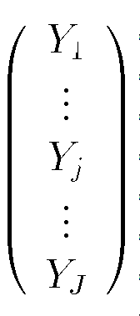
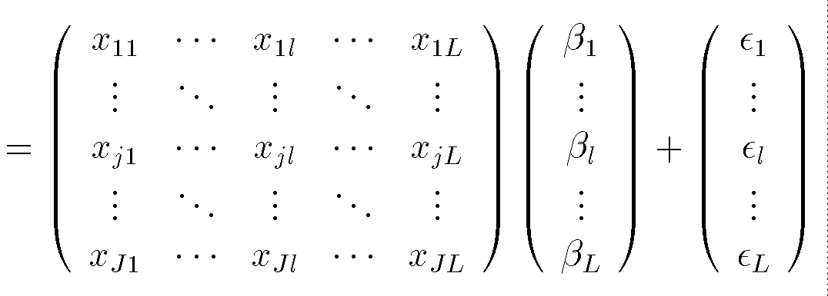
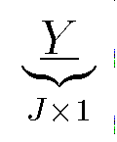
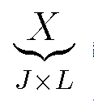
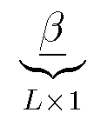
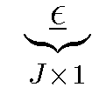
General Linear Model
The general linear model includes everything of the form:
Y = XB + U

Slide 45
General Linear Model
This includes:
t-test
Regression
ANOVA
ANCOVA
ANOVA with categorical & continuous variables
MANOVA
ANOVA with multiple variables being predicted
MANCOVA

