Slide 1
Statistics Lesson 14
BT221
Professor Winter Mason

Slide 2
Outline
Time Series
Moving Average models
Autoregressive models
Multiple variables

Slide 3
Time Series Data
Time series data always has
A temporal variable
At least one (quantitative) variable
Time (t) | Value (y)
1 | 1.89
2 | 2.46
3 | 3.23
4 | 3.95
5 | 4.56
6 | 5.07
7 | 5.62
8 | 6.16
9 | 6.26

Slide 4
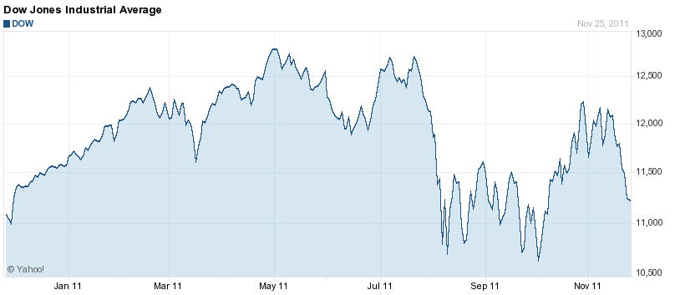
Stock Market

Slide 5
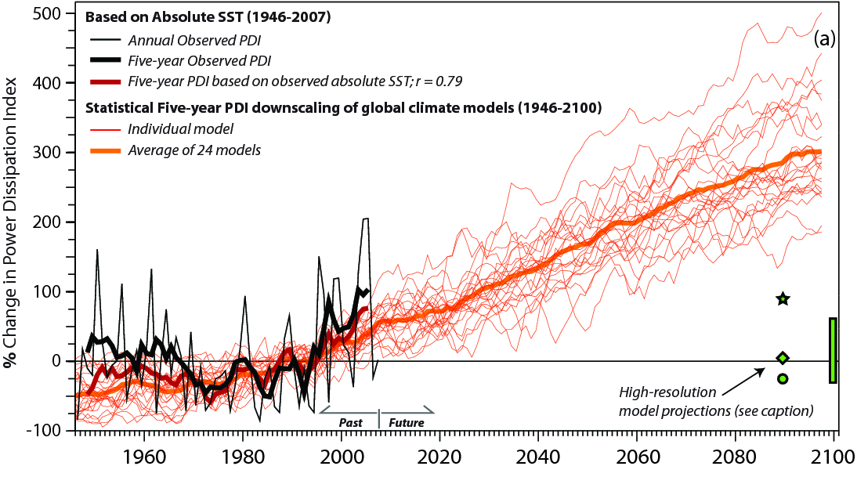
Hurricanes

Slide 6
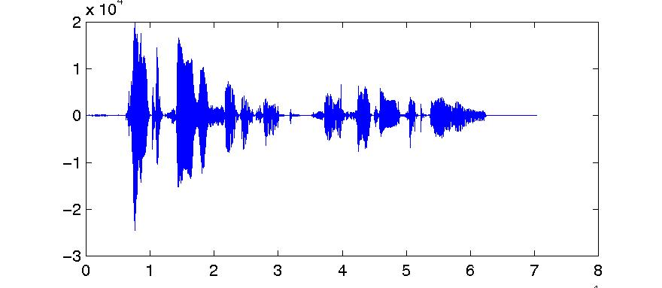
Sound & Speech

Slide 7
Time Series Analysis
Identifying trends & cycles
Forecasting
Identifying relationships between variables over time

Slide 8
Time Series Analysis
Frequency domain
Treat a time series as a signal, such as sound waves
Fourier transform to break a wave into its component frequencies
Time domain
Auto-correlation
Cross-correlation
Forecast models

Slide 9
Stock Market
Date | Close
25-Nov-11 | 11,231.78
23-Nov-11 | 11,257.55
22-Nov-11 | 11,493.72
21-Nov-11 | 11,547.31
18-Nov-11 | 11,796.16
17-Nov-11 | 11,770.73
16-Nov-11 | 11,905.59
15-Nov-11 | 12,096.16
14-Nov-11 | 12,078.98
11-Nov-11 | 12,153.68
10-Nov-11 | 11,893.79
9-Nov-11 | 11,780.94
8-Nov-11 | 12,170.18
Temporal variable might be month, day, hour, minute, or even microsecond
Quantitative variable could be price of a particular stock, an index, or a market

Slide 10
Identifying Trends

Slide 11
Correlation
Date | Close
13 | 11,231.78
12 | 11,257.55
11 | 11,493.72
10 | 11,547.31
9 | 11,796.16
8 | 11,770.73
7 | 11,905.59
6 | 12,096.16
5 | 12,078.98
4 | 12,153.68
3 | 11,893.79
2 | 11,780.94
1 | 12,170.18
Recode time variable
Calculate correlation between price and time
Determine if correlation is significant

Slide 12
Date | Close | zDate | zClose | zD * zC
13 | 11,231.78 | 1.54 | -1.73 | -2.66
12 | 11,257.55 | 1.28 | -1.65 | -2.12
11 | 11,493.72 | 1.03 | -0.91 | -0.93
10 | 11,547.31 | 0.77 | -0.74 | -0.57
9 | 11,796.16 | 0.51 | 0.04 | 0.02
8 | 11,770.73 | 0.26 | -0.04 | -0.01
7 | 11,905.59 | 0.00 | 0.39 | 0.00
6 | 12,096.16 | -0.26 | 0.98 | -0.25
5 | 12,078.98 | -0.51 | 0.93 | -0.48
4 | 12,153.68 | -0.77 | 1.16 | -0.90
3 | 11,893.79 | -1.03 | 0.35 | -0.36
2 | 11,780.94 | -1.28 | -0.01 | 0.01
1 | 12,170.18 | -1.54 | 1.21 | -1.87
7 | 11782.81 |  |  | -10.11
3.89 | 318.82 |  | Correlation: | -0.84

Slide 13
Significant trend?

Slide 14
Regression
Can also do regression to find best fitting line across time span
Gives a more precise definition of the trend line
Also allows de-trending and assessment of errors

Slide 15
Regression

Slide 16
Identifying Cycles
Decompose time series into frequencies using Fourier transform
Component frequencies with different amplitudes sum to make time series
Frequencies with especially high power (amplitude) indicate cycles in time series

Slide 17
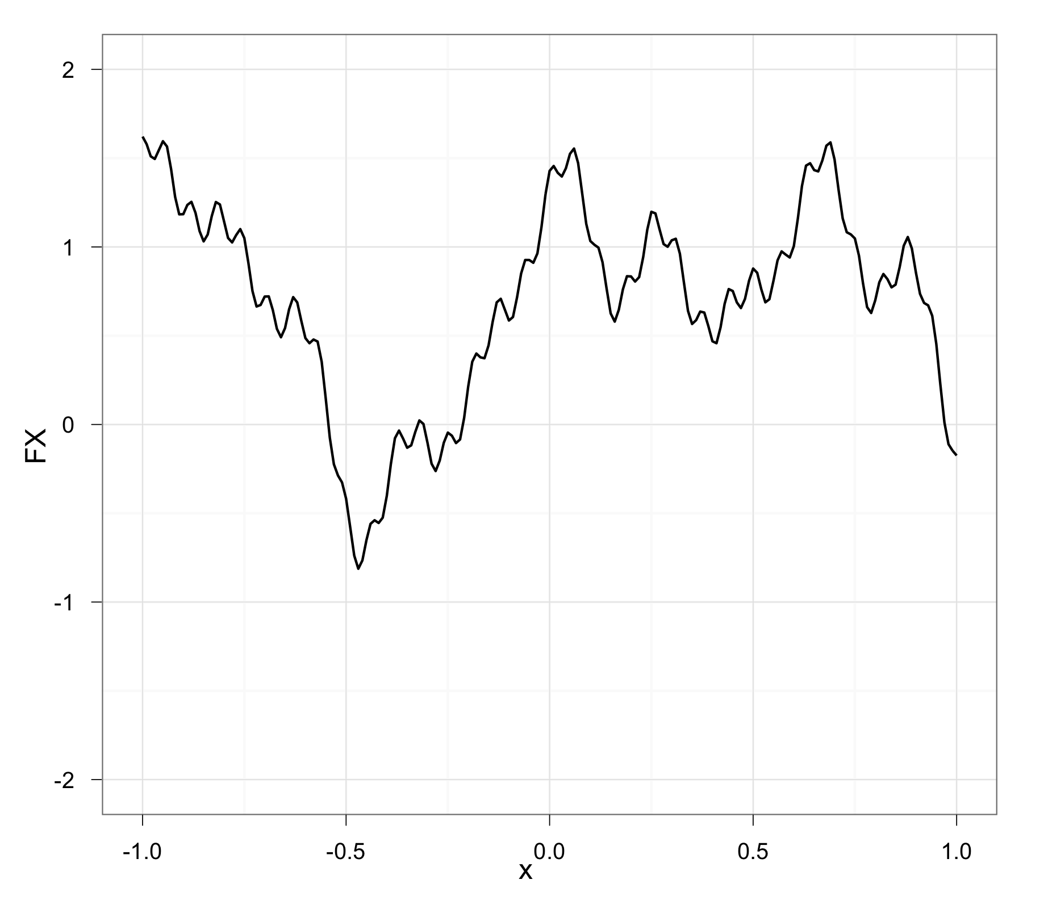
Fourier Transform

Slide 18
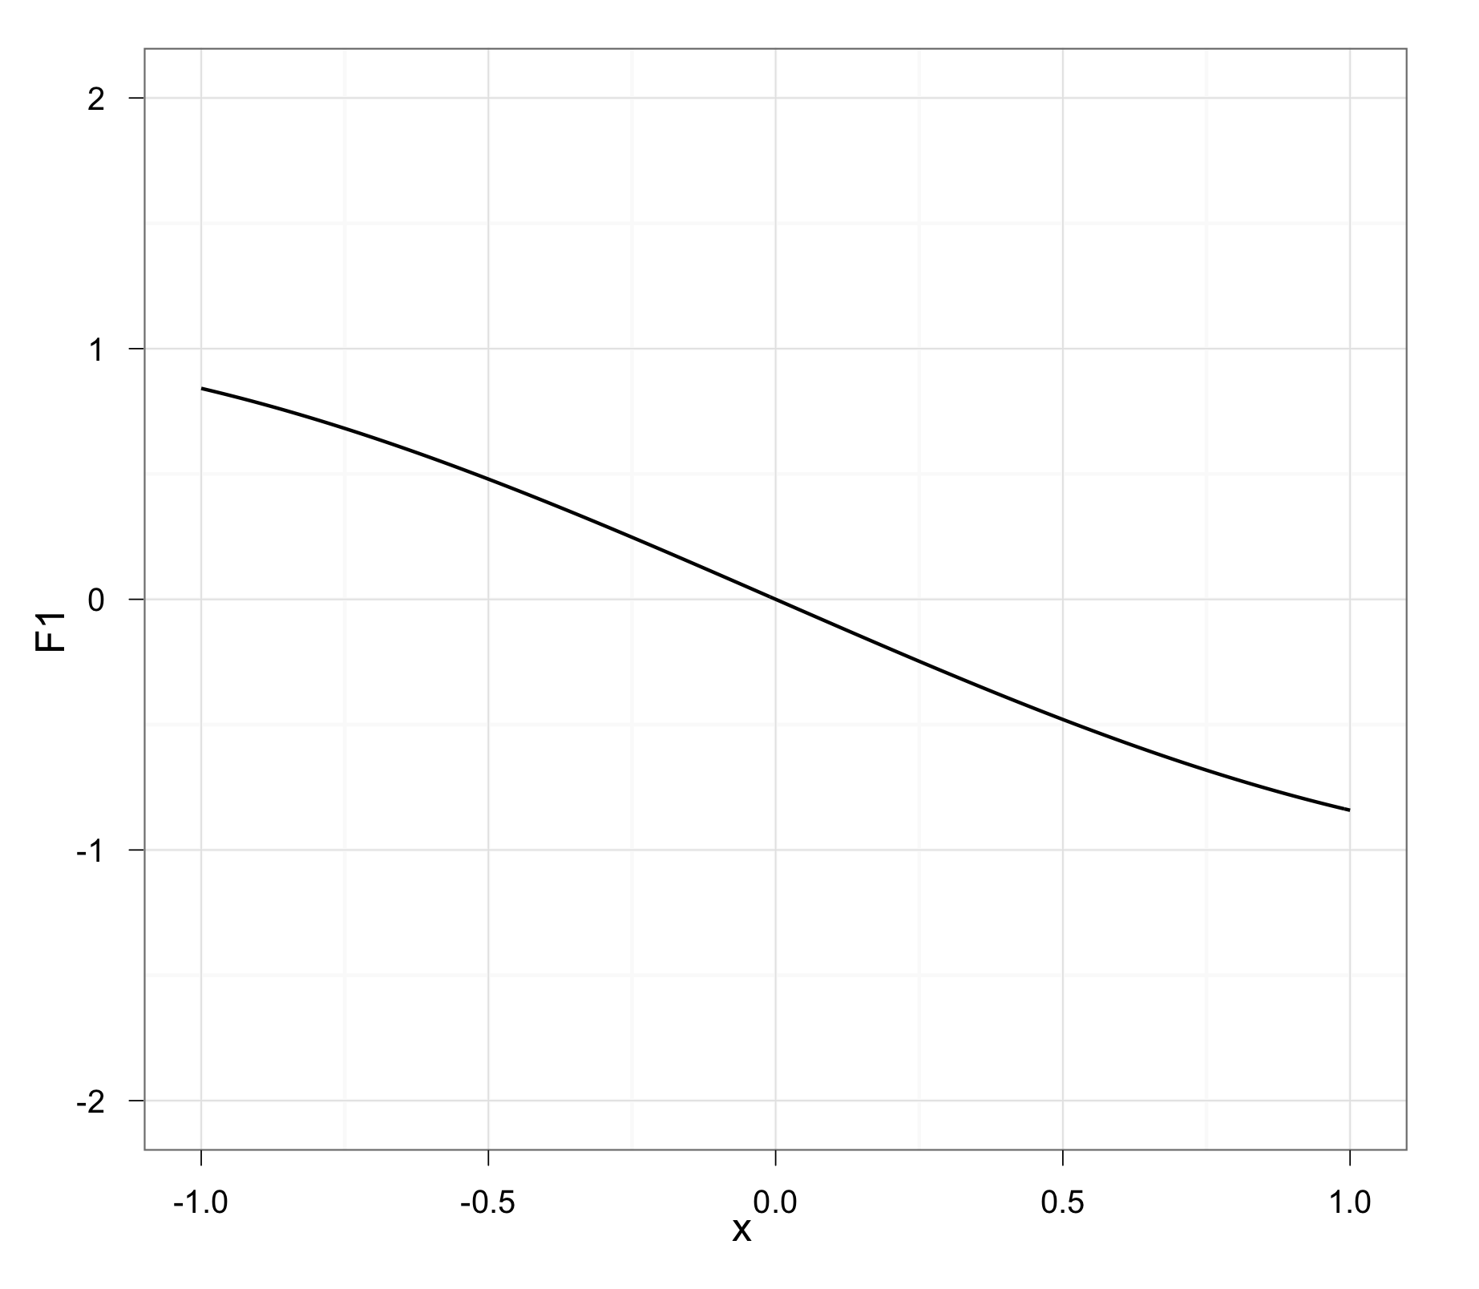
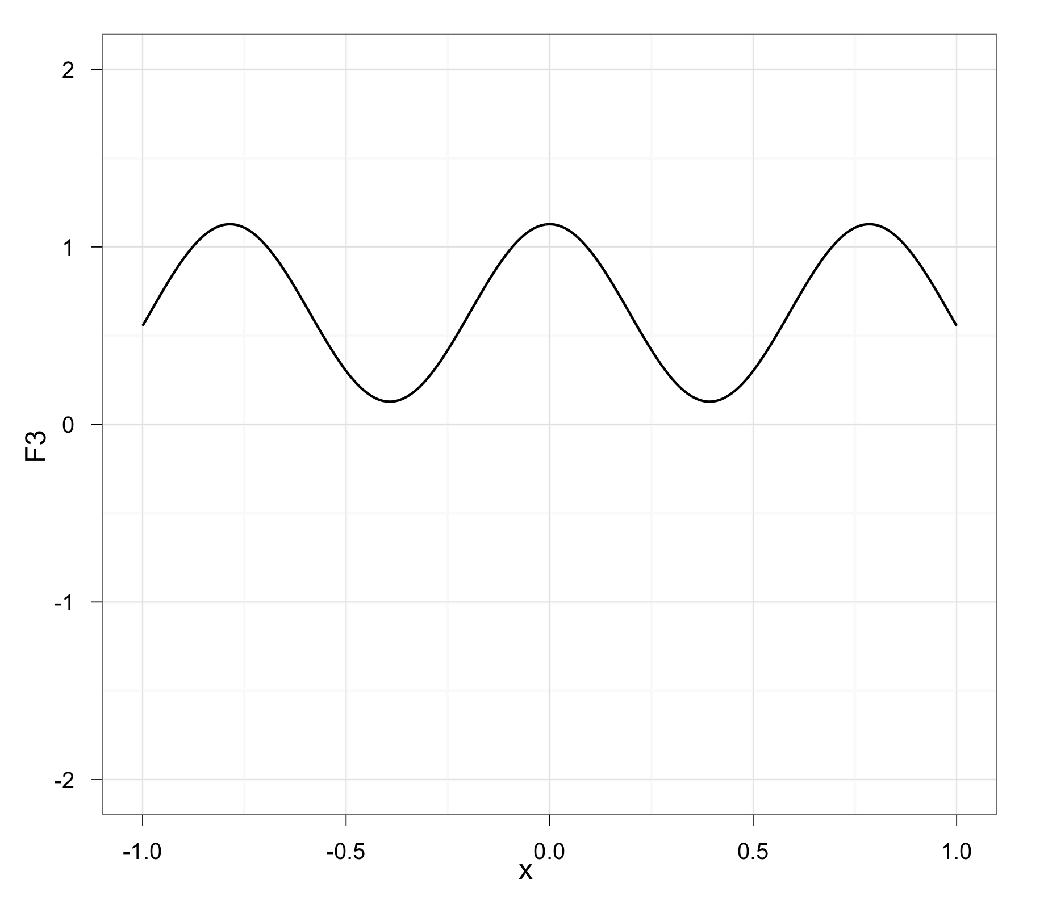
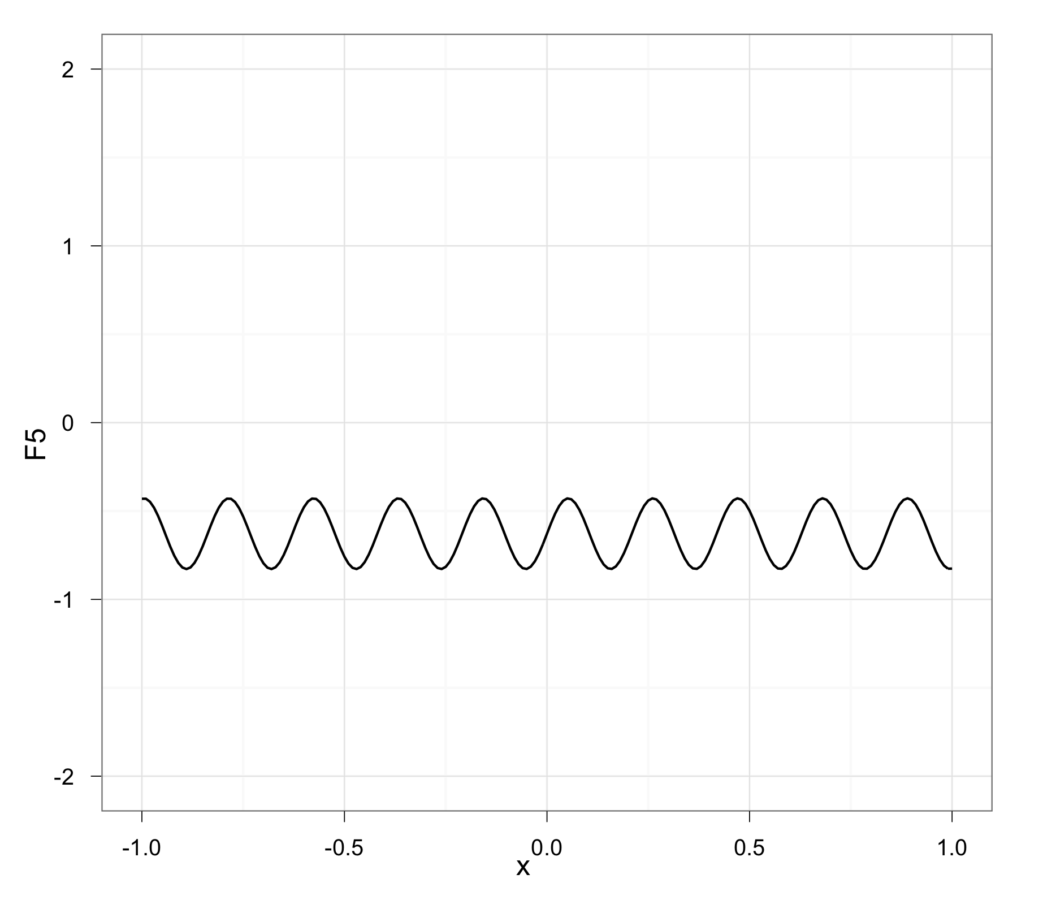
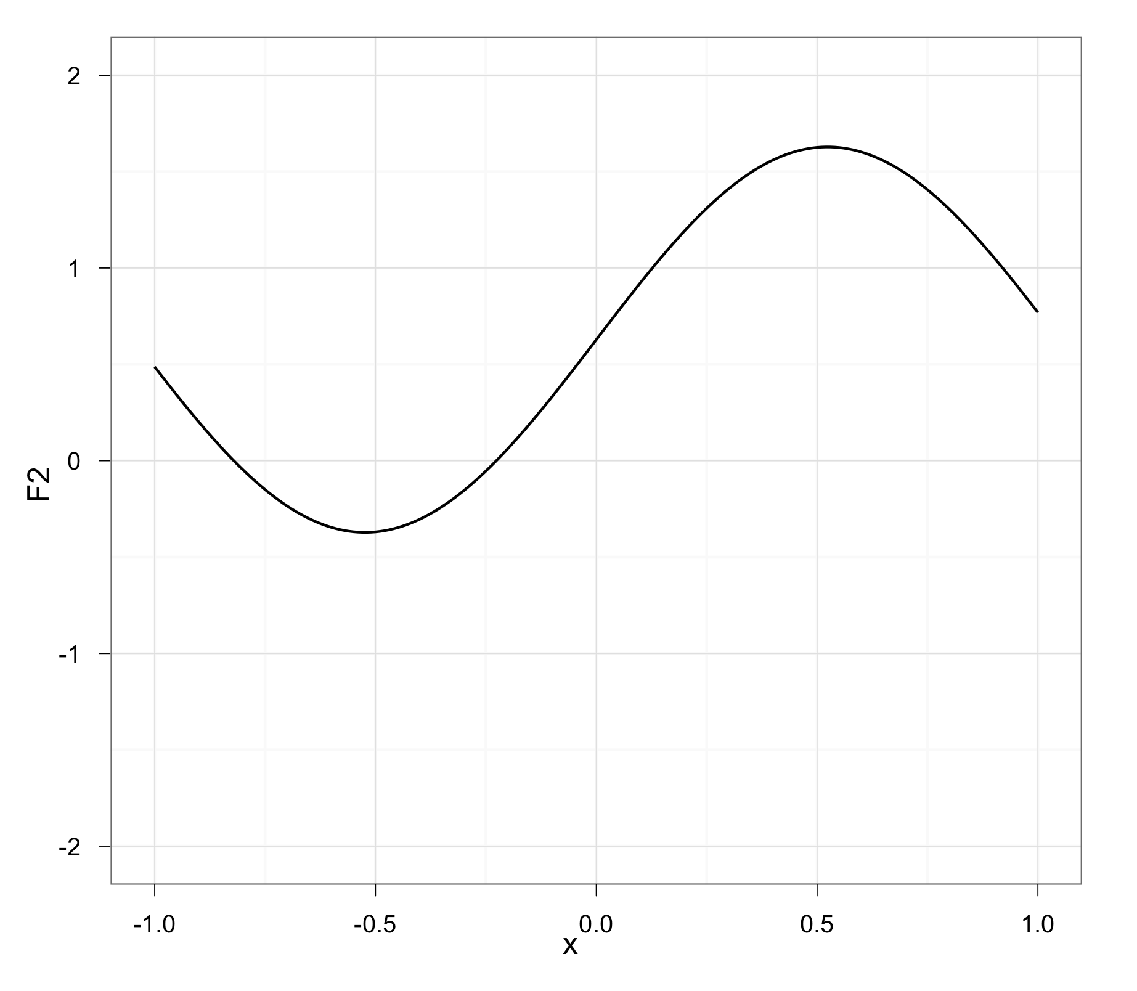
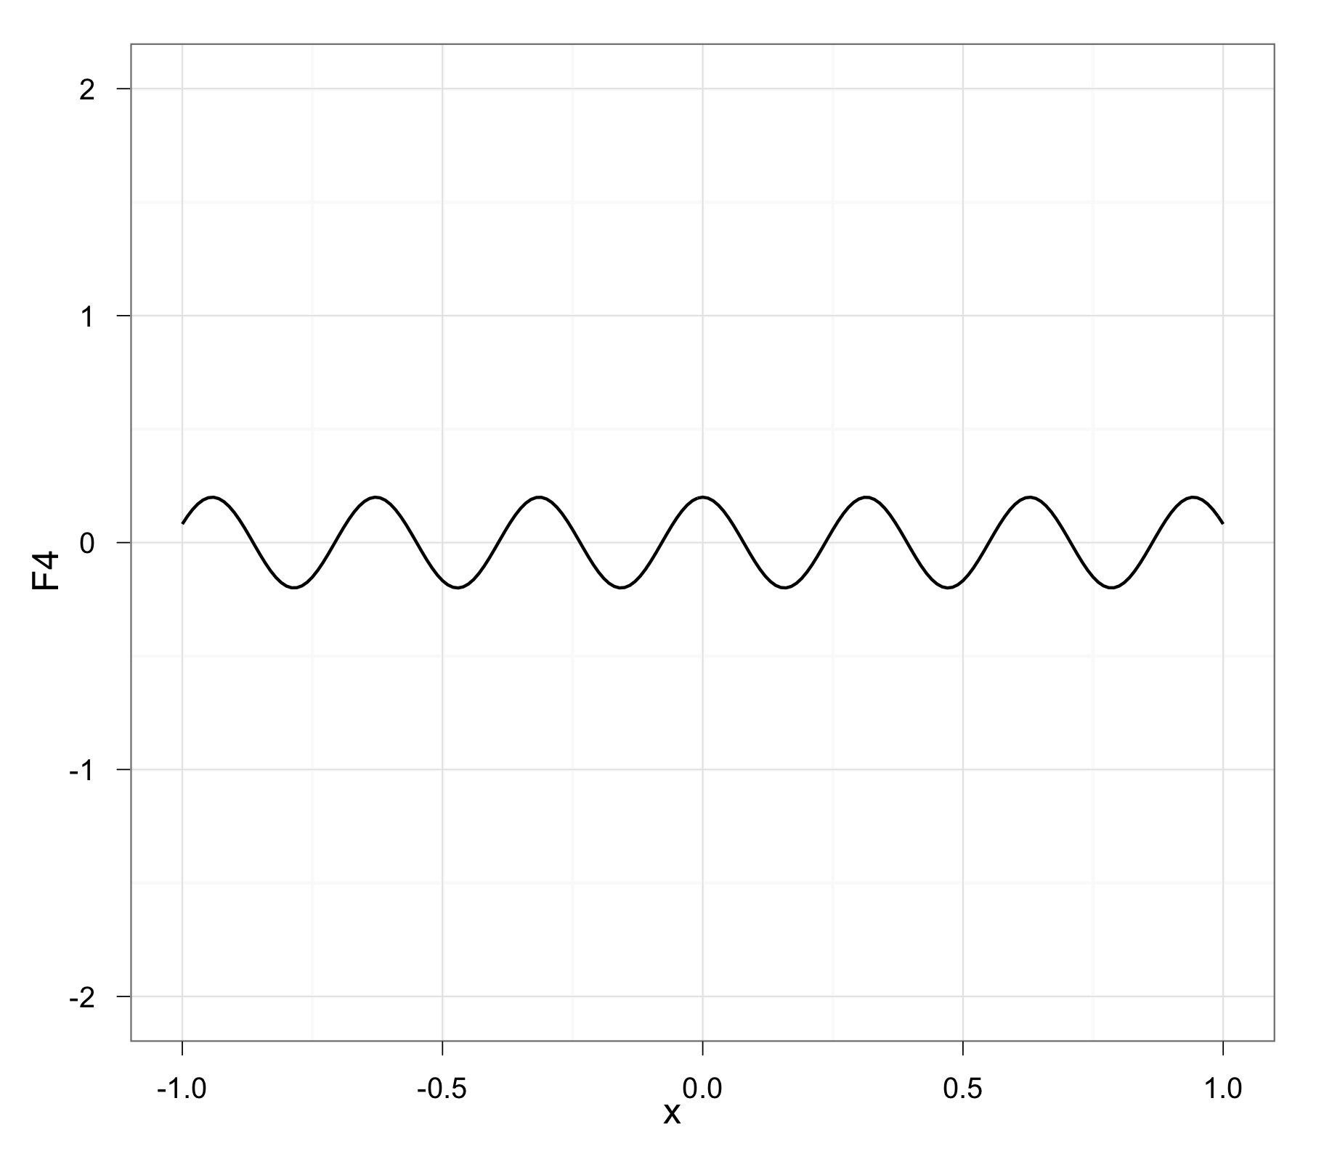
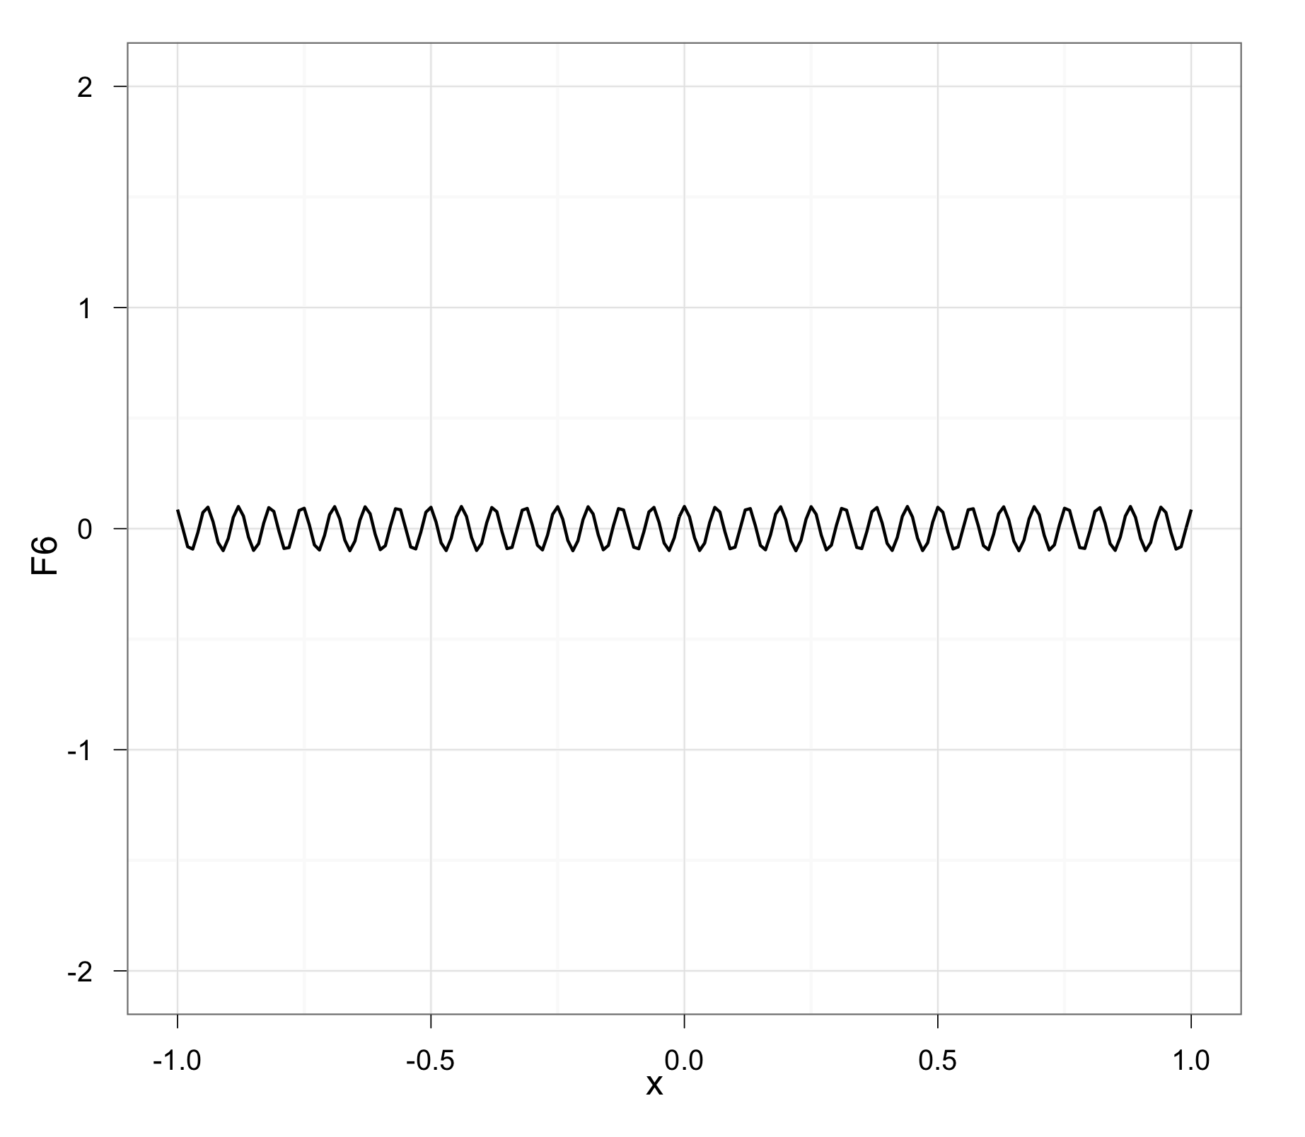

Slide 19
Forecasting

Slide 20
Decomposing Time Series
Time series can be fruitfully analyzed by decomposing them into key components
Trend Component T_{t}
Seasonal Component S_{t}
Cyclical Component C_{t}
Irregular Component I_{t}

Slide 21
Forecast Variations
Irregular variation
Trend
Cycles
10
09
08
Seasonal variations

Slide 22
Time Series Forecasts
Trend - long-term movement in data
Seasonality - short-term regular variations in data
Cycle – wavelike variations of a longer duration
Irregular variations - caused by unusual circumstances
Random variations - caused by chance

Slide 23
Simple Forecasts
Stable time series data
s_{t} = x_{t-1} + ε
Seasonal variations
s_{t} = x_{t-n} + ε
Data with trends
s_{t}= x_{t-1} + (x_{t-1} – x_{t-2}) + ε

Slide 24
Techniques for Smoothing
Moving average
Weighted moving average
Exponential smoothing

Slide 25
Moving Averages
Moving average – A technique that averages a number of recent actual values, updated as new values become available.
Weighted moving average – Certain values in a series are given more weight in computing the forecast.

Slide 26
Moving Averages
Moving average – A technique that averages a number of recent actual values, updated as new values become available.
This is equivalent to:

Slide 27
Moving Average
Date | Close | MA₃ | MA₅
25-Nov-11 | 11,231.78
23-Nov-11 | 11,257.55
22-Nov-11 | 11,493.72
21-Nov-11 | 11,547.31
18-Nov-11 | 11,796.16 |  | (12170.18 + 11780.94 + 11893.79 + 12153.68 + 12078.98) / 5 = 12,015.51
17-Nov-11 | 11,770.73
16-Nov-11 | 11,905.59
15-Nov-11 | 12,096.16
14-Nov-11 | 12,078.98 | (12170.18 + 11780.94 + 11893.79) / 3 = 11,948.30
11-Nov-11 | 12,153.68
10-Nov-11 | 11,893.79
9-Nov-11 | 11,780.94
8-Nov-11 | 12,170.18

Slide 28
Moving Average
Date | Close | MA₃ | MA₅
25-Nov-11 | 11,231.78
23-Nov-11 | 11,257.55
22-Nov-11 | 11,493.72
21-Nov-11 | 11,547.31 |  | (11780.94 + 11893.79 + 12153.68 + 12078.98 + 12096.16) / 5 = 12,000.71
18-Nov-11 | 11,796.16
17-Nov-11 | 11,770.73
16-Nov-11 | 11,905.59
15-Nov-11 | 12,096.16 | (11780.94 + 11893.79 + 12153.68) / 3 = 11,942.80
14-Nov-11 | 12,078.98 |  | 12,015.51
11-Nov-11 | 12,153.68
10-Nov-11 | 11,893.79 | 11,948.30
9-Nov-11 | 11,780.94
8-Nov-11 | 12,170.18

Slide 29
Moving Average
Date | Close | MA₃ | MA₅
25-Nov-11 | 11,231.78 | 11,327.68 | 11,465.30
23-Nov-11 | 11,257.55 | 11,432.86 | 11,573.09
22-Nov-11 | 11,493.72 | 11,612.40 | 11,702.70
21-Nov-11 | 11,547.31 | 11,704.73 | 11,823.19
18-Nov-11 | 11,796.16 | 11,824.16 | 11,929.52
17-Nov-11 | 11,770.73 | 11,924.16 | 12,001.03
16-Nov-11 | 11,905.59 | 12,026.91 | 12,025.64
15-Nov-11 | 12,096.16 | 12,109.61 | 12,000.71
14-Nov-11 | 12,078.98 | 12,042.15 | 12,015.51
11-Nov-11 | 12,153.68 | 11,942.80
10-Nov-11 | 11,893.79 | 11,948.30
9-Nov-11 | 11,780.94
8-Nov-11 | 12,170.18

Slide 30
Simple Moving Average

Slide 31
Exponential Smoothing
Premise: The most recent observations might have the highest predictive value.
Therefore, we should give more weight to the more recent time periods when forecasting.

Slide 32
Exponential Smoothing
Weighted averaging method based on previous forecast plus a percentage of the forecast error
(x – s) is the error term, α is the % feedback

Slide 33
Exponential Smoothing
Period | Actual | Alpha = 0.1 | Alpha = 0.4
25-Nov-11 | 11,231.78
23-Nov-11 | 11,257.55
22-Nov-11 | 11,493.72
21-Nov-11 | 11,547.31
18-Nov-11 | 11,796.16
17-Nov-11 | 11,770.73
16-Nov-11 | 11,905.59
15-Nov-11 | 12,096.16
14-Nov-11 | 12,078.98 | 11780.94 + 0.1*(11780.94 –12170.18) = 12131.26 | 11780.94 + 0.4*(11780.94 –12170.18) = 12014.48
11-Nov-11 | 12,153.68
10-Nov-11 | 11,893.79
9-Nov-11 | 11,780.94 | 12170.18 | 12170.18
8-Nov-11 | 12,170.18

Slide 34
Exponential Smoothing
Period | Actual | Alpha = 0.1 | Alpha = 0.4
25-Nov-11 | 11,231.78
23-Nov-11 | 11,257.55
22-Nov-11 | 11,493.72
21-Nov-11 | 11,547.31
18-Nov-11 | 11,796.16
17-Nov-11 | 11,770.73
16-Nov-11 | 11,905.59
15-Nov-11 | 12,096.16 | 11893.79 + 0.1*(11893.79 –12131.26) = 12107.51 | 11893.79 + 0.4*(11893.79 –12014.48) = 11966.21
14-Nov-11 | 12,078.98
11-Nov-11 | 12,153.68
10-Nov-11 | 11,893.79 | 12131.26 | 12014.48
9-Nov-11 | 11,780.94 | 12170.18 | 12170.18
8-Nov-11 | 12,170.18

Slide 35
Exponential Smoothing
Period | Actual | Alpha = 0.1 | Alpha = 0.4
25-Nov-11 | 11,231.78 | 11865.20 | 11487.26
23-Nov-11 | 11,257.55 | 11932.72 | 11640.40
22-Nov-11 | 11,493.72 | 11981.49 | 11738.19
21-Nov-11 | 11,547.31 | 12029.74 | 11865.45
18-Nov-11 | 11,796.16 | 12055.69 | 11911.64
17-Nov-11 | 11,770.73 | 12087.35 | 12005.59
16-Nov-11 | 11,905.59 | 12107.55 | 12072.25
15-Nov-11 | 12,096.16 | 12108.81 | 12056.31
14-Nov-11 | 12,078.98 | 12112.13 | 12041.20
11-Nov-11 | 12,153.68 | 12107.51 | 11966.21
10-Nov-11 | 11,893.79 | 12131.26 | 12014.48
9-Nov-11 | 11,780.94 | 12170.18 | 12170.18
8-Nov-11 | 12,170.18

Slide 36
Picking a Smoothing Constant

Slide 37
Autoregressive Models
These models assume the current data can be best predicted by the preceding data
The basic assumption is that observed outcomes predict future outcomes

Slide 38
Multiple Regression
Idea: Examine the linear relationship between
1 dependent (y) & 2 or more independent variables (x_{i})
Population model:
Y-intercept
Population slopes
Random Error
Estimated multiple regression model:
Estimated
(or predicted)
value of y
Estimated
intercept
Estimated slope coefficients

Slide 39
Autoregressive models
The creation of an autoregressive model generates a new predictor variable by using the Y variable lagged 1 or more periods.
Dependent variable is a function of itself at one or more previous period(s) of time.

Slide 40
Autoregression
Date | Close
25-Nov-11 | 11,231.78
23-Nov-11 | 11,257.55
22-Nov-11 | 11,493.72
21-Nov-11 | 11,547.31
18-Nov-11 | 11,796.16
17-Nov-11 | 11,770.73
16-Nov-11 | 11,905.59
15-Nov-11 | 12,096.16
14-Nov-11 | 12,078.98
11-Nov-11 | 12,153.68
10-Nov-11 | 11,893.79
9-Nov-11 | 11,780.94
8-Nov-11 | 12,170.18
Time series data
Stock market closing prices over 12 days

Slide 41
Lagged variables
Date | Close | T-1 | T-2
25-Nov-11 | 11,231.78 | 11,257.55 | 11,493.72
23-Nov-11 | 11,257.55 | 11,493.72 | 11,547.31
22-Nov-11 | 11,493.72 | 11,547.31 | 11,796.16
21-Nov-11 | 11,547.31 | 11,796.16 | 11,770.73
18-Nov-11 | 11,796.16 | 11,770.73 | 11,905.59
17-Nov-11 | 11,770.73 | 11,905.59 | 12,096.16
16-Nov-11 | 11,905.59 | 12,096.16 | 12,078.98
15-Nov-11 | 12,096.16 | 12,078.98 | 12,153.68
14-Nov-11 | 12,078.98 | 12,153.68 | 11,893.79
11-Nov-11 | 12,153.68 | 11,893.79 | 11,780.94
10-Nov-11 | 11,893.79 | 11,780.94 | 12,170.18
9-Nov-11 | 11,780.94 | 12,170.18
8-Nov-11 | 12,170.18

Slide 42
Lagged variables
Date | Close | T-1 | T-2
25-Nov-11 | 11,231.78 | 11,257.55 | 11,493.72
23-Nov-11 | 11,257.55 | 11,493.72 | 11,547.31
22-Nov-11 | 11,493.72 | 11,547.31 | 11,796.16
21-Nov-11 | 11,547.31 | 11,796.16 | 11,770.73
18-Nov-11 | 11,796.16 | 11,770.73 | 11,905.59
17-Nov-11 | 11,770.73 | 11,905.59 | 12,096.16
16-Nov-11 | 11,905.59 | 12,096.16 | 12,078.98
15-Nov-11 | 12,096.16 | 12,078.98 | 12,153.68
14-Nov-11 | 12,078.98 | 12,153.68 | 11,893.79
11-Nov-11 | 12,153.68 | 11,893.79 | 11,780.94
10-Nov-11 | 11,893.79 | 11,780.94 | 12,170.18
9-Nov-11 | 11,780.94 | 12,170.18
8-Nov-11 | 12,170.18
y_{t} = b₀ + b₁y_{t-1} + b₂y_{t-2} + e_{t}

Slide 43
Lagged variables
Date | Close | T-1 | T-2
25-Nov-11 | 11,231.78 | 11,257.55 | 11,493.72
23-Nov-11 | 11,257.55 | 11,493.72 | 11,547.31
22-Nov-11 | 11,493.72 | 11,547.31 | 11,796.16
21-Nov-11 | 11,547.31 | 11,796.16 | 11,770.73
18-Nov-11 | 11,796.16 | 11,770.73 | 11,905.59
17-Nov-11 | 11,770.73 | 11,905.59 | 12,096.16
16-Nov-11 | 11,905.59 | 12,096.16 | 12,078.98
15-Nov-11 | 12,096.16 | 12,078.98 | 12,153.68
14-Nov-11 | 12,078.98 | 12,153.68 | 11,893.79
11-Nov-11 | 12,153.68 | 11,893.79 | 11,780.94
10-Nov-11 | 11,893.79 | 11,780.94 | 12,170.18
9-Nov-11 | 11,780.94 | 12,170.18
8-Nov-11 | 12,170.18
y_{t} = b₀ + b₁y_{t-1} + b₂y_{t-2} + e_{t}

Slide 44
Lagged variables
Date | Close | T-1 | T-2
25-Nov-11 | 11,231.78 | 11,257.55 | 11,493.72
23-Nov-11 | 11,257.55 | 11,493.72 | 11,547.31
22-Nov-11 | 11,493.72 | 11,547.31 | 11,796.16
21-Nov-11 | 11,547.31 | 11,796.16 | 11,770.73
18-Nov-11 | 11,796.16 | 11,770.73 | 11,905.59
17-Nov-11 | 11,770.73 | 11,905.59 | 12,096.16
16-Nov-11 | 11,905.59 | 12,096.16 | 12,078.98
15-Nov-11 | 12,096.16 | 12,078.98 | 12,153.68
14-Nov-11 | 12,078.98 | 12,153.68 | 11,893.79
11-Nov-11 | 12,153.68 | 11,893.79 | 11,780.94
10-Nov-11 | 11,893.79 | 11,780.94 | 12,170.18
9-Nov-11 | 11,780.94 | 12,170.18
8-Nov-11 | 12,170.18
y_{t} = b₀ + b₁y_{t-1} + b₂y_{t-2} + e_{t}

Slide 45
Lagged variables
Date | Close | T-1 | T-2
25-Nov-11 | 11,231.78 | 11,257.55 | 11,493.72
23-Nov-11 | 11,257.55 | 11,493.72 | 11,547.31
22-Nov-11 | 11,493.72 | 11,547.31 | 11,796.16
21-Nov-11 | 11,547.31 | 11,796.16 | 11,770.73
18-Nov-11 | 11,796.16 | 11,770.73 | 11,905.59
17-Nov-11 | 11,770.73 | 11,905.59 | 12,096.16
16-Nov-11 | 11,905.59 | 12,096.16 | 12,078.98
15-Nov-11 | 12,096.16 | 12,078.98 | 12,153.68
14-Nov-11 | 12,078.98 | 12,153.68 | 11,893.79
11-Nov-11 | 12,153.68 | 11,893.79 | 11,780.94
10-Nov-11 | 11,893.79 | 11,780.94 | 12,170.18
9-Nov-11 | 11,780.94 | 12,170.18
8-Nov-11 | 12,170.18
y_{t} = b₀ + b₁y_{t-1} + b₂y_{t-2} + e_{t}

Slide 46
Lagged variables
Date | Close | T-1 | T-2
25-Nov-11 | 11,231.78 | 11,257.55 | 11,493.72
23-Nov-11 | 11,257.55 | 11,493.72 | 11,547.31
22-Nov-11 | 11,493.72 | 11,547.31 | 11,796.16
21-Nov-11 | 11,547.31 | 11,796.16 | 11,770.73
18-Nov-11 | 11,796.16 | 11,770.73 | 11,905.59
17-Nov-11 | 11,770.73 | 11,905.59 | 12,096.16
16-Nov-11 | 11,905.59 | 12,096.16 | 12,078.98
15-Nov-11 | 12,096.16 | 12,078.98 | 12,153.68
14-Nov-11 | 12,078.98 | 12,153.68 | 11,893.79
11-Nov-11 | 12,153.68 | 11,893.79 | 11,780.94
10-Nov-11 | 11,893.79 | 11,780.94 | 12,170.18
9-Nov-11 | 11,780.94 | 12,170.18
8-Nov-11 | 12,170.18
Can’t use these observations

Slide 47
Autoregression
With data set up this way, the procedure is almost exactly like regular multiple regression
Find the best fitting slopes
Test the goodness-of-fit of the model (R²)
Test the significance of individual slopes

Slide 48
Autoregression
With data set up this way, the procedure is almost exactly like regular multiple regression
Find the best fitting slopes
b₀ = -1389.54
b₁ = 0.911
b₂ = 0.201
y_{t} = b₀ + b₁y_{t-1} + b₂y_{t-2} + e_{t}

Slide 49
Autoregression
With data set up this way, the procedure is almost exactly like regular multiple regression
Find the best fitting slopes
Test the goodness-of-fit of the model (R²)
R² = 0.7873

Slide 50
Autoregression
With data set up this way, the procedure is almost exactly like regular multiple regression
Find the best fitting slopes
Test the goodness-of-fit of the model (R²)
Test the significance of individual slopes
b₀ = -1389.54 (2742.16)
b₁ = 0.911 (0.2908)
b₂ = 0.201 (0.3474)
df = n – k – 1 = 8
t_{crit} = 2.306
b₀: t = -1389.54 / 2742.16 = -0.507
b₁: t = 0.911 / 0.2908 = 3.134
b₂: t = 0.201 / 0.3474 = 0.578

Slide 51
Autogregressive Modeling
Like Multiple Autocorrelation
1st order: correlation between consecutive values
2nd order: correlation between values 2 periods apart
Autoregressive Model for pth order:
Random Error

Slide 52
Autoregressive Modeling Steps
Choose p:
Form a series of “lag predictor” variables Y_{i-1} , Y_{i-2} , … Y_{i-p}
Run regression model using all p variables
Test significance of B_{p}
If null hypothesis rejected, this model is selected
If null hypothesis not rejected, decrease p by 1 and repeat calculations

Slide 53
Stock Market
Time series can have multiple variables
Date | Close | Volume (M)
25-Nov-11 | 11,231.78 | 1,664.2
23-Nov-11 | 11,257.55 | 3,798.94
22-Nov-11 | 11,493.72 | 3,911.71
21-Nov-11 | 11,547.31 | 4,050.07
18-Nov-11 | 11,796.16 | 3,827.61
17-Nov-11 | 11,770.73 | 4,596.45
16-Nov-11 | 11,905.59 | 4,085.01
15-Nov-11 | 12,096.16 | 3,599.3
14-Nov-11 | 12,078.98 | 3,219.68

Slide 54
Stock Market
Date | Close | Volume (M)
25-Nov-11 | 11,231.78 | 1664.2
23-Nov-11 | 11,257.55 | 3798.94
22-Nov-11 | 11,493.72 | 3911.71
21-Nov-11 | 11,547.31 | 4050.07
18-Nov-11 | 11,796.16 | 3827.61
17-Nov-11 | 11,770.73 | 4596.45
16-Nov-11 | 11,905.59 | 4085.01
15-Nov-11 | 12,096.16 | 3599.3
14-Nov-11 | 12,078.98 | 3219.68
11-Nov-11 | 12,153.68 | 3329.83
10-Nov-11 | 11,893.79 | 4002.76
9-Nov-11 | 11,780.94 | 4659.74
8-Nov-11 | 12,170.18 | 3908.49
Time series can have multiple variables
Of course, one can calculate correlation between two variables
r(Close, Volume) =
0.268

Slide 55
Cross-correlation
Date | Close | Volume (M)
25-Nov-11 | 11,231.78 | 1664.2
23-Nov-11 | 11,257.55 | 3798.94
22-Nov-11 | 11,493.72 | 3911.71
21-Nov-11 | 11,547.31 | 4050.07
18-Nov-11 | 11,796.16 | 3827.61
17-Nov-11 | 11,770.73 | 4596.45
16-Nov-11 | 11,905.59 | 4085.01
15-Nov-11 | 12,096.16 | 3599.3
14-Nov-11 | 12,078.98 | 3219.68
11-Nov-11 | 12,153.68 | 3329.83
10-Nov-11 | 11,893.79 | 4002.76
9-Nov-11 | 11,780.94 | 4659.74
8-Nov-11 | 12,170.18 | 3908.49
One can also calculate the correlation between one variable and the lagged version of the other
This is known as cross-correlation

Slide 56
Cross-correlation
Date | Close | Volume_{t-1} (M)
25-Nov-11 | 11,231.78 | 3798.94
23-Nov-11 | 11,257.55 | 3911.71
22-Nov-11 | 11,493.72 | 4050.07
21-Nov-11 | 11,547.31 | 3827.61
18-Nov-11 | 11,796.16 | 4596.45
17-Nov-11 | 11,770.73 | 4085.01
16-Nov-11 | 11,905.59 | 3599.3
15-Nov-11 | 12,096.16 | 3219.68
14-Nov-11 | 12,078.98 | 3329.83
11-Nov-11 | 12,153.68 | 4002.76
10-Nov-11 | 11,893.79 | 4659.74
9-Nov-11 | 11,780.94 | 3908.49
8-Nov-11 | 12,170.18
Again, have to leave out some observations

Slide 57
Cross-correlation
Date | Close | Volume_{t-1} (M)
25-Nov-11 | 11,231.78 | 3798.94
23-Nov-11 | 11,257.55 | 3911.71
22-Nov-11 | 11,493.72 | 4050.07
21-Nov-11 | 11,547.31 | 3827.61
18-Nov-11 | 11,796.16 | 4596.45
17-Nov-11 | 11,770.73 | 4085.01
16-Nov-11 | 11,905.59 | 3599.3
15-Nov-11 | 12,096.16 | 3219.68
14-Nov-11 | 12,078.98 | 3329.83
11-Nov-11 | 12,153.68 | 4002.76
10-Nov-11 | 11,893.79 | 4659.74
9-Nov-11 | 11,780.94 | 3908.49
8-Nov-11 | 12,170.18
Again, have to leave out some observations
Cross-correlation
r(Close,Volume_{t-1}) = -0.178

Slide 58
Granger causality
If adding the additional lagged variable X to the autoregressive model Y significantly improves the prediction of Y, then X “Granger-causes” Y
This means that X can be used to improve the prediction of future values of Y over just Y itself
Typically, this is because X actually influences the outcome of Y

Slide 59
Granger causality
Typically, this is because X actually influences the outcome of Y
However, it could be a third variable causes X and then Y, so changing X would not change Y
Example:
Gasoline prices may “Granger-cause” milk prices
But Fed lending rates may first affect gasoline prices and then milk prices, so changing gas prices would have no effect on milk prices

Slide 60
Thursday
Practice problems
Next week
Review
Review
Review

