Slide 1
Statistics Lesson 4
BT221
Professor Winter Mason

Slide 2
Visualizing Data
So far:
Histograms
Today:
Box-plots
Bar charts
Line plots
Scatter plots
Proportion plots
Chart Junk

Slide 3
Histogram
Single Quantitative Variable

Slide 4
Histogram
A histogram is a bar chart in which:
The y-axis is frequency or count
The x-axis is a quantitative variable
The entire range of data is covered on the x-axis
The range of data is typically divided into bins
(almost same process as for calculating mode)
Notes:
Go to Excel Spreadsheet

Slide 5
Box Plots
Quantitative Variables

Slide 6
Box Plots
Indicates the variability by showing key percentiles:
Min
25%
Median
75%
Max
Allows comparison of the distribution of multiple variables
Can be modified to show outliers: extreme data points that fall far outside the range of most of the data

Slide 7
Outlier
Tukey’s definition:
Any point outside:
25th percentile – 1.5 * (IQR)
75th percentile + 1.5 * (IQR)
There are other definitions—can be arbitrary, but we’ll go with Tukey for this class

Slide 8
Drawing a boxplot
Company | CEO Salary
IBM | 10,000,000
AMD | 7,328,600
Sun | 4,871,300
Compaq | 3,891,000
Applied Materials | 3,835,800
EMC | 2,809,900
Micron | 2,774,800
HP | 2,766,300
Motorola | 2,525,000
National Semi | 2,369,800
TI | 2,096,200
Qualcomm | 1,723,600
Unisys | 1,716,000
Pitney Bowes | 1,519,000
NCR | 1,452,100
Harris | 1,450,000
Cisco | 1,323,300
Lucent | 1,100,000
SG | 692,300
Microsoft | 628,400
Western Digital | 580,500
Oracle | 280,000
Apple | 0
Calculate:
min
25th percentile
median
75th percentile
max

Slide 9
Bar Chart
Categorical Variable(s)
vs.
Quantitative Variable

Slide 10
Bar Chart
Useful for plotting categorical variables against quantitative variables
Typically used for comparing types of things
Error bars show variability
Helpful hints:
The quantitative variable is typically shown on the y-axis
Always have axis showing the quantitative variable start from zero
Don’t forget to label your axes!
Notes:
Use student data to create bar chart of heights for women vs. men

Slide 11
Line plots
Qualitative Variable(s)
vs.
Quantitative Variable

Slide 12
Line plots
Useful for plotting qualitative variables against ordered quantitative variables
Helpful when comparing factors
Error bars can be used to show variability
Helpful hints:
The quantitative variable is typically shown on the y-axis
Always have axis showing the quantitative variable start from zero
Don’t forget to label your axes!

Slide 13
Scatter Plots
Quantitative Variable
vs.
Quantitative Variable

Slide 14
Scatter plots
Used to visualize the relationship between two quantitative variables:
How does one variable change in response to change in another variable?
How closely related are the variables?
Notes:
Show relationship between height and shoe size

Slide 15
Proportion plots
Categorical Variable
vs.
Proportion

Slide 16
Proportion plots
Shows whole divided into parts by proportion
Pie charts
Stacked bar charts
Chart junk

Slide 17
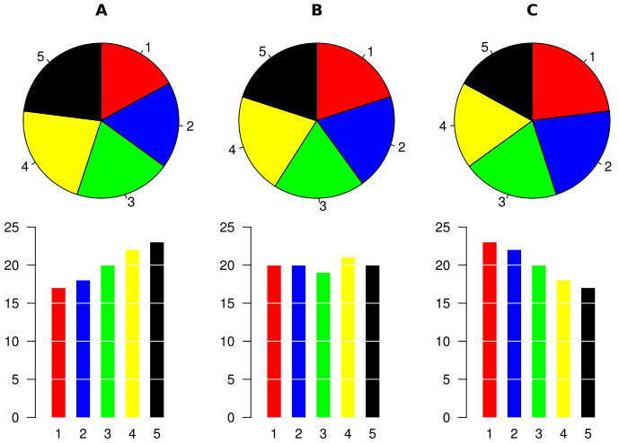
Why pie charts are bad

Slide 18
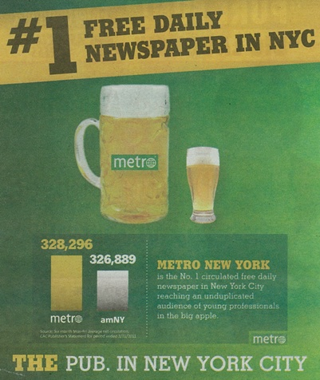
What story does this tell?

Slide 19
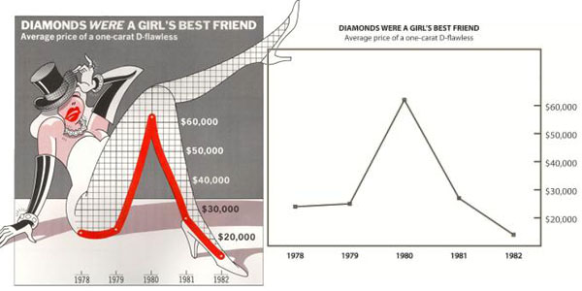
Chartjunk

Slide 20
Choosing a Figure
How many variables are you trying to plot?
More than 4 is almost always too difficult to make sense of
What types of variables are you plotting?
What is the purpose of the plot?
i.e., What are you trying to show?

Slide 21
Rules of Thumb
Make the visualization understandable without explanation (or as little as possible)
Additional information can be helpful
BUT don’t let it distract from the main point
Use as little ink as possible
(See also: books by Edward Tufte)
Notes:
http://junkcharts.typepad.com/junk_charts/2011/08/light-entertainment-how-social-media-saves-education-and-education-saves-us-all.html
http://flowingdata.com/2011/09/09/girl-scout-cookie-pie-chart/
http://junkcharts.typepad.com/junk_charts/2011/08/chart-of-the-.html
http://flowingdata.com/2011/08/26/generic-terms-for-streams-mapped/
http://flowingdata.com/2011/08/12/rethinking-the-food-nutrition-label/
http://flowingdata.com/2011/09/07/five-years-of-kiva-lending-and-borrowing/

Slide 22
Probability

Slide 23
Probability, defined
The relative frequency of an event as the number of recorded events approaches infinity
The degree of belief that an event will occur
A precise measurement of uncertainty

Slide 24
Probability, defined
The relative frequency of an event as the number of recorded events approaches infinity (frequentist)
The degree of belief that an event will occur (subjectivist)
A precise quantification of uncertainty (Bayesian, or objective Bayesian)

Slide 25
Frequentist probability
Everyone with a coin, toss it!

Slide 26
Frequentist probability
Everyone with a coin, toss it!
How many were heads? What percent were heads?
What would happen if we did this 1000 times? 1,000,000 times?

Slide 27
Frequentist probability
Everyone with a coin, toss it!
How many were heads? What percent were heads?
What would happen if we did this 1000 times? 1,000,000 times? INFINITY times?!?!?!

Slide 28
Subjective probability
What are the odds the Jets beat the Jaguars next Sunday?

Slide 29
Subjective probability
What are the odds the Jets beat the Jaguars next Sunday?
Probabilities can represent the belief in an outcome. Clearly true for:
Vegas sports betting
Prediction markets
Stock market

Slide 30
Bayesian probability
The likelihood of an event given prior knowledge and observed outcomes.
Like subjective probability, but explicitly incorporates knowledge into probability

Slide 31
Let’s Make a Deal!!

Slide 32
Probability, defined
Note that every definition of probability assumes randomness
When is something random?

Slide 33
Probability, defined
Note that every definition of probability assumes randomness
When is something random?
When it is unpredictable.
This can be because it is out of anyone’s control
Or because we do not have enough information
But only in the first case is it truly random

Slide 34
Up next…
Sample space, events, outcomes

Slide 35
Sample space
The set of all possible outcomes for a random variable
What is the sample space for a coin toss?
What is the sample space for a standard die?
What is the sample space for a deck of cards?

Slide 36
Events
An event in probability theory is a subset of the sample space
It can also be thought of as a potential outcome of a random variable

Slide 37
Set Logic
Key symbols & terms:
Set
For all
Exists
Null or empty set
Subset
Proper subset
Intersection
Union
Set difference
Symmetric difference
Complement
Notes:
A set is a collection of objects

Slide 38
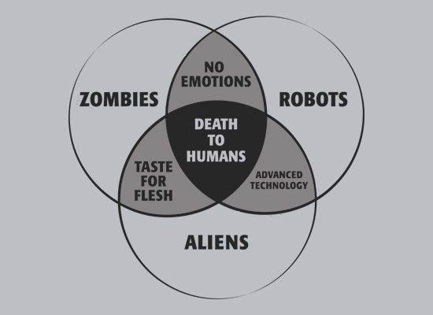
Venn Diagrams

Slide 39
Up next…
Outcome tables,
Joint Probability,
Marginal Probability,
and Conditional Probability

Slide 40
Probability Density Function
Quantitative Variables

Slide 41
Probability Density Function (PDF)
With infinite data, as you decrease the bin size, you get higher resolution.
But infinity is hard to display on the y-axis, so normalize by the size of the data set
The result is the probability of obtaining a range of values

Slide 42
Cumulative Density Function
Quantitative Variables

Slide 43
Cumulative Density Function (CDF)
Value of variable on x-axis and percentiles on y-axis
Easy way to show all percentile values at once

