Slide 1
Statistics Lesson 5
BT221
Professor Winter Mason

Slide 2
Probability

Slide 3
Probability, defined
The relative frequency of an event as the number of recorded events approaches infinity
The degree of belief that an event will occur
A precise measurement of uncertainty

Slide 4
Probability, defined
The relative frequency of an event as the number of recorded events approaches infinity (frequentist)
The degree of belief that an event will occur (subjectivist)
A precise quantification of uncertainty (Bayesian, or objective Bayesian)

Slide 5
Frequentist probability
Everyone with a coin, toss it!

Slide 6
Frequentist probability
Everyone with a coin, toss it!
How many were heads? What percent were heads?
What would happen if we did this 1000 times? 1,000,000 times?

Slide 7
Frequentist probability
Everyone with a coin, toss it!
How many were heads? What percent were heads?
What would happen if we did this 1000 times? 1,000,000 times? INFINITY times?!?!?!

Slide 8
Subjective probability
What are the odds the Jets beat the Jaguars next Sunday?

Slide 9
Subjective probability
What are the odds the Jets beat the Jaguars next Sunday?
Probabilities can represent the belief in an outcome. Clearly true for:
Vegas sports betting
Prediction markets
Stock market

Slide 10
Bayesian probability
The likelihood of an event given prior knowledge and observed outcomes.
Like subjective probability, but explicitly incorporates knowledge into probability

Slide 11
Let’s Make a Deal!!

Slide 12
Probability, defined
Note that every definition of probability assumes randomness
When is something random?

Slide 13
Probability, defined
Note that every definition of probability assumes randomness
When is something random?
When it is unpredictable.
This can be because it is out of anyone’s control
Or because we do not have enough information
But only in the first case is it truly random

Slide 14
Up next…
Sample space, events, outcomes

Slide 15
Sample space
The set of all possible outcomes for a random variable
What is the sample space for a coin toss?
What is the sample space for a standard die?
What is the sample space for a deck of cards?

Slide 16
Events
An event in probability theory is a subset of the sample space
It can also be thought of as a potential outcome of a random variable

Slide 17
Set Logic
Key symbols & terms:
Set
For all
Exists
Null or empty set
Subset
Proper subset
Intersection
Union
Set difference
Symmetric difference
Complement
Notes:
A set is a collection of objects

Slide 18
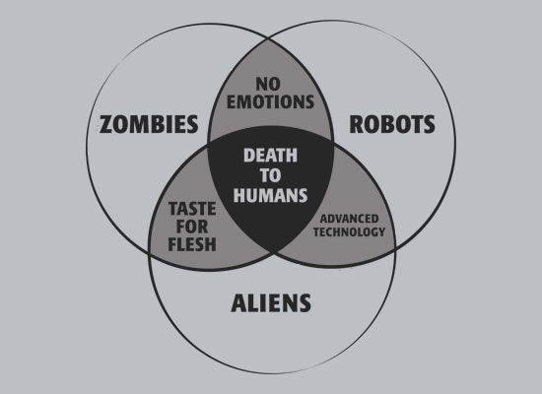
Venn Diagrams

Slide 19
Up next…
Outcome tables,
Joint Probability,
Marginal Probability,
and Conditional Probability

Slide 20
Probability Density Function
Quantitative Variables

Slide 21
Probability Density Function (PDF)
With infinite data, as you decrease the bin size, you get higher resolution.
But infinity is hard to display on the y-axis, so normalize by the size of the data set
The result is the probability of obtaining a range of values

Slide 22
Cumulative Density Function
Quantitative Variables

Slide 23
Cumulative Density Function (CDF)
Value of variable on x-axis and percentiles on y-axis
Easy way to show all percentile values at once

