Slide 1
Statistics Lesson 6
BT221
Professor Winter Mason

Slide 2
Discrete random variable
A discrete random variable has a finite set of outcomes
The variable can be qualitative or quantitative

Slide 3
Discrete random variables
8
1
5
3

Slide 4
Probability Mass

Slide 5
Expected Value
The expected value of a discrete quantitative random variable is:
This is denoted E[X]
This is known as the first moment of the variable

Slide 6
Expected value
What is the expected value for a fair die?
What is the expected value for a die that turns up 6s twice as often as any other number (which all turn up equally)?

Slide 7
Bernoulli trial
A random “experiment” that has exactly two outcomes
These are typically called “success” and “failure”
Example:
Whether a car starts when you turn the key

Slide 8
Bernoulli trial
A random “experiment” that has exactly two outcomes
These are typically called “success” and “failure”
Example:
Whether a car starts when you turn the key
Whether a card turns up black or red

Slide 9
Bernoulli trial
A random “experiment” that has exactly two outcomes
These are typically called “success” and “failure”
Example:
Whether a car starts when you turn the key
Whether a card turns up black or red
Whether a coin comes up heads or tails

Slide 10
Binomial distribution
Given a Bernoulli variable with probability p of success, the binomial distribution is the probability of getting k successes out of N trials
0 ≤ k ≤ N
0 ≤ p ≤ 1

Slide 11
Let’s Roll!
Keep track of 3 things
How many rolls greater than 3 (4, 5, or 6)
How many rolls of exactly 1
How many rolls until first 1

Slide 12
Binomial distribution
The probability mass function for the binomial distribution:
The first expression is the binomial coefficient, said as n choose k.
It is mathematically equivalent to

Slide 13
Binomial distribution
If you toss a fair coin 100 times, what is the probability it comes up heads 50 times?
What is the probability it comes up heads 5 times?
What is the probability it comes up heads more than 60 times?

Slide 14
Geometric distribution
Given a coin with probability p of turning up heads, what is the probability it will take k tosses to turn up the first head?
The probability mass function for the geometric distribution:
k ≥ 1
0 ≤ p ≤ 1

Slide 15
Geometric distribution
If you toss a fair coin 100 times, what is the probability it takes 5 tosses before it comes up heads?
What is the probability it takes 30 tosses to come up heads?

Slide 16
Continuous random variable
A continuous random variable is quantitative
And has an infinite set of outcomes

Slide 17
Probability Density Function (PDF)
With infinite data, as you decrease the bin size, you get higher resolution.
But infinity is hard to display on the y-axis, so normalize by the size of the data set
The result is the probability of obtaining a range of values

Slide 18
Random variables
1
0.75
0.25
0.5
Notes:
What is the sample space for this random variable? What is the probability of getting a value less than 0.25? What is the probability of getting a value between 0.25 & 0.75?

Slide 19
PDF of spinner

Slide 20
Random variables
0.5
0.325
0.125
0.25
Notes:
What is the sample space for this random variable? What is the probability of getting a value less than 0.25?

Slide 21
PDF of spinner

Slide 22
Random variables
1000
100
1
10

Slide 23
PDF of spinner

Slide 24
Expected Value
The expected value of a continuous quantitative random variable is:
Still denoted E[X]
Still known as the first moment of the variable

Slide 25
Normal Distribution
Continuous extension of binomial distribution
Common in nature:
Heights
Test scores
Kernels on a cob of corn
Mathematically convenient:
Perfectly described by the first two “moments”, i.e., its mean and variance

Slide 26
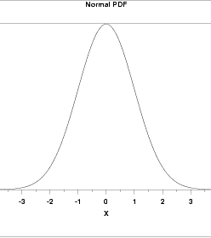
Normal Distribution
Key features

Slide 27
Normal Distribution
Key features
Symmetric

Slide 28
Normal Distribution
Key features
Symmetric
Mean = Median = Mode

Slide 29
Normal Distribution
Key features
Symmetric
Mean = Median = Mode
Standard Deviation = width

Slide 30
Normal Distribution
Key features
Symmetric
Mean = Median = Mode
Standard Deviation = width
“Tails”

Slide 31
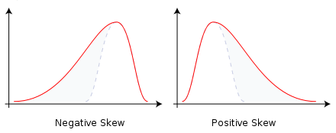
Skewness
Left Skew
Right Skew
Notes:
Generally (but not always!), mean is left of median is left of mode in left skewed data (or right for right-skewed data)

Slide 32
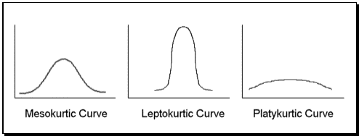
Kurtosis

Slide 33
Standard Normal Distribution
Mean = 0
σ² = 1

Slide 34
Standard Normal Distribution
Mean = 0
σ² = 1
Notes:
Go to Grapher

Slide 35
(Stigler) Standard Normal Distribution
Mean = 0
σ² = 1/2π

Slide 36
Normal approximates binomial
A binomial distribution of n trials with probability p of success can be approximated by:

Slide 37
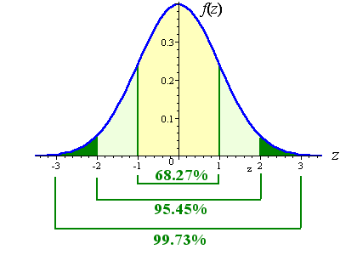
Important percentiles
In the standard normal distribution:
There is about 68% probability in the range [-1, 1]
There is about 95% probability in the range [-2, 2]
There is about 99.7% probability in the range [-3, 3]

Slide 38
z-score
Used to calculate the probability that x ≥ x* for normal distribution
Transforms a normal distribution into the standard normal distribution
Allows one to answer the question, “How many standard deviations is x from the mean”?

Slide 39
z-score
Suppose heights of females are normally distributed.
If the average female height is 64” and the standard deviation is 8”, what is the probability that a woman is 6’ or taller?
How tall would a woman be if 20% of all women were shorter than her?
Approximately what percentage of women are between 56” and 72” tall?

Slide 40
Exponential Distribution
Continuous extension of geometric distribution
The value of compounding interest
The inverse of the “natural” log
Equal to its derivative

Slide 41
Power Law Distribution
Common in nature:
Income
Earthquakes
Word frequencies
Scale-invariant:
“Zooming in” on any part of the distribution does not change the shape of the distribution

Slide 42
Poisson Distribution
Assume within time interval τ, there is a fixed probability of an event.
Arrival times will follow a Poisson distribution
Occurs in nature
The number of yeast cells used when brewing Guinness beer.
The number of phone calls arriving at a call centre per minute.
The number of goals in sports involving two competing teams.
The number of deaths per year in a given age group.
The number of jumps in a stock price in a given time interval.

Slide 43
Sampling

Slide 44
Sample
A sample is a subset of a population.
Most of the examples we’ve seen have been samples of an underlying population
Last 20 Knicks scores ⬄All Knicks scores
Heights of people in class ⬄ Heights of all Stevens students
Age of 20 people in Grand Central Station ⬄ All people in Grand Central Station

Slide 45
Random Sample
Something is a (simple) random sample if the instances are i.i.d. (independent and identically distributed)
Each sample is unrelated to prior or subsequent samples
Each elementary unit is equally likely to be sampled

Slide 46
Sample
Samples vary in their representativeness
Because measures on the sample are estimates of the same measures on the population
When using the sample to understand the population, the sample statistics are estimators

Slide 47
Estimators
Estimators always come with error
Estimators can also be biased:
Biased estimators are systematically different from the population statistic
Unbiased estimators do not need correcting to be an accurate representation of the population statistics

Slide 48
Estimating mean & SD
Roll 2 die 5 times
Calculate mean & sum of squared deviations

Slide 49
Central Limit Theorem
As the number of samples increases, the sampling distribution of a statistic approaches the normal distribution

