Slide 1
Statistics Lesson 8
BT221
Professor Winter Mason

Slide 2
Inference
Null Hypothesis Significance Testing (NHST)

Slide 3
Sampling distributions
The distribution of a statistic if one had an infinite number of draws of size N from the population.
Central limit theorem
As the sample size increases, the distribution of the sample mean approaches a normal distribution

Slide 4
Null Hypothesis
The null hypothesis is the default position:
There is no difference between the target group and the general population
The drug had no effect
There is no relationship between the variables
The investments performed equivalently
H₀: The key sample(s) is (are) not different

Slide 5
Alternative hypothesis
The opposite of the null hypothesis:
There is a difference between the target group and the general population
The drug did have an effect
There is a relationship between the variables
The investments did not perform equivalently
H₁: The key sample(s) is (are) different

Slide 6
Example
Pfizer developed a drug meant to reduce cholesterol. They randomly assigned people to the experimental group (received the drug) and the control group (received a placebo). Six months later, they measured the cholesterol of both groups
H₀:
H₁:

Slide 7
Example
Pfizer developed a drug meant to reduce cholesterol. They randomly assigned people to the experimental group (received the drug) and the control group (received a placebo). Six months later, they measured the cholesterol of both groups
H₀: There are no differences in the cholesterol of the control group and the experimental group
H₁:

Slide 8
Example
Pfizer developed a drug meant to reduce cholesterol. They randomly assigned people to the experimental group (received the drug) and the control group (received a placebo). Six months later, they measured the cholesterol of both groups
H₀: There are no differences in the cholesterol of the control group and the experimental group
H₁: There are differences in the cholesterol of the control group and the experimental group

Slide 9
Example
Pfizer developed a drug meant to reduce cholesterol. They randomly assigned people to the experimental group (received the drug) and the control group (received a placebo). Six months later, they measured the cholesterol of both groups
H₀: There are no differences in the cholesterol of the control group and the experimental group
H₂: The cholesterol of the control group is higher than the cholesterol of the experimental group

Slide 10
Alternate hypothesis
Alternative hypotheses can be undirected (there is a difference) or directional (the alternative is higher or lower than the null)

Slide 11
Another Example
Within the West African population, the frequency of mutations on a particular gene approximately follows an exponential distribution with an exponent ~ 0.2.
In the Caribbean population, the mutations follow an exponential distribution with an exponent ~ 0.4.
You believe a certain group of African-Americans from Louisiana are actually descendants of people from the Caribbean, not West Africa, and measure the frequency of mutations on that gene.

Slide 12
Step 1: Stating Hypotheses
H₀:
H₁:

Slide 13
Step 1: Stating Hypotheses
H₀: The average number of mutations on the gene in the target group are not different from the average number of mutations in descendants of people from West Africa.
H₁:

Slide 14
Step 1: Stating Hypotheses
H₀: The average number of mutations on the gene in the target group are not different from the average number of mutations in descendants of people from West Africa.
H₁: The average number of mutations on the gene in the target group are different from the average number of mutations in descendants of people from West Africa.

Slide 15
Step 1: Stating Hypotheses
H₀: The average number of mutations on the gene in the target group are not different from the average number of mutations in descendants of people from West Africa.
H₁: The average number of mutations on the gene in the target group are greater than the average number of mutations in descendants of people from West Africa.

Slide 16
Step 2: Sampling Distribution
Generate the sampling distribution under the null hypothesis.

Slide 17
Step 3: Probability of Sample
Given the sampling distribution, what is the probability that the actual sample came from the sampling distribution under the null hypothesis?

Slide 18
Step 4: Reject the null hypothesis
If the probability that the sample was drawn from the sampling distribution under the null hypothesis, reject the null hypothesis.

Slide 19
Statistical Inference
State the null and alternative hypothesis
Generate the sampling distribution under the null hypothesis
Find the probability of the sample given the null hypothesis
Reject (or do not reject) the null hypothesis

Slide 20
Type I error
Rejecting the null hypothesis when it is true
Equivalent to a “false positive” or “false alarm”
Commonly denoted α

Slide 21
Type II error
Not rejecting the null hypothesis when it is false
Equivalent to a “false negative”, or a “miss”
Commonly denoted ß, and the power of a test is (1 – ß)

Slide 22
Type I & II errors
 | Null hypothesis is true | Null hypothesis is false
Reject null hypothesis | Type I error False positive (FP) False alarm (FA) | Correct rejection True Positive
Do not reject null hypothesis | Correct outcome True Negative Hit | Type II error False Negative Miss

Slide 23
Student’s t-distribution
The Central Limit Theorem states: as the sample size increases, the distribution of the mean approaches a normal distribution.
But what happens when the sample size is small?

Slide 24
Guinness
When testing the efficiency of a new type of barley in creating malts (that become alcohol with the application of yeast), creating batches was very expensive
How can you estimate the quality of the barley when you only have a very small sample?

Slide 25
Student’s t-distribution
When determining the sampling distribution of the mean, there are 2 unknown quantities
Mean
Variance
The only information available to estimate these quantities are the sample mean and variance, and these estimates must correct for the sample size

Slide 26
Student’s t-distribution
The way to correct for this error is to calculate the t-statistic:
As the sample size, n, increases, the t-distribution approaches a normal distribution

Slide 27
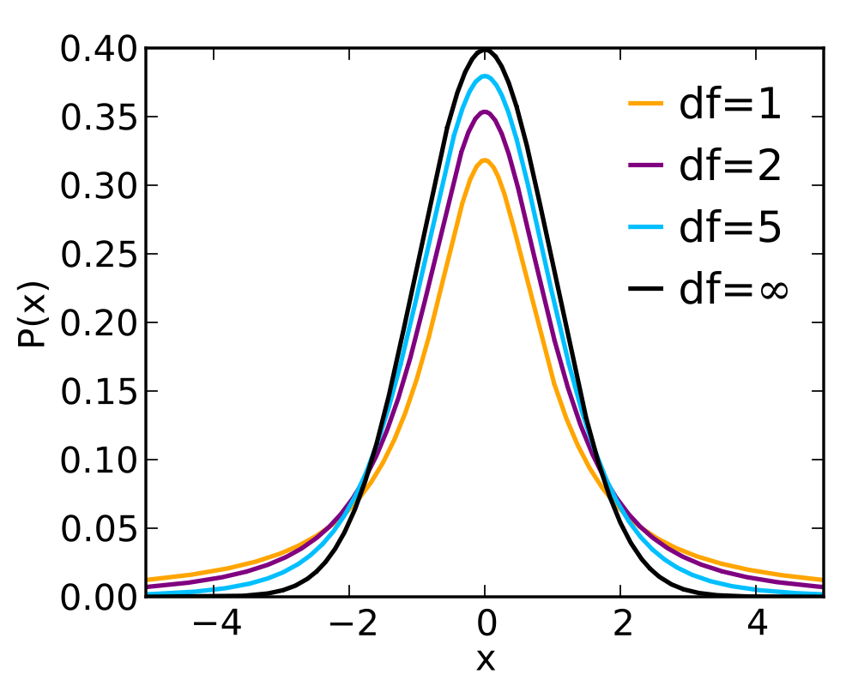

Slide 28
Degrees of Freedom
The degree of freedom is the number of unique pieces of information used in an estimate
More specifically, it is the number of values in a calculation that are free to vary
For instance, when calculating the variance of a sample, the sample mean is included. Which means if you know n-1 deviations from the mean, you can calculate the n^{th} deviation. We would say there are n-1 degrees of freedom in the calculation.

Slide 29
Different from zero?
The easiest example of how and why to calculate a t-statistic:
Is the average X significantly different from zero?
This will use the one-sample t-test

Slide 30
An example
In order for the wildlife in the local stream to survive, the pH of the water must be close to zero. You take 20 measurements at different locations along the stream, and want to know if the average pH is different from zero.

Slide 31
Step 1
H₀: The average pH is not different from zero
H₁:

Slide 32
Step 1
H₀: The average pH is not different from zero
H₁: The average pH is different from zero

Slide 33
Step 2
Generate the sampling distribution under the null hypothesis

Slide 34
Step 2
Generate the sampling distribution under the null hypothesis
For a sample size of N, the sampling distribution of the mean follows a t-distribution with N-1 degrees of freedom

Slide 35
Step 3
Estimate the probability of the sample given the null hypothesis

Slide 36
Step 3
Estimate the probability of the sample given the null hypothesis
Calculate the probability of the mean pH given the corresponding t-distribution

Slide 37
Step 4
Reject the null hypothesis?

Slide 38
Step 4
Reject the null hypothesis?
The convention is to set a threshold for Type I errors (alpha) = 0.05.
In other words, if the probability the sample came from the sampling distribution of the null hypothesis is less than 0.05, reject the null

Slide 39
Different from a specific value?
The second easiest example of calculate a one-sample t-statistic:
Is the average X significantly different from x*?
df is the degrees of freedom (n – 1)

Slide 40
An example
According to published data, the Stevens website receives 250 hits each day. You want to know if your website receives significantly more hits than the Stevens website.

Slide 41
Step 1
H₀: The average daily hits to your webpage is not different from 250
H₁:

Slide 42
Step 1
H₀: The average daily hits to your webpage is not different from 250
H₁: The average daily hits to your webpage is greater than 250

Slide 43
Step 2
Generate the sampling distribution under the null hypothesis
For a sample size of N, the sampling distribution of the mean follows a t-distribution with N-1 degrees of freedom

Slide 44
Step 3
Estimate the probability of the sample given the null hypothesis
Calculate the probability of the average daily hits given the corresponding t-distribution

Slide 45
Step 4
Reject the null hypothesis?
The convention is to set a threshold for Type I errors (alpha) = 0.05.
In other words, if the probability the sample came from the sampling distribution of the null hypothesis is less than 0.05, reject the null

Slide 46
Paired t-test
Suppose you are Pfizer from the earlier example. Instead of comparing the experimental group to the control group, you’re interested in whether each person’s cholesterol lowered on average.
This is a matched-sample t-test or paired t-test

Slide 47
Step 1
H₀: The change in cholesterol is not different from zero
H₁: The change in cholesterol is greater than zero

Slide 48
Step 2
Generate the sampling distribution under the null hypothesis
For a sample size of N, the sampling distribution of the mean follows a t-distribution with N-1 degrees of freedom

Slide 49
Step 3
Estimate the probability of the sample given the null hypothesis
Calculate the probability of the mean change in cholesterol given the corresponding t-distribution

Slide 50
Step 4
Reject the null hypothesis?
The convention is to set a threshold for Type I errors (alpha) = 0.05.
In other words, if the probability the sample came from the sampling distribution of the null hypothesis is less than 0.05, reject the null

Slide 51
Two samples
For the two-sample t-test, the question is whether the two samples are from the same or different populations.

Slide 52
Step 1
H₀: The experimental group is not different from the control group
H₁: The experimental group is different from the control group

Slide 53
Step 2
Generate the sampling distribution under the null hypothesis
Use both samples to estimate the sampling distribution under the null hypothesis
The sampling distribution of the null hypothesis is the difference in means between two samples from the same population

Slide 54
Step 3
Estimate the probability of the difference in means given the null hypothesis
Calculate the probability of the difference in means given the corresponding t-distribution

Slide 55
Step 4
Reject the null hypothesis?
The convention is to set a threshold for Type I errors (alpha) = 0.05.
In other words, if the probability the sample came from the sampling distribution of the null hypothesis is less than 0.05, reject the null

Slide 56
Two-sample t-test
Difference in means
How should you estimate the variance?

Slide 57
Different means?
Equal sample size, equal variance

Slide 58
Different means?
Unequal sample size, equal variance

Slide 59
Different means?
Unequal sample size, unequal variance

Slide 60
Excel
T.TEST(array1,array2,tails,type)
Type:
Paired t-test
Two-sample, equal variance
Two-sample, unequal variance

