Slide 1
Statistics Lesson 9
BT221
Professor Winter Mason

Slide 2
Confidence Interval
The sampling distribution of the mean captures the probability the population mean has a certain value
We can say the population mean falls within +/- 1.96 SD of the sample mean with 95% certainty.
If the sample is truly random, and the sampling distribution is normally distributed
In other words, the 95% confidence interval around the sample mean is +/- 1.96 SD

Slide 3
Confidence Interval
If the sampling distribution is a t-distribution, the 95% confidence interval can still be determined
In this case, find the critical t-value that is greater than 2.5% of the sample means for the appropriate degrees of freedom
This is the lower bound of the confidence interval
Find the critical t-value that is greater than 97.5% of the sample means for the appropriate degrees of freedom
This is the upper bound of the confidence interval
Convert the critical t-values to the units of the mean

Slide 4
Student’s t-distribution
When you only have one sample, you calculate the one-sample t-statistic:
As the sample size, n, increases, the t-distribution approaches a normal distribution
The degrees of freedom (df) for one sample = n-1

Slide 5
Confidence Interval
Convert the critical t-values to the units of the mean

Slide 6
t-test
In the t-test, you are looking for a critical t-value:
If the absolute value of the t for your sample is greater than the critical t-value, you reject the null hypothesis
The t-test also determines the p-value:
The probability that the statistic could have occurred by chance if the null hypothesis is true

Slide 7
Different from a specific value?
Calculate a one-sample t-statistic for questions of the form:
Is the average X significantly different from x*?

Slide 8
2000 Election
In 2000, the U.S. Presidential election was extremely close.
One of the issues was how one of the counties in Flordia—Palm Beach—and how residents would cast their vote

Slide 9
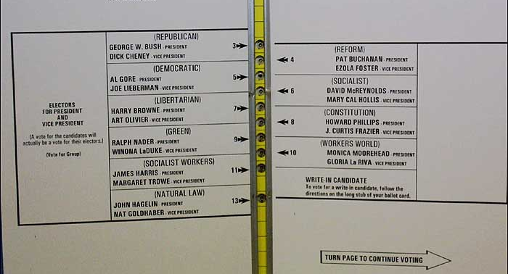
Palm Beach County

Slide 10
2000 Election
Some suggested that this led to people who meant to vote for Al Gore accidentally voting for Pat Buchanan, causing him to lose this critical county.
Suppose you look at a sample of counties who did not have this “butterfly ballot”, and observe the number of votes Buchanan received. Are the votes received by Buchanan in Palm Beach significantly higher?

Slide 11
Paired t-test
To compare the change from one time to another
To compare pairs of elementary units matched on characteristics other than the one being measured
Use a matched-sample t-test or paired t-test

Slide 12
Have stock prices recovered?
In 2007, the stock market experienced a large crash induced by the housing market bubble.
Suppose we look at a sample of asset prices from 2007 and now. Have they changed significantly over that time?

Slide 13
Two samples
For the two-sample t-test, the question is whether the two samples are from the same or different populations.

Slide 14
Two-sample t-test
Difference in means
Estimate of variance (SX1,X2) depends on the two sample sizes and whether the population variance of the two samples are expected to be different.

Slide 15
Equal sample size, Equal variance

Slide 16
Equal sample size, Equal variance
Budweiser claims to have more alcohol than PBR, but you’re not sure. You grab a case of each and measure the alcohol content of each bottle.

Slide 17
Unequal sample size, Equal variance

Slide 18
Unequal sample size, Equal variance
The Jets have played 10 games (including preseason games) in 2011. Have they scored more this year than they did last year?

Slide 19
Unequal sample size, Unequal variance

Slide 20
Unequal sample size, Unequal variance
As a descendent of Van Helsing’s, you’ve been given the chance to meet a small group of vampires. Seeking to develop a blood-substitute for them, you measure their hemoglobin and compare it to a larger sample of human donors.
Do the vampires have significantly higher or lower hemoglobin counts?

Slide 21
Excel
T.TEST(array1,array2,tails,type)
Type:
Paired t-test
Two-sample, equal variance
Two-sample, unequal variance

