Slide 1
Statistics Lesson 10
BT221
Professor Winter Mason

Slide 2
Chi-squared Test
Categorical variables
Are the observed outcomes different than expected?
Example:
You measure the frequencies of hair colors for a random sample of people.
You want to know if any hair color is significantly more or less common than other hair colors.

Slide 3
Hypotheses
Null hypothesis:
No hair color is significantly more or less common than any other hair color
Alternative hypothesis:
At least one hair color is significantly more or less common than other hair colors

Slide 4
Sampling Distribution

Slide 5
Contingency Table
 | Black | Blond | Brown | Red | Sum
Observed | 25 | 38 | 42 | 23 | 128
Expected

Slide 6
Contingency Table
 | Black | Blond | Brown | Red | Sum
Observed | 25 | 38 | 42 | 23 | 128
Expected |  |  |  |  | 128

Slide 7
Contingency Table
 | Black | Blond | Brown | Red | Sum
Observed | 25 | 38 | 42 | 23 | 128
Expected | (128/4) = 32 | (128/4) = 32 | (128/4) = 32 | (128/4) = 32 | 128

Slide 8
Contingency Table
 | Black | Blond | Brown | Red | Sum
Observed | 25 | 38 | 42 | 23 | 128
Expected | (128/4) = 32 | (128/4) = 32 | (128/4) = 32 | (128/4) = 32 | 128
 |  |  |  |  | 8.312

Slide 9
Contingency Table
 | Black | Blond | Brown | Red | Sum
Observed | 25 | 38 | 42 | 23 | 128
Expected | (128/4) = 32 | (128/4) = 32 | (128/4) = 32 | (128/4) = 32 | 128
 |  |  |  |  | 8.312
Pearson’s Chi-squared Statistic

Slide 10
Chi-squared Distribution
Pearson’s chi-squared statistic approximates a chi-squared distribution with degrees of freedom df
df = k – 1
k is the number of cells in the contingency table

Slide 11
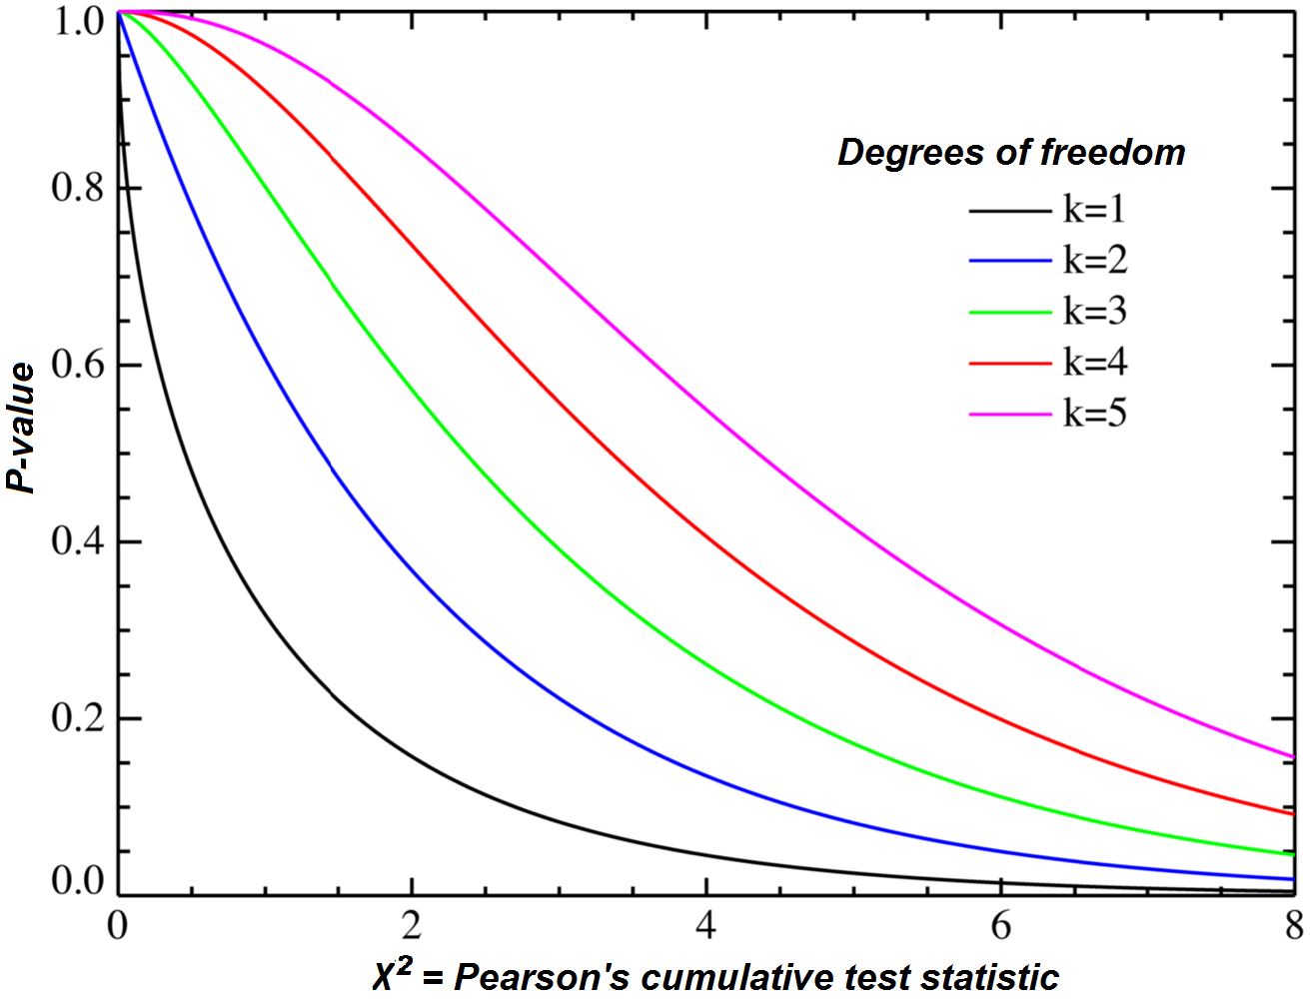
Chi-squared Distribution

Slide 12
2-way Sampling Distribution

Slide 13
Example samples

Slide 14
Example samples

Slide 15
2-way Contingency Table
 | Blue | Brown | Green | Hazel
Curly | 9 | 17 | 15 | 11 | 52
Straight | 23 | 12 | 27 | 14 | 76
Wavy | 32 | 17 | 18 | 15 | 82
 | 64 | 46 | 60 | 40 | 210

Slide 16
2-way Contingency Table
 | Blue | Brown | Green | Hazel
Curly | 17.5 | 17.5 | 17.5 | 17.5 | 70
Straight | 17.5 | 17.5 | 17.5 | 17.5 | 70
Wavy | 17.5 | 17.5 | 17.5 | 17.5 | 70
 | 52.5 | 52.5 | 52.5 | 52.5 | 210

Slide 17
 |  | Observed | Expected | ((O-E)^2)/E
Curly | Blue | 9 | 17.5 | 4.129
Curly | Brown | 17 | 17.5 | 0.014
Curly | Green | 15 | 17.5 | 0.357
Curly | Hazel | 11 | 17.5 | 2.414
Straight | Blue | 23 | 17.5 | 1.729
Straight | Brown | 12 | 17.5 | 1.729
Straight | Green | 27 | 17.5 | 5.157
Straight | Hazel | 14 | 17.5 | 0.7
Wavy | Blue | 32 | 17.5 | 12.014
Wavy | Brown | 17 | 17.5 | 0.014
Wavy | Green | 18 | 17.5 | 0.014
Wavy | Hazel | 15 | 17.5 | 0.357
 |  |  | Chi-Squared | 28.628
 |  |  | df | 11
 |  | CHISQ.INV(0.05,11) | Critical χ² | 4.575

Slide 18
In Excel
Calculate Pearson’s chi-squared statistic
Do: 1 – CHISQ.DIST(chi,df,1)
OR
Do CHISQ.TEST(actual_values,expected_values)

Slide 19
On TI-83
Enter observed matrix ([MATRX])
[STAT][TEST]
Select C: c²-test

Slide 20
Correlation

Slide 21
Correlation
For two continuous variables:
Are X and Y related?
How much does X tell you about Y?
A change in X corresponds to what kind of change in Y?

Slide 22
Examples
On average, how much heavier is someone who is an inch taller than someone else?
How closely related are number of yards a team gains to their final score?
How much extra revenue does a store get for every additional customer?
SAT score and first-year GPA at a university

Slide 23
Why do we care?
To be able to forecast
SAT-GPA
To adjust, control or optimize a process
How many books should we buy for a library in an affluent county?
To better understand reality

Slide 24
Visualizing Correlation
Correlation is the relationship between two continuous variables
How should this be visualized?

Slide 25
Scatterplot
Pablo
Notes:
Talk about the axes, point out Pablo and other scores.

Slide 26
Scatter Plots: Picking the Axes
The influencing variable is the predictor, and we assign it to the horizontal axis
a.k.a.: x variable, independent variable, explanatory variable, regressor, factor
The other variable is the response, which we assign to the vertical axis
a.k.a.: y variable, dependent variable, criterion variable

Slide 27
Correlation
There is a correlation between ice cream sales and violent crime in the U.S.A.
Why?

Slide 28
Correlation
There is a correlation between Turkey’s annual coal consumption and the yearly win/loss ratios of Michigan St. Spartans Men’s basketball team.
Why?
Notes:
Do enough tests between different variables and you’ll find some correlations!
(Checked 55 teams and 82 countries)
Had statistics for 55 basketball teams and 82 countries
From Yuval Nov

Slide 29
Correlation, not Causation:
Even if we show that two related variables are correlated, it does not imply that either one causes the other

Slide 30
Correlation, not Causation:
Even if we show that two related variables are correlated, it does not imply that either one causes the other
Possible explanations:
A causes B
B causes A
Something else causes A and B
A and B are just randomly correlated

Slide 31
Types of Linear Correlation
Positive Correlation: relationships that shows up on a scatter diagram as the dots roughly following a straight line sloping up and to the right
“Highs with highs, lows with lows”
Negative Correlation: relationships that shows up on a scatter diagram as the dots roughly following a straight line sloping down and to the right
“Highs with lows, lows with highs”
Notes:
We’ve seen only positive linear correlations so far

Slide 32
Positive correlation
Notes:
Added a “trend line”

Slide 33
Negative correlation
Notes:
Notice highs with lows; lows with highs

Slide 34
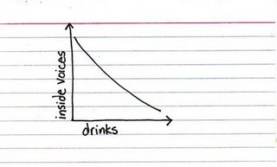
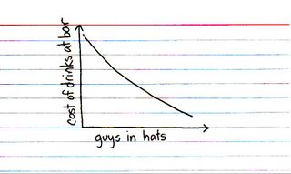
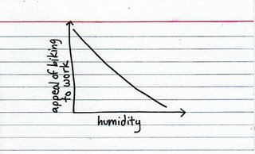
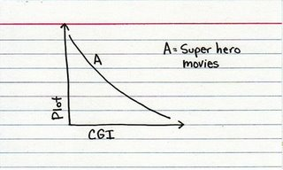
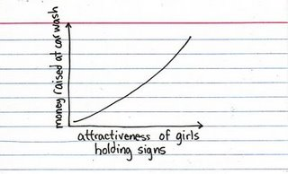
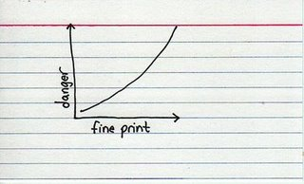
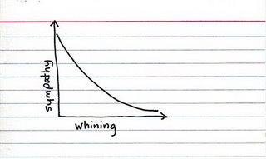
Jessica’s view on Correlation
http://indexed.blogspot.com/
© Jessica Hagy
Notes:
One of my favorite blogs
But often her figures do not make sense in a strict presentation way…
“Trend line”
Did she get the axis right? Correlation right? Is there influence or just correlation?

Slide 35
Covariance
 | Height | Weight
Bill | 74 | 200
Charlie | 68 | 220
Dudley | 71 | 260
Ginny | 63 | 115
Harry | 69 | 130
Molly | 65 | 160
Percy | 69 | 150
Petunia | 71 | 110
Ron | 72 | 135
Vernon | 71 | 280

Slide 36
Covariance
 | Height | Weight
Bill | 74 | 200
Charlie | 68 | 220
Dudley | 71 | 260
Ginny | 63 | 115
Harry | 69 | 130
Molly | 65 | 160
Percy | 69 | 150
Petunia | 71 | 110
Ron | 72 | 135
Vernon | 71 | 280
 | 69.3 | 176
(x-µ_{x}) | (y-µ_{y}) | (x-µ_{x}) (y-µ_{y})
4.7 | 24 | 112.8
-1.3 | 44 | -57.2
1.7 | 84 | 142.8
-6.3 | -61 | 384.3
-0.3 | -46 | 13.8
-4.3 | -16 | 68.8
-0.3 | -26 | 7.8
1.7 | -66 | -112.2
2.7 | -41 | -110.7
1.7 | 104 | 176.8
 | sum | 627
 | cov | 627/9 = 69.7
Notes:
What are the units of covariance?

Slide 37
Covariance
 | Height | Weight
Bill | 74 | 200
Charlie | 68 | 220
Dudley | 71 | 260
Ginny | 63 | 115
Harry | 69 | 130
Molly | 65 | 160
Percy | 69 | 150
Petunia | 71 | 110
Ron | 72 | 135
Vernon | 71 | 280

Slide 38
Covariance
(x-µ_{x}) | (y-µ_{y}) | (x-µ_{x}) (y-µ_{y})
4.7 | 24 | 112.8
-1.3 | 44 | -57.2
1.7 | 84 | 142.8
-6.3 | -61 | 384.3
-0.3 | -46 | 13.8
-4.3 | -16 | 68.8
-0.3 | -26 | 7.8
1.7 | -66 | -112.2
2.7 | -41 | -110.7
1.7 | 104 | 176.8
 | sum | 627
 | cov | 627/9 = 69.7
 | Height | Weight
Bill | 74 | 200
Charlie | 68 | 220
Dudley | 71 | 260
Ginny | 63 | 115
Harry | 69 | 130
Molly | 65 | 160
Percy | 69 | 150
Petunia | 71 | 110
Ron | 72 | 135
Vernon | 71 | 280
Notes:
What would the covariance of a variable with itself be?

Slide 39
Covariance
(x-µ_{x}) | (y-µ_{y}) | (x-µ_{x}) (y-µ_{y})
4.7 | 24 | 112.8
-1.3 | 44 | -57.2
1.7 | 84 | 142.8
-6.3 | -61 | 384.3
-0.3 | -46 | 13.8
-4.3 | -16 | 68.8
-0.3 | -26 | 7.8
1.7 | -66 | -112.2
2.7 | -41 | -110.7
1.7 | 104 | 176.8
 | sum | 627
 | cov | 627/9 = 69.7
 | Height | Weight
Bill | 74 | 200
Charlie | 68 | 220
Dudley | 71 | 260
Ginny | 63 | 115
Harry | 69 | 130
Molly | 65 | 160
Percy | 69 | 150
Petunia | 71 | 110
Ron | 72 | 135
Vernon | 71 | 280
Notes:
What would the covariance of a variable with itself be?

Slide 40
Correlation
 | Height | Weight
Bill | 74 | 200
Charlie | 68 | 220
Dudley | 71 | 260
Ginny | 63 | 115
Harry | 69 | 130
Molly | 65 | 160
Percy | 69 | 150
Petunia | 71 | 110
Ron | 72 | 135
Vernon | 71 | 280

Slide 41
Correlation Coefficient
Correlation Coefficient (r): measure of the degree of linear correlation between two variables
a.k.a. “Pearson Correlation Coefficient”
“how close the dots are to a straight line”

Slide 42
Coefficient Properties
Range: -1 to 1
Negative number = negative correlation
Positive number = positive correlation
-1: Perfect negative correlation
0: No correlation
1: Perfect positive correlation

Slide 43
r = 1
r = 0.75
r = 0.25
r = 0
r = -1
r = -0.75
r = -0.25

Slide 44
Which Coefficient is Higher?
Notes:
The top left is closer to one.

Slide 45
Computing the Correlation Coefficient
r is the mean of the cross-product of Z scores of two variables
Notes:
Scary words! “Cross product” – simply the multiplication of corresponding variables.

Slide 46
Example
 | Height | Z_{x} (height) | Weight | Z_{y} (weight) | Z_{x} * Z_{y}
Bill | 74 | 1.424 | 200 | 0.395 | 0.563
Charlie | 68 | -0.394 | 220 | 0.725 | -0.285
Dudley | 71 | 0.515 | 260 | 1.383 | 0.712
Ginny | 63 | -1.908 | 115 | -1.004 | 1.917
Harry | 69 | -0.091 | 130 | -0.757 | 0.069
Molly | 65 | -1.302 | 160 | -0.263 | 0.343
Percy | 69 | -0.091 | 150 | -0.428 | 0.039
Petunia | 71 | 0.515 | 110 | -1.087 | -0.560
Ron | 72 | 0.818 | 135 | -0.675 | -0.552
Vernon | 71 | 0.515 | 280 | 1.713 | 0.882
 | 69.3 |  | 176 | sum | 3.127
 | 3.302 |  | 60.73 | sum/(N-1) | 0.347

Slide 47
Correlation Coefficient

Slide 48
Steps
Calculate mean, SD for the X and Y variables
Calculate Z-scores for all objects, both variables
For each object, multiply the Z-score from X variable by the Z-Score from the Y variable
Sum up the products and divide by the number of scores minus one

Slide 49
What’s r²?
r²
Measure of association between variables
The proportion of the total variance in one variable that can be explained by the other
Notes:
The 0.5 correlation is actually much stronger.

Slide 50
Significance Test for Correlation
Define your null and alternative hypotheses
Figure out the “baseline” numbers
Find the critical value for declaring deviation from the baseline
Get your sample’s scores
Decide if your sample deviates from the baseline according to the requirement

Slide 51
1. Hypotheses
The null hypothesis will assume 0 correlation
The alternative hypothesis is either:
There is a non-zero correlation in the population
There is a positive correlation in the population
There is a negative correlation in the population

Slide 52
2. Baseline numbers
Calculate the means and standard deviations of each variable
Calculate the correlation coefficient (r)

Slide 53
3. Critical Values
The sampling distribution is the t distribution with df = N-2, where N is the number of score pairs.
For chosen Type I error rate, and degrees of freedom, find the critical values for either one tailed (alternative hypothesis about a positive correlation, or about a negative correlation) or two-tailed (hypothesis about some correlation) test
Notes:
We know the means and scores for each var, so only one value each can vary.

Slide 54
4. Calculate the sample’s t score
Variance that’s “not explained” (1-r²) in the sample contributes negatively
Larger sample is better

Slide 55
5. Decide
Does the t value meet the criteria for rejection of the null hypothesis?
Again, make sure you make the right assumption of directionality in your research hypothesis

Slide 56
Example
SAT | First Year GPA
1100 | 3.4
1000 | 3
1400 | 3.9
1000 | 2.8
910 | 2.8
967 | 3
1200 | 3.6
1300 | 3.5
1200 | 3.5
900 | 2.5
1350 | 3.95
880 | 3.3
970 | 2.9
1010 | 3.1
1130 | 2.7
1320 | 3.4

Slide 57
Hypotheses
Null hypothesis?

Slide 58
Hypotheses
Null hypothesis
There is no correlation between SAT and GPA in the population
Alternative Hypothesis:
There is a positive correlation between the SAT and GPA
1% one-tailed Type I error rate

Slide 59
Sample values
r=.8 (r² = .64)
df = N – 2 = 16 – 2 = 14

Slide 60
Critical values
r=.8 (r² = .64)
df = N – 2 = 16 – 2 = 14
Critical value for a one-tailed hypothesis with 0.01 Type I error rate and df=14
2.625

Slide 61
Getting the t score
We can reject the null hypothesis: there is a significant correlation with .64 of the variance explained.

Slide 62
Same example, fewer scores
What happens when we have less information?
Same r, different N (N=6):
Cut off: 3.747

Slide 63
What weight to expect given height?
Notes:
What’s the likely GPA for a person that had an SAT score of 1350? 1150?

Slide 64
Use the best-fitting line!
Notes:
What’s the likely GPA for a person that had an SAT score of 1350? 1150?

Slide 65
A badly fitting line
Notes:
What’s the likely GPA for a person that had an SAT score of 1350? 1150?

Slide 66
A better fitting line
Notes:
What’s the likely GPA for a person that had an SAT score of 1350? 1150?

Slide 67
The best fitting line
Minimizes the squared distances from the data to the prediction line
i.e., minimizes the squared deviations
Which is conveniently related to the correlation coefficient!
Notes:
What’s the likely GPA for a person that had an SAT score of 1350? 1150?

Slide 68
Regression
β, standardized regression coefficient:
coefficient used to predict a Y score based on an X score
Ŷ is the predicted value of Y
Ŷ = bX + a
Or standardized:
z_{Ŷ} = βz_{X}
Simply use β= r
Notes:
Using the correlation coefficient. Why special beta then? When more than one variable predicts (see later).

Slide 69
So, for the weight…
r = 0.34
µ_{X} = 69.3
σ_{X} = 3.3
µ_{Y} = 176
σ_{Y} = 60.7
X = 70
Notes:
What’s the likely GPA for a person that had an SAT score of 1500?

Slide 70
So, for the weight…
r = 0.34
µ_{X} = 69.3
σ_{X} = 3.3
µ_{Y} = 176
σ_{Y} = 60.7
X = 70
z_{X} = (70 – 69.3)/3.3 = 0.212
z_{Ŷ} = βz_{X} = (0.34)(0.212) = 0.072
Notes:
What’s the likely GPA for a person that had an SAT score of 1500?

Slide 71
So, for the weight…
r = 0.34
µ_{X} = 69.3
σ_{X} = 3.3
µ_{Y} = 176
σ_{Y} = 60.7
X = 70
z_{X} = (70 – 69.3)/3.3 = 0.212
z_{Ŷ} = βz_{X} = (0.34)(0.212) = 0.072
Ŷ = z_{Ŷ}σ_{Y} + µ_{Y} =
(0.072)(60.7) + 176 = 180.38
Notes:
What’s the likely GPA for a person that had an SAT score of 1500?

Slide 72
Multiple Regression
It is possible (and likely) that more than one independent variable is influencing the dependent variable
Example:
Citizen’s degree of liking Mitt Romney and degree of worrying about the economy => Likelihood of citizen to vote for Obama
Price of gas and availability of jobs => average distance a person is likely to travel for work
Notes:
Other examples?
In your Paper 1… many of them

Slide 73
Multiple Regression
We can compute the correlation coefficient (R), and predict Y value based on X₁ and X₂
R² will still be the amount of variance accounted for
Notice: using upper case R for multiple regression

