Slide 1
Statistics Lesson 11
BT221
Professor Winter Mason

Slide 2
What weight to expect given height?
Notes:
What’s the likely GPA for a person that had an SAT score of 1350? 1150?

Slide 3
Use the best-fitting line!
Notes:
What’s the likely GPA for a person that had an SAT score of 1350? 1150?

Slide 4
A badly fitting line
Notes:
What’s the likely GPA for a person that had an SAT score of 1350? 1150?

Slide 5
A better fitting line
Notes:
What’s the likely GPA for a person that had an SAT score of 1350? 1150?

Slide 6
The best fitting line
Minimizes the squared distances from the data to the prediction line
i.e., minimizes the squared deviations
This is known as the least squares line
Which is conveniently related to the correlation coefficient!
Notes:
What’s the likely GPA for a person that had an SAT score of 1350? 1150?

Slide 7
Regression
β, standardized regression coefficient:
coefficient used to predict a Y score based on an X score
z_{Ŷ} = βz_{X}
Simply use β= r
Notes:
Using the correlation coefficient. Why special beta then? When more than one variable predicts (see later).

Slide 8
Regression
Ŷ is the predicted value of Y
Ŷ = bX + a
Notes:
Using the correlation coefficient. Why special beta then? When more than one variable predicts (see later).

Slide 9
So, for the weight…
r = 0.34
µ_{X} = 69.3
σ_{X} = 3.3
µ_{Y} = 176
σ_{Y} = 60.7
X = 70
Notes:
What’s the likely GPA for a person that had an SAT score of 1500?

Slide 10
So, for the weight…
r = 0.34
µ_{X} = 69.3
σ_{X} = 3.3
µ_{Y} = 176
σ_{Y} = 60.7
X = 70
z_{X} = (70 – 69.3)/3.3 = 0.212
z_{Ŷ} = βz_{X} = (0.34)(0.212) = 0.072
Notes:
What’s the likely GPA for a person that had an SAT score of 1500?

Slide 11
So, for the weight…
r = 0.34
µ_{X} = 69.3
σ_{X} = 3.3
µ_{Y} = 176
σ_{Y} = 60.7
X = 70
z_{X} = (70 – 69.3)/3.3 = 0.212
z_{Ŷ} = βz_{X} = (0.34)(0.212) = 0.072
Ŷ = z_{Ŷ}σ_{Y} + µ_{Y} =
(0.072)(60.7) + 176 = 180.38
Notes:
What’s the likely GPA for a person that had an SAT score of 1500?

Slide 12
ANOVA: Analysis of Variance

Slide 13
Motivation
More than two groups to compare
High school, college, graduate school
Search “expert”, “novice”, “intermediate”
French, British, Australian, American
Any breakdown…
The t-test cannot handle this situation
Still want to reason about differences between populations
Notes:
T test is not the right thing:
More information with the scores and three+ means
Testing pair-wise is not correct, we are more likely to find something by chance

Slide 14
When to do ANOVA
When the dependent variable is quantitative
When the independent variable is categorical and there are more than two categories

Slide 15
Hypotheses
H₀: The means of the groups are all equal
H₁: At least one of the group means is significantly different from one of the other group means (the means are not all equal)

Slide 16
Number of keywords used in search
Expert | Novice | Intermediate
2.5 | 2.1 | 3
3.2 | 2.7 | 3.2
4.5 | 4 | 0.9
5.3 | 0.4 | 3.9
4.5 | 0.9 | 1.2
5.4 | 3.3 | 4.4
3.4 | 0.8 | 1.6
 | 1.4 | 2.1
µ₁=4.11 | µ₂=1.95 | µ₃=2.53
SD₁=1.10 | SD₂=1.30 | SD₃=1.28
n₁=7 | n₂=8 | n₃=8
Running example: the average number of keywords used in search, grouped by expertise level (FAKE DATA)

Slide 17
Insight
If the null hypothesis is true, the differences between the means could be explained by the score variance.
If the means deviate more than expected, we will reject the null hypothesis

Slide 18
In Pictures
Population Distribution. Our sample scores come from this distribution.
x
x
x
x
x
x
x
x
x
Sampling Distribution (dist. of means). Our means come from this distribution.
x
x
x
Notes:
Basically, we’ll try to see if it’s reasonable to assume the means and scores distributions are “coherent”

Slide 19
If the null hypothesis is true
The difference in means will not be very large
The same underlying population distribution would have generated all of the samples

Slide 20
If the null hypothesis is false
The difference in means will be surprisingly large
Different underlying populations generated some of the samples

Slide 21
What are we going to do?
To compare the variance of means and scores, we will estimate the population variance twice: once using the means, and once using the sample scores

Slide 22
If the null hypothesis is true
The variance estimated from the different sample means…
…will be the same as the variance estimated from the aggregated scores

Slide 23
If the null hypothesis is false
The variance estimated from the different sample means will be larger than…
…the variance estimated from the aggregated scores

Slide 24
If the null hypothesis is false
The between-group variance will be larger…
…than the within-group variance

Slide 25
If the null hypothesis is false
Because the samples are actually coming from different underlying populations!

Slide 26
The F Ratio
The ratio of the between-group variance divided by the within-group variance is called the F ratio:
A sufficiently large F ratio suggests more than expected variance of means and thus rejection of the null hypothesis.

Slide 27
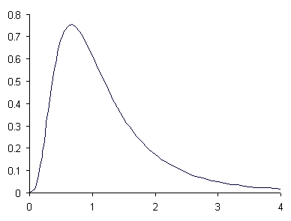
The F Distribution
How likely are different F values? Can select a cut off
5%
Notes:
Talk about the shape – cannot be smaller than 0.
NOT SAY: How is it created? Taking, say, 5 random samples of 10 scores, caculating F, putting on graph. Doing infinite number of times.

Slide 28
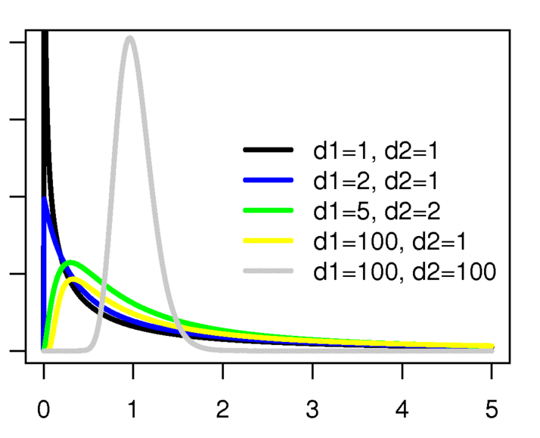
The F Distribution
Different curves for different df values (df means and df of samples)
Notes:
DF = n-1!

Slide 29
The Grand Mean
The grand mean is simply the average of all scores from all samples
Two ways to calculate:
Take the average of all of the scores
Or
where n is sum of all sample sizes

Slide 30
Between-Group Variance
The (weighted average) squared deviations of the sample means from the grand mean
Degrees of freedom = number of groups (k) – 1

Slide 31
Within-Group Variance
The within-group variance is the (weighted average) sum of squared deviations (from each sample mean)
Degrees of freedom = n – k
n is total number of elementary units
k is number of groups

Slide 32
Continuing the Example
Grand Mean:
7*(4.11)+8*(1.95)+8*(2.53)
7 + 8 + 8
= 2.813
Total Sample Size:
7 + 8 + 8 = 23
Expert | Novice | Intermediate
2.5 | 2.1 | 3
3.2 | 2.7 | 3.2
4.5 | 4 | 0.9
5.3 | 0.4 | 3.9
4.5 | 0.9 | 1.2
5.4 | 3.3 | 4.4
3.4 | 0.8 | 1.6
 | 1.4 | 2.1
µ₁=4.11 | µ₂=1.95 | µ₃=2.53
SD₁=1.10 | SD₂=1.30 | SD₃=1.28
n₁=7 | n₂=8 | n₃=8

Slide 33
Between-Group Variance
Grand Mean = 2.813
S_{B}² = 7*(4.11–2.813)² + 8*(1.95–2.813)² + 8*(2.53–2.813)²
3 – 1
= 11.85+5.96+0.61
2
S_{B}² = 9.209
Expert | Novice | Intermediate
2.5 | 2.1 | 3
3.2 | 2.7 | 3.2
4.5 | 4 | 0.9
5.3 | 0.4 | 3.9
4.5 | 0.9 | 1.2
5.4 | 3.3 | 4.4
3.4 | 0.8 | 1.6
 | 1.4 | 2.1
µ₁=4.11 | µ₂=1.95 | µ₃=2.53
SD₁=1.10 | SD₂=1.30 | SD₃=1.28
n₁=7 | n₂=8 | n₃=8

Slide 34
Within-Group Variance
Total Sample = 23
S_{W}² = (7–1)*(1.10)² + (8–1)*(1.30)² + (8–1)*(1.28)²
23 – 3
= 6.62+9.06+8.98
20
S_{W}² = 1.233
Expert | Novice | Intermediate
2.5 | 2.1 | 3
3.2 | 2.7 | 3.2
4.5 | 4 | 0.9
5.3 | 0.4 | 3.9
4.5 | 0.9 | 1.2
5.4 | 3.3 | 4.4
3.4 | 0.8 | 1.6
 | 1.4 | 2.1
µ₁=4.11 | µ₂=1.95 | µ₃=2.53
SD₁=1.10 | SD₂=1.30 | SD₃=1.28
n₁=7 | n₂=8 | n₃=8

Slide 35
F-test
Total Sample = 23
S_{B}² = 9.209
S_{W}² = 1.233
F = 9.209 / 1.233 = 7.467
F-critical(0.05,2,20) = 3.4928
Expert | Novice | Intermediate
2.5 | 2.1 | 3
3.2 | 2.7 | 3.2
4.5 | 4 | 0.9
5.3 | 0.4 | 3.9
4.5 | 0.9 | 1.2
5.4 | 3.3 | 4.4
3.4 | 0.8 | 1.6
 | 1.4 | 2.1
µ₁=4.11 | µ₂=1.95 | µ₃=2.53
SD₁=1.10 | SD₂=1.30 | SD₃=1.28
n₁=7 | n₂=8 | n₃=8

Slide 37
But which mean is higher?
We showed that the means are not all the same
Can we say which of the means are significantly different from each other?
Sounds like a t-test between the pairs,
Nope! Cannot do it: the more tests you do, the more likely to reject a true null hypothesis

Slide 38
Special tests to the rescue
E.g., Tukey’s HSD test
Beyond the scope of this class, but something to keep in mind!

Slide 39
Practice!

