Slide 1
Statistics Lesson 12
BT221
Professor Winter Mason

Slide 2
What is a model?
Models are precise theories about the relationship(s) between variables
Models reduce the complexity of data
Models assume data is structure plus noise

Slide 3
Simple Linear Regression Model
The equation that describes how y is related to x and an error term is called the regression model.
The simple linear regression model is:
where:
ß₀ and ß₁ are parameters of the model,
εis a random variable called the error term or the residual
So the formula for the estimate is:

Slide 4
The least-squares line
residual
Notes:
What’s the likely GPA for a person that had an SAT score of 1350? 1150?

Slide 5
Least-squares line
The best fitting line (in simple linear regression, the one with slope ~ correlation) minimizes the squared error:

Slide 6
Multiple Regression
Idea: Examine the linear relationship between
1 dependent (y) & 2 or more independent variables (x_{i})
Population model:
Y-intercept
Population slopes
Random Error
Estimated multiple regression model:
Estimated
(or predicted)
value of y
Estimated
intercept
Estimated slope coefficients

Slide 7
Multiple Regression Model
Two variable model
y
Slope for variable x₁
x₂
Slope for variable x₂
x₁

Slide 8
Multiple Regression Model
Two variable model
y
Sample observation
y_{i}
<
y_{i}
<
e = (y – y)
x_{2i}
x₂
x_{1i}
<
The best fit equation, y ,
is found by minimizing the
sum of squared errors, Σe²

Slide 9
Example
A distributor of frozen desert pies wants to evaluate factors thought to influence demand
Dependent variable: Pie sales (units per week)
Independent variables: Price (in $)
Advertising ($100’s)
Data are collected for 15 weeks

Slide 10
Pie Sales Model
Week | Pie Sales | Price ($) | Advertising ($100s)
1 | 350 | 5.50 | 3.3
2 | 460 | 7.50 | 3.3
3 | 350 | 8.00 | 3.0
4 | 430 | 8.00 | 4.5
5 | 350 | 6.80 | 3.0
6 | 380 | 7.50 | 4.0
7 | 430 | 4.50 | 3.0
8 | 470 | 6.40 | 3.7
9 | 450 | 7.00 | 3.5
10 | 490 | 5.00 | 4.0
11 | 340 | 7.20 | 3.5
12 | 300 | 7.90 | 3.2
13 | 440 | 5.90 | 4.0
14 | 450 | 5.00 | 3.5
15 | 300 | 7.00 | 2.7
Multiple regression model:
Sales = b₀ + b₁ (Price)
+ b₂ (Advertising)
Correlation matrix:
 | Pie Sales | Price | Advertising
Pie Sales | 1
Price | -0.44327 | 1
Advertising | 0.55632 | 0.03044 | 1

Slide 11
Interpretation of Estimated Coefficients
Slope (b_{i})
Estimates that the average value of y changes by b_{i} units for each 1 unit increase in X_{i} holding all other variables constant
Example: if b₁ = -20, then sales (y) is expected to decrease by an estimated 20 pies per week for each $1 increase in selling price (x₁), net of the effects of changes due to advertising (x₂)
y-intercept (b₀)
The estimated average value of y when all x_{i} = 0 (assuming all x_{i} = 0 is within the range of observed values)

Slide 12
Pie Sales Correlation Matrix
 | Pie Sales | Price | Advertising
Pie Sales | 1
Price | -0.44327 | 1
Advertising | 0.55632 | 0.03044 | 1
Price vs. Sales : r = -0.44327
There is a negative association between
price and sales
Advertising vs. Sales : r = 0.55632
There is a positive association between
advertising and sales

Slide 13
Scatter Diagrams
Sales
Sales
Price

Slide 14
Estimating a Multiple Linear Regression Equation
Computer software is generally used to generate the coefficients and measures of goodness of fit for multiple regression
Excel:
Data / Data Analysis / Regression

Slide 15
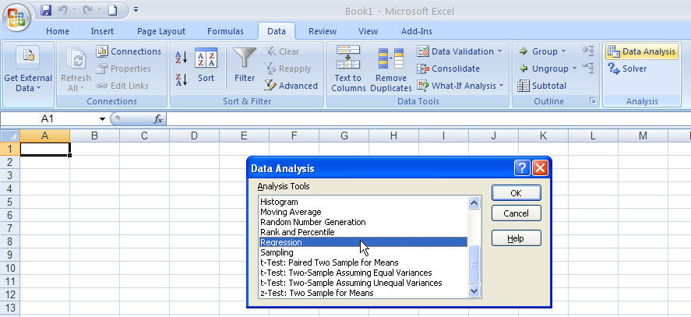
Estimating a Multiple Linear Regression Equation
Excel:
Data / Data Analysis / Regression

Slide 16
Multiple Regression Output
Regression Statistics
Multiple R | 0.72213
R Square | 0.52148
Adjusted R Square | 0.44172
Standard Error | 47.46341
Observations | 15
ANOVA | df | SS | MS | F | Significance F
Regression | 2 | 29460.027 | 14730.013 | 6.53861 | 0.01201
Residual | 12 | 27033.306 | 2252.776
Total | 14 | 56493.333
 | Coefficients | Standard Error | t Stat | P-value | Lower 95% | Upper 95%
Intercept | 306.52619 | 114.25389 | 2.68285 | 0.01993 | 57.58835 | 555.46404
Price | -24.97509 | 10.83213 | -2.30565 | 0.03979 | -48.57626 | -1.37392
Advertising | 74.13096 | 25.96732 | 2.85478 | 0.01449 | 17.55303 | 130.70888

Slide 17
Multiple Regression
where
Sales is in number of pies per week
Price is in $
Advertising is in $100’s.
b₁ = -24.975: sales will decrease, on average, by 24.975 pies per week for each $1 increase in selling price, net of the effects of changes due to advertising
b₂ = 74.131: sales will increase, on average, by 74.131 pies per week for each $100 increase in advertising, net of the effects of changes due to price

Slide 18
Using The Model to Make Predictions
Predict sales for a week in which the selling price is $5.50 and advertising is $350:
Note that Advertising is in $100’s, so $350 means that x₂ = 3.5
Predicted sales is 428.62 pies

Slide 19
Is the Model Significant?
F-Test for Overall Significance of the Model
Shows if there is a linear relationship between all of the x variables considered together and y
Use F test statistic
Hypotheses:
H₀: β₁ = β₂ = … = β_{k} = 0 (no linear relationship)
H_{A}: at least one β_{i} ≠ 0 (at least one independent
variable affects y)

Slide 20
F-Test for Overall Significance
Test statistic:
where F has (numerator) D₁ = k and
(denominator) D₂ = (n – k – 1)
degrees of freedom

Slide 21
F-Test for Overall Significance
(continued)
Regression Statistics
Multiple R | 0.72213
R Square | 0.52148
Adjusted R Square | 0.44172
Standard Error | 47.46341
Observations | 15
ANOVA | df | SS | MS | F | Significance F
Regression | 2 | 29460.027 | 14730.013 | 6.53861 | 0.01201
Residual | 12 | 27033.306 | 2252.776
Total | 14 | 56493.333
 | Coefficients | Standard Error | t Stat | P-value | Lower 95% | Upper 95%
Intercept | 306.52619 | 114.25389 | 2.68285 | 0.01993 | 57.58835 | 555.46404
Price | -24.97509 | 10.83213 | -2.30565 | 0.03979 | -48.57626 | -1.37392
Advertising | 74.13096 | 25.96732 | 2.85478 | 0.01449 | 17.55303 | 130.70888
With 2 and 12 degrees of freedom
P-value for the F-Test

Slide 22
F-Test for Overall Significance
(continued)
H₀: β₁ = β₂ = 0
H_{A}: β₁ and β₂ not both zero
α = .05
df₁= 2 df₂ = 12
Test Statistic:
Decision:
Conclusion:
Critical Value:
F_{α} = 3.885
Reject H₀ at α = 0.05
The regression model does explain a significant portion of the variation in pie sales
(There is evidence that at least one independent variable affects y )
α = .05
0
F
Do not
reject H₀
Reject H₀
F_{.05} = 3.885

Slide 23
Are Individual Variables Significant?
Use t-tests of individual variable slopes
Shows if there is a linear relationship between the variable x_{i} and y
Hypotheses:
H₀: β_{i} = 0 (no linear relationship)
H_{A}: β_{i} ≠ 0 (linear relationship does exist
between x_{i} and y)

Slide 24
Are Individual Variables Significant?
(continued)
H₀: β_{i} = 0 (no linear relationship)
H_{A}: β_{i} ≠ 0 (linear relationship does exist
between x_{i} and y )
Test Statistic:
(df = n – k – 1)

Slide 25
Are Individual Variables Significant?
(continued)
Regression Statistics
Multiple R | 0.72213
R Square | 0.52148
Adjusted R Square | 0.44172
Standard Error | 47.46341
Observations | 15
ANOVA | df | SS | MS | F | Significance F
Regression | 2 | 29460.027 | 14730.013 | 6.53861 | 0.01201
Residual | 12 | 27033.306 | 2252.776
Total | 14 | 56493.333
 | Coefficients | Standard Error | t Stat | P-value | Lower 95% | Upper 95%
Intercept | 306.52619 | 114.25389 | 2.68285 | 0.01993 | 57.58835 | 555.46404
Price | -24.97509 | 10.83213 | -2.30565 | 0.03979 | -48.57626 | -1.37392
Advertising | 74.13096 | 25.96732 | 2.85478 | 0.01449 | 17.55303 | 130.70888
t-value for Price is t = -2.306, with p-value .0398
t-value for Advertising is t = 2.855, with p-value .0145

Slide 26
Inferences about the Slope: t Test Example
From Excel output:
H₀: β_{i} = 0
H_{A}: β_{i} ≠ 0
 | Coefficients | Standard Error | t Stat | P-value
Price | -24.97509 | 10.83213 | -2.30565 | 0.03979
Advertising | 74.13096 | 25.96732 | 2.85478 | 0.01449
d.f. = 15-2-1 = 12
= .05
t_{α/2} = 2.1788
The test statistic for each variable falls in the rejection region (p-values < .05)
Decision:
Conclusion:
α/2=.025
α/2=.025
Reject H₀ for each variable
There is evidence that both Price and Advertising affect pie sales at α = .05
Reject H₀
Do not reject H₀
Reject H₀
-t_{α/2}
0
t_{α/2}
-2.1788
2.1788

Slide 27
Confidence Interval Estimate for the Slope
Confidence interval for the population slope β₁
(the effect of changes in price on pie sales):
where t has
(n – k – 1) d.f.
 | Coefficients | Standard Error | … | Lower 95% | Upper 95%
Intercept | 306.52619 | 114.25389 | … | 57.58835 | 555.46404
Price | -24.97509 | 10.83213 | … | -48.57626 | -1.37392
Advertising | 74.13096 | 25.96732 | … | 17.55303 | 130.70888
Example: Weekly sales are estimated to be reduced by between 1.37 to 48.58 pies for each increase of $1 in the selling price

Slide 28
Standard Deviation of the Regression Model
The estimate of the standard deviation of the regression model is:
Is this value large or small? Must compare to the mean size of y for comparison

Slide 29
Standard Deviation of the Regression Model
(continued)
Regression Statistics
Multiple R | 0.72213
R Square | 0.52148
Adjusted R Square | 0.44172
Standard Error | 47.46341
Observations | 15
ANOVA | df | SS | MS | F | Significance F
Regression | 2 | 29460.027 | 14730.013 | 6.53861 | 0.01201
Residual | 12 | 27033.306 | 2252.776
Total | 14 | 56493.333
 | Coefficients | Standard Error | t Stat | P-value | Lower 95% | Upper 95%
Intercept | 306.52619 | 114.25389 | 2.68285 | 0.01993 | 57.58835 | 555.46404
Price | -24.97509 | 10.83213 | -2.30565 | 0.03979 | -48.57626 | -1.37392
Advertising | 74.13096 | 25.96732 | 2.85478 | 0.01449 | 17.55303 | 130.70888
The standard deviation of the regression model is 47.46

Slide 30
Standard Deviation of the Regression Model
(continued)
The standard deviation of the regression model is 47.46
A rough prediction range for pie sales in a given week is
Pie sales in the sample were in the 300 to 500 per week range, so this range is probably too large to be acceptable. The analyst may want to look for additional variables that can explain more of the variation in weekly sales

Slide 31
Multiple Regression Model
Two variable model
y
Slope for variable x₁
x₂
Slope for variable x₂
x₁

Slide 32
Goodness-of-Fit

Slide 33
Goodness-of-Fit (continued . . .)
How well does our sample regression line fit our sample data?
R-squared of regression is the fraction of the total sum of squares (SST) that is explained by the model.
R² = SSR/SST = 1 – SSE/SST

Slide 34
More about R-Squared
R² can never decrease when another variable is added to a regression; usually R² will increase.
Because R² will usually increase (or at least not decrease) with increases in the number of right-hand side or explanatory variables, it is not necessarily a good way to compare alternative models with the same dependent variable.

Slide 35
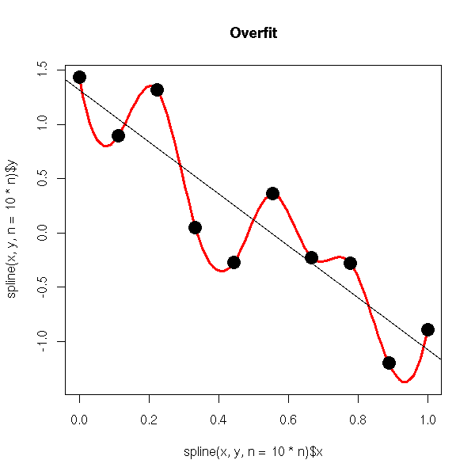
Overfitting
By including too many parameters in the model, you can overfit
If you added more data, the predictions would get worse

Slide 36
R² and Adjusted R²
R²
Adjusted R²
Questions:
Why do we care about the adjusted R² ?
Is adjusted R² always better than R² ?
What’s the relationship between R² and adjusted R² ?

Slide 37
Multiple Coefficient of Determination
(continued)
Regression Statistics
Multiple R | 0.72213
R Square | 0.52148
Adjusted R Square | 0.44172
Standard Error | 47.46341
Observations | 15
ANOVA | df | SS | MS | F | Significance F
Regression | 2 | 29460.027 | 14730.013 | 6.53861 | 0.01201
Residual | 12 | 27033.306 | 2252.776
Total | 14 | 56493.333
 | Coefficients | Standard Error | t Stat | P-value | Lower 95% | Upper 95%
Intercept | 306.52619 | 114.25389 | 2.68285 | 0.01993 | 57.58835 | 555.46404
Price | -24.97509 | 10.83213 | -2.30565 | 0.03979 | -48.57626 | -1.37392
Advertising | 74.13096 | 25.96732 | 2.85478 | 0.01449 | 17.55303 | 130.70888
44.2% of the variation in pie sales is explained by the variation in price and advertising, taking into account the sample size and number of independent variables

Slide 38
Estimate of Error Variance
df = n – (k + 1), or df = n – k – 1
df (i.e. degrees of freedom) is the (number of observations) – (number of estimated parameters)

Slide 39
Multiple Regression Assumptions
The model errors are independent and random
The errors are normally distributed
The mean of the errors is zero
Errors have a constant variance
Errors (residuals) from the regression model:
e = (y – y)
<

Slide 40
Residual Analysis
residuals
x
x
residuals
✓
Non-constant variance
Constant variance
residuals
x
x
residuals
Not Independent
✓
Independent

Slide 41
Multicollinearity
Multicollinearity: High correlation exists between two independent variables
This means the two variables contribute redundant information to the multiple regression model

Slide 42
Multicollinearity
(continued)
Including two highly correlated independent variables can adversely affect the regression results
No new information provided
Can lead to unstable coefficients (large standard error and low t-values)
Coefficient signs may not match prior expectations

Slide 43
Some Indications of Severe Multicollinearity
Incorrect signs on the coefficients
Large change in the value of a previous coefficient when a new variable is added to the model
A previously significant variable becomes insignificant when a new independent variable is added
The estimate of the standard deviation of the model increases when a variable is added to the model

