Slide 1
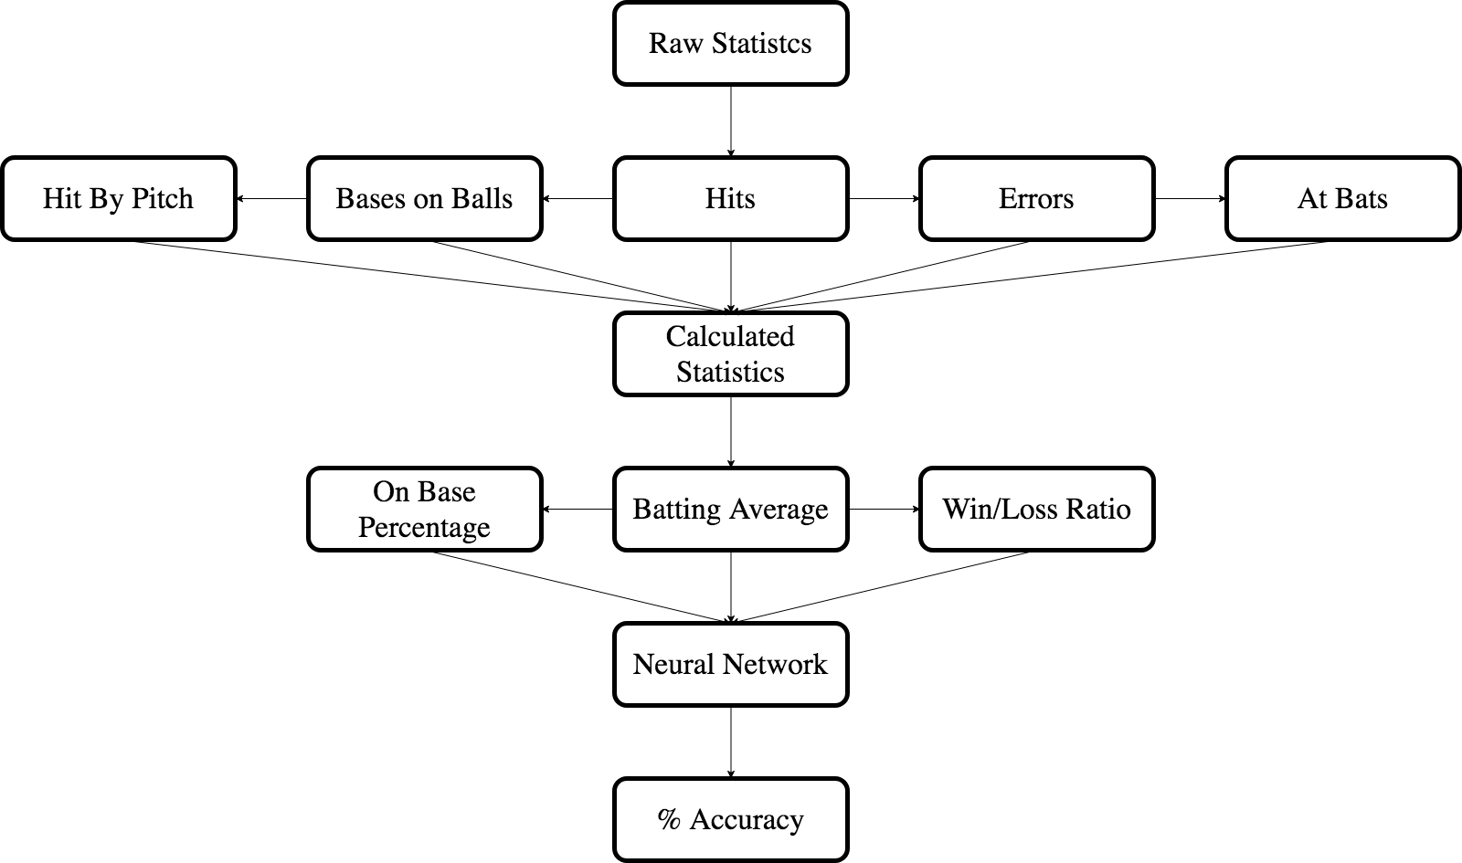
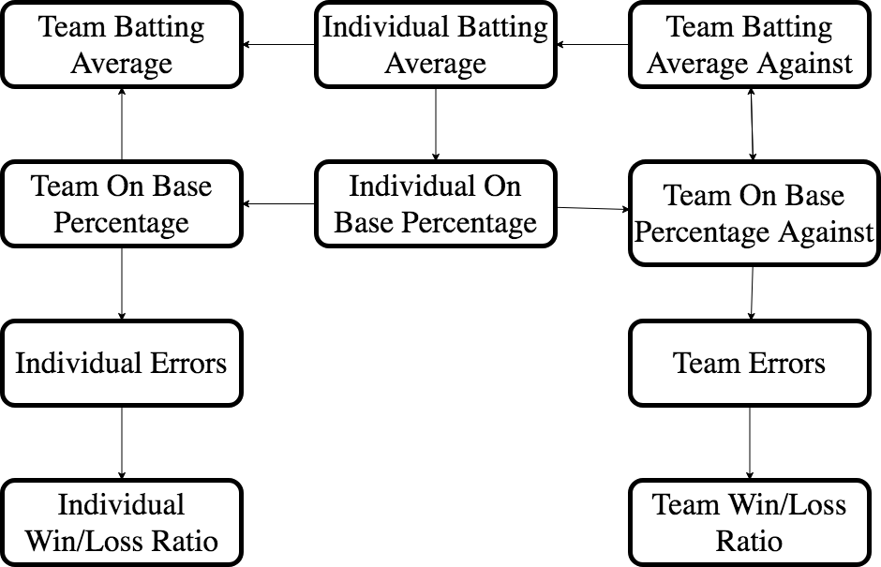
Using Machine Learning to Predict Baseball Game Outcomes
Figure 1: Separation of raw data and steps of sorting it for progression of the neural network. Each raw statistic calculated for use of the entire team as well as for each individual starting pitcher.
Figure 2: Each of these Statistics were The ones used in Creating the data for the neural network, each of them having a different meaning.
Team Batting Average- The batting average of the team for all games in the season leading up to the game. Calculated by Hits/At Bats.
Individual Batting Average- The batting average of the team for all games with that specific starting pitcher. Calculated by Hits/At Bats.
Team Batting average Against- The batting average calculated from all of the hits given up by the team to others from all previous games. It measures the effectiveness of the team in not giving up hits. Calculated by Hits given up/Opponents At Bats.
Team On Base Percentage- The On Base Percentage calculated from all previous games. Calculated by Hits + Walks + Hit by Pitch/At Bats.
Individual On Base Percentage- The On Base Percentage calculated from all previous games with that specific starting pitcher. Calculated by Hits + Walks + Hit by Pitch/At Bats.
Individual Errors- All errors accrued in the field in any game with that specific starting pitcher.
Team Errors- All errors accrued in the field in all previous games.
Individual Win/Loss Ratio- Win/Loss ratio of all games with that specific starting pitcher.
Team Win/Loss Ratio- Win/Loss ratio of all previous games.

Slide 2
Background
Conclusion
The Neural network predicted the outcome of the games in its input list with an accuracy of 66.08%. The most likely answer for explaining this outcome would be the inclusion of the On Base Percentage statistic. This statistic has been well known to track MLB players and organize individuals, but not as often to separate as team’s differences. This project really shows the impact that only a few statistics can have on the game.
The statistical side of baseball made large movements of progression due to the publication of a book written by Bill James entitled Historical Baseball Abstract. In this book James analyzed the progression of the game from the 1870’s up to the time of publication in 1984. He looked at movements in the statistical analysis of the game, including spikes in batting average, and what were the variables that helped to make teams have spikes of winning and losing streaks. This book also helped to progress the way that the game was played with the invention of multiple ways of tracking statistics, such as On Base Percentage, Defensive Efficiency Rating, Runs Created, and many many more. The best example of the impact this book had include the 2002 MLB draft, in which the Oakland A’s used statistics in this book to bring together a group of players who seemed to be beyond their times but had the ability to exploit these statistics. A book entitled Moneyball: The Art of Winning an Unfair Game was later written about the story of what went on behind the scenes of this draft and in this time.
Future Development
In the future, I would like to progress with this project by adding more statistics to it to create a larger pool of information, and by collecting statistics of games from the 2020 regular season. With this I hope to also have more comparison with the two teams that are currently playing instead of just that of the teams have played in the past individually. I hope to take into account how each team has done against each other in the past and also how they have done against other teams they have both faced in the past. I wish to make the formula more in depth and create a more complex method which will hopefully produce more in depth and accurate results.
Procedures
Setting up Sorting Environment
Python 3.7.3
Sci-Kit, Pandas, and Random
Data purchased from BigDataBall.com
Data from excel spreadsheet sorted into used groups
Hits, Bases on Balls, Hit by Pitch, At Bats, Team, Pitcher, Date, Wins, Losses, Errors
Use Sci-Kit to pull in these statistics and sort them out by date, team, and pitcher.
With that, use formulas to calculate Batting Average and On Base Percentage.
Then create the environment for the Neural Network.
Python 3.7.3
Pandas, Random, and NumPy
Run the Neural Network and take the results and compare them to other predictions made by odds makers
Results and Comparison
Percent of Correct Predictions
66.08%
57.88%
Neural Network
Odds Makers

