Slide 1

JupyterLab
JupyterNotebook
or an IDE of your choice…
Please type and execute this code:
import pandas as pd
print(pd.__version__)
Raise your hand if you cannot import Pandas or if you get a version < 2.0
'2.2.3'
← you should get something like this

Slide 2





Roll Call
Your name
Role or class year
Department or major
A source or form of tabular data you regularly use or want to learn to use

Slide 3

Workshop Policies
Lecture Notes (.ipynb)
Link automatically sent to the email you registered with 24 hours before the workshop
Slides
Updated a few days after the workshop

Slide 4
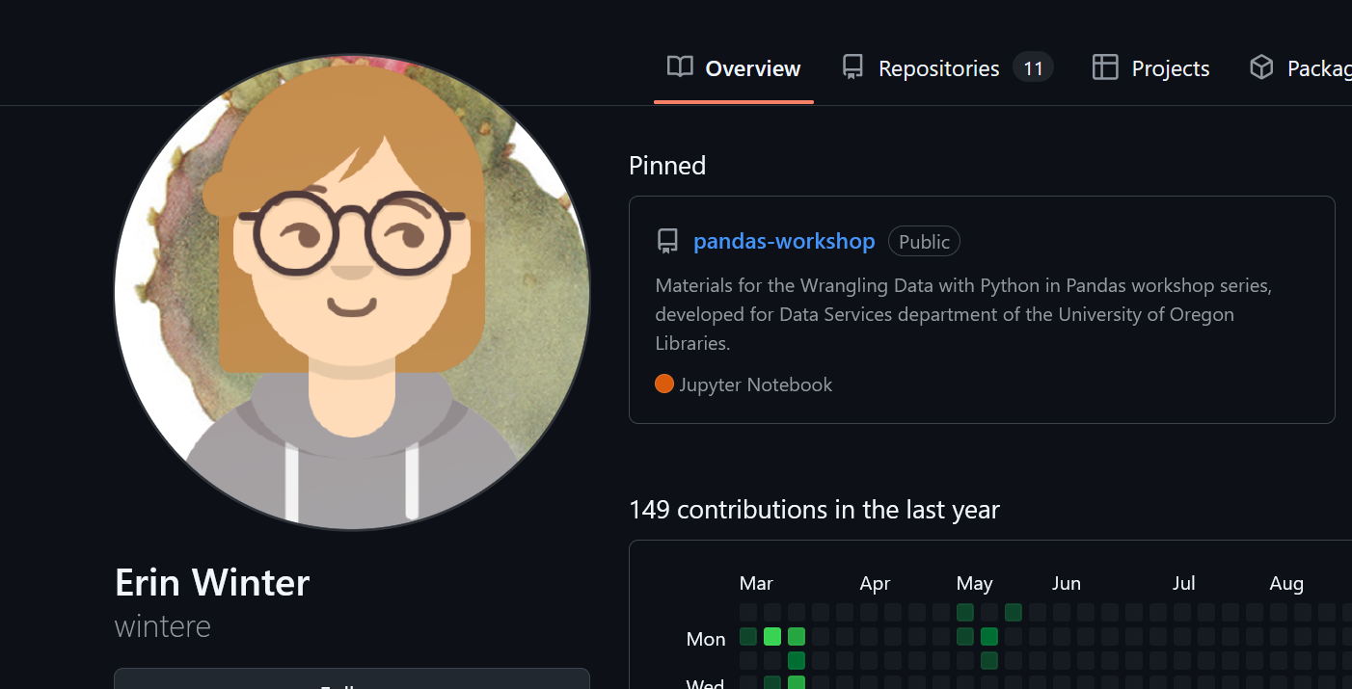
Lecture Notes and Slides on GitHub
https://github.com/wintere/pandas-workshop

Slide 5

Prerequisites
Software Carpentries: Plotting and Programming in Python
OR
variables, assignment
standard Python primitives
int, float, string, boolean
control flow: if and else
functions, scope
You will get opportunities to practice these if you’re still grasping them.

Slide 6
Workshop Objectives
Goals
Manipulate, analyze, and visualize data in Pandas and related libraries
Import data from a variety of sources
Identify and correct common problems in tabular data
Learn basic data visualization techniques
Not Covered
Topics in “big data” Optimization
Math
Data in formats that are not tabular: ie. genetic sequences, geodatabases, images
Notes:
Pandas is a data analysis library designed for “spreadsheet-like” or “tabular” data.

Slide 7






Why Pandas?
Free, easy to learn
Compatible with a growing data science ecosystem in Python
Visualization
Machine learning
Statistics
Scientific applications
Flexible in terms of input and output

Slide 8
Data Wrangling
From Raw Data to Analysis
Handle missing values
Convert measurements, apply functions, and correct mistakes at scale
Prepare data to be used for other applications
Create reusable code so you don’t have to do it from scratch again
A professor gave me this data but it won’t open.
I need to use this data but this variable is in the wrong format.
Someone else entered the data and they did it wrong.
I want to put data from multiple sources together.

Slide 9
Creating DataFrame Objects
Can be constructed directly from hardcoded Python objects like dictionaries
Loaded from a file or URL:
delimited text file (.txt, .tsv)
comma-separated values (.csv)
Excel sheet (.xlsx)
JSON dictionary (.json)
Stata/SAS files (.sav, .sas, .dta)

Slide 10
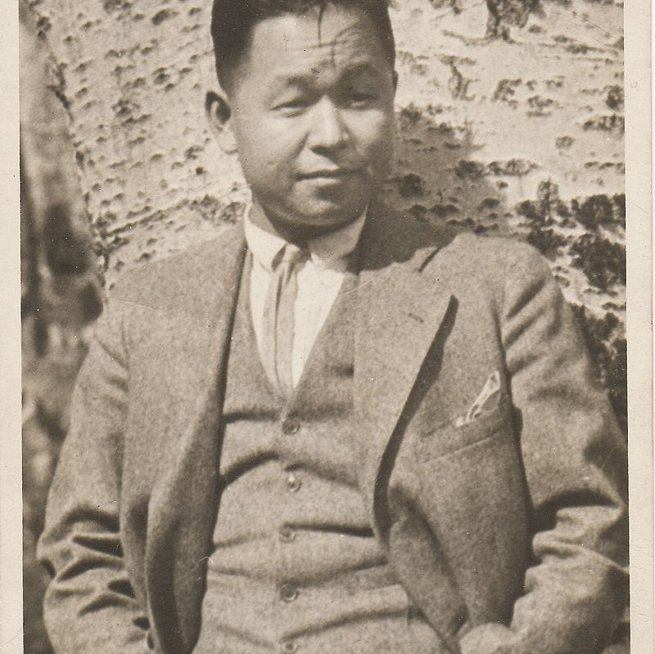
A Little Modern Art
Our first dataset is the MOMA’s Watson Library Index of Asian American and Pacific Islander Artists.
This is a collection of AAPI artists featured in the Watson Library’s catalog of exhibit records and artist biographies.
Kamekichi Tokita
(1897-1948)

Slide 11

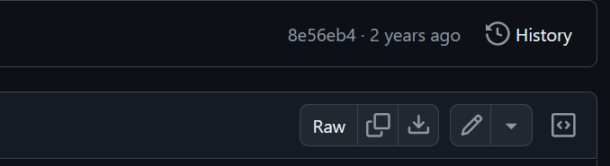
Loading Data From A File
Find the download link in the resources.md in the class GitHub page
Download this file from the Watson Library GitHub by clicking the download button
Copy this .csv file into your JupyterLab project directory
Tokita, Kamekichi. Alley. 1929. Seattle Art Museum. Collection of Shokichi & Elise Y. Tokita.

Slide 12
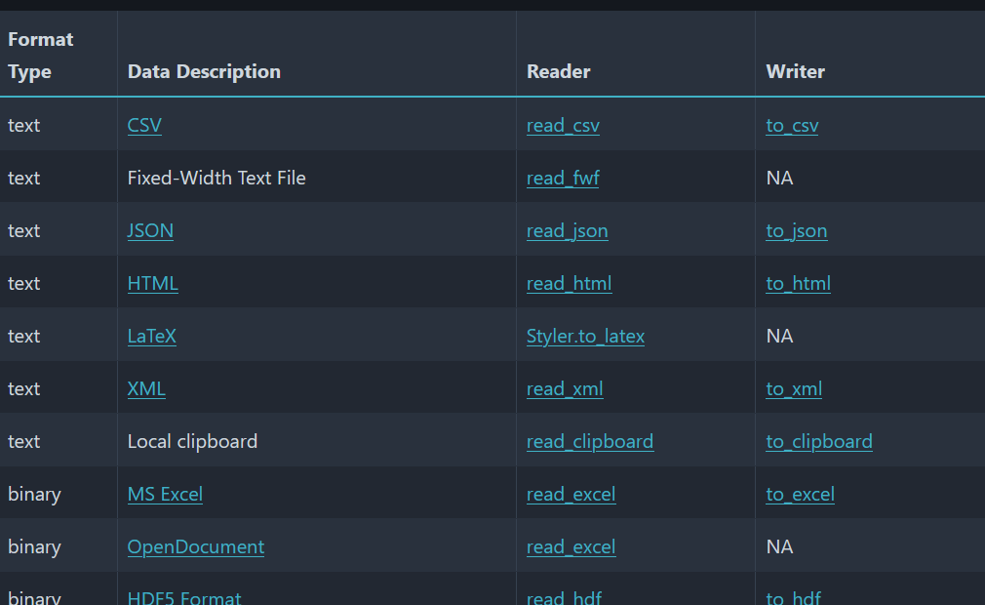
Reading Input
Reading files into Pandas is as simple as matching the file type to the name of a function…
pd.read_csv()
pd.read_json()
pd.read_excel()
pd.read_sql()
pd.read_stata()
…
https://pandas.pydata.org/docs/dev/user_guide/io.html

Slide 13
Understanding Your Data (I/O)
After reading from a file to a DataFrame, check
delimiting (are the columns separated?)
the shape – a (row #, column #) tuple
the types of each variable – dtypes
which columns have nulls/nones/NaNs (and why)
If it is not what you expect, you probably need to adjust the formatting arguments passed to Pandas.

Slide 14
What Can Go in a DataFrame?
name | colour | location | seed | shape | sweetness | water_content
apple | red | canada | TRUE | round | TRUE | 84
int64, float64
bool
object, Categorical
datetime64
Integers, Floats
Booleans
Strings
Dates
Columns with values of a type that Pandas cannot infer will be labeled as objects.

Slide 15
The Pandas DataFrame
Each DataFrame column is a Series.
.columns
axis = 1
.index
0
1
2
3
4
name | colour | location | seed | shape | sweetness | water_content | weight
apple | red | canada | TRUE | round | TRUE | 84 | 100
banana | yellow | mexico | FALSE | long | TRUE | 75 | 120
cantaloupe | orange | spain | TRUE | round | TRUE | 90 | 1360
dragon fruit | magenta | china | TRUE | round | FALSE | 96 | 600
elderberry | purple | austria | FALSE | round | TRUE | 80 | 5
axis = 0
All values in the DataFrame have an indexed position in .iloc[row_index, column_number] form.
Total elements = .size
R, C form = .shape

Slide 16
The Pandas Series
The Series is the simplest of the Pandas data structures: a one-dimensional array with an index. The alpha-numeric index is exactly as long as the data.
.index
0 | 1 | 2 | 3 | 4 | 5 | 6 | 7
burgundy | red | green | gray | blue | yellow | orange | teal
All values in the Series have an indexed position in [index] or .iloc[index_num] form.
.index
a | b | c | d | e | f | g | h
burgundy | red | green | gray | blue | yellow | orange | teal

Slide 17
Slicing and Indexing with .loc
Column Labels
.loc – index and column based slicing”
a
b
c
d
e
name | colour | location
apple | red | canada
banana | yellow | mexico
cantaloupe | orange | spain
dragon fruit | magenta | china
elderberry | purple | austria
.loc[‘a’] returns a pandas.Series with the first row
Index
.loc[‘a’, ‘location’] returns the string “canada”
.loc[‘b’:’d’, ‘name’: ‘colour’] returns the DataFrame below
.loc slicing is inclusive on both ends because it is intended to behave like R (not Python)
name | colour
b
c
d
banana | yellow
cantaloupe | orange
dragon fruit | magenta

Slide 18
Slicing and Indexing with .iloc
Column Labels
.iloc – integer-based slicing
a
b
c
d
e
name | colour | location
apple | red | canada
banana | yellow | mexico
cantaloupe | orange | spain
dragon fruit | magenta | china
elderberry | purple | austria
.iloc[0] returns a pandas.Series with the first row
Index
.iloc[1, 2] returns the string “mexico”
.iloc[2:, 1:3] returns the DataFrame below
.iloc slices behave like Python list slices (exclusive at the end of a range)
colour | location
c
c
d
orange | spain
magenta | china
purple | austria

Slide 19
Boolean Indexing
Pandas .loc and .iloc can return subsets of a DataFrame specified by a boolean array.
Boolean arrays filter DataFrames or Series by testing values against a condition. NaNs evaluate to False.
under21 = students[‘age’] < 21
a series of size (# of rows in students)
a pd.DataFrame
numeric column
the “test”, must evaluate to True or False
studentsUnder21 = students[under21]
only the rows in the students DataFrame where the column‘age’ < 21
x[‘col_name’] is shorthand for x.loc[:, ‘col_name’]

Slide 20
Boolean Indexing with Multiple Conditions
We can combine boolean indexing with multiple conditions as follows:
boolean operator
a pd.DataFrame
column
test
ok_to_drink = (students[‘age’] >= 21) & ( students[‘has_id’] == ‘Yes’)
a series of size (# of rows in students)
test
studentDrinkers = students[ok_to_drink]
a DataFrame with only the rows in the students DataFrame where the column ‘age’ > 21 AND column ‘has_id’ has a ‘Yes’ value

Slide 21
What is a NaN? (null, None, etc.)
The np.NaN is the way Pandas represents missing values by default, but missing values occur in almost all domains:
Product of the data entry process
Missing from the source data
Measurement error
Participant declined to respond
Something went wrong computationally when creating the data

Slide 22
Why Dtypes Matter
continuous
discrete
discrete
ordinal/continuous
Integers, Floats
Booleans
Strings
Dates
sort/compare
arithmetic
percentiles
filter
count
filter
count
sort/compare
count
compare
alphabetize
filter
sort/compare
add/subtract
filter
count

Slide 23
Inferring New Columns
Infer a new column from an existing column or columns
Map()
Vectorized operations
F[mpg] = F[miles_per_tank]/F[gallons_per_tank]

Slide 24
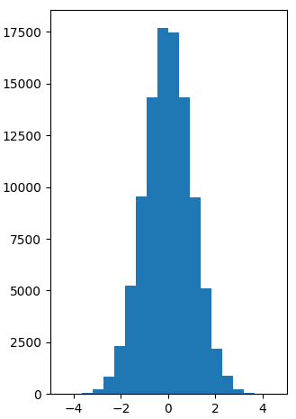
The Histogram
Every bin of frequencies has an associated count
X, Y - one continuous variable
Y = frequency of the values within each bin
Gives you a sense of the shape of the distribution, very sensitive to the number of bins.

Slide 25
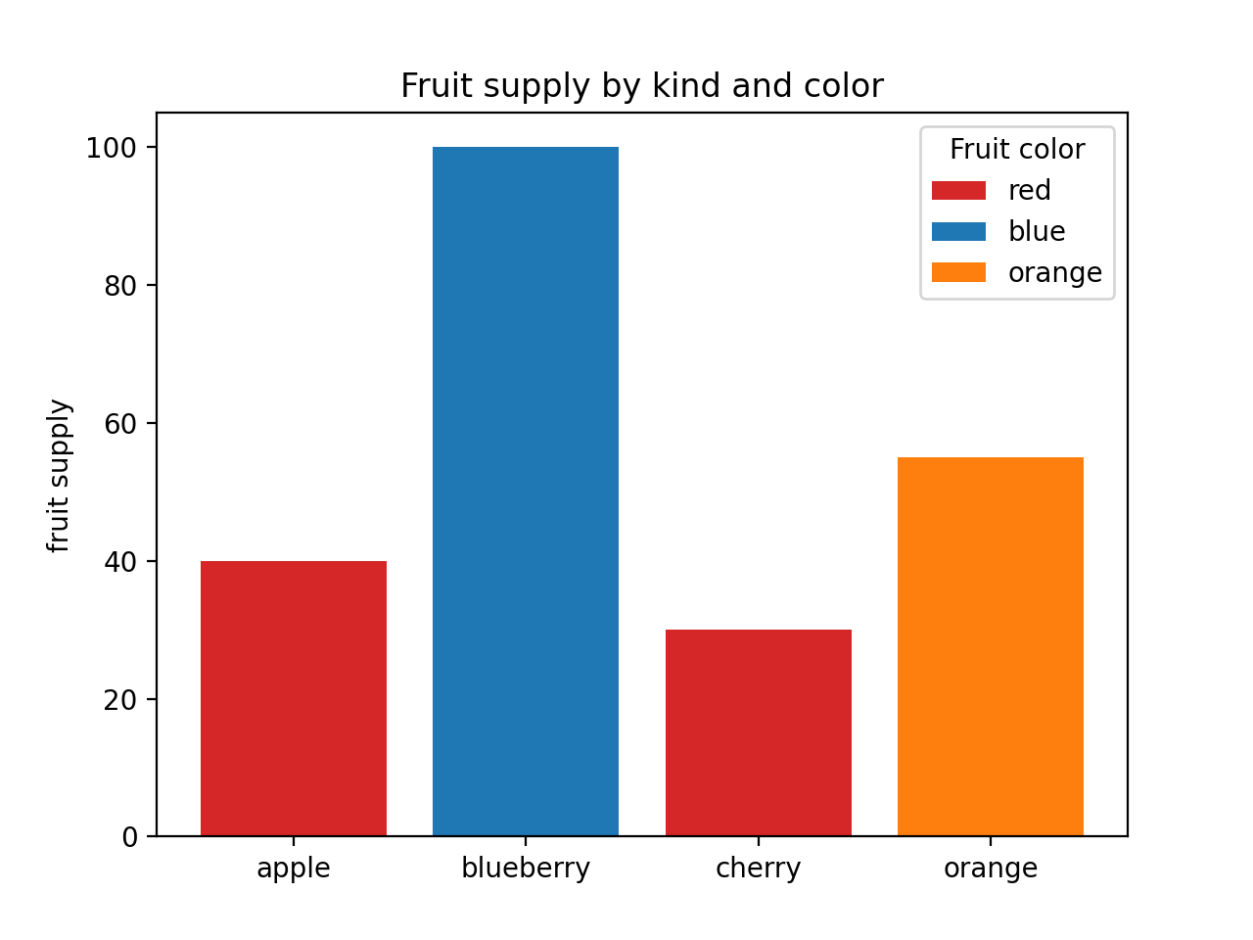
The Bar Chart
X, Y
X = categorical
Y = numeric
Every bar has a category X and a value Y
Color
distinguishes between bars, can also be another categorical variable
Z = fruit color

Slide 26
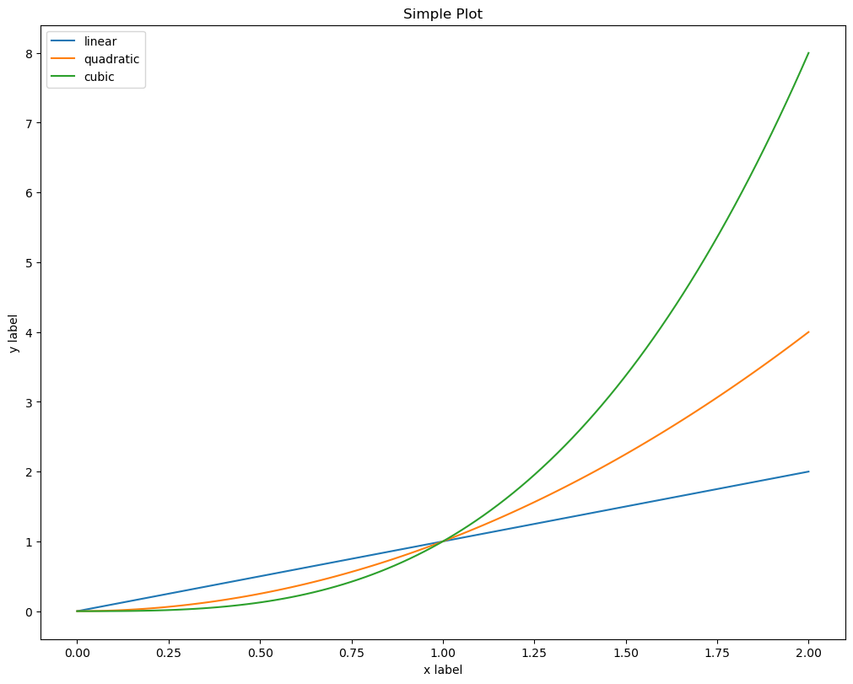
The Line Graph
X, Y
two continuous variables
Every line has…
X, Y coordinates
Color
distinguishes between multiple lines

Slide 27
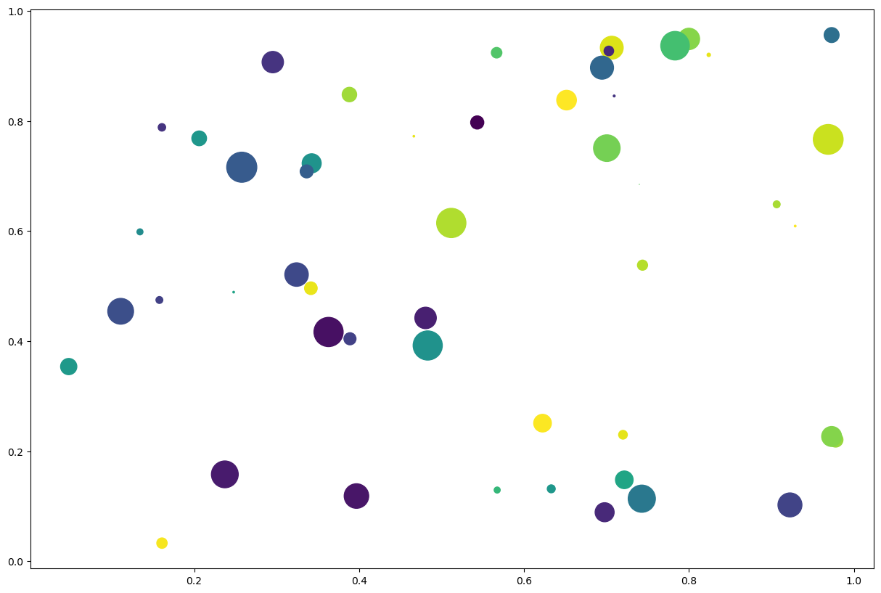
The Scatter Plot
X, Y
two continuous variables
Every point has…
X, Y
Color
Size
Color
continuous: shades
discrete: hues
Size
a continuous variable

Slide 28
Combining Data Sources
The simplest (and most naïve approach) to combining DataFrames is to concatenate them
+
=
Pandas.concat
Axis =index
+
=
Axis = columns

Slide 29
JSON
A structured text-formatting standard compatible with Python, R, JavaScript etc.
Python has a robust built-in JSON parser
JSONs can be treated as dictionaries or lists of dictionaries
{ }

Slide 30
From JSON to Pandas DataFrame
A JSON file can be treated as a list of dictionaries with a shared schema
JSON 1
JSON 2
JSON 3
For simple JSON files, Pandas can directly read JSON files from URLs or from disk into DataFrames

Slide 31
Merge (Join)
 |  | 2
 |  | 3
+
2
3
=
2
3
Allows you to join two or more DataFrames using shared values in a shared key column to align the rows in the DataFrames
Akin to a SQL join, R's merge, or an Excel VLOOKUP

Slide 32
Thank you for attending!

