Slide 1
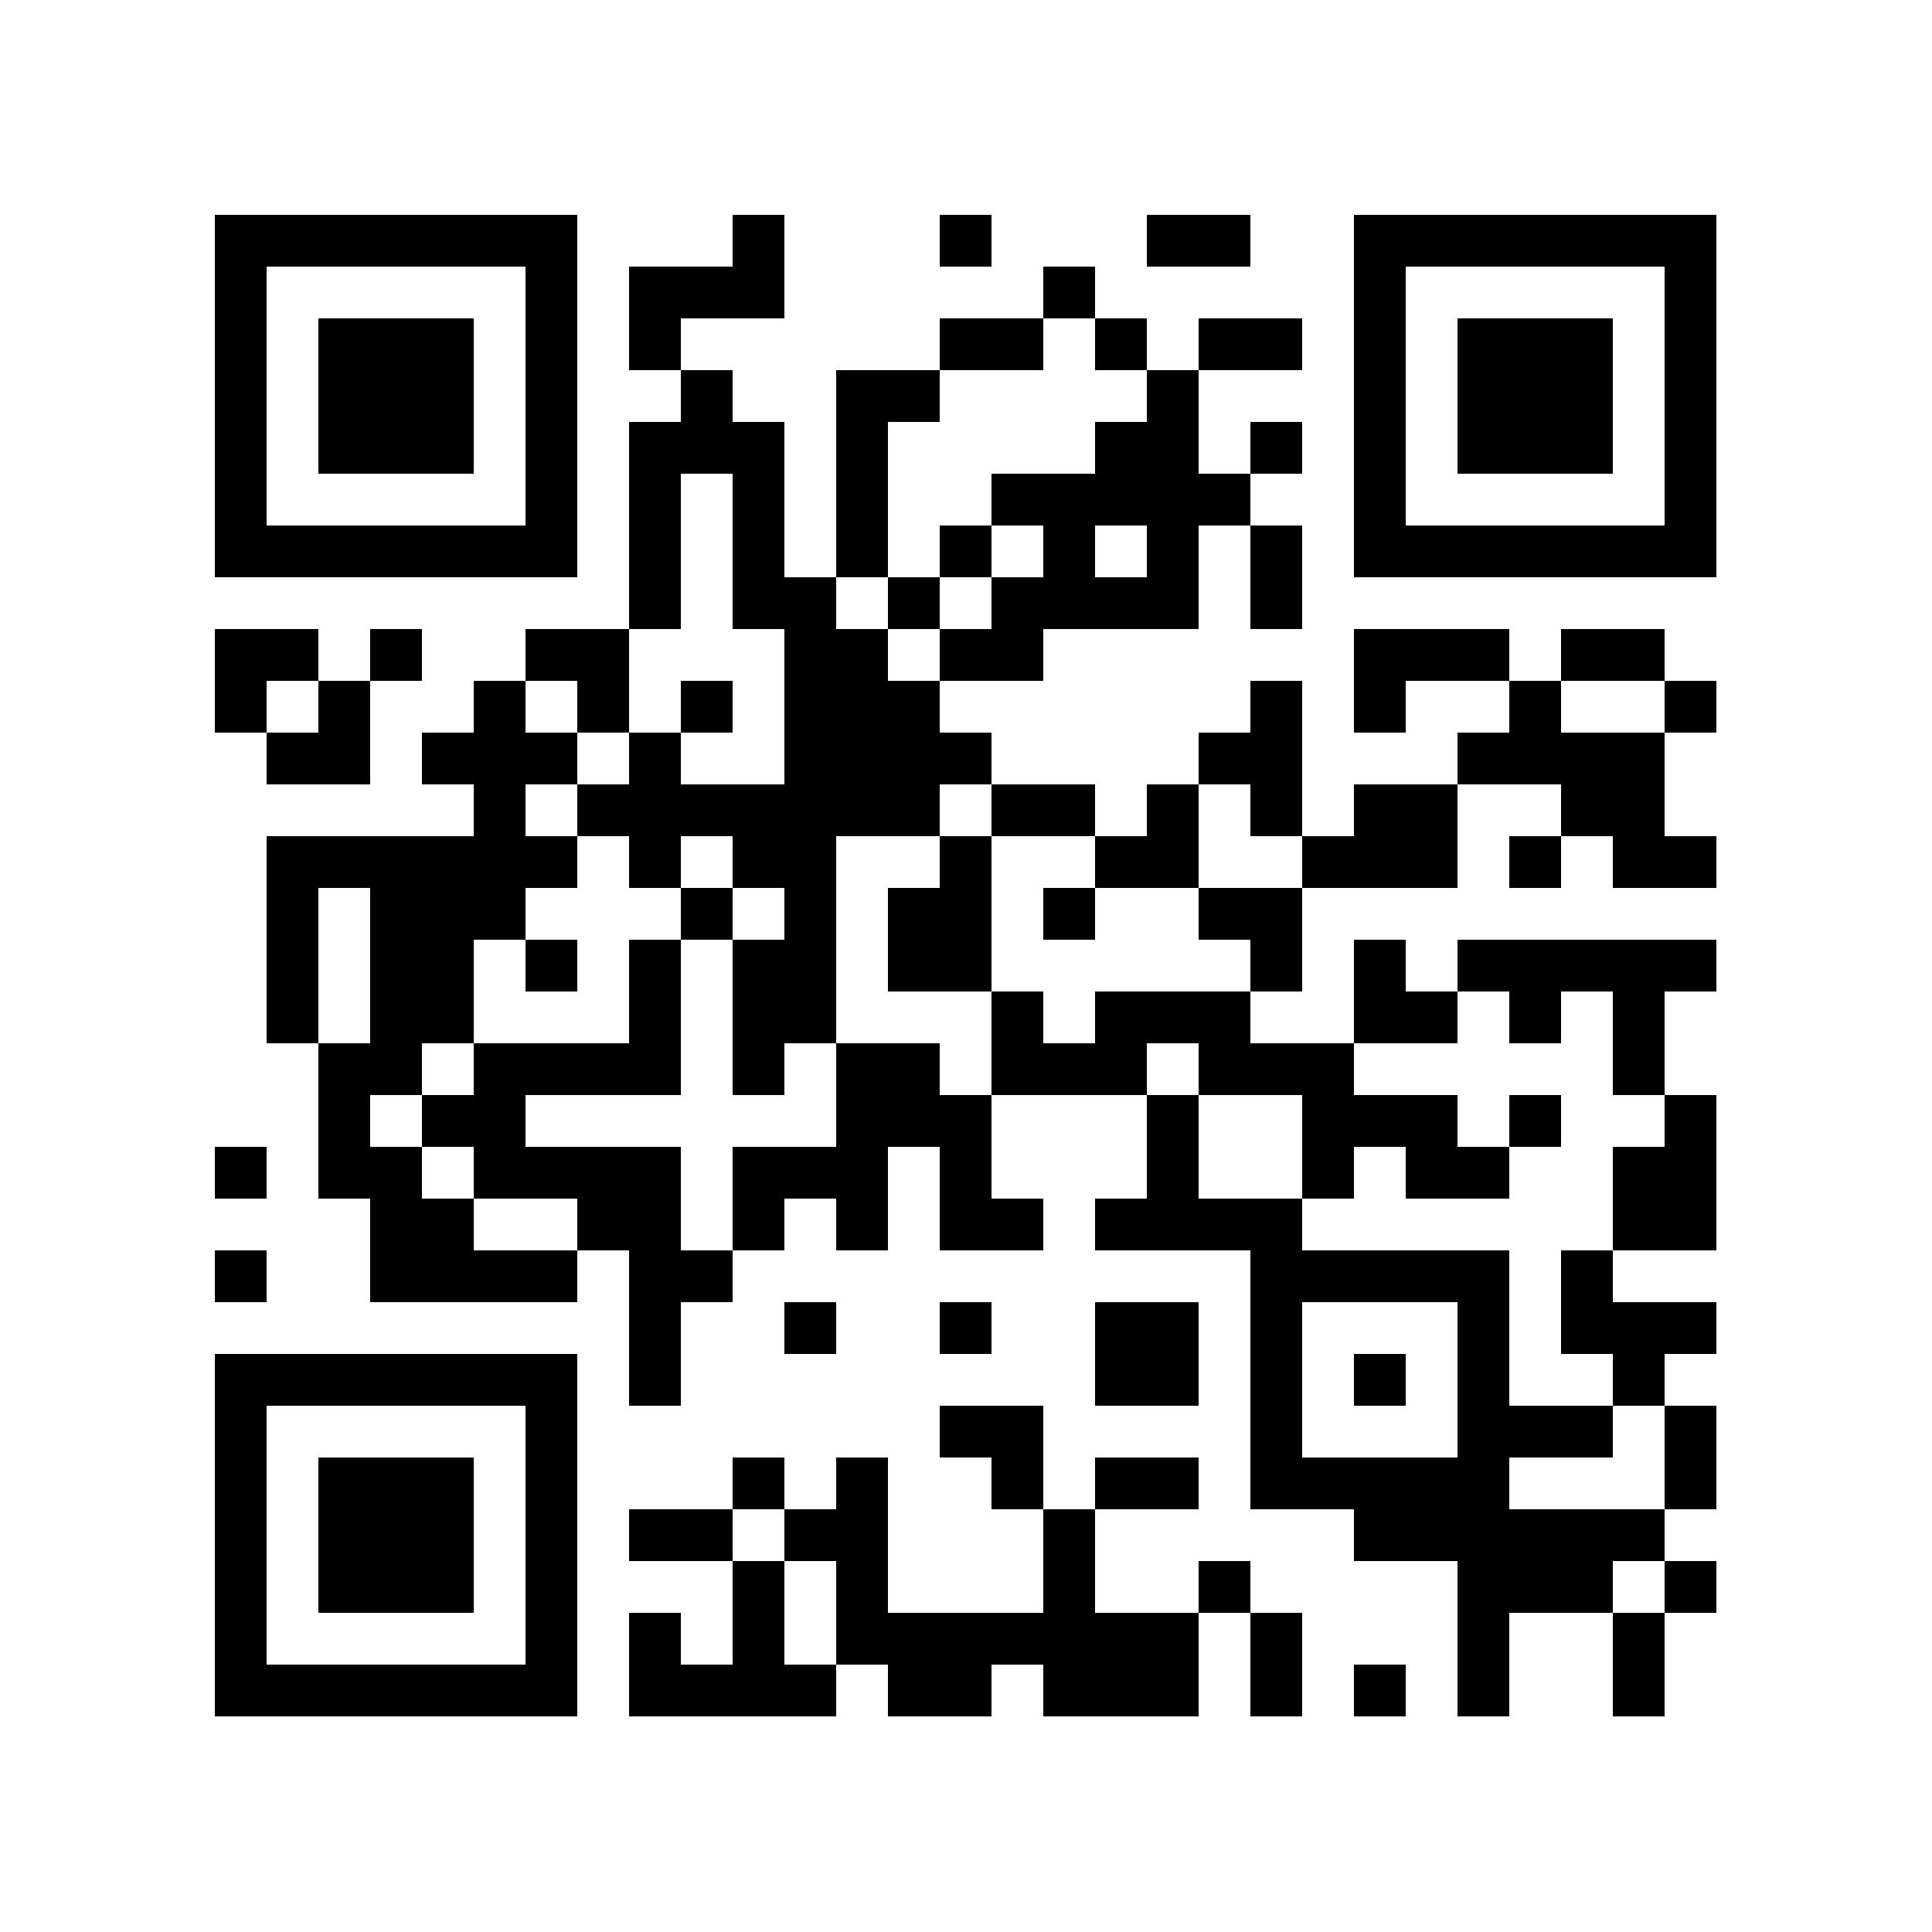
Software Engineering 1:
Introduction to Software Security
COMP23311
Week 10, Session 1

Slide 2
Pre-cap
We will define standard notions of security and use them to evaluate a system’s confidentiality, integrity, and availability

Slide 3
Pre-cap
We will define standard notions of security and use them to evaluate a system’s confidentiality, integrity, and availability
Explain standard software security problems in real-world applications and examples

Slide 4
Pre-cap
We will define standard notions of security and use them to evaluate a system’s confidentiality, integrity, and availability
Explain standard software security problems in real-world applications and examples
Discuss common vulnerabilities found in software

Slide 5
Motivating Example
#include <stdio.h>
#include <stdlib.h>
#include <string.h>
int getPassword() {
char buf[4];
gets(buf);
return strcmp(buf, "SMT");
}
int main(){
printf(”Enter your password:\n");
int x = getPassword();
if(x){
printf("Access Denied\n");
exit(0);
}
printf("Access Granted\n");
return 0;
}

Slide 6
Motivating Example
#include <stdio.h>
#include <stdlib.h>
#include <string.h>
int getPassword() {
char buf[4];
gets(buf);
return strcmp(buf, "SMT");
}
int main(){
printf(”Enter your password:\n");
int x = getPassword();
if(x){
printf("Access Denied\n");
exit(0);
}
printf("Access Granted\n");
return 0;
}

Slide 7
Motivating Example
#include <stdio.h>
#include <stdlib.h>
#include <string.h>
int getPassword() {
char buf[4];
gets(buf);
return strcmp(buf, "SMT");
}
int main(){
printf(”Enter your password:\n");
int x = getPassword();
if(x){
printf("Access Denied\n");
exit(0);
}
printf("Access Granted\n");
return 0;
}
What happens if the user enters “SMT"?
On a Linux x64 platform running GCC 4.8.2, an input consisting of 24 arbitrary characters followed by ], <ctrl-f>, and @, will bypass the “Access Denied” message 🏴‍☠️
A more extended input will run over into other parts of the computer memory
(gets is unsafe: no bounds check)

Slide 8
Motivating Example
#include <stdio.h>
#include <stdlib.h>
#include <string.h>
int getPassword() {
char buf[4];
gets(buf);
return strcmp(buf, "SMT");
}
int main(){
printf(”Enter your password:\n");
int x = getPassword();
if(x){
printf("Access Denied\n");
exit(0);
}
printf("Access Granted\n");
return 0;
}
What happens if the user enters “SMT"?
On a Linux x64 platform running GCC 4.8.2, an input consisting of 24 arbitrary characters followed by ], <ctrl-f>, and @, will bypass the “Access Denied” message 🏴‍☠️
A more extended input will run over into other parts of the computer memory
(gets is unsafe: no bounds check)

Slide 9
Motivating Example
#include <stdio.h>
#include <stdlib.h>
#include <string.h>
int getPassword() {
char buf[4];
gets(buf);
return strcmp(buf, "SMT");
}
int main(){
printf(”Enter your password:\n");
int x = getPassword();
if(x){
printf("Access Denied\n");
exit(0);
}
printf("Access Granted\n");
return 0;
}
What happens if the user enters “SMT"?
On a Linux x64 platform running GCC 4.8.2, an input consisting of 24 arbitrary characters followed by ], <ctrl-f>, and @, will bypass the “Access Denied” message 🏴‍☠️
A more extended input will run over into other parts of the computer memory
(gets is unsafe: no bounds check)

Slide 10
Motivating Example
…but I’m using python! 🤓
Who cares about C anyway?
  This is not only a C problem… (there are many other “unsafe” languages)
Python itself (interpreter) is written in C!
And most existing critical systems (OS, DB, Network prot, etc)

Slide 11
Motivating Example
…but I’m using python! 🤓
Who cares about C anyway?
  This is not only a C problem… (there are many other “unsafe” languages)
Python itself (interpreter) is written in C!
And most existing critical systems (OS, DB, Network prot, etc)

Slide 12
Motivating Example
…but I’m using python! 🤓
Who cares about C anyway?
  This is not only a C problem… (there are many other “unsafe” languages)
Python itself (interpreter) is written in C!
And most existing critical systems (OS, DB, Network prot, etc)

Slide 13
Motivating Example
…but I’m using python! 🤓
Who cares about C anyway?
  This is not only a C problem… (there are many other “unsafe” languages)
Python itself (interpreter) is written in C!
And most existing critical systems (OS, DB, Network prot, etc)

Slide 14
What is Security?
Security = Protection against intentional damage
Intentional damage: usually external threats
More features = higher attack risk
Threat Model: assumptions, actors, who can attack, etc.

Slide 15
What is Security?
Security = Protection against intentional damage
Intentional damage: usually external threats
More features = higher attack risk
Threat Model: assumptions, actors, who can attack, etc.

Slide 16
What is Security?
Security = Protection against intentional damage
Intentional damage: usually external threats
More features = higher attack risk
Threat Model: assumptions, actors, who can attack, etc.

Slide 17
What is Security?
Security = Protection against intentional damage
Intentional damage: usually external threats
More features = higher attack risk
Threat Model: assumptions, actors, who can attack, etc.

Slide 18


Threat Model
System
Alice
Mallory
  Alice: Honest user
  Mallory: Malicious attacker
  System: target of the attacker
Boneh, D. and Mitchell, J., “Computer and Network Security”, 2009.

Slide 19
CIA Principle: Expectations of Secure Systems
Confidentiality: Attacker does not learn the user’s secrets.
Integrity: Attacker does not undetectably corrupt system’s function for the user
Availability: Attacker does not keep system from being useful to the user
System
User
Attacker

Slide 20
CIA Principle: Expectations of Secure Systems
Confidentiality: Attacker does not learn the user’s secrets.
Integrity: Attacker does not undetectably corrupt system’s function for the user
Availability: Attacker does not keep system from being useful to the user
System
User
Attacker
A system is secure if it satisfies the specified/implied security objective, i.e.
requirements on confidentiality, integrity, availability

Slide 21

Example: Social Network Application
Example: Linkify: fictitious social network
Confidentiality:
Integrity:
Availability:
Linkify

Slide 22
Example: Social Network Application
Example: Linkify: fictitious social network
Confidentiality: Pictures posted by a user can only be seen by that user’s friends (3rd-order contacts)
Integrity:
Availability:
Linkify

Slide 23
Example: Social Network Application
Example: Linkify: fictitious social network
Confidentiality: Pictures posted by a user can only be seen by that user’s friends (3rd-order contacts)
Integrity: A user can like any given post at most once
Availability:
Linkify

Slide 24
Example: Social Network Application
Example: Linkify: fictitious social network
Confidentiality: Pictures posted by a user can only be seen by that user’s friends (3rd-order contacts)
Integrity: A user can like any given post at most once
Availability: The service is operational more than 99.9% of the time on average
Linkify

Slide 25
Security Failure and Vulnerability
Security failure: a scenario where the software system does not achieve its security objective
Vulnerability: the underlying cause of a security failure
Most software: no precise, explicit security objectives
  Security objectives are not absolute
  Often traded off against performance or usability
Implementation bugs can lead to a substantial disruption in the behaviour of the software

Slide 26
Security Failure and Vulnerability
Security failure: a scenario where the software system does not achieve its security objective
Vulnerability: the underlying cause of a security failure
Most software: no precise, explicit security objectives
  Security objectives are not absolute
  Often traded off against performance or usability
Implementation bugs can lead to a substantial disruption in the behaviour of the software

Slide 27
Security Failure and Vulnerability
Security failure: a scenario where the software system does not achieve its security objective
Vulnerability: the underlying cause of a security failure
Most software: no precise, explicit security objectives
  Security objectives are not absolute
  Often traded off against performance or usability
Implementation bugs can lead to a substantial disruption in the behaviour of the software

Slide 28
Security Failure and Vulnerability
Security failure: a scenario where the software system does not achieve its security objective
Vulnerability: the underlying cause of a security failure
Most software: no precise, explicit security objectives
  Security objectives are not absolute
  Often traded off against performance or usability
Implementation bugs can lead to a substantial disruption in the behaviour of the software

Slide 29
Why are there security vulnerabilities?
Software is one of the sources of security problems
  Why do programmers write insecure code?
    Awareness is the main issue
Other factors
  Limited number of courses in computer security
  Programming textbooks do not emphasize security
  Limited number of security audits
  Programmers are focused on implementing features
  Security is expensive and takes time
  Legacy software (e.g., C is an unsafe language)

Slide 30

Implementation Vulnerability
Implementation vulnerability (or security bug): is bug that
  - makes it possible for an attacker to violate a security objective
  - describes vulnerabilities in widely-used software components
Common Vulnerabilities and Exposures (CVE) is a publicly available list of entries
  describes vulnerabilities in widely-used software components
  it lists ~300,000 security vulnerabilities
https://www.cve.org/

Slide 31
Implementation Vulnerability
Implementation vulnerability (or security bug): is bug that
  - makes it possible for an attacker to violate a security objective
  - describes vulnerabilities in widely-used software components
Common Vulnerabilities and Exposures (CVE) is a publicly available list of entries
  describes vulnerabilities in widely-used software components
  it lists ~300,000 security vulnerabilities
https://www.cve.org/

Slide 32
Common Vulnerabilities and Exposures by year
The number of software vulnerabilities is increasing rapidly
More than 40,000 vulnerabilities in 2025
https://www.cvedetails.com/

Slide 33
Common Vulnerabilities and Exposures by year
The number of software vulnerabilities is increasing rapidly
More than 40,000 vulnerabilities in 2025
https://www.cvedetails.com/

Slide 34
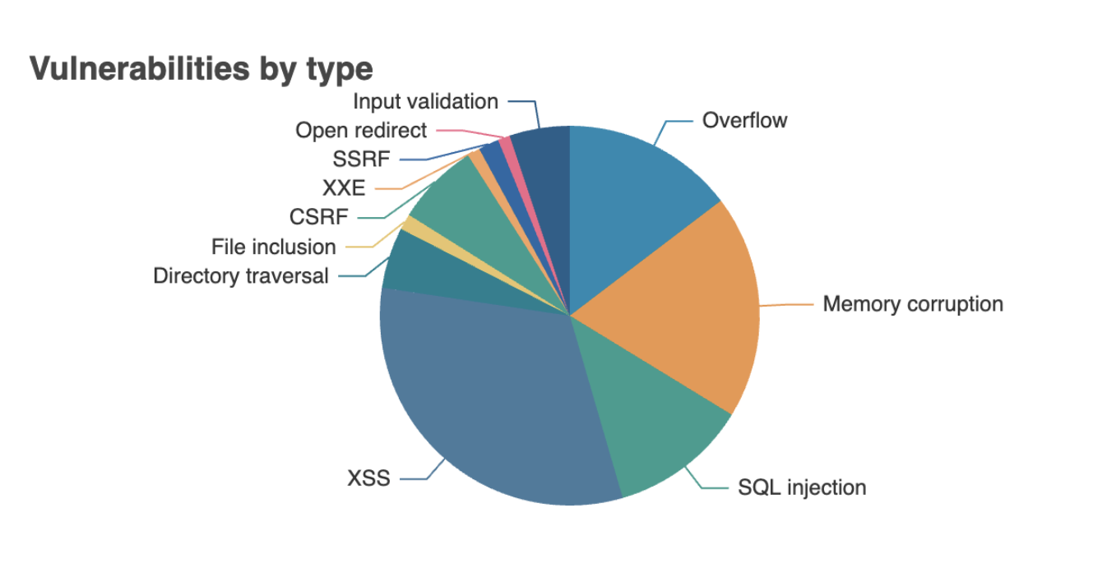
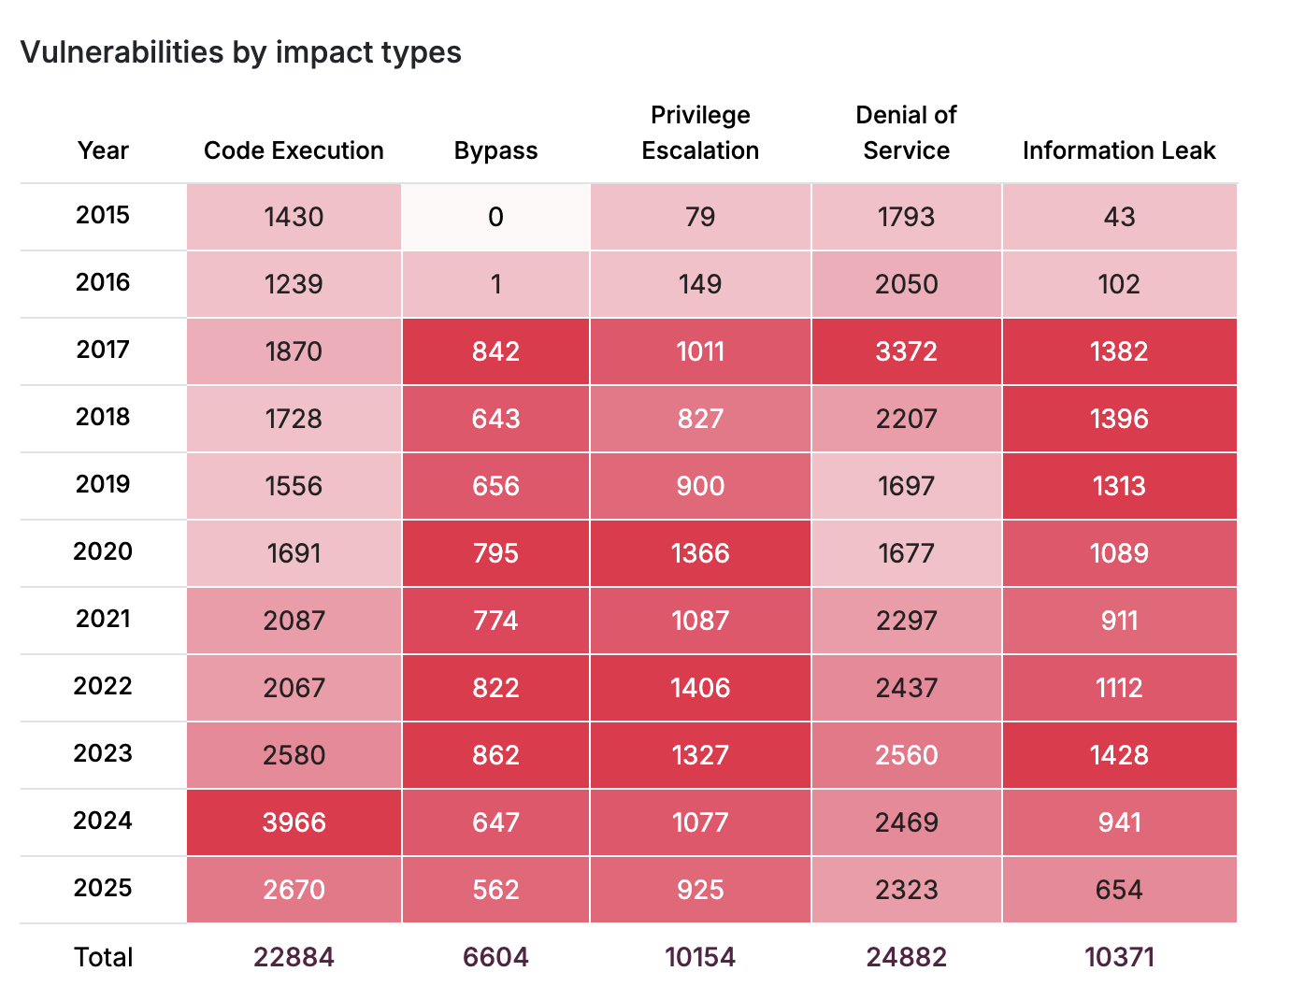
Most Common Vulnerabilities (since 2015)
  By type/catgory
  XSS (Cross-site scripting)
  Memory Corruption
  4. SQL Injection
  …
  By impact type
  Denial of Service
  …
https://www.cvedetails.com/

Slide 35
Memory Corruption:
Null Pointer Dereference
int main() {
double *p = NULL;
int n = 8;
for (int i = 0; i < n; ++i) {
*(p+i) = i*2;
}
return 0;
}
Scope | Impact
Availability | Crash, exit and restart
Integrity Confidentiality | Execute Unauthorized Code or Commands
Occurs when the application dereferences a pointer that it expects to be valid, but is NULL

Slide 36
Memory Corruption:
Double Free
int main(){​
char* ptr = (char *)malloc(sizeof(char));​
if(ptr == NULL) return -1;​
*ptr = 'a’;​
free(ptr);​
free(ptr);​
return 0;
}
Scope | Impact
Availability | Could Crash, exit and restart; could also run silently corrupt heap
Integrity Confidentiality | Execute Unauthorized Code or Commands
The code calls free() twice on the same memory address, leading to modification of unexpected memory locations

Slide 37
Memory Corruption:
Other types
Null pointer dereference
Double free
Unchecked Return Value to NULL
Division by zero
Missing free
Use after free
…

Slide 38
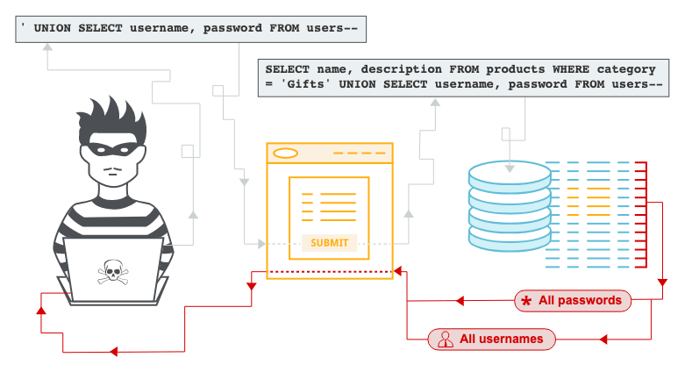
SQL Injection
SQL injection allows an attacker to interfere with the queries to the database to retrieve data
retrieving hidden data
subverting application logic
UNION attacks
examining the database
blind SQL injection
https://portswigger.net/web-security/sql-injection

Slide 39
SQL Injection: Example
A programmer can construct a SQL query with the intention to check name and password as
However, if the name string is provided by an attacker, the attacker can set name to “John’ --”
  this would remove the password check from the query! (note that -- starts a comment in SQL)
query = "select * from users where name=’" + name + "’" and pw = ’" + password + "’"

Slide 40
Cross-site Scripting (XSS) Attack
XSS attacks represent injection of malicious scripts into trusted websites
XSS allows attackers to bypass access controls
  If eid has a value that includes source code, then the code will be executed by the web browser
  use e-mail or social engineering tricks to lead victims to visit a link to another URL
<% String eid = request.getParameter("eid"); %>
...
Employee ID: <%= eid %>
More xss attacks

Slide 41
Denial of Service (DoS) Attack
A DoS attack makes a machine or network resource unavailable to its intended users
  Flood attacks occur when the system receives too much traffic for the server to buffer, causing them to slow down
  Crashing attacks exploit vulnerabilities that cause the target system or service to crash

Slide 42
Supply Chain Attacks
Uses third-party tools or services (“supply chain”) to gain access to a target system or network.

Slide 43
How is a supply chain attack carried out?
Attacker gain access to the third-party system they plan to exploit (“Upstream” attack)
  Using stolen credentials, targeting vendors with temporary access to an organization’s system, or exploiting an unknown software vulnerability, among other methods
Once the Upstream attack is done, the “Downstream” attack is performed when that malicious code executes on end-user devices, e.g., via a routine software update.

Slide 44
Types of Supply Chain “Upstream” Attacks
Browser-based attacks
  Run malicious code on end-user browsers.
Software attacks
  Disguise malware in software updates.
Open-source attacks
  Exploit vulnerabilities in open-source code.
Etc…

Slide 45
How to prevent Supply Chain Attacks
Code audit
Choose third-party software carefully
Etc

Slide 46
Real World Examples
SolarWinds attack in 2018
  Used to transmit malware to clients of SolarWinds software
  Detailed discussion
Linux XZ vulnerability in March 2024
  allowed attacker to execute arbitrary commands through ssh)
  Detailed discussion

Slide 47


The Rust Programming Language: Memory Safety without sacrificing performance
Eliminates an entire class of memory-safety vulnerabilities
Performance comparable to C/C++ (no garbage collection)
Strong type system reduces logic & API misuse errors (a bit tedious to write)
Any 2025 programmer may want to have Rust on their stack!

Slide 48
Take-Aways
Security is a fundamental part of software engineering
  System security = CIA: Confidentiality, Integrity, Availability
Security failure
  Scenario where the software system doesn’t meet security objectives
  Security Vulnerability:
Different Types of Security Vulnerabilities
  Memory Corruption
  XSS attacks
  SQL Injections
  DoS
  Supply chain attacks

